Slide 1
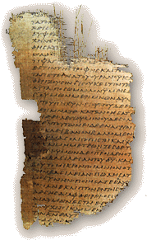

Authorship & Date
of the
Synoptic Gospels
Robert C. Newman

Slide 2
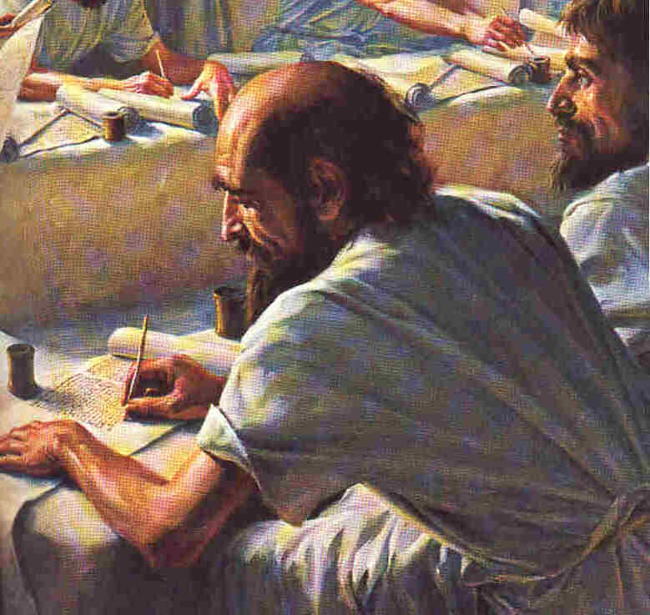
Authorship

Slide 3
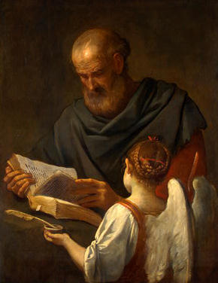
Authorship of Matthew
Internal Evidence
External Evidence

Slide 4
Internal Evidence
Except for the title, the text of Matthew is anonymous.
Title: Euaggelion kata Maqqaion
  No titles on Matthew manuscripts give any other author, or none.
  Don't know if title put on Gospel by original author or not.
Interesting that only this Gospel lists Matthew as "tax collector."

Slide 5
External Evidence
A number of early church fathers testify to this Gospel as being written by Matthew:
  Papias (~130)
  Irenaeus (~180)
  Pantaenus (~180)
  Clement of Alexandria (~200)
  Origen (~240)
None suggest another author nor deny Matthew as author.

Slide 6
Papias (writing ~130)
"Then Matthew wrote the oracles in the Hebrew dialect, but everyone interpreted them as he was able."
  Cited by Eusebius, Church History 3.39.16
Papias' original is not extant, but still survived into the Middle Ages.

Slide 7

Papias (writing ~130)
What is meant by "oracles"?
What is meant by "Hebrew dialect"?
George Howard has recently discovered a Hebrew Matthew preserved in an anti-Xn Jewish polemic from the Middle Ages.

Slide 8
Irenaeus (~180)
"Now Matthew published also a book of the Gospel among the Hebrews in their own dialect, while Peter & Paul were preaching the Gospel in Rome & founding the church."
  Against Heresies 3.1.2
Calls Matthew's work a Gospel, puts it in Hebrew dialect, and gives a date.

Slide 9
Pantaenus (~180)
"Pantaenus also was one of them and is said to have gone to India, where the story goes that he found the Gospel according to Matthew, which had preceded his arrival, among certain people there who had learned of Christ; that Bartholomew, one of the Apostles, had preached to them; and that he had left the writing of Matthew in Hebrew letters, which also was preserved to the time indicated."
  Eusebius, Church History 5.10.3

Slide 10
Pantaenus (~180)
A Christian from Alexandria, who was head of the catechetical school there.
Notice Eusebius gives this as indirect information.
The Hebrew text is said to have been preserved still in the late 2nd century.

Slide 11
Clement of Alexandria (~200)
"Again in the same books, Clement gives a tradition of the early presbyters concerning the order of the Gospels in the following manner: He said that those Gospels which contain the genealogies were written first; but the Gospel according to Mark had this occasion…"
  Outlines, cited in Eusebius 6.14.5
Puts Matthew & Luke earlier than Mark.

Slide 12
Origen (~240)
"In the first of the books on the Gospel according to Matthew, observing the ecclesiastical canon, he [Origen] testifies that he knows only four Gospels, writing somewhat as follows: As he has learned by tradition concerning the four Gospels, which alone are undisputed in the Church of God under heaven, that first there was written the Gospel according to Matthew, the one-time publican but afterwards an apostle of Jesus Christ, who published it in the Hebrew language for those from Judaism who believed."
  Comm on Matthew, cited in Eusebius 6.25.3

Slide 13
Summary on Authorship
That Matthew wrote the Gospel ascribed to him is the unanimous opinion of tradition & of the titles on extant manuscripts.
That Matthew's Gospel was the first written is also given several times in the tradition.
That Matthew's Gospel was written in Hebrew (or Aramaic) is a regular feature of the tradition.

Slide 14
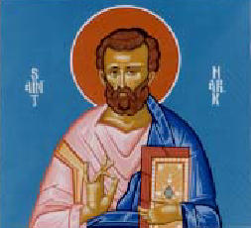
Authorship of Mark
Internal Evidence
External Evidence

Slide 15
Internal Evidence
Like Matthew, Mark is anonymous in its text, except for its title, Euaggelion kata Markon.
Some have suggested the style fits Peter's personality:
  Impressionable rather than reflective
  Emotional rather than logical
  Many vivid details
The outline of Mark fits Peter's talk at Cornelius' house.
The narrative standpoint is consistent with Peter's authorship.
Mark 14:51 makes best sense as a sketch of Mark himself.

Slide 16
Is this Mark?
Mark 14:51 (NASU) A young man was following Him, wearing [nothing but] a linen sheet over [his] naked [body]; and they seized him. 52 But he pulled free of the linen sheet and escaped naked.

Slide 17
External Evidence
A number of early church fathers testify to this Gospel as being written by Mark:
  Papias (~130)
  Justin Martyr (~145)
  Irenaeus (~180)
  Clement of Alexandria (~200)
  Tertullian (~200)
  Origen (~240)

Slide 18
Papias (~130)
"And this the Presbyter used to say: Mark, indeed, since he was the interpreter of Peter, wrote accurately, but not in order the things either said or done by the Lord as much as he remembered. For he neither heard the Lord nor followed him, but afterwards, as I have said Peter, who fitted his discourses to the needs but not as if making a narrative of the Lord’s sayings; consequently, Mark, writing some things just as he remembered, erred in nothing; for he was careful of one thing — not to omit anything of the things he heard or to falsify anything in them."
  Cited in Eusebius 3.39.15

Slide 19
Papias (~130)
Papias is citing information from before him.
The "Presbyter" is most likely the author of 2 & 3 John — the Apostle John.
Mark is the "interpreter of Peter."
Is Papias following rabbinic usage here? (quotation & comment?)

Slide 20
Justin Martyr (~145)
"It is written in his memoirs that He changed Peter's name, as well as the sons of Zebedee, Boanerges."
Justin has just mentioned Peter; here alludes to Mark 3:16-17.
Justin's usage is "memoirs of the Apostles," not "memoirs of Jesus."
So Mark is pictured as "memoirs of Peter."

Slide 21
Irenaeus (~180)
"Matthew published… while Peter & Paul were preaching the Gospel in Rome… After their departure Mark, the disciple & interpreter of Peter, also handed down to us in writing the things preached by Peter."
  Against Heresies 3.1.2
"Departure" could be taken literally (leaving Rome) or figuratively (death).

Slide 22
Clement (~200)
"… the Gospel acc to Mark had this occasion: When Peter had preached the word publicly in Rome & had declared the Gospel by the Spirit, those who were present — they were many — besought Mark, since he had followed him for a long time & remembered the things that had been spoken, to write out the things that had been said; and when he had done this, he gave the Gospel to those who had asked him. When Peter learned of it later, he neither obstructed nor commended it."
Peter is apparently still alive at the time.

Slide 23
Tertullian (~200)
"So then, of Apostles, John & Matthew instill us with faith; of apostolic men, Luke & Mark renew it."
  Against Marcion 4.2
Is Tertullian giving an order of writing here?

Slide 24
Origen (~240)
"… and that 2ndly there was written the Gospel acc to Mark, who made it as Peter instructed him, whom also he acknowledges as son in the Catholic Epistle in these words saying, 'The church in Babylon, elect together with you, & Mark my son, salute you.' "
  Comm on Matthew

Slide 25
Summary on Authorship
That Mark wrote the Gospel ascribed to him is the unanimous opinion of tradition & of the titles on extant manuscripts.
So is the belief that he gives us Peter's preaching.
These traditions are consistent with the nature of the Gospel itself in a stronger & more obvious way than for Matthew.
Some see a contradiction in the tradition re/ the date of Mark & Luke.

Slide 26
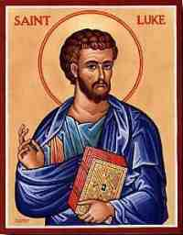
Authorship of Luke
Internal Evidence
External Evidence

Slide 27
Internal Evidence
Except for the title, the Gospel text is anonymous, Euaggelion kata Lukan.
However, the prologue of Acts links Acts to this Gospel. So does the style of each.
Internal evidence in Acts suggests that its author was a companion of Paul.

Slide 28
External Evidence
We have fewer early references to Luke than Matthew and Mark. If Papias said anything about Luke, it has not been preserved.
  Muratorian Canon (~180)
  Irenaeus (~180)
  Clement (~200)
  Tertullian (~200)
  Origen (~240)

Slide 29
Muratorian Canon (~180)
Early list of books in NT; fragmentary at beginning & end.
"…but he was present among them, and so he put. The third book of the Gospel is that acc to Luke. Luke, the physician, after the ascension of Christ, when Paul had taken him with him as a companion of his traveling, [made] an investigation, wrote in his own name — but neither did he see the Lord in the flesh — and thus, as he was able to investigate, so also he begins to tell the story from the nativity of John."

Slide 30
Irenaeus (~180)
"Now Matthew published … After their departure, Mark … Luke also, the follower of Paul, put down in a book the Gospel preached by that one. Afterwards John…"
  Against Heresies 3.1.1-2
Seems to be giving chronological order, but doesn't quite say Luke is written third.

Slide 31
Clement (~200)
"Again in the same books, Clement gives a tradition of the early presbyters concerning the order of the Gospels in the following manner: He said that those Gospels which contain the genealogies were written first; but the Gospel according to Mark had this occasion… Last of all, John…"
  Outlines; cited in Eusebius 6.14.5
Note the chronological order seems to differ from Irenaeus' order.

Slide 32
Tertullian (~200)
"So then, of Apostles, John & Matthew instill us with faith; of apostolic men, Luke & Mark renew it... For Luke's Gospel similarly men are used to ascribe to Paul."
  Against Marcion 4.2

Slide 33
Origen (~240)
"… and thirdly, that acc to Luke — the Gospel praised by Paul — who made it for those from the Gentiles who believed."
  Comm on Matthew
The remark about Paul is probably an allusion to 2 Cor 8:18.

Slide 34
Reference to Luke?
2Cor 8:18 (NASU) We have sent along with him the brother whose fame in [the things of] the gospel [has spread] through all the churches;

Slide 35
Summary on Authorship
That Luke wrote the Gospel ascribed to him is the unanimous opinion of tradition & of the titles on extant manuscripts.
None of the remarks for Luke are quite as early as those of Papias for Matt & Mark; but by AD 200, these are from whole Mediterranean area.
These traditions are consistent with the internal evidence of vocabulary & connection with Acts.
The Gospel is frequently mentioned third, perhaps preserving a tradition on order of authorship.

Slide 36
Dates
of the Synoptic Gospels

Slide 37
Date of Matthew
Internal Evidence
External Evidence

Slide 38
Internal Evidence
Very little help here.
Two remarks suggest Matthew not written immediately after the resurrection ("to this day").
Liberals tend to date Matthew after AD 70:
  Partly to post-date Mark
  Partly to avoid fulfilled prophecy

Slide 39
External Evidence
Matthew was written before the earliest surviving manuscripts of it.
  P^{64,67} and p⁷⁷ come from ~200.
Pseudo-Barnabas (~132) cites Matt 22:14.
Tradition on authorship would place it before Matthew's death, so probably well before AD 100.
Irenaeus' tradition would put it 61-68.
Other traditions put Matthew first, so perhaps even earlier.

Slide 40
Various Proposals
Range from AD 37 (Old Scofield) to 125 (e.g., Robert Kraft @ UPenn).
My suggestion:
  Irenaeus is giving date of Greek edition.
  Original Hebrew earlier, 40s-early 50s.
  This model is proposed to fit Matthew being 1st Gospel, and Luke written before AD 60.

Slide 41
Date of Mark
Internal Evidence
External Evidence

Slide 42
Internal Evidence
Nothing direct here.
Liberals try to post-date predictions, so tend to put it late, just before 70 or later.
Solution to Synoptic Problem will have a bearing here.

Slide 43
External Evidence
See various church fathers cited earlier. Do Clement and Irenaeus disagree?
Counts of early mss & citations show Mark was considerably less popular than Matthew. Does this have a bearing on the date question?

Slide 44
Various Proposals
Several dating schemes:
  Concordant – Mark in 60s before death of Peter.
  Discordant – Clement wrong, and Irenaeus means after death of Peter & Paul, so after 68.
  Conservative 2-document view – put Mark ahead of Matt & Luke, so in late 50s.

Slide 45
Date of Luke
Internal Evidence
External Evidence

Slide 46
Internal Evidence
Clearly Acts presupposes Luke, so Gospel written first.
Liberals feel Luke 21:20 reflects Jewish war, so date Luke after AD 70 (usually in 80s).
Not necessary if Jesus can predict future.
Evidence from Acts points to its being written before 64.

Slide 47
External Evidence
Acts seems to date from end of Paul’s 1st Roman imprisonment, ~63.
  Must precede Roman fire, summer 64.
  No hint of Paul's death, ~68.
Luke is somewhat earlier than Acts.
The problem of tradition on relative date of Luke and Mark.

Slide 48
Summary on Luke's Date
We date Luke 58-60, before Acts in 63-64.
Suggest Luke did his research for Gospel during 2 years Paul in prison in Caesarea; Gospel began to circulate as they left Palestine.
Luke did research for Acts in Rome during Paul's imprisonment there.

Slide 49
Summary on Dates
Matthew – 40s or 50s in Hebrew; Greek edition in mid-60s.
Luke – 58-60 in Caesarea.
Mark – early to mid-60s in Rome.

Slide 50
Characteristics
of the Synoptic Gospels

Slide 51
Characteristics of Matthew
Author
Audience
Aim & Structure
Distinctive Phrases
Other Material

Slide 52
Matthew the Author
Mentioned by name 7x in NT
These involve only 2 occasions:
  His conversion
  Apostle lists
Conversion
  Held dinner for friends to meet Jesus
Apostle lists
  Only called "tax collector" in Matthew list
  Always in 2nd group of 4 apostles

Slide 53
Matthew's Audience
Messianic emphasis
  Implies original audience were Jews
Tends to assume readers know Jewish practices.
  Mt 15:2 – tradition of elders
  Mt 23:5 – broaden phylacteries…
  Mt 23:27 – like whitewashed tombs…

Slide 54
Aim & Structure
Aim
  No direct statement
  Contents suggest Matthew’s purpose is to show Jesus as Messiah fulfilling OT prophecies.
Structure
  2 narrative transition passages
  5 discourses w/ closing transitions

Slide 55
Distinctive Phrases
"That it might be fulfilled"
  Emphasis on fulfillment of Messianic prophecies and OT typologies
"Kingdom of Heaven"
  Synonymous with "kingdom of God"
  "heaven" one of the common rabbinic substitutions for God

Slide 56
Other Unique Materials
References to Jewish customs
Particular birth materials
  Wise men, Herod, flight to Egypt
  Joseph’s perspective
Church passages
  Peter & the church – Mt 16
  Church discipline – Mt 18
Great Commission – Mt 28

Slide 57
Characteristics of Mark
Author
Audience
Aim
Characteristics

Slide 58
Mark the Author
Mentioned in NT 10-11x
Tracing his life:
  A cousin of Barnabas – Col 4:10
  Lived w/ mother in Jerusalem – Ac 12
  Present at Jesus' arrest? – Mk 14:52
  Associate of Paul & Barnabas on 1st missionary journey – Ac 13
    Bails out in middle
    Paul won’t take him on 2nd journey

Slide 59
Mark the Author
Tracing his life (continued):
  Shows up ~10 yrs later:
    Being sent on mission by Paul – Col 4:10
    Again a fellow-worker w/ Paul – Phm 24
  Still later, near Ephesus – 2 Tim 4:11
    Useful to Paul, to come w/ Timothy
  Peter calls Mark "my son" – 1 Pet 5:13

Slide 60
Mark's Audience
Pretty clearly Gentile
  Aramaic phrases are translated
  Jewish practices explained
Possibly Roman
  Several Latinisms
  But these are associated w/ Roman rule, so probably generally known

Slide 61
Mark's Aim
No direct statement in Gospel.
Does not say "to preserve teaching of Peter."
Opening line may state aim, but this is general aim of all Gospels.
Perhaps Mark is aimed or especially suited to Roman mentality:
  Practical, action-oriented, organized

Slide 62
Mark's Characteristics
Vividness
  Graphic & picturesque detail
Detail
  Covers fewer events w/ more detail
Activity
  Use of euqu" euthus (immediately)
Aramaic
  See my notes

Slide 63
Characteristics of Luke
Author
Audience
Aim & Method
Characteristics

Slide 64
Luke the Author
Mentioned by name only 3x in NT
  A physician – Col 4:14
  Faithful companion of Paul – 2 Tim 4:11
  Gentile – Col 4:14 (in Gentile group)
Traveled w/ Paul – "we" passages in Acts

Slide 65
Luke the Greek Physician
Terminology suggests he was trained in the tradition of the Hippocratic school, noted for:
  Diagnosis by observation & deduction
  Careful case reports
  Simple treatments
  High standards of hygiene

Slide 66
Other Suggestions
Luke's Hometown?
  Syrian Antioch acc to Eubebius & Jerome
  Philippi acc to Sir Wm Ramsay
Luke is brother of Titus
  Souter bases this on 2 Cor 8:18
  Possible, but speculative

Slide 67
Aim & Method – Luke 1:1-4
Aim – to help Theophilus know the reliability of the Gospel history
Method
  Aware of status of his subject
  Studied all related matters carefully
  Used materials from "eyewitnesses & ministers of the word"
  Wrote up an orderly, sequential account

Slide 68
Luke's Characteristics
Emphases of his Gospel
  Universalism
  Jesus’ gracious attitude to outcasts
  Prayer
  Social relationships
Unique Materials
  Semitic praise psalms
  Certain parables
  Certain miracles
  Perean narrative

Slide 69
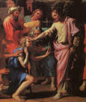
The End
But hopefully, the beginning of a lifetime study of Jesus in the Gospels

