Slide 1
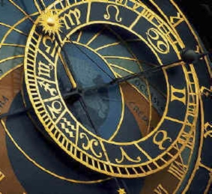

Astrology:
Is Your Destiny in the Stars?
Robert C. Newman
Biblical Seminary

Slide 2

Astrology is Very Popular
Most bookstores have many books on the subject.
Nearly every newspaper has an astrology column.
You can get your horoscope through the internet.

Slide 3
Looking at Astrology
We want to think about several topics related to the subject:
The history of astrology
Scientific problems for astrology
What the Bible has to say about astrology

Slide 4
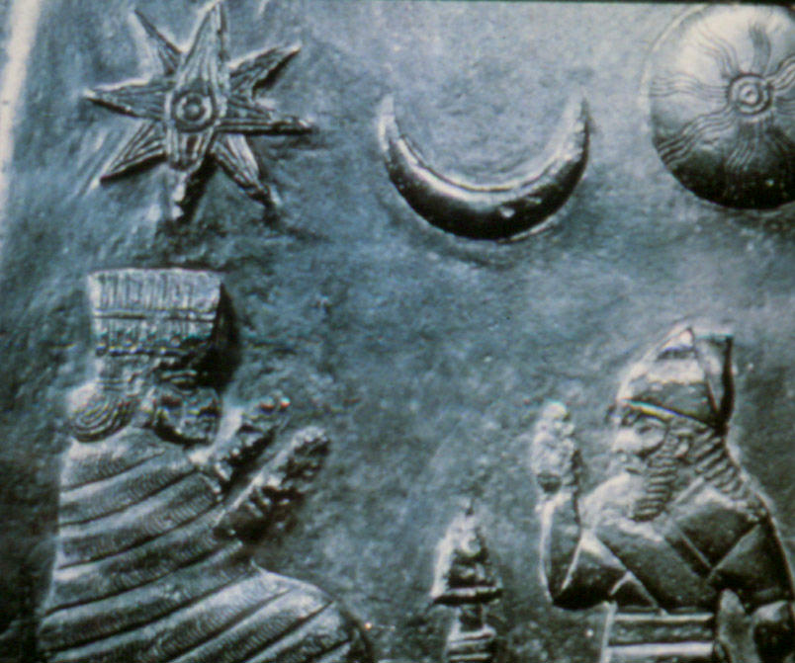
The History of Astrology

Slide 5
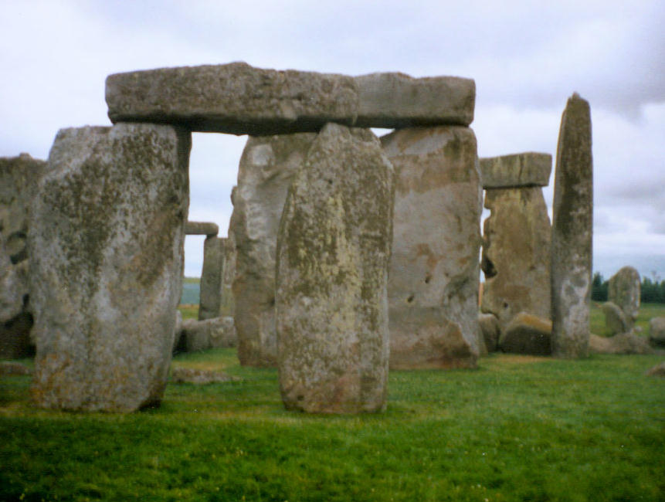
Origins of Astrology
Lost in antiquity
Perhaps originally related to planting at right season
Hints of astrology in early civilizations:
  Newgrange, Ireland
    ~3000 BC
  Stonehenge, England
    2500-1500 BC

Slide 6
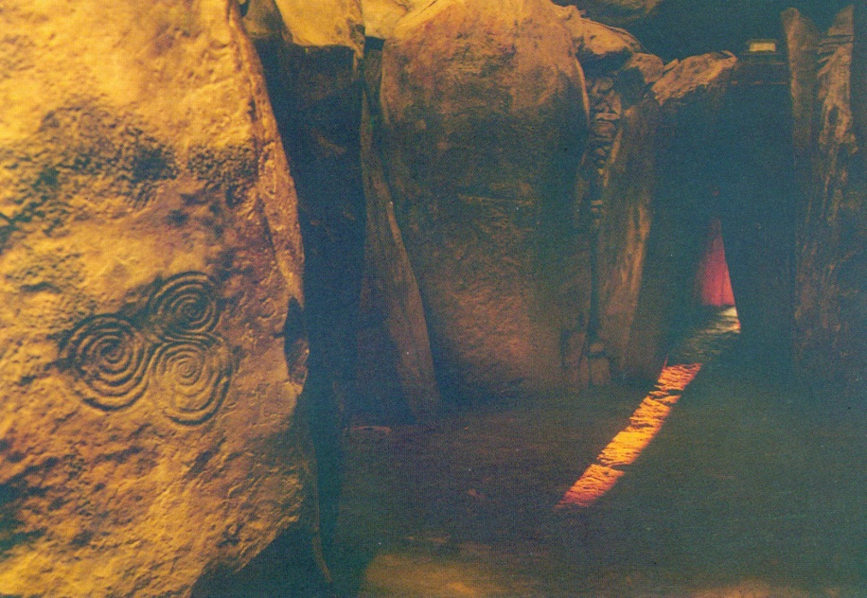
Newgrange, Ireland
A passage grave inside a mound some 35 feet high and nearly 300 feet across.
The tunnel & inner chamber total about 75 feet long.
The inner chamber is illumined by the sun only at winter solstice.

Slide 7
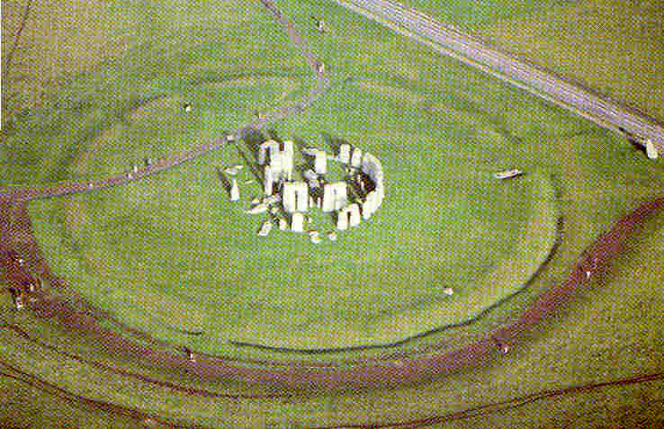
Stonehenge, England
A circle of large upright stones, completed about 1500 BC.
Major sight lines mark the sun’s position at the solstices, and the moon at its extreme risings & settings.

Slide 8
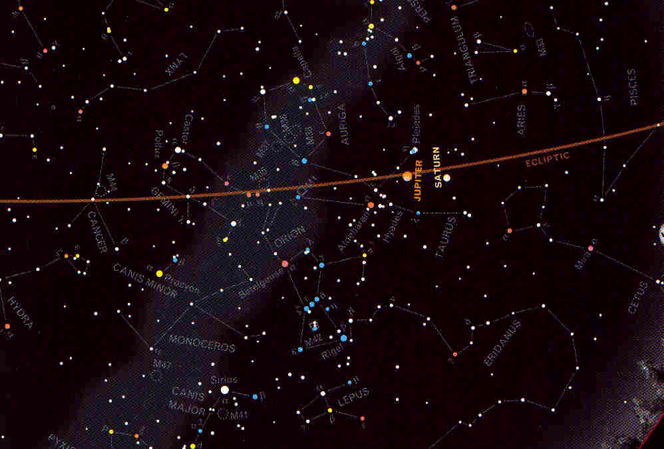
Origins of Astrology
The positions of stars relative to the sun "predict" the agricultural seasons.
The positions of stars can be used to tell time at night.
The Babylonians and Egyptians early developed techniques for doing this.

Slide 9
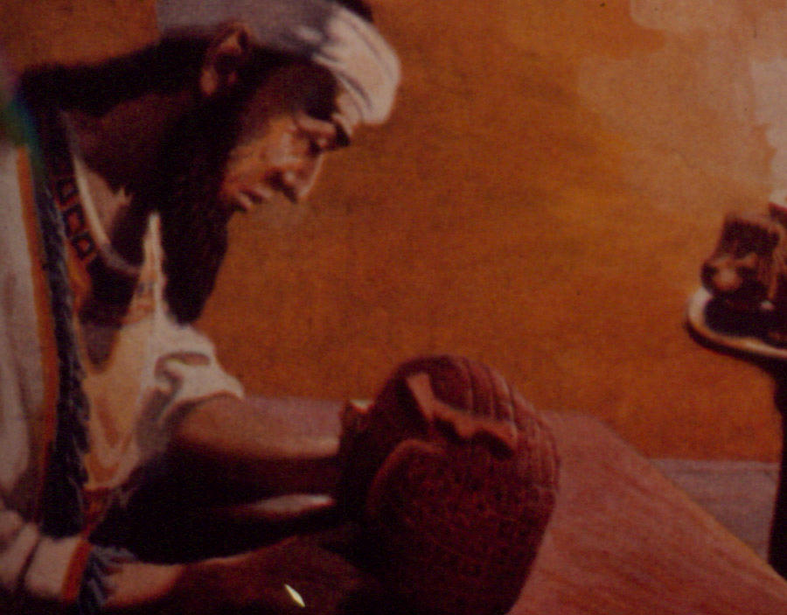
Origins of Astrology
First clear evidence in Babylonian civilization
Astrology used to tell future, together with other forms of divination, such as liver-looking
Idea: gods communicate, if humans use the right techniques

Slide 10
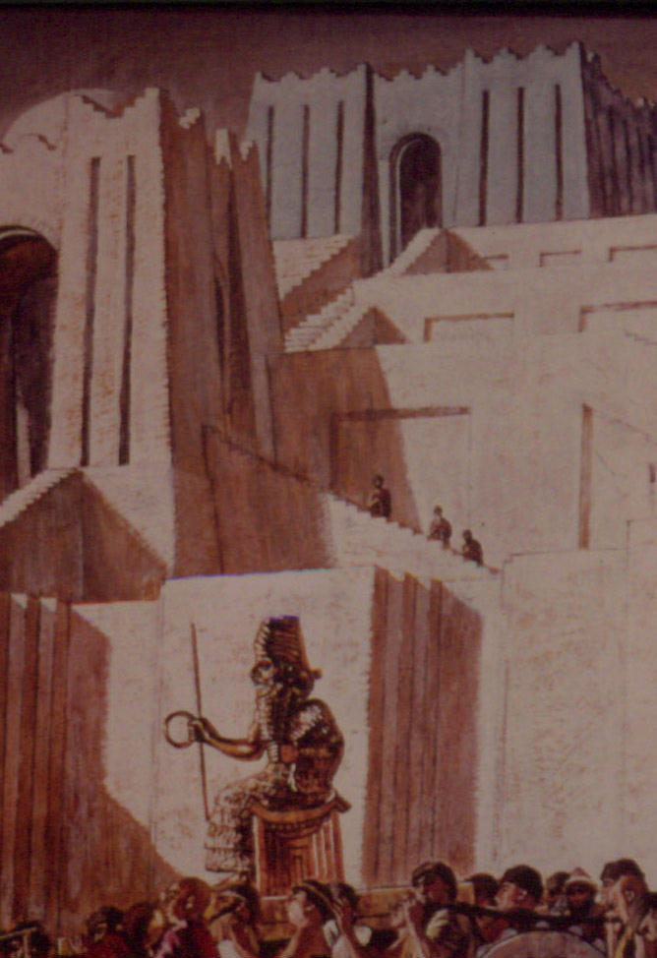
Babylonian Astrology
Ziggurats: step pyramids where heavenly bodies observed & worshiped
Stelae: inscribed pillars w/ sun, moon, Venus, constellations
Menologies: tablets for lucky & unlucky days & months

Slide 11
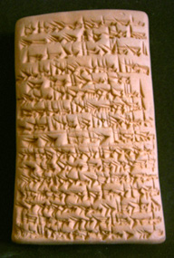
Babylonian Menology
For an army in battle or conquering the hostile land:
  Lucky in Ayar, Elul, Teshrit, Archsamna, Adar
  Other months unlucky.

Slide 12
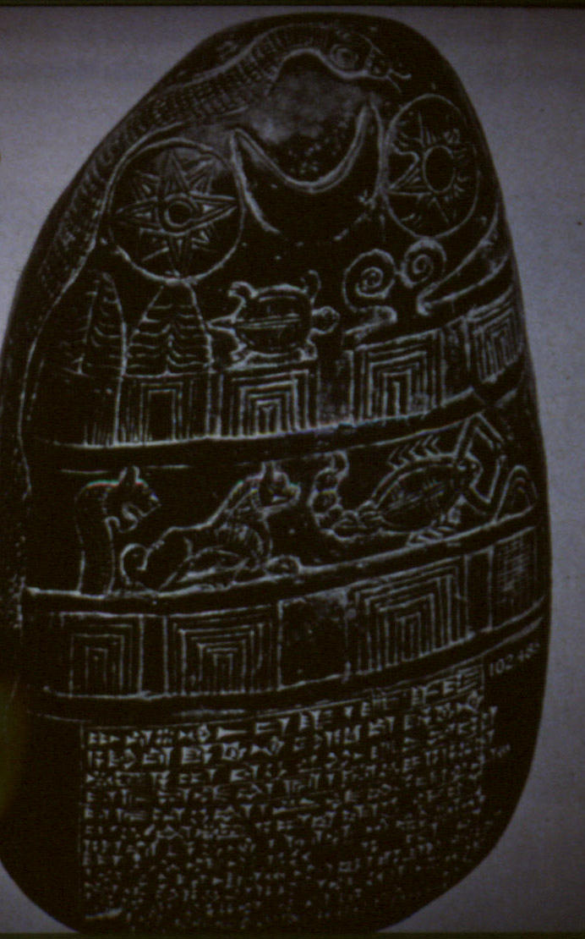
Babylonian Astrology
Strongly connected to polytheism, in which the planets viewed as gods or goddesses
Typically the predictions were for whole societies or their rulers, rather than individuals

Slide 13
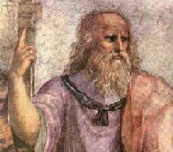
Greek Astrology
Plato (~375 BC) identified the planets with the gods
Our astronomical terms typically come from the Greeks via the Romans:
  Planet names
  Zodiac

Slide 14
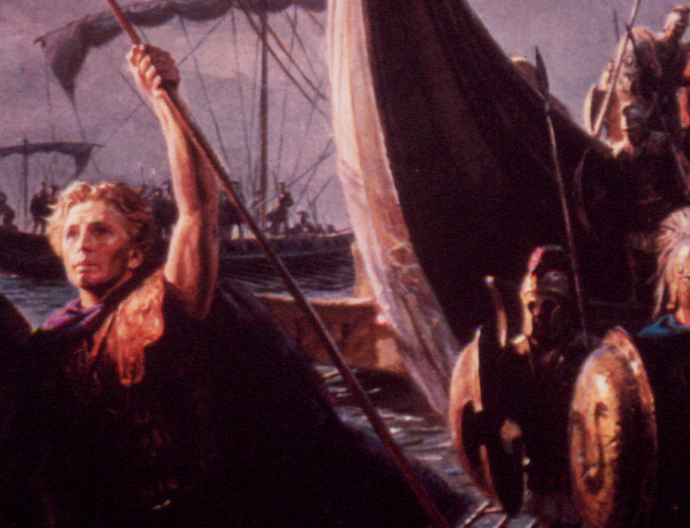
Greek Astrology
Alexander's conquests united East & West, mixing Greek philosophy & math with Babylonian astrology, 333-323 BC.
This led to astrology for individuals.
Today's astrology is Greek with virtually no changes.

Slide 15
Classical
Greco-Roman Astrology
The seven planets:
  Sun, Moon, Mercury, Venus, Mars, Jupiter, Saturn.
The twelve constellations of the Zodiac:
  Aries, Taurus, Gemini, Cancer, Leo, Virgo, Libra,
  Scorpio, Sagittarius, Capricorn, Aquarius, Pisces.
The twelve houses of a horoscope:
  Life, riches, kindred, inheritance, children, sickness,
  Marriage, death, journeys, honor, friends, enemies.
Various angular relationships:
  Opposition, square, trine, etc.

Slide 16

A Sample Horoscope
The birth of Philoe. The 10th year of Antoninus Caesar the Lord [AD 150], Phamenoth 15 to 16, 1st hour of the night. Sun in Pisces, Jupiter and Mercury in Aries, Saturn in Cancer, Mars in Leo, Venus and Moon in Aquarius, horoscope Scorpio.

Slide 17
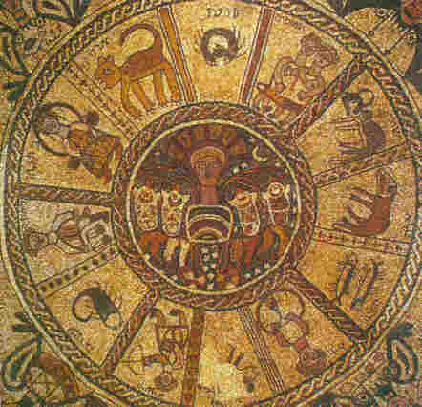
Astrology in
Judeo-Christian Circles
Both Jews & Christians influenced by astrology, which was very popular in ancient society.
Several ancient synagogue mosaics show the Zodiac symbols & the seasons personified.
This influence resisted by negative remarks in Bible.

Slide 18
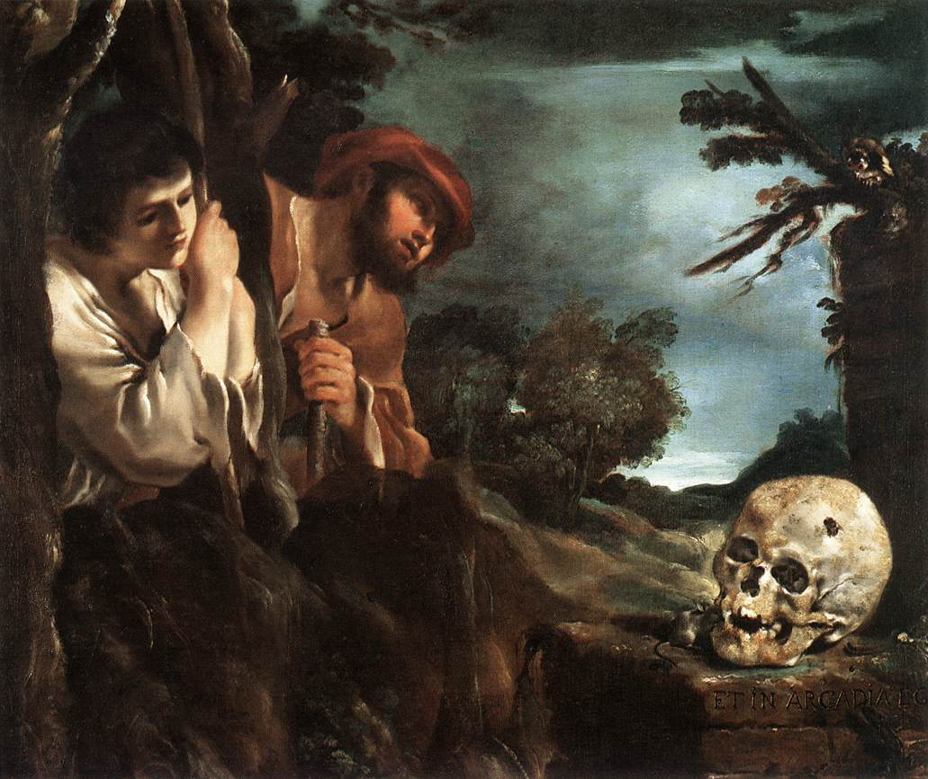
The Renaissance
Though pictured as a time of enlightenment & escape from superstition, it was a revival for astrology.
In turning away from Christianity, many went into occultism.
Some problem separating astrology & astronomy.
Johann Kepler, discoverer of planetary laws, also cast horoscopes to earn money.

Slide 19
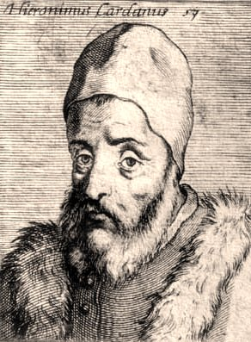
Renaissance Astrology
Geronimo Cardano cast a horoscope for England’s King Edward 6:
  Illness at age 55
  But he died at 16!
Cast own horoscope:
  Death at 75
  Fulfilled by suicide!

Slide 20
Astrology in the West
After the Reformation, astrology nearly died out in places where the church was restored to biblical principles.
Like Halloween, harmless fun in my childhood.
But since the 1960s, a revival of occultism, including astrology.
Os Guinness' parable of the campfire.

Slide 21
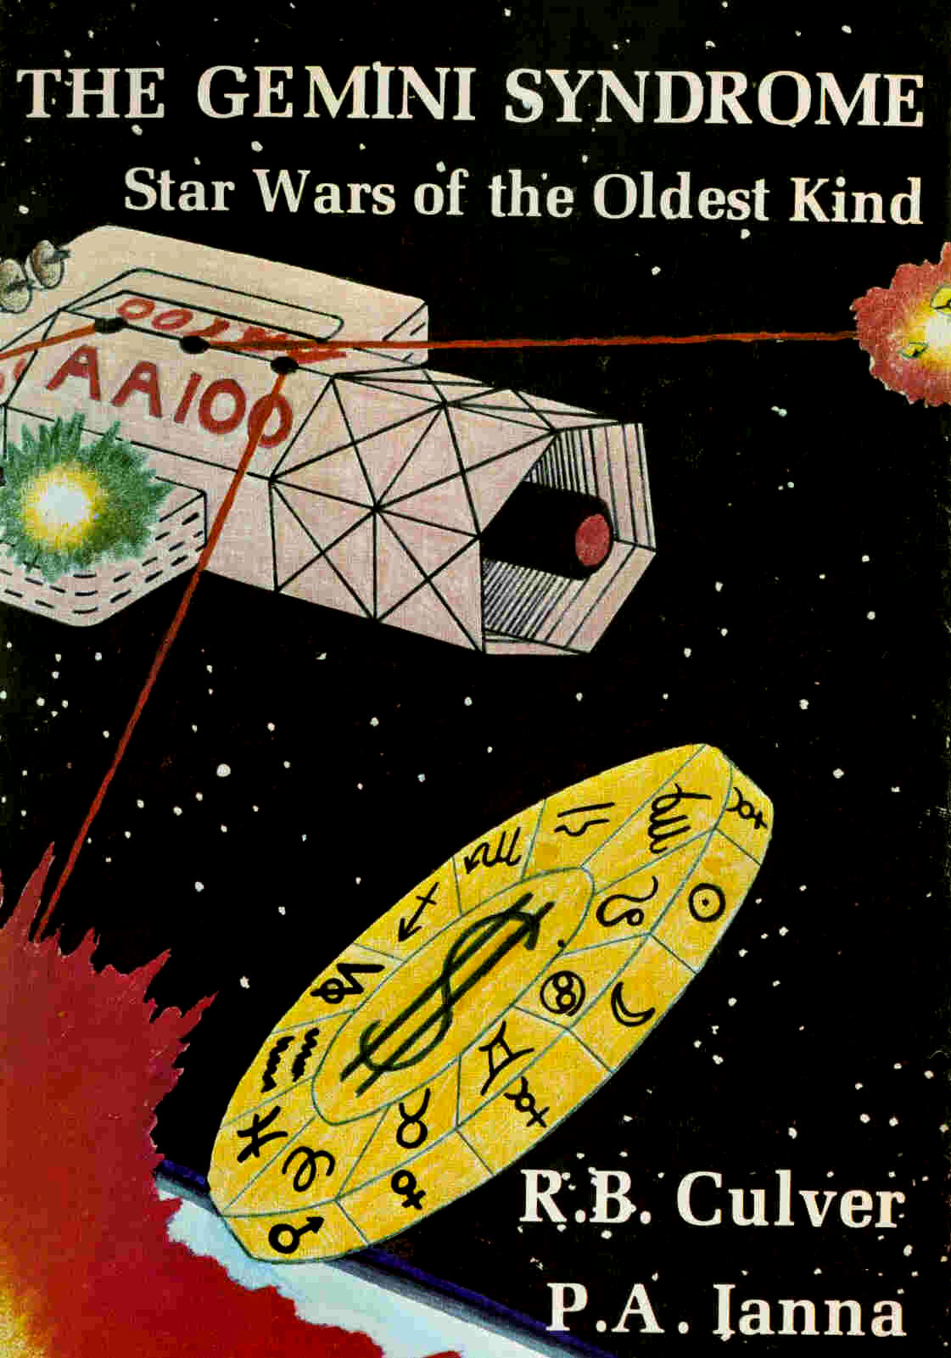
Scientific Problems for Astrology
Culver & Ianna,
The Gemini Syndrome

Slide 22
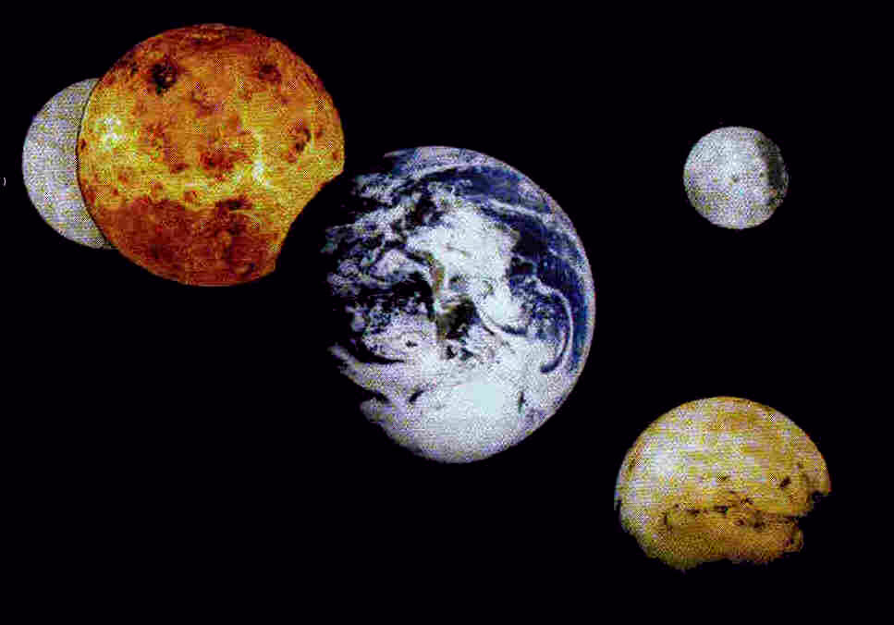
What are Astronomical Objects?
Ancient astrology had planets as gods or angels.
Telescopes & space travel show they are worlds like our Earth.
Nothing to indicate they are living beings like gods or angels.

Slide 23
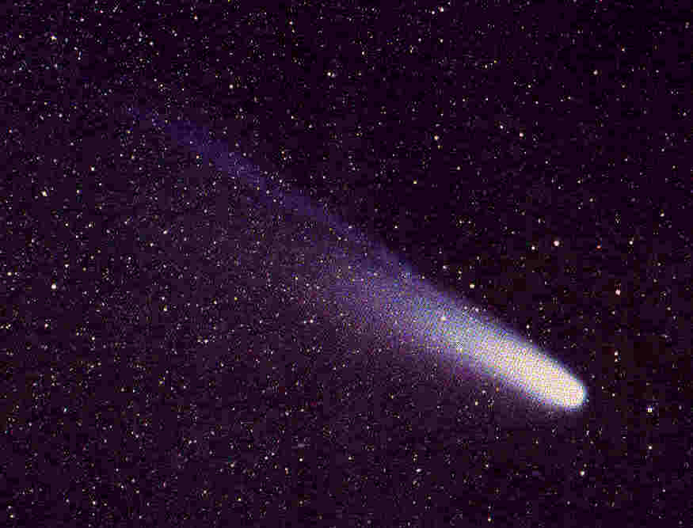
What are Astronomical Objects?
Similarly, stars are burning gas balls like our sun.
Comets are large, dirty snowballs.
These discoveries require (at least) a large adjustment in astrology.

Slide 24
Geocentrism
Ancient astrology was founded on geocentrism, that the Earth is the center around which the heavenly bodies move.
Copernicus (~1540) showed a great simplification was possible if the sun were in the center instead.
This was eventually shown to fit the observations far better.

Slide 25
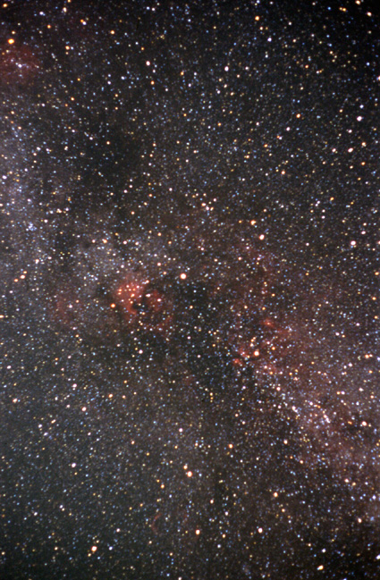
Stars & Constellations
Using parallax, we now realize that the stars are very distant.
Using telescopes, that the stars are very numerous.
The constellations disappear when dimmer stars are taken into account.
The constellations are also just the result of local perspective.

Slide 26
Stellar Influence
We do not claim that the sun and moon have no effect on earth:
  Light, heat, tides
But planets & stars exert negligible forces at a person’s birth:
  Compared to gravity of mother, doctor, hospital
  Compared to radiation from room lamps
Astrological successes are probably a combination of luck, fraud, and the occult.

Slide 27
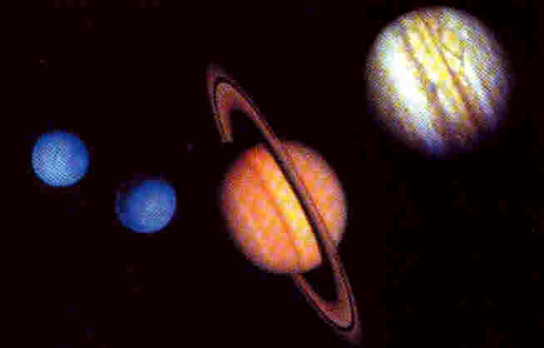
New Planets
Discovery of Uranus, Neptune & Pluto since 1700s
How are these taken into account by astrologers?
  Most ignore them
  A few include them
  No evidence the latter have better results

Slide 28
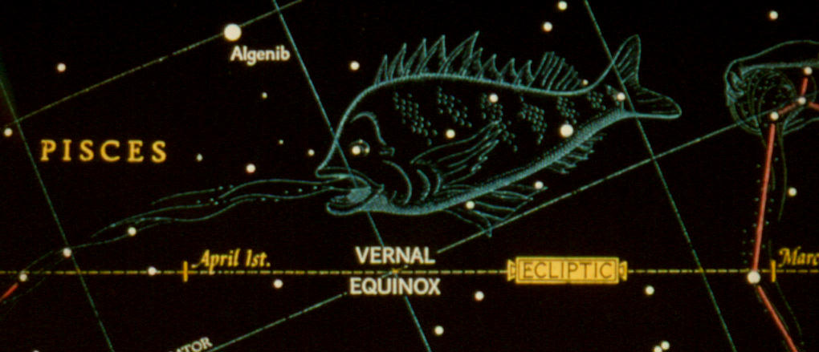
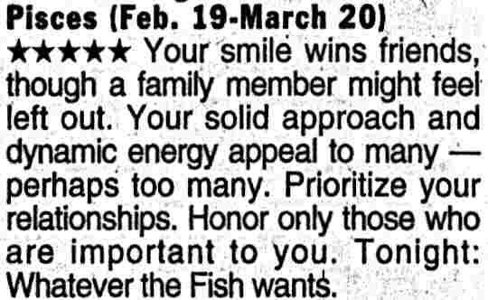
Shift of the Equinox
Movement of the earth's axis (with a period of 24,000 years) has gradually shifted which sign of the Zodiac the sun is in each month.
Today the sun is in Pisces from March 5 to April 10.
But modern astrology columns still give its location 2000 years ago, February 19 to March 20.

Slide 29
Shift of the Equinox
Thus modern newspaper astrology columns are about one sign (a month) off from where the sun actually is!
So you've been reading the wrong sign for years!
Astrologers who adjust for this seem to have no better success than those who don't.

Slide 30
The Twin Problem
Astrological horoscopes are based on the position of the planets & Zodiac at a person’s birth.
Though identical twins often have very similar character, they sometimes have very different lives.
Fraternal twins often have very different character.
"Time twins" have very few similarities.

Slide 31
Testing Astrology
See Culver and Ianna, The Gemini Syndrome, for lots of examples.
No real correlation between sun-sign and people's talents or occupations.
Consider marital compatibility charts:
  Compare those of Teri King, Sydney Omarr, and Carroll Righter.

Slide 32
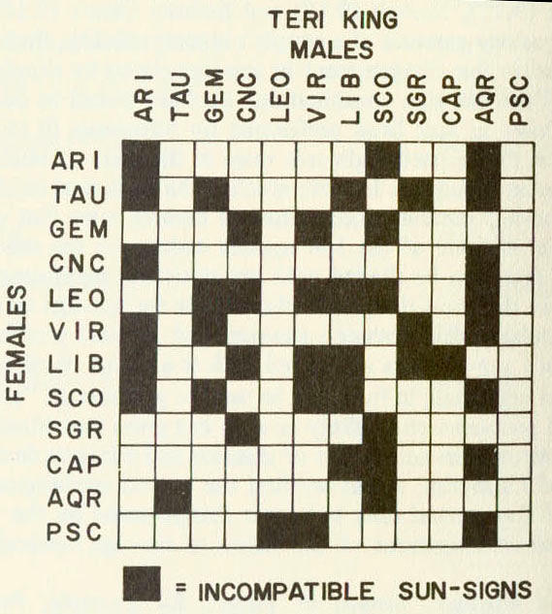
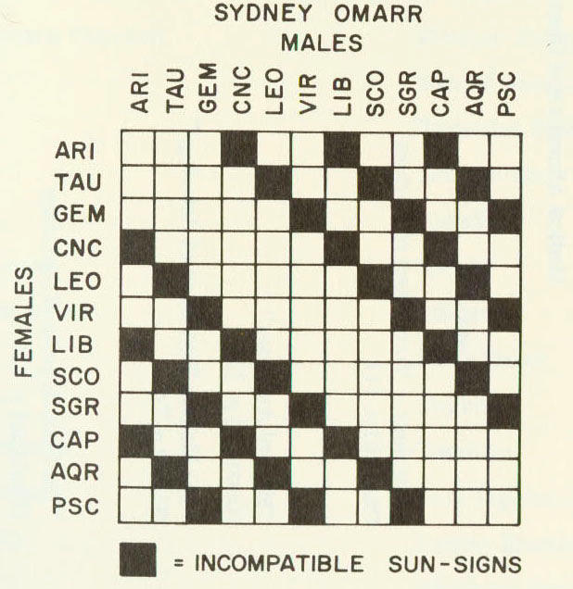
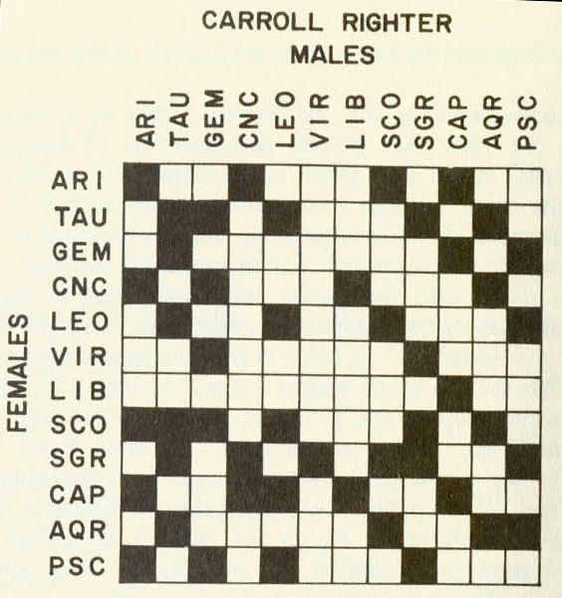
Testing Astrology

Slide 33
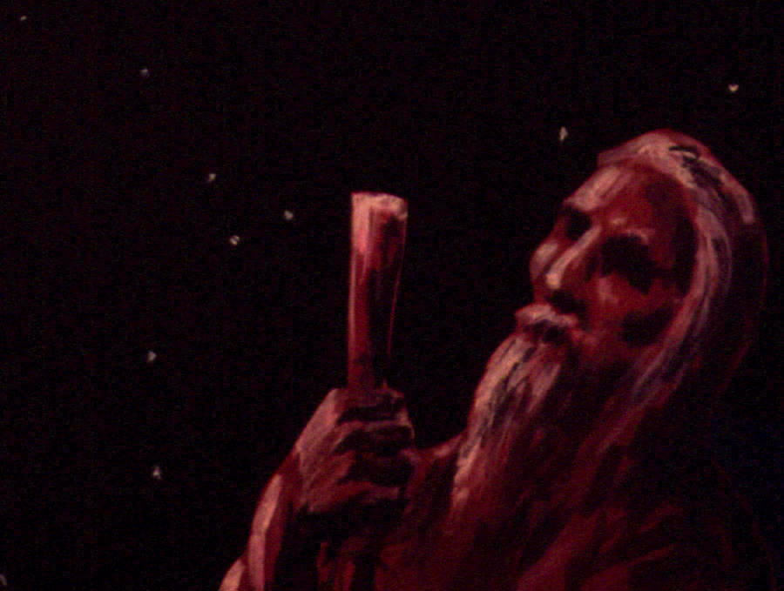
Biblical Problems with Astrology

Slide 34
God forbids divination
When you enter the land the LORD your God is giving you, do not learn to imitate the detestable ways of the nations there. Let no one be found among you who sacrifices his son or daughter in the fire, who practices divination or sorcery, interprets omens, engages in witchcraft, or casts spells, or who is a medium or spiritist or who consults the dead (Deuteronomy 18:9-11).

Slide 35
It won’t work against God
All the counsel you have received has only worn you out! Let your astrologers come forward, those stargazers who make predictions month by month, let them save you from what is coming upon you. Surely they are like stubble; the fire will burn them up. They cannot even save themselves from the power of the flame (Isaiah 47:13-14).

Slide 36
An occult connection
When men tell you to consult mediums and spiritists, who whisper and mutter, should not a people inquire of their God? Why consult the dead on behalf of the living? To the law and to the testimony! If they do not speak according to this word, they have no light of dawn (Isaiah 8:19-20).

Slide 37
God controls the universe
Hear what the LORD says to you, O house of Israel. This is what the LORD says, "Do not learn the ways of the nations or be terrified by signs in the sky, though the nations are terrified by them. The customs of the people are worthless" (Jeremiah 10:1-3).

Slide 38
Biblical Problems for Astrology
God forbids divination.
It won't work against God anyway.
It has an occult connection.
The God of the Bible controls the universe.

Slide 39
Summary on Astrology
Astrology is historically connected with paganism, polytheism and idolatry.
Astrology is not supported by scientific evidence and is quite arbitrary.
Astrology is condemned by the Bible as an attempt to live without dependence on God.

Slide 40
The End
Don't be misled by astrology!

