Slide 1

Astronomy & the Bible
Robert C. Newman

Slide 2
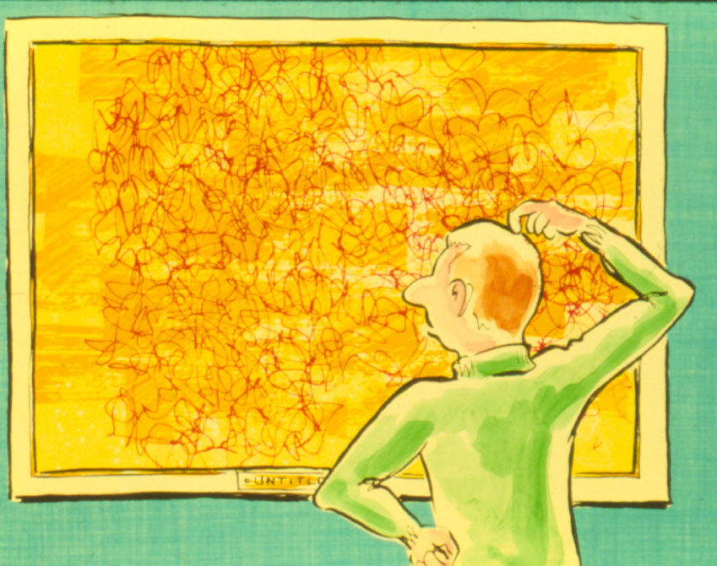
Is Religion a Matter of Taste?
Is religion like art, a matter of taste?
But each religion claims to tell us how things really are.
They make claims that are incompatible.
So they cannot all be right.

Slide 3
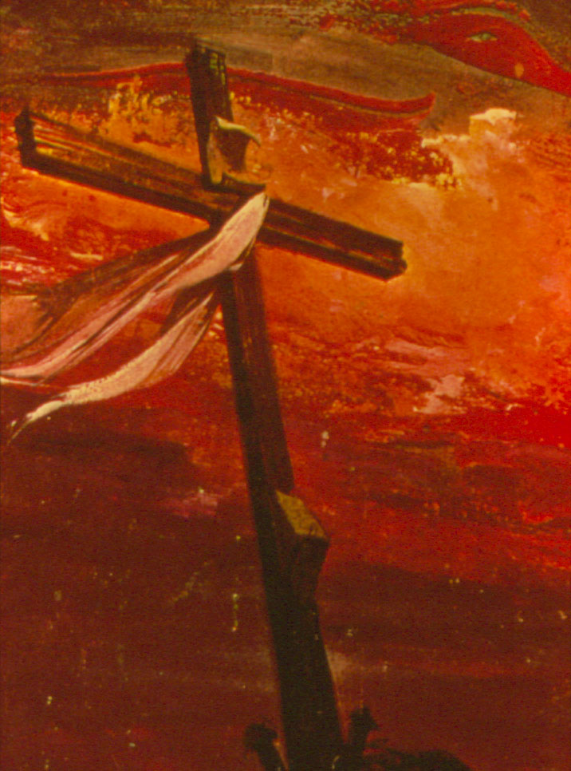
Consider Christianity
Among the world religions, only Christianity offers much evidence for its truth.
Evidence - from the nature of the universe - for a God who is infinite & personal
Evidence that this God is behind the Bible, from:
  Fulfilled prophecy
  Jesus
  Changed lives
  Preknowledge of science

Slide 4
Astronomy & the Bible
Want to look at one area here, pre-knowledge of astronomy
Compare the Bible's statements with other ancient views & with modern science
Our topics:
  Size of universe
  Number of stars
  Support of earth
  Shape of earth

Slide 5
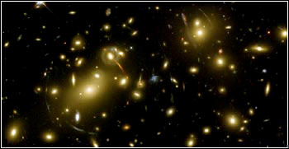
The Size of the Universe

Slide 6
Size according to Psalm 8
O LORD, our Lord, how majestic is your name in all the earth!… When I consider your heavens, the work of your fingers, the moon and the stars, which you have set in place, what is man that you are mindful of him, the son of man that you care for him?

Slide 7
Size according to Jeremiah 31
This is what the LORD says:
Only if the heavens above can be measured and the foundations of the earth below searched out will I reject all the descendants of Israel for all they have done, declares the LORD.

Slide 8
Size according to Qur'an 2:19-20
Men, serve your Lord, who has created you and those who have gone before you, so that you may guard yourselves against evil; who has made the earth a bed for you and the sky a dome, and has sent down water from the sky to bring forth fruits for your sustenance.

Slide 9
Size according to Qur'an 22:64
His is all that the heavens and earth contain. He is the Self-sufficient, the Glorious One. Do you not see how He subdued to you all that is in the earth? He has given you ships which sail the sea at His bidding. He holds the sky from falling down; this it shall not do except by His own will. Compassionate is Allah, and merciful to men.

Slide 10
Size according to Qur'an 34:9
Truly, those who deny the life to come are doomed, for they have grossly erred. Do they not see what is before them and behind them in heaven and earth? If We will, We can cave in the earth under their feet or let a part of heaven fall upon them. Surely there is a sign in this for every penitent man.

Slide 11
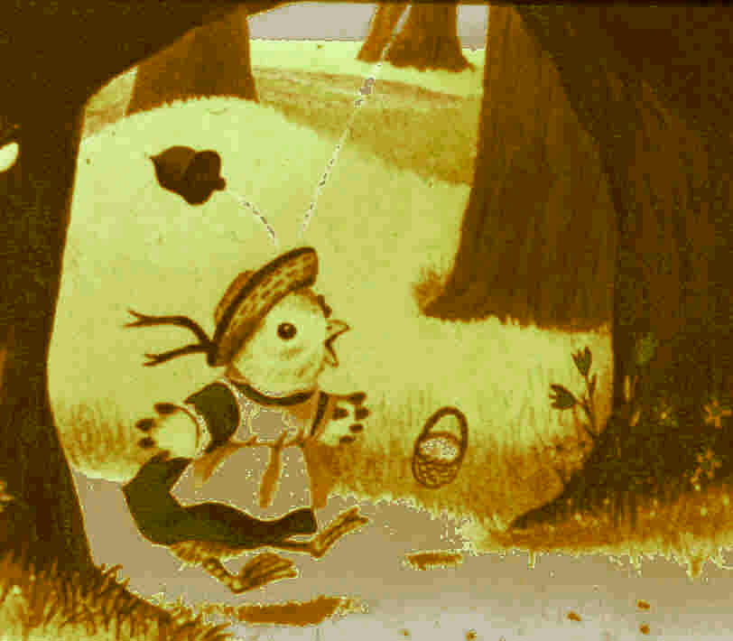
Size of the Universe
Bible:
  Immeasurably large
  Amazing that God cares about humans
Qur'an
  Dome sky, that might fall on people
  A "Chicken Little" universe

Slide 12
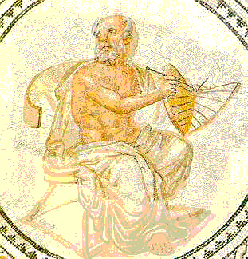
Size of the Universe
More scientific is Anaximander of Miletus, in his work About Nature (c 600 BC).
Yet even he pictures a universe less than a hundred times larger than the earth.
Consider these quotations from his treatise About Nature:

Slide 13
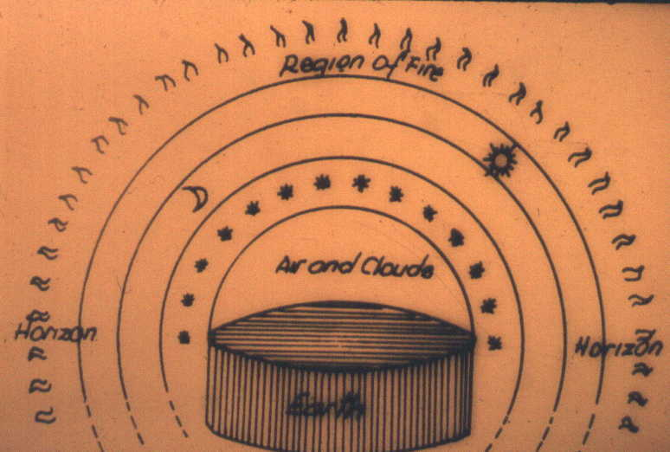
Size according to Anaximander
The stars are wheel-shaped masses of air, full of fire, breathing out flames from pores in different parts…. The sun has the highest position of all, the moon is next in order, and under it are the fixed stars and planets…. The circle of the sun is 28 times as large as the earth, like a chariot wheel, having a hollow center and this full of fire, shining in every part, and sending out fire through a narrow opening like the air from a flute.

Slide 14
Size according to
Modern Science
We still don't know how large the universe is, as we have not found any ends!
It is about 25 trillion miles (4 light-years) to the nearest star beyond the sun.
It is about 2 million light-years (12 quintillion miles) to the next large galaxy.
The most distant known objects are about 10 billion light-years away.

Slide 15
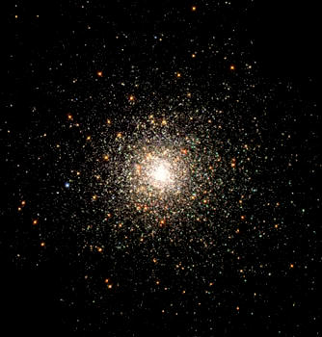
The Number of Stars

Slide 16
Number according to Genesis 15
[God] took [Abraham] outside and said, 'Look up at the heavens and count the stars – if indeed you can count them.' Then he said to him, 'So shall your offspring be.' Abraham believed the LORD, and he credited it to him as righteousness.

Slide 17
Number according to Jeremiah 33
I will make the descendants of David my servant and the Levites who minister before me as countless as the stars of the sky and as measureless as the sand on the seashore.

Slide 18
Number according to Genesis 22
The angel of the LORD called to Abraham from heaven a second time and said, 'I swear by myself, declares the LORD, that because you have done this and have not withheld your son, your only son, I will surely bless you and make your descendants as numerous as the stars in the sky and as the sand on the seashore.'

Slide 19
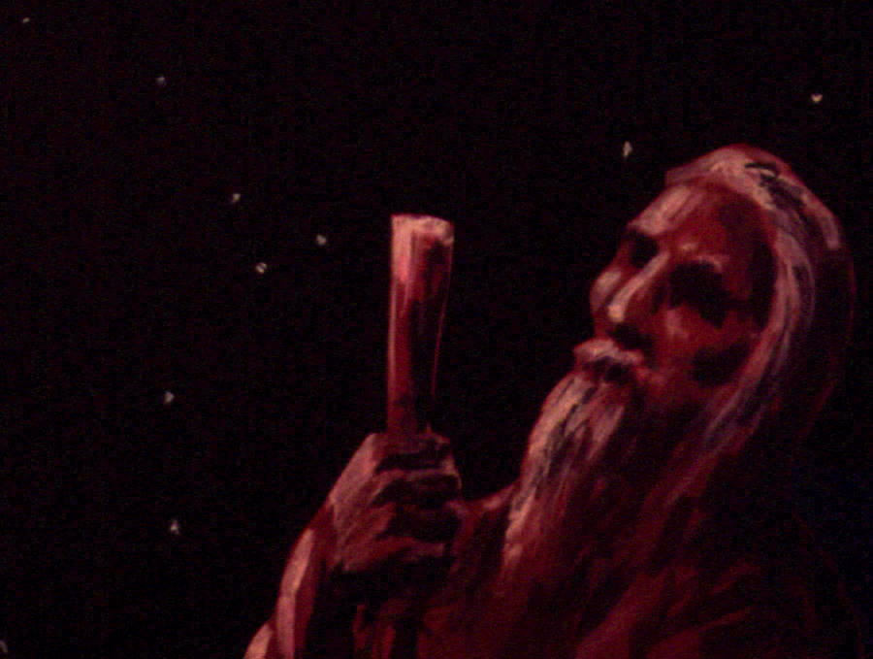
Number according to the Bible
This promise must have seemed strange to Abraham:
  He came from Ur, with a 100,000+ population.
  As a shepherd he probably spent hours looking at the stars above and the sand below.
He must have realized that he could only see a few thousand stars, less than a good handful of sand.

Slide 20
Number by Ancient Science
Less than 6,000 stars are visible from earth without telescopes.
The ancient star catalogs of Hipparchus and Ptolemy listed only about 2,000.
So claims to an uncountable number of stars would be surprising unless one went beyond observation.

Slide 21
Number according to Democritus
Democritus would say that there are an infinite number of worlds, differing in size; in some there is neither sun nor moon, in others they are larger than ours, and in others there are many suns and moons. The distances between the worlds are unequal and in some quarters there are more worlds, and in others fewer… in some quarters worlds are coming into being and in others they are ceasing to exist.

Slide 22
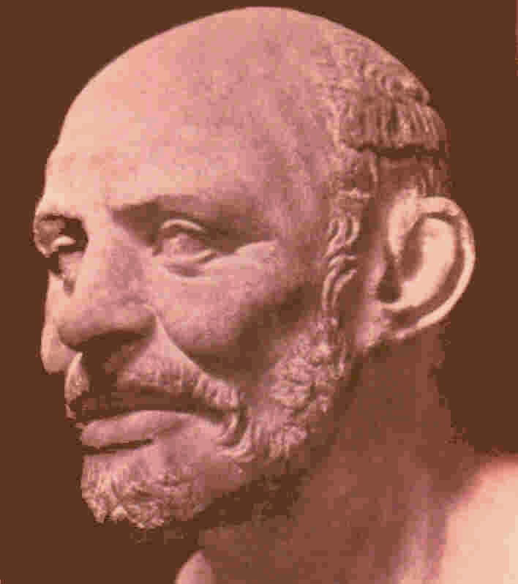
Number according to Democritus
This is the best guess from antiquity.
Yet Democritus means something a little different than we do when he speaks of a world.
His guess of infinity is probably way too high.

Slide 23
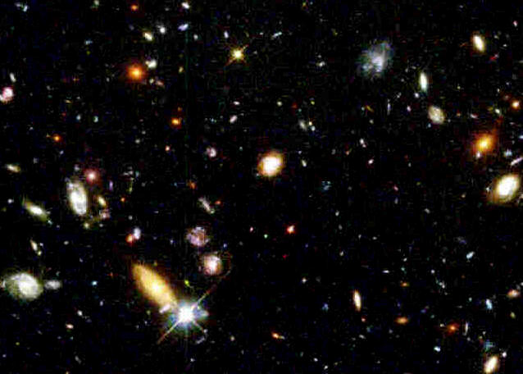
Number by Modern Science
We can see millions of stars with even a moderate telescope.
Our galaxy the Milky Way has perhaps 200 billion stars.
There are estimated to be some 100 billion galaxies in our universe.

Slide 24
Number by Modern Science
We obviously cannot state the total number of stars in the whole universe with any approach to accuracy, but its vastness is suggested by the statement that there are probably something like as many stars in the universe as there are grains of sand on all the seashores of the world.
Sir James Jeans, The Stars in Their Courses, 137

Slide 25
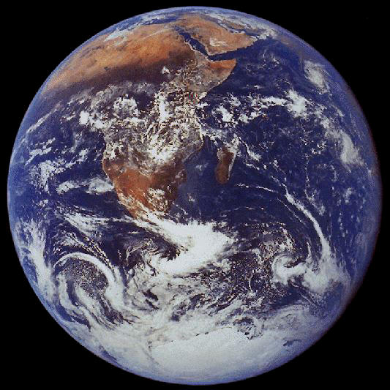
Support of the Earth

Slide 26
Earth Support in Job 26
[God] spreads out the northern skies over empty space; he suspends the earth over nothing.

Slide 27
Earth Support in Rigveda
This world, flat and triangular, is composed of seven stages, one of honey, another of sugar, a third of butter, and still another of wine, and the whole mass is borne on the heads of countless elephants, which in shaking produce earthquakes.

Slide 28

Earth Support in Rigveda

Slide 29
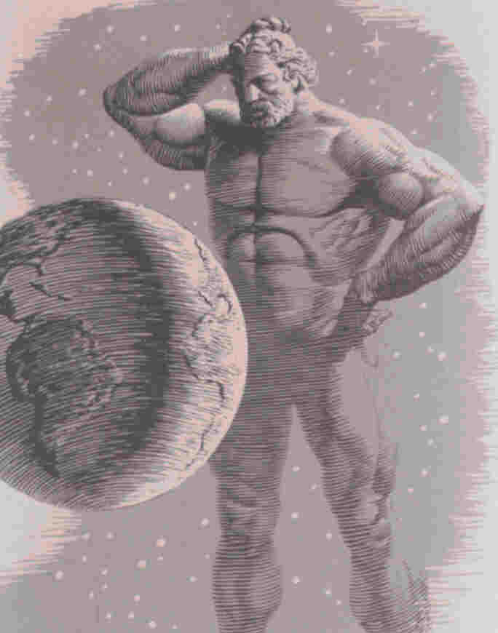
Earth Support among Greeks
Greek mythology had Atlas supporting the earth.
Thales said the earth was held up by water.
Anaxagoras thought it floated on air, a sort of large frisbie!
Anaximander claimed it was supported by nothing, but was refuted by Aristotle.

Slide 30
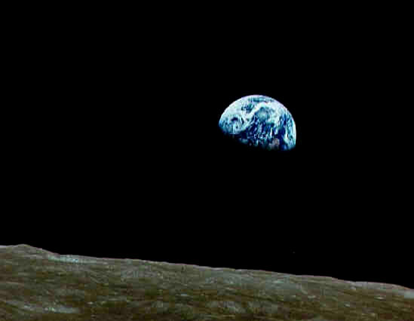
Earth Support in Modern Science
Indeed, the earth is held up by no material support.
The earth's support is immaterial, a balance between the earth's inertia & the gravity of the sun.

Slide 31
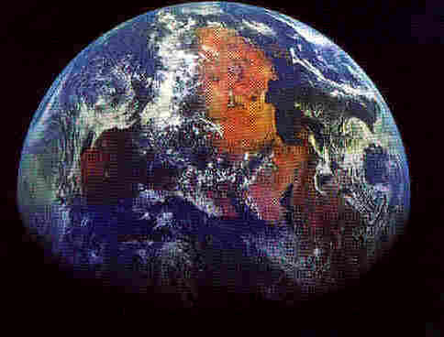
The Shape of the Earth

Slide 32
Shape in Revelation 20?
When the thousand years are over, Satan will be released from his prison and will go out to deceive the nations in the four corners of the earth – Gog and Magog – to gather them for battle.

Slide 33
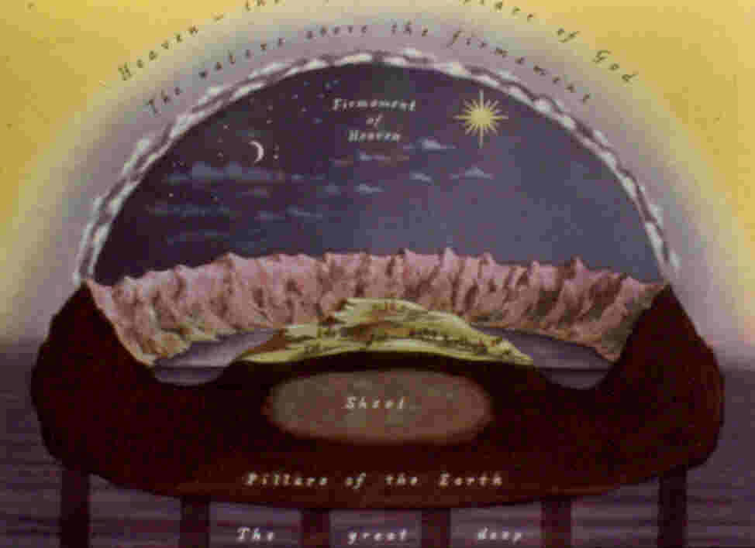
Shape according to Liberals
Taking some poetic expressions literally, and using much guesswork, they claim the Bible has:
  Flat earth with round or angular edges
  Dome sky
  Attic rooms for rain
  Earth floating on water

Slide 34
Shape in Isaiah 40?
[God] sits enthroned above the circle of the earth, and its people are like grasshoppers. He stretches out the heavens like a canopy, and spreads them out like a tent to live in.

Slide 35
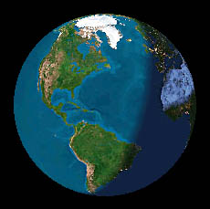
Shape in Job 26
[God] has described a circle on the face of the waters, at the boundary between light and darkness.

Slide 36
Shape in Matthew 24, Luke 17
The passages describing the 2nd coming picture events characteristic of different times of day:
  Sleeping
  Working in the fields
  Grinding grain
This fits well with a round earth, on which it is day or night depending on location.

Slide 37
Shape in Greek Science
Hecataios – flat, circular earth
Anaximander – pillar-shaped earth
Pythagoras – spherical earth
  Oldest known Greek to postulate this
  Don’t know his reasoning
  Problem of gravity tended to prevent this solution

Slide 38
Shape in Modern Science
Earth is pretty close to spherical
  Slightly flattened at poles
  Equatorial diameter about 20 miles longer than polar, less than 1/10" on a 20" globe
The line marking off day and night is thus very nearly a circle.

Slide 39
Summary on Astronomy & Bible
The Bible sees the universe as enormous, in contrast to most ancient views.
The Bible says the stars are uncountable, like the sand of the sea, also a rare idea.
The Bible has the earth supported by nothing, also rare in antiquity.
The Bible seems to picture a round earth, which was rare and counterintuitive.

Slide 40
Summary on Astronomy & Bible
Did the Jews have some special talent in science?
No, their uninspired books are not impressive in this regard:
  1 Enoch 72:
    The sun is a chariot driven by wind.
  3 Baruch 3:
    The Tower of Babel built to drill a hole in heaven’s dome!
The Bible's explanation is that it is a revelation from the God who made the universe.

Slide 41
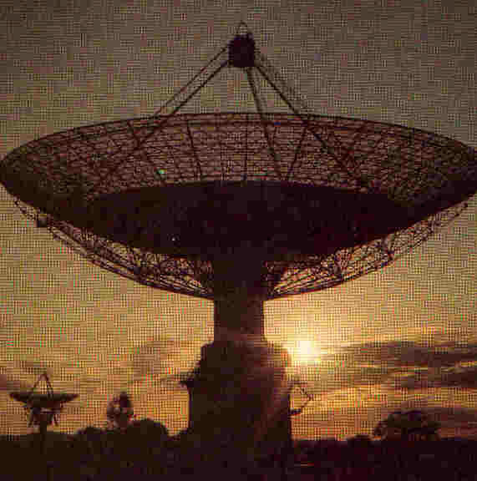
An ET Message from Your Maker
Seek the LORD while he may be found; call on him while he is near. Let the wicked forsake his way and the evil man his thoughts. Let him turn to the LORD, and he will have mercy on him, and to our God, for he will freely pardon.
Isaiah 55

Slide 42
The End
May you seek the author of the universe and the Bible!

