Slide 1
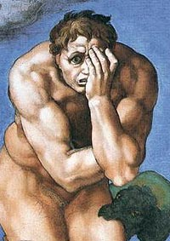

Apostasy & Assurance
Hebrews 6:13-20
Robert C. Newman

Slide 2
Apostasy & Assurance
Can believers in Jesus lose their salvation?
  Calvinist Christians say no.
  Arminian Christians say yes.
Both agree that people who think they are saved can fall away, and many do.
We are not going to answer the whole question, but look at one important passage, which many think teaches believers can lose their salvation.

Slide 3
Hebrews Chapter 6
Our passage (verses 13-20) is an important part of this chapter, as it puts the first part of the chapter in perspective.
We can sketch the first part like this:
  The fearful nature of apostasy (vv 4-6)
  An illustration: two types of ground (vv 7-8)
  The things that accompany salvation (vv 9-12)
Let’s look at these verses first.

Slide 4
The Fearful Nature of Apostasy
Hebrews 6:4 (NIV) It is impossible for those who have once been enlightened, who have tasted the heavenly gift, who have shared in the Holy Spirit, 5 who have tasted the goodness of the word of God and the powers of the coming age, 6 if they fall away, to be brought back to repentance, because to their loss they are crucifying the Son of God all over again and subjecting him to public disgrace.

Slide 5
The Fearful Nature of Apostasy
These verses form a major area of dispute between those who believe saved people can never be lost (Calvinists) and those who believe saved people can be lost (Arminians).
The verses picture people who show characteristics we usually associate with the saved, yet they finally fall away.
For such people, this passage says there is no possibility of return.

Slide 6
An Illustration
Hebrews 6:7 (NIV) Land that drinks in the rain often falling on it and that produces a crop useful to those for whom it is farmed receives the blessing of God. 8 But land that produces thorns and thistles is worthless and is in danger of being cursed. In the end it will be burned.

Slide 7
An Illustration
This illustrates the previous remarks.
Here we see two types of ground:
  Both receive rain.
  One yields good fruit, the other thorns & thistles.
Like these two types of ground, so there are two types of people.
  Both receive heavenly gifts.
  One yields faithfulness, the other falls away.
Some internal difference in both cases produces different external results, even though both receive the same benefits.
What is this internal difference?

Slide 8
The Things That
Accompany Salvation
Hebrews 6:9 (NIV) Even though we speak like this, dear friends, we are confident of better things in your case ─ things that accompany salvation. 10 God is not unjust; he will not forget your work and the love you have shown him as you have helped his people and continue to help them. 11 We want each of you to show this same diligence to the very end, in order to make your hope sure. 12 We do not want you to become lazy, but to imitate those who through faith and patience inherit what has been promised.

Slide 9
The Things That
Accompany Salvation
The writer of Hebrews believes that verses 4-6 do not apply to his original readers.
Why?
  Apparently they show evidences of being saved which he considers convincing.
  These are love & good works, so long as they continue, which will make one’s hope sure.
Also, “God is not unjust to forget…”
  What is this all about?

Slide 10
The Example of Abraham
The writer of Hebrews urges his readers to be imitators of those who through faith and endurance inherited the promises.
  Like Abraham
Let’s look at what the writer has to say about Abraham.

Slide 11
The Example of Abraham
Hebrews 6:13 (NIV) When God made his promise to Abraham, since there was no one greater for him to swear by, he swore by himself, 14 saying, "I will surely bless you and give you many descendants." [Gen. 22:17] 15 And so after waiting patiently, Abraham received what was promised.

Slide 12
The Example of Abraham
This is not just any example.
Abraham is the “father” of the faithful.
We are included in Abraham’s covenant by trusting in Jesus as our Lord & Savior.
Abraham’s blessing is promised by God’s oath (vv 13-14), referring to Gen 22:16-17 (see next panel).
As a result, Abraham (enduring) inherits.

Slide 13
God’s Oath
Genesis 22:15 (NIV) The angel of the LORD called to Abraham from heaven a second time 16 and said, "I swear by myself, declares the LORD, that because you have done this and have not withheld your son, your only son, 17 I will surely bless you and make your descendants as numerous as the stars in the sky and as the sand on the seashore. Your descendants will take possession of the cities of their enemies, 18 and through your offspring all nations on earth will be blessed, because you have obeyed me."

Slide 14
The Significance of God’s Oath
Let’s look here at two things:
The Significance of an Oath in General
The Purpose of God in Taking this Oath

Slide 15
The Significance of an Oath
Hebrews 6:16 (NIV) Men swear by someone greater than themselves, and the oath confirms what is said and puts an end to all argument.

Slide 16
Sworn by Someone Greater
Genesis 31:53: Jacob & Laban swear:
  “May God judge”
2 Kings 2:2: God & Elijah swear:
  “As ___ lives”
1 Kings 19:2: Jezebel swearing by her gods:
  “May they do to me & more also”

Slide 17
Puts an End to Argument
Exodus 22:10-11:
  In matter of a lost deposit
1 Kings 8:31-32:
  Passing on the case to a higher court

Slide 18
Puts an End to Argument
Exodus 22:10 (NIV) "If a man gives a donkey, an ox, a sheep or any other animal to his neighbor for safekeeping and it dies or is injured or is taken away while no one is looking, 11 the issue between them will be settled by the taking of an oath before the LORD that the neighbor did not lay hands on the other person's property. The owner is to accept this, and no restitution is required.
1 Kings 8:31 (NIV) "When a man wrongs his neighbor and is required to take an oath and he comes and swears the oath before your altar in this temple, 32 then hear from heaven and act. Judge between your servants, condemning the guilty and bringing down on his own head what he has done. Declare the innocent not guilty, and so establish his innocence.

Slide 19
The Purpose of God
Hebrews 6:17 (NIV) Because God wanted to make the unchanging nature of his purpose very clear to the heirs of what was promised, he confirmed it with an oath. 18 God did this so that, by two unchangeable things in which it is impossible for God to lie, we who have fled to take hold of the hope offered to us may be greatly encouraged.

Slide 20
The Purpose of God
His purpose in making this oath to Abraham was to demonstrate to believers even more surely the unchangeableness of His promise to them.
What are the two unchangeable things?
  The promise itself, resting on God’s mercy
  The oath, resting on law, God’s justice
  This explains the remark “God is not unjust”

Slide 21
The Result for Believers
Hebrews 6:19 (NIV) We have this hope as an anchor for the soul, firm and secure. It enters the inner sanctuary behind the curtain, 20 where Jesus, who went before us, has entered on our behalf. He has become a high priest forever, in the order of Melchizedek.

Slide 22
The Result for Believers
Strong assurance
An anchor for the soul
  Secure
  Permanent
  Entering the most holy place:
    Anchored in the very presence & character of God

Slide 23
The Result for Believers
God will keep us as He promised.
He does this by changing us so that we will endure and persevere.
Praise God for His faithfulness!
May we press on to serve Him without fear.

Slide 24
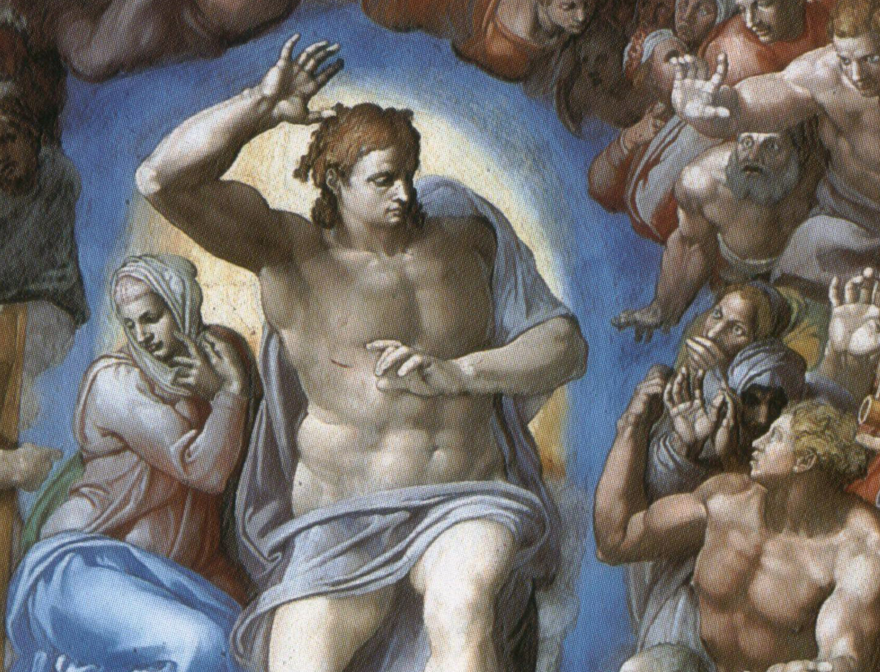
The End
May we, too, show by our love, work and endurance, that we are really God’s people!

