Slide 1
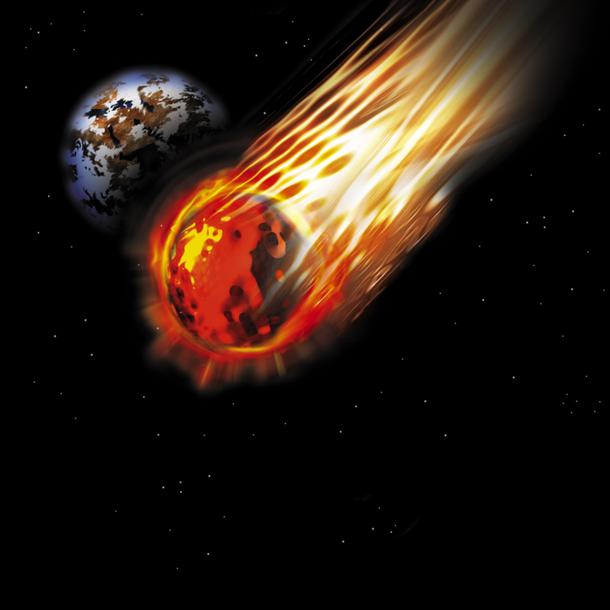

Apocalyptic Genre
Robert C. Newman

Slide 2
Definitions
Apocalyptic – those ancient visionary writings which purport to reveal the mystery of the end of the age and of the glories of the age to come.
Prophecy – an utterance of a prophet, one who claims to speak for God. Since it often pertained to the future, comes to be identified with foretelling future events. Usually distinguished from narrative, law, psalms, wisdom; but not strictly a category of form, but rather of claimed source.
  Soulen, Handbook of Biblical Criticism

Slide 3
Characteristics of Apocalyptic
Revelation of a visionary sort
Extensive use of symbolism
Tendency to pessimism re/ human nature
Cosmic perspective
World-shaking events
Triumph of God
Deterministic – events are set
Dualistic – struggle between good and evil
Pseudonymous – claims famous author
History rewritten as prophecy

Slide 4
OT Material usually considered Apocalyptic
Numbers 23-24 – Balaam's oracles
Isaiah 24-27 – events of end of age
Ezekiel – chariot w/ cherubim, departure of Glory, invasion of Israel, visionary temple, parabolic visions
Daniel – parabolic visions, dreams re/ future & end of age
Zechariah – parabolic visions, events of end

Slide 5
NT Material usually considered Apocalyptic
Olivet Discourse – Christ reveals signs of end, 2nd coming to disciples
1 Thessalonians 4-5 – 2nd coming, resurrection, end of age
2 Thessalonians 1-2 – 2nd coming, man of lawlessness
Revelation – visions of heaven, symbolism, end of age

Slide 6
Extrabiblical Apocalypses
1-3 Enoch
  1 Enoch – visionary journeys thru world & underworld; angels, Messiah; world history
  2 Enoch – visionary journey thru heavens; revelation of creation & world history to flood
  3 Enoch – visionary journey of R. Ishmael to heaven; secrets from Metatron re/ cosmos, end
2-3 Baruch
  2 Baruch – preview of world history to Messiah
  3 Baruch – complaint re/ destruction of Jerusalem leads to visit to different heavens

Slide 7
Extrabiblical Apocalypses
War Scroll (1QM) – rules for conducting end-time war against Gentiles
Assumption of Moses – Moses, before departure, reveals history of Israel
Martyrdom & Ascension of Isaiah – visits heaven, sees future; sawn in two by king
4 Ezra – 7 visions answering Ezra’s Qs re/ Jerusalem, # of saved, history to Messiah

Slide 8
Extrabiblical Apocalypses
Shepherd of Hermas – allegorical visions from woman & shepherd re/ Christian life
Apocalypse of Peter – Christ on Mt Olives describes heaven & hell, esp punishments
Apocalypse of Paul – carried up to 3rd heaven, meets angels, patriarchs; blessing of righteous, punishment of wicked
Apocalypse of Thomas – events leading up to end in a 7-day scheme

Slide 9
Summary on Apocalyptic
Diverse materials here, particularly when both canonical & non-canonical lumped together
Origin of genre is earlier than IT period, continues centuries later.
Except for Jude, no clear evidence that canonical borrowed from non-canonical.
Rather dependence seems to go the other way
  1 Enoch dependent on Ezekiel, Daniel
  Hermas, Apoc Peter on Revelation

Slide 10
Summary on Apocalyptic
Does not mean canonical cannot use symbolism existing in culture at time:
  Some Greco-Roman symbolism in Revelation
  Seven-sealed book, white stone, etc.
No real evidence of pseudonymity in canonical apocalyptic.
What does this mean for interpretation?
  End of age, history
  Final judgment
  Fate of wicked
  Eternal state

Slide 11
Some Comments on Genre
Genre studies often overlook important items:
Truth vs fiction of the book's contents
Public vs private status of the book's circulation

Slide 12
Truth vs Fiction
Book of Mormon shares many genre features with Old Testament, but
  BM is fiction
  OT is history
Apocryphal Acts resemble Canonical, but latter is history, former fiction
Similarly with the Canonical vs Apocryphal Gospels
I suggest that the Canonical Apocalypses are real visions from God while Apocryphal are not.

Slide 13
Public vs Private
Canonical apocalypses apparently in public circulation since time of claimed authors, no reason to think this true for apocryphal ones.
Compare Gospel of Thomas: "These are the secret words…" and Joseph Smith 'finding' golden plates.
I think the apocryphal apocalypses were semi-secret works of Mormon-like groups in antiquity.
Semi-secret because all such groups have occasional cases of apostasy.

Slide 14
Some Comments on Genre
These two matters will have considerable bearing on whether false authorship was OK in antiquity:
  Obviously it was OK to the founders of heretical cults who wrote such stuff
  They would have been in big trouble with their followers if they found out!
I suspect the apocryphal works were written to mimic the canonical when these became well-known.

Slide 15
The End!
Don't dismiss end-times prophecy as just 'apocalyptic'!

