Slide 1
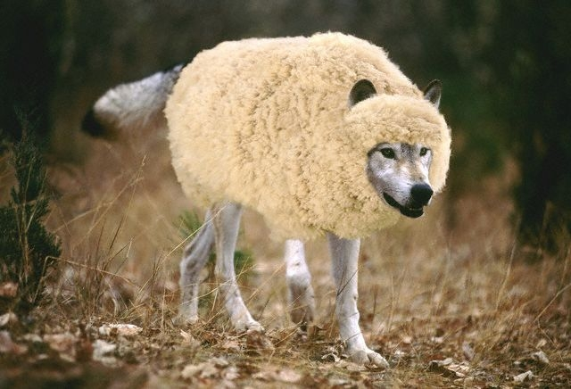
Another Jesus?
False Messiahs Then & Now
Robert C. Newman

Slide 2
Another Jesus
The apostle Paul, writing to one of his churches, rebuked them for being open to lies about Jesus:
2 Cor 11:4 (NASU) For if one comes and preaches another Jesus whom we have not preached, or [if] you receive a different spirit which you have not received, or a different gospel which you have not accepted, you bear [this] beautifully.

Slide 3
False Christs
Even earlier, Jesus warned of imposters who would try to substitute for himself:
Mark 13:22 (NASU) for false Christs and false prophets will arise, and will show signs and wonders, in order to lead astray, if possible, the elect.
We want to consider how this has happened in the past and today.

Slide 4
Overview
We will subdivide our discussion into three headings:
Another Historical Jesus
Another Spiritual Jesus
Another Political Jesus
These categories will overlap somewhat, but represent different emphases.

Slide 5
Another Historical Jesus

Slide 6
Another Historical Jesus
What do we mean by "another historical Jesus"?
Though the phrase could be taken in several ways, we will understand it this way:
"Writings or teachings in which Jesus is pictured quite differently than he is in the New Testament Gospels."

Slide 7
Another Historical Jesus
This term arises from what is probably the most famous survey of writings on this topic, Albert Schweitzer's Quest of the Historical Jesus (English Transl 1910).
Schweitzer sketches over 100 retellings of the life of Jesus, from the perspective of theological liberalism, written between the late 1700s and the early 1900s.

Slide 8
Another Historical Jesus
But such retellings did not begin in the 1700s, nor end early in the 1900s, nor have they all have had the same liberal perspective.
The first retellings, popular in the early centuries of Christianity, were what we now call the "Gnostic Gospels."

Slide 9
Gnostic Gospels
Between perhaps AD 150-350, a number of pictures of Jesus were given from the theological perspective of Gnosticism.
These include quite a few 'gospels,' of which the best-known today are:
The Gospel of Thomas
The Gospel of Mary (Magdalene)
The Gospel of Philip
The Gospel of Judas

Slide 10
What was Gnosticism?
Gnosticism was a religious movement in which Christianity was combined with various themes from Greek philosophy & religion.
It was characterized by belief that:
Matter is bad, but spirit is good.
The Creator is evil or (at best) ignorant.
The God of the OT is not the God of the NT.
Salvation is escape from the world of matter.

Slide 11
The Gnostic Jesus
Naturally the Jesus that Gnosticism pictures is very different from the Jesus of the NT.
The Gnostic Jesus:
…seems to do nothing but teach.
…teaches in secret to a small group.
…only appears to have a physical body.
…does not die on the cross.
…despises those who worship the Creator.
Interest in Gnosticism has revived in recent years since the publication of the Nag Hammadi papyri.

Slide 12
Recent Jesus Pictures
Since Schweitzer wrote, there has been a revival of different pictures of Jesus in the late 20th century.
These include:
Jesus Christ Superstar
The Jesus of the Passover Plot
Jesus the Magician
The Jesus of the Da Vinci Code

Slide 13
Jesus Christ Superstar
Rock opera (1971) & film (1973) by Andrew Lloyd-Weber & Tim Rice
The Plot:
Jesus is a superstar religious guru, but his fame goes to his head.
Begins believing what others say about him (that he is God), leading to the cross.
Blames God, but dies anyway.
Judas speaks from grave, also blames God.
No resurrection

Slide 14
The Passover Plot
Book (1966) by Hugh J. Schonfield
Here Jesus has (almost) everything under control:
Learns to interpret prophecy
Decides he is Messiah
Sets out to fulfill prophecy
Stages triumphal entry
Blows Judas’ mind
Times events so only on cross briefly
(But speared by soldier)
Revived in tomb, sends message, dies

Slide 15
Jesus the Magician
Book (1978) by Morton Smith
Jesus is a Gnostic magician
Possessed by a spirit
Claims to be deity
Develops self-hypnosis
Claims to fly & teaches flying to disciples
Visits heaven, sees God
Freed by God from Law

Slide 16
The DaVinci Code
A murder mystery (2003), set in the present
Yet the plot turns on the idea that Jesus:
was merely human
he had children
the Holy Grail is Jesus' royal blood-line, not the cup at the Last Supper.

Slide 17
New Age Movement
Besides these retellings of the life of Christ, other pictures of Jesus have arisen with the New Age movement.
The New Age movement resembles the old Gnosticism in being a combination of other religious ideas with Christianity, but these come from westernized versions of Hinduism and Buddhism rather than from Greek philosophy & religion.

Slide 18
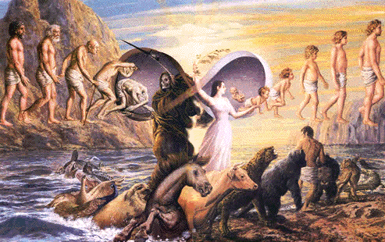
New Age Movement
Like Gnosticism, the New Age movement is characterized by a diverse group of beliefs taught by various gurus, rather than a single, unified system.
Some characteristic features of the New Age movement include:
Reincarnation
Individualism
Humans can rise to levels of being above humanity
Here we give two New Age pictures of Jesus, those of Edgard Cayce & Benjamin Crème.

Slide 19
Edgar Cayce's Jesus
Jesus became the Christ (Edgar Cayce's Story of Jesus [1969] 16, 42) …
…thru acceptance of God’s will
Jesus exemplifies the universal Christ-consciousness (16, 42).
Jesus became aware he would be Savior of the world when he fell in Eden (23).

Slide 20
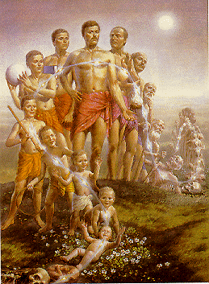
Jesus' Previous Incarnations
Amilius of Atlantis
Adam
Enoch
Melchizedek
Joseph
Joshua
Zend (father of Zoroaster)
And others (23, 28, 37).

Slide 21
Jesus & Mary
Jesus sinned in at least some of these incarnations (23).
His mother, Mary, did not sin in her incarnation as his mother (27-28).
She had no human father either!
In a previous incarnation, she was Eve, the twin-soul of Jesus.

Slide 22
Benjamin Crème's Christ
The Christ is the Master of all Masters, but not God; He is a Son of God, and so are we (Reappearance of the Christ & the Masters of Wisdom [1980], 115).
The Christ is not an individual but an office … held (for the past 26,000 years) by Lord Maitreya.
He was manifested in Palestine by overshadowing his disciple Jesus (RC 30).

Slide 23
Jesus & the Christ
Jesus is not the Christ. He was, and still is, a Disciple of the Christ.
He gave up his body for the use of the Christ, who took over … his body from the baptism onwards.
Jesus, in his next incarnation as Apollonius of Tyana, became a Master.
He lives now (in a 600 year-old Syrian body) in Palestine (RC 46).

Slide 24
Another Historical Jesus
Are any of these pictures really consistent with what is taught in the Gospels of the New Testament?
No, but if people don't know what the Bible teaches, they are easily deceived by any charlatan that comes along.
And if they reject what the Bible teaches, they have no one but themselves to blame for whatever consequences follow.

Slide 25
Another Historical Jesus
From the perspective of the Bible, it is reasonable to think that these alternative pictures of Jesus are inspired by Satan, "The Father of Lies."
CS Lewis, in his imaginative fiction The Screwtape Letters (1942), chapter 23, pictures a senior demon instructing his nephew on this subject:

Slide 26
CS Lewis on Another Jesus
"… this idea must be used by us to encourage once again the conception of a 'historical Jesus' to be found by clearing away later 'accretions and perversions' and then to be contrasted with the whole Christian tradition. In the last generation we promoted the construction of such a 'historical Jesus' on liberal and humanitarian lines; we are now putting forward a new 'historical Jesus' on Marxian, catastrophic and revolutionary lines. The advantages of these constructions, which we intend to change every thirty years or so, are manifold."

Slide 27
Another Historical Jesus
We need to be aware of this strategy and help people to see that the real historical Jesus is the Jesus of the Bible.

Slide 28
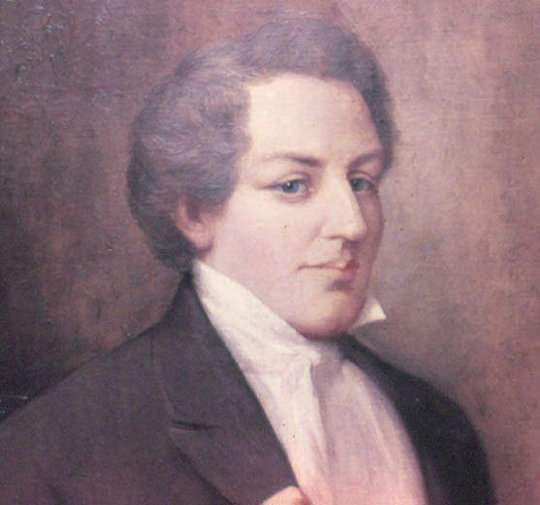
Another Spiritual Jesus

Slide 29
Another Spiritual Jesus
What do we mean by "another spiritual Jesus"?
Here we mean "someone who is the founder of a major religion, one who claims to do the sort of spiritual things that the Bible claims for Jesus":
Shows his followers what ultimate reality is like.
Helps them overcome life's obstacles.
Leads them to eternal life or the equivalent.

Slide 30
Another Spiritual Jesus
Before the time of Jesus, this would presumably include:
Buddha
Zoroaster
Other less well-known figures.
Jesus was probably speaking of such as these when he said: (John 10:8, NIV) "All who ever came before me were thieves and robbers, but the sheep did not listen to them."

Slide 31
Another Spiritual Jesus
Since the time of Jesus, I would suggest (among others less well-known):
Various Jewish persons professing to be the Messiah (e.g., Bar Kochba, Shabbati Zvi)
Muhammad
Emmanuel Swedenborg
Joseph Smith
Sung Myung Moon

Slide 32
Another Spiritual Jesus
To these we might add:
Eastern Lightning, a messianic movement in China today
Even in orthodox circles, the idea that Jesus is a vending machine or a 'Buddha' to give us health and wealth, rather than the One who is saving us from our sin and sending us out on His mission.

Slide 33
Another Spiritual Jesus
We should not be surprised about these, either, as they would fall under the Bible’s categories of false Christs and false prophets.

Slide 34
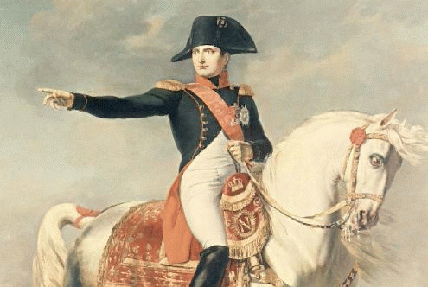
Another Political Jesus

Slide 35
Another Political Jesus
What do we mean by "another political Jesus"?
One of the defining characteristics of the OT Messiah is that he is to be the ruler of the world (see Daniel 7:13-14).
So another political Jesus would be "one who attempts to be a world-ruler."

Slide 36
Ruler of the World
Dan 7:13 (NASU) I kept looking in the night visions, And behold, with the clouds of heaven One like a Son of Man was coming, And He came up to the Ancient of Days And was presented before Him. 14 And to Him was given dominion, Glory and a kingdom, That all the peoples, nations and [men of every] language Might serve Him. His dominion is an everlasting dominion Which will not pass away; And His kingdom is one Which will not be destroyed.

Slide 37
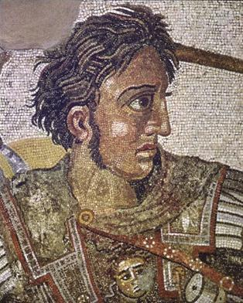
Another Political Jesus
Before the coming of Jesus, these would be such persons as:
Nebuchadnezzar
Alexander the Great
Antiochus Epiphanes
Caesar Augustus

Slide 38
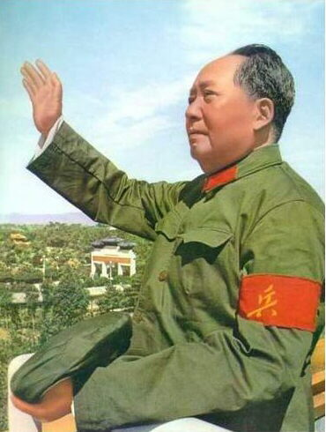
Another Political Jesus
Since the coming of Jesus, we would include:
Nero
Muhammad
Genghis Khan
Napoleon
Stalin
Mao Tzedong
Plus many others who were not as successful as these.

Slide 39
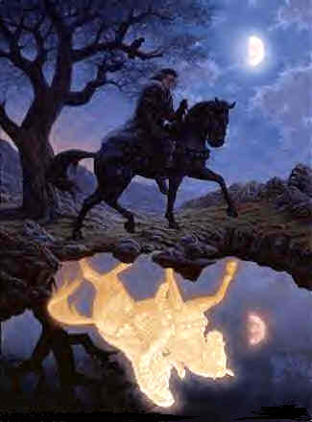
Putting It Together

Slide 40
Putting It Together
What do we get when we try to put together the historical, spiritual, and political attempts to replace Jesus?
Collectively, we may call these "antichrists," as does the apostle John.
He says they were already around in his own time:

Slide 41
Antichrists
1 John 2:18 (NASU) Children, it is the last hour; and just as you heard that antichrist is coming, even now many antichrists have appeared; from this we know that it is the last hour. 19 They went out from us, but they were not [really] of us; for if they had been of us, they would have remained with us; but [they went out], so that it would be shown that they all are not of us.

Slide 42
The Antichrist
John distinguishes these antichrists from "the antichrist" who is coming.
This is seen more clearly in Jesus' Olivet Discourse, in Paul’s remarks about the "man of lawlessness," and in the picture of the "beast" in Revelation.

Slide 43
The Abomination of Desolation
Matt 24:15 (NASU) Therefore when you see the abomination of desolation which was spoken of through Daniel the prophet, standing in the holy place (let the reader understand), 16 then those who are in Judea must flee to the mountains; 17 Whoever is on the housetop must not go down to get the things out that are in his house. 18 Whoever is in the field must not turn back to get his cloak. 19 But woe to those who are pregnant and to those who are nursing babies in those days! 20 But pray that your flight will not be in the winter, or on a Sabbath. 21 For then there will be a great tribulation, such as has not occurred since the beginning of the world until now, nor ever will.

Slide 44
The Lawless One
2 Thess 2:5 (NASU) Do you not remember that while I was still with you, I was telling you these things? 6 And you know what restrains him now, so that in his time he will be revealed. 7 For the mystery of lawlessness is already at work; only he who now restrains [will do so] until he is taken out of the way. 8 Then that lawless one will be revealed whom the Lord will slay with the breath of His mouth and bring to an end by the appearance of His coming; 9 [that is], the one whose coming is in accord with the activity of Satan, with all power and signs and false wonders, 10 and with all the deception of wickedness for those who perish, because they did not receive the love of the truth so as to be saved.

Slide 45
The Beast
Rev 13:1 (NASU) And the dragon stood on the sand of the seashore. Then I saw a beast coming up out of the sea, having ten horns and seven heads, and on his horns [were] ten diadems, and on his heads [were] blasphemous names. 2 And the beast which I saw was like a leopard, and his feet were like [those] of a bear, and his mouth like the mouth of a lion. And the dragon gave him his power and his throne and great authority. 3 [I saw] one of his heads as if it had been slain, and his fatal wound was healed. And the whole earth was amazed [and followed] after the beast; 4 they worshiped the dragon because he gave his authority to the beast; and they worshiped the beast, saying, "Who is like the beast, and who is able to wage war with him?"

Slide 46
Conclusions
Beware of False Prophets!

Slide 47
Conclusions
The Lord wants us, without becoming paranoid, to know what is going on around us:
Historically
Spiritually
Politically
The Lord wants us to help others see who Jesus is, and flee to Him as our only hope.

Slide 48
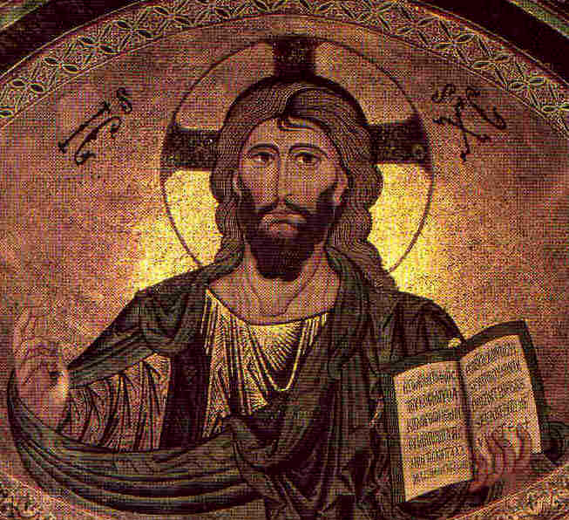
The End
Flee to Jesus!

Slide 49
For Further Information
On:
Gnosticism
The New Age Movement
Liberal Lives of Jesus
Biblical Prophecy
See our website:
www.ibri.org

