Slide 1
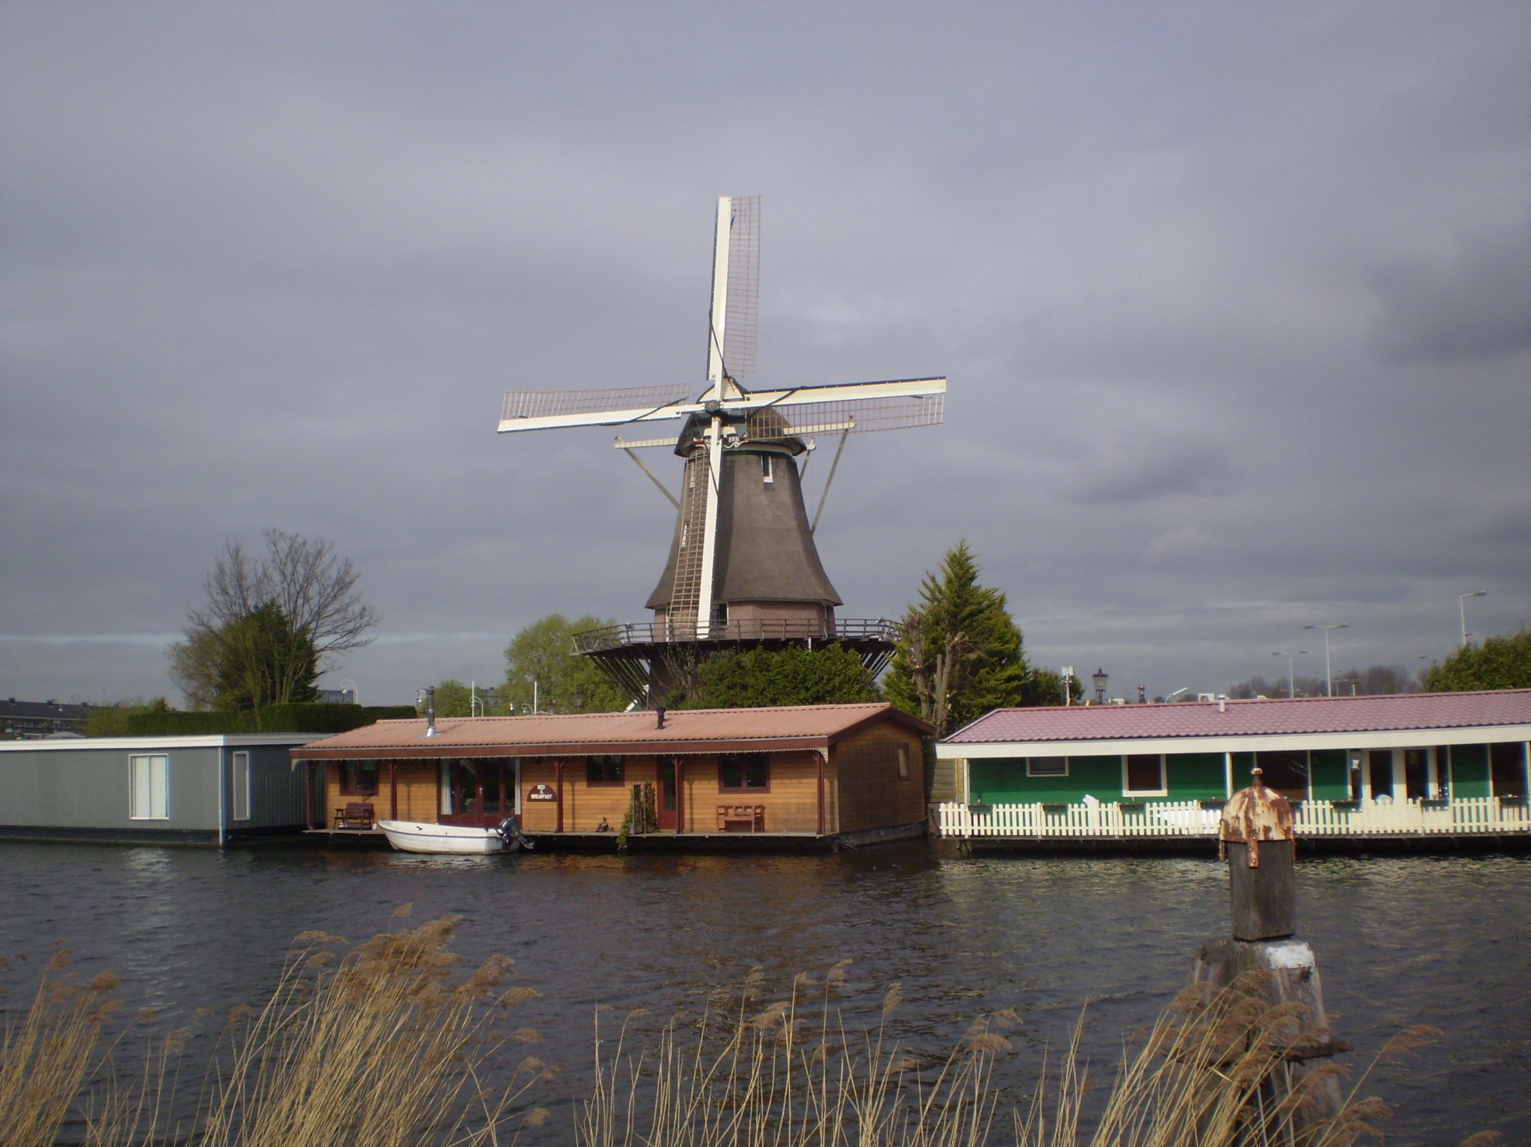

2011 Europe Trip
Amsterdam & Cologne
Robert C. Newman

Slide 2
Travel Over
Left Charlottesville, VA by air Friday 18 March, about 5 PM
Layover in Atlanta, 6:15 to 10:55
Overnight flight across the Atlantic
Land at Amsterdam, 11:20 AM Saturday 19 March.
Arrive at Tyndale Theological Seminary, 1 PM.

Slide 3
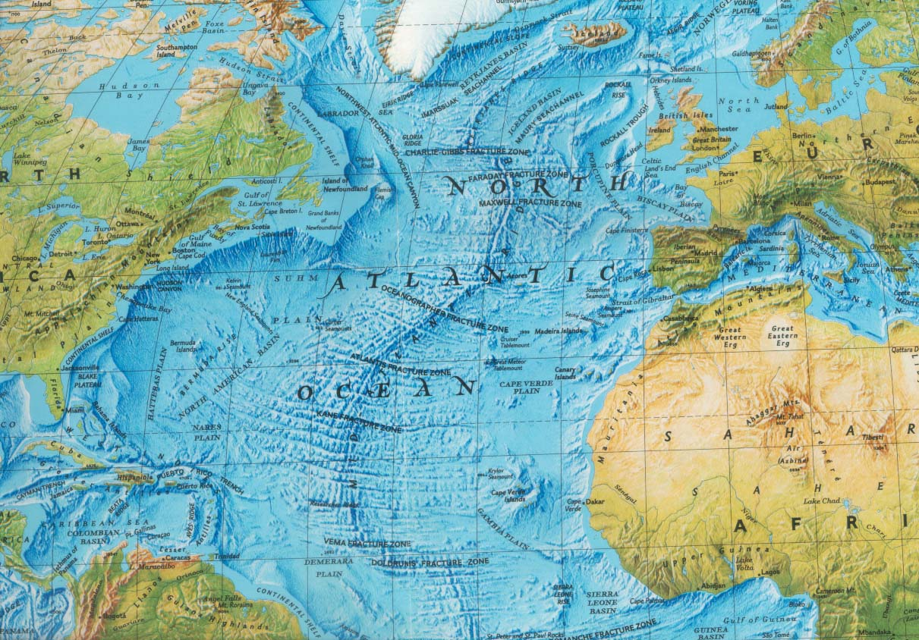
Travel Over

Slide 4
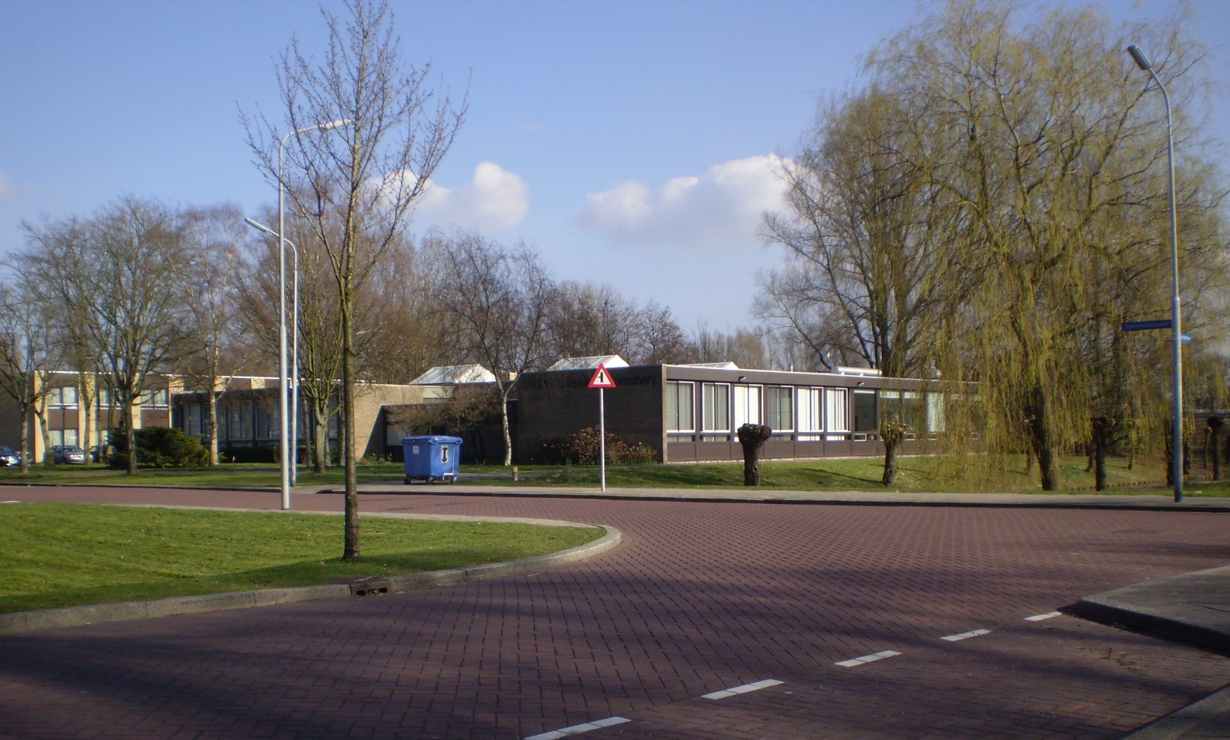
Tyndale Theological Seminary

Slide 5
Teaching at Tyndale
Mainly teaching the Luke part of a Luke-Acts course, eight 2-hour sessions.
Also taught New Testament Survey, three 2-hour lectures.
Gave a one-hour lecture in their Romans course.
Also a one-hour Q & A session in their Apologetics class.

Slide 6
Luke Course
The Gospel as History
Biblical Theology of the Gospels
Jesus’ Attitudes & Actions
Jesus’ Miracles
Jesus’ Parables
Jesus’ Discourses
Jesus’ Controversies
Jesus’ Death & Resurrection

Slide 7
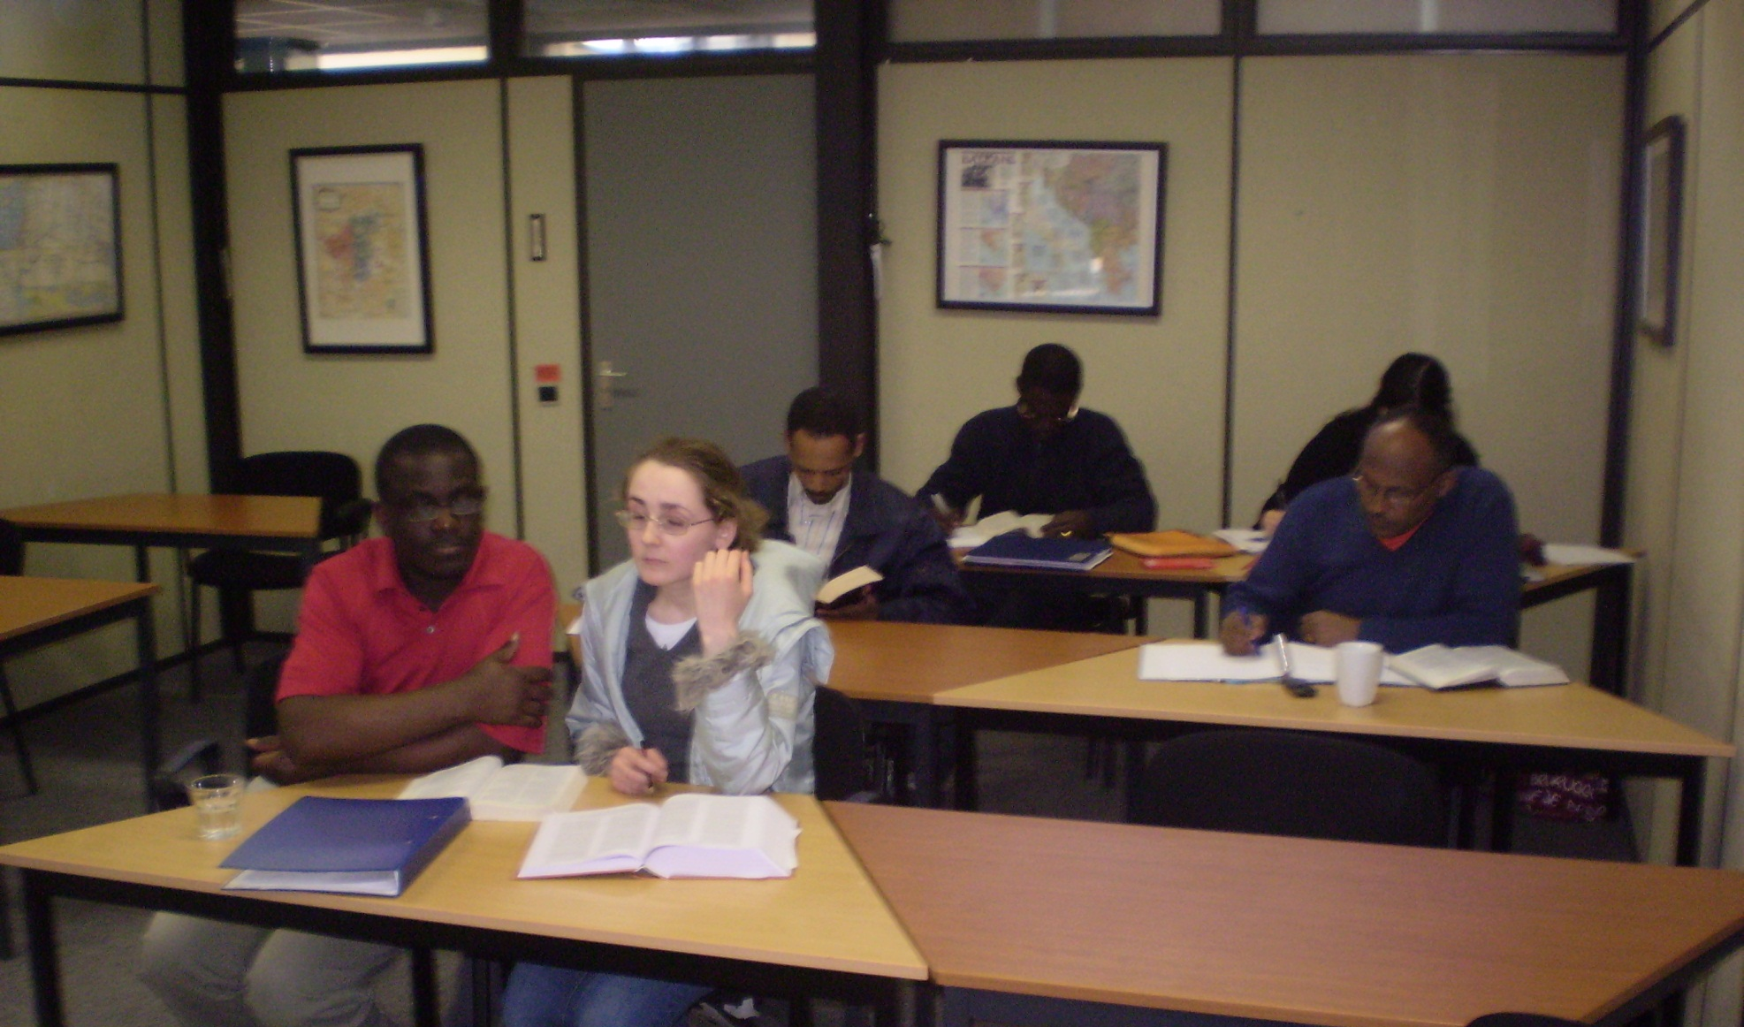
Luke Course

Slide 8
Other Courses
New Testament Survey
  Gospel of John, Gnostic Gospel of Judas
  God’s Self-Portraits, Biblical Pictures of Salvation
  Revelation
Romans
  Biblical Pictures of Salvation
Apologetics
  Answering various questions

Slide 9
Other Speaking at Tyndale
Chapel, Tuesday 29 March
  “Disaster: What to Make of It?”
MET Colloquium, Thursday 31 March
  “The Star of Bethlehem”
Seminar for Faculty & Others, Thursday 7 April
  “Christianity and Science”

Slide 10
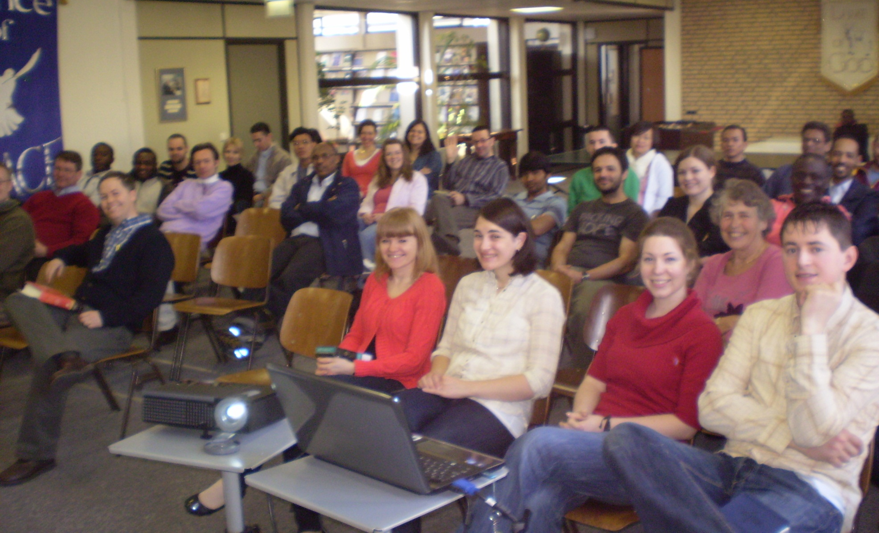
Tyndale Chapel

Slide 11
Churches & Some Preaching
Attended two churches as visitor:
  Christ Church, Amsterdam South, on Sunday 20 March
  Crossroads Church, Amstelveen, on Sunday 27 March
Preached at two churches:
  Apostolic Church International, Amstelveen, on Sunday 3 April
  Christ Church, Heiloo, on Sunday, 10 April

Slide 12
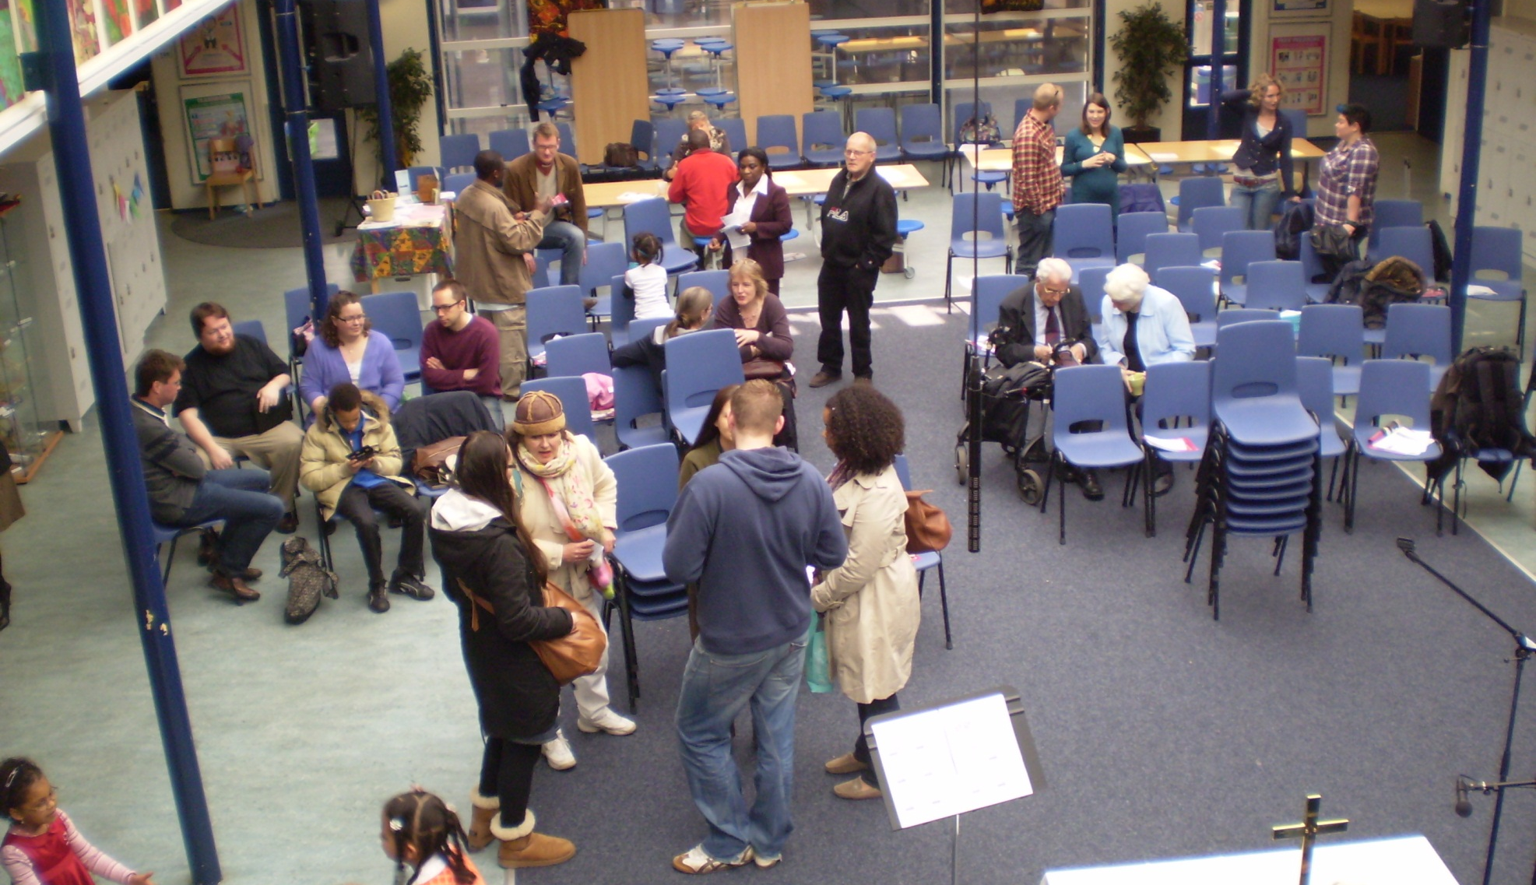
Christ Church (South)

Slide 13
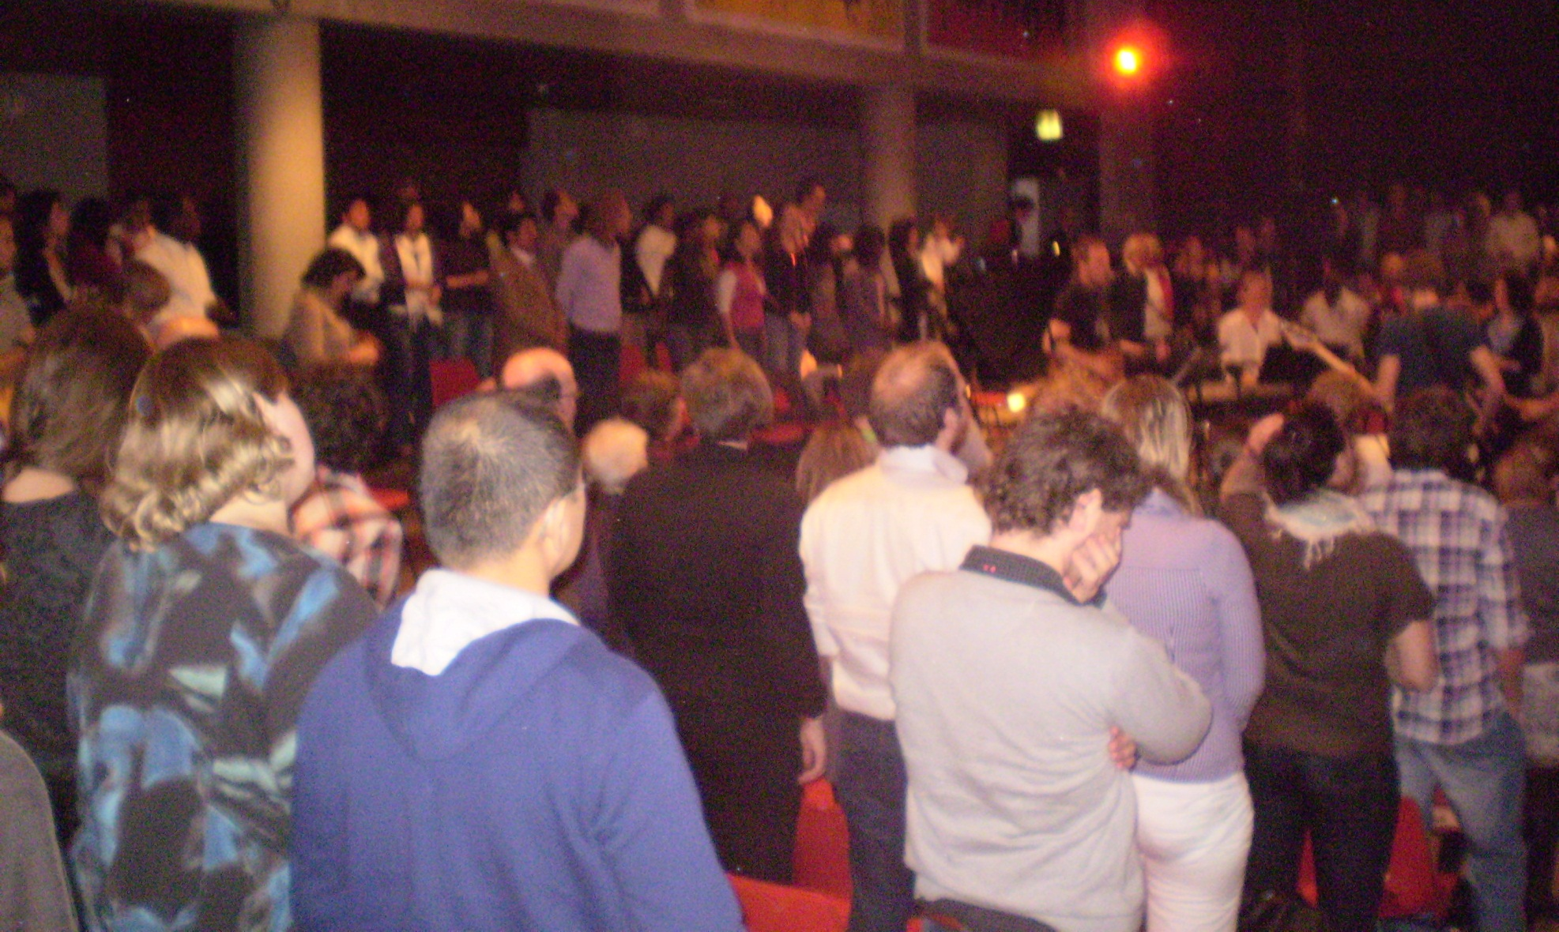
Crossroads Church

Slide 14
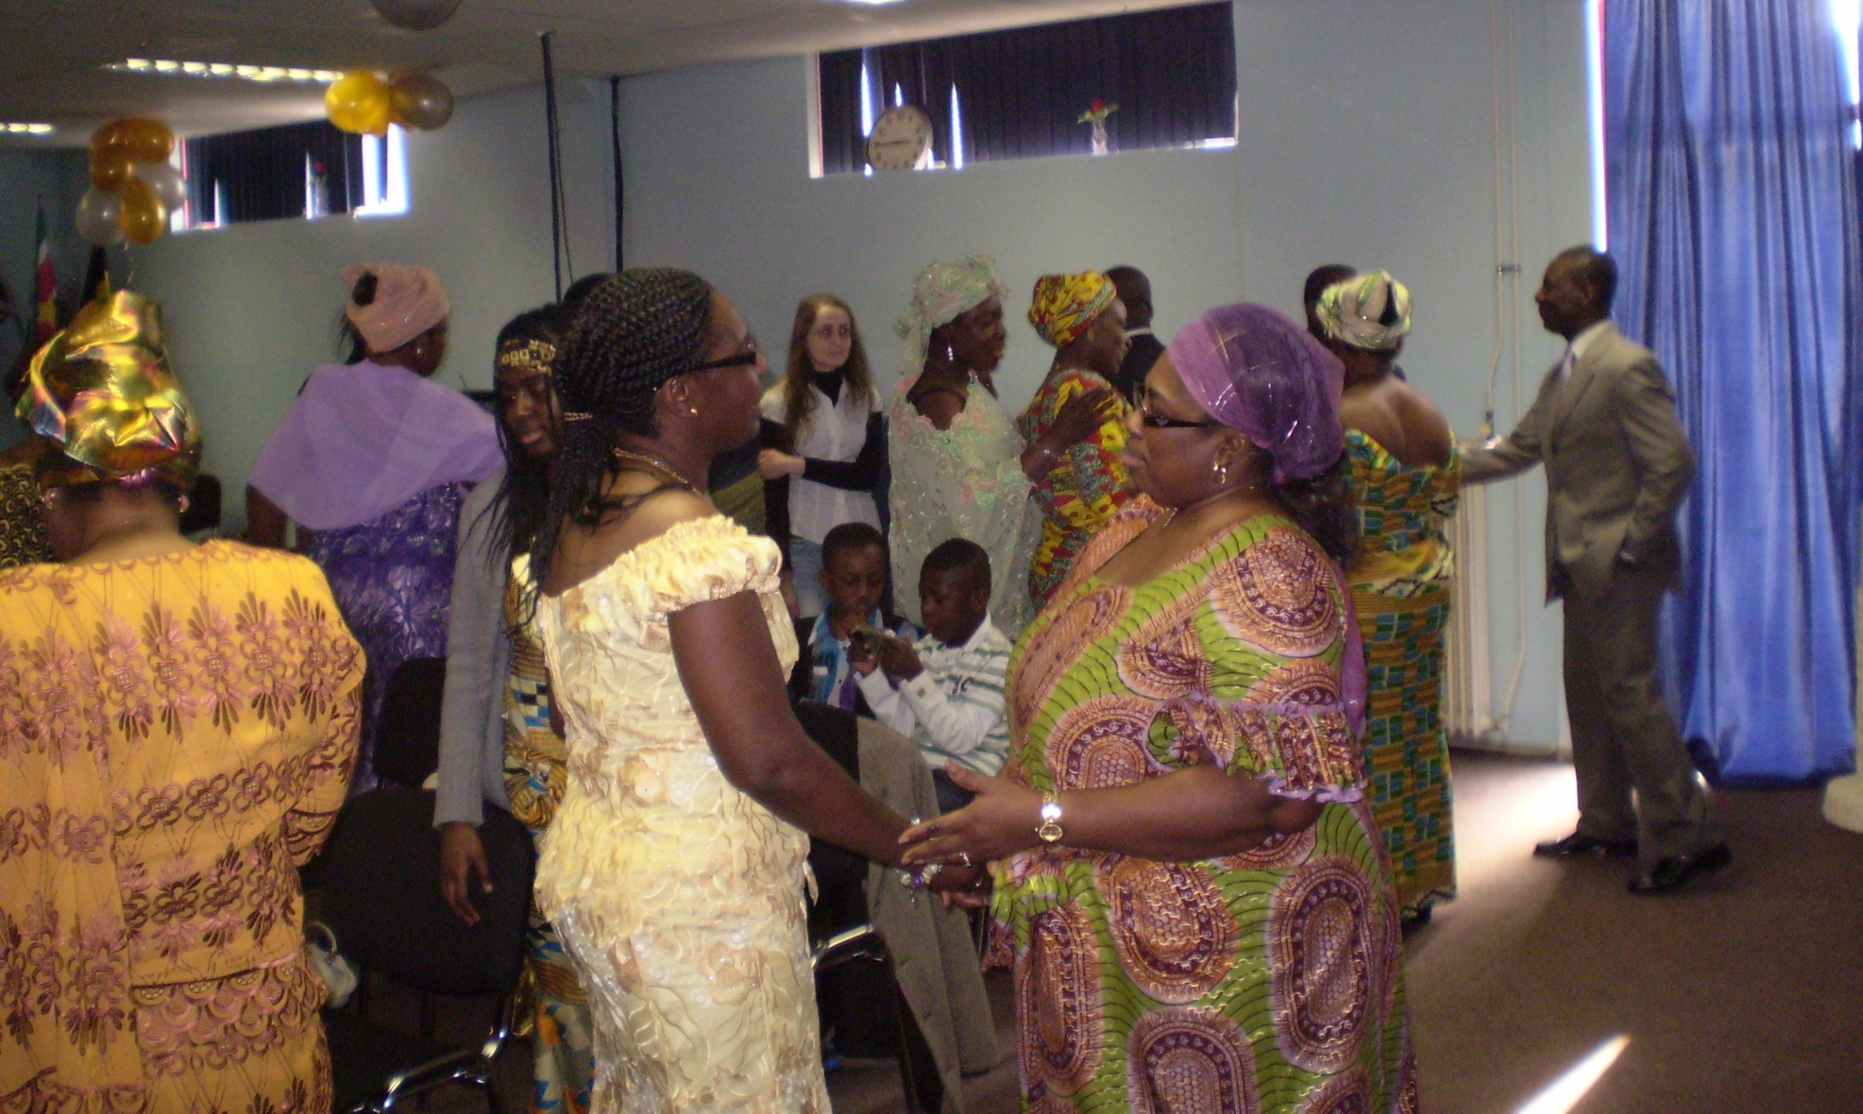
Apostolic Church International

Slide 15
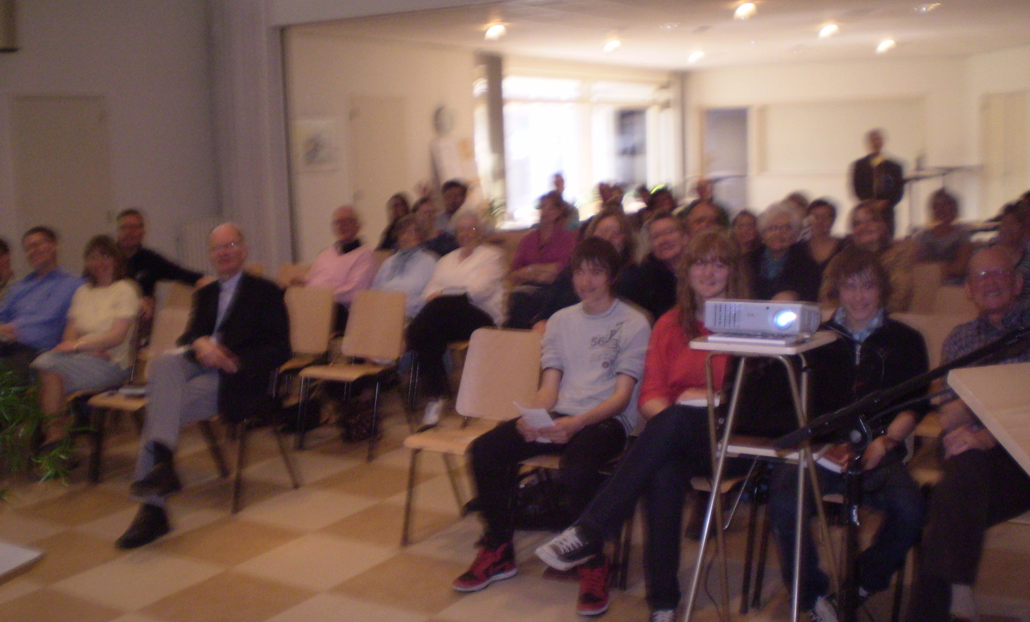
Christ Church, Heiloo

Slide 16
Sightseeing
Sightseeing in Downtown Amsterdam
  On my 70th birthday, Saturday 2 April
  Boat tour of canals and old harbor
  Walking tour of Royal Palace
At Museum de Cruquius, south of Haarlem
  Friday 8 April
  Techniques of reclaiming land from sea

Slide 17
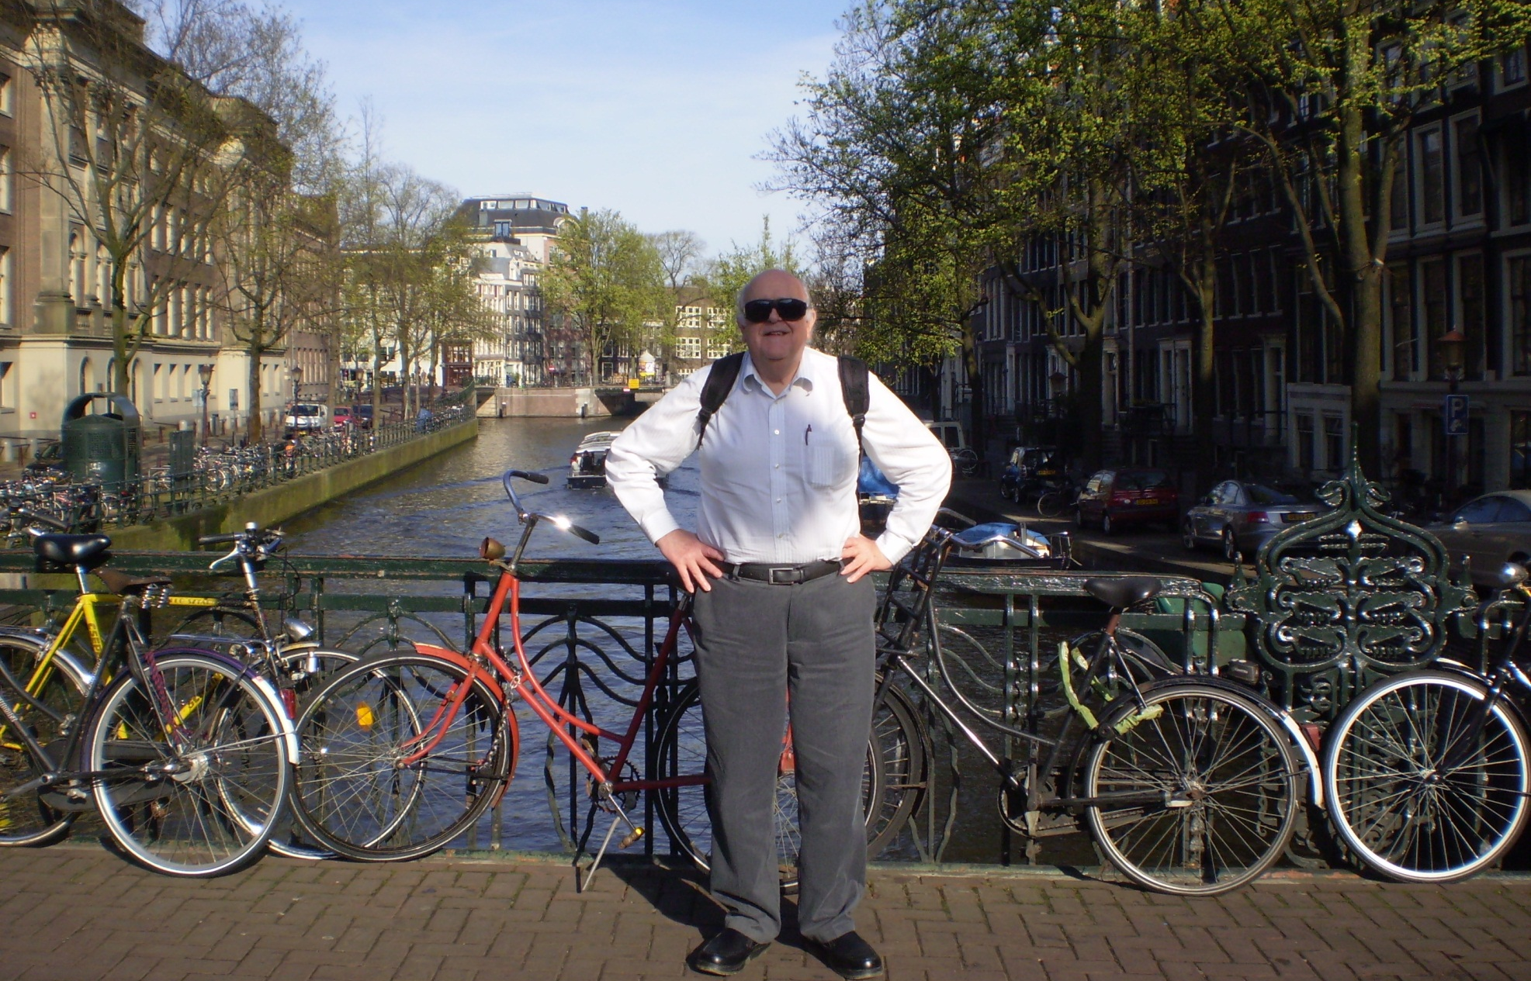
Amsterdam

Slide 18
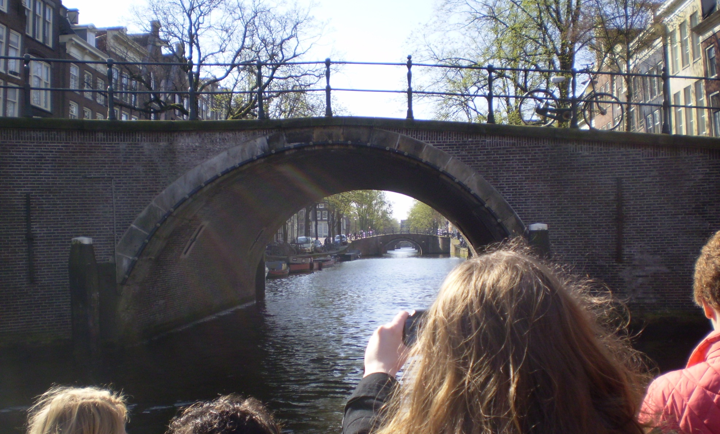
Boat Tour

Slide 19
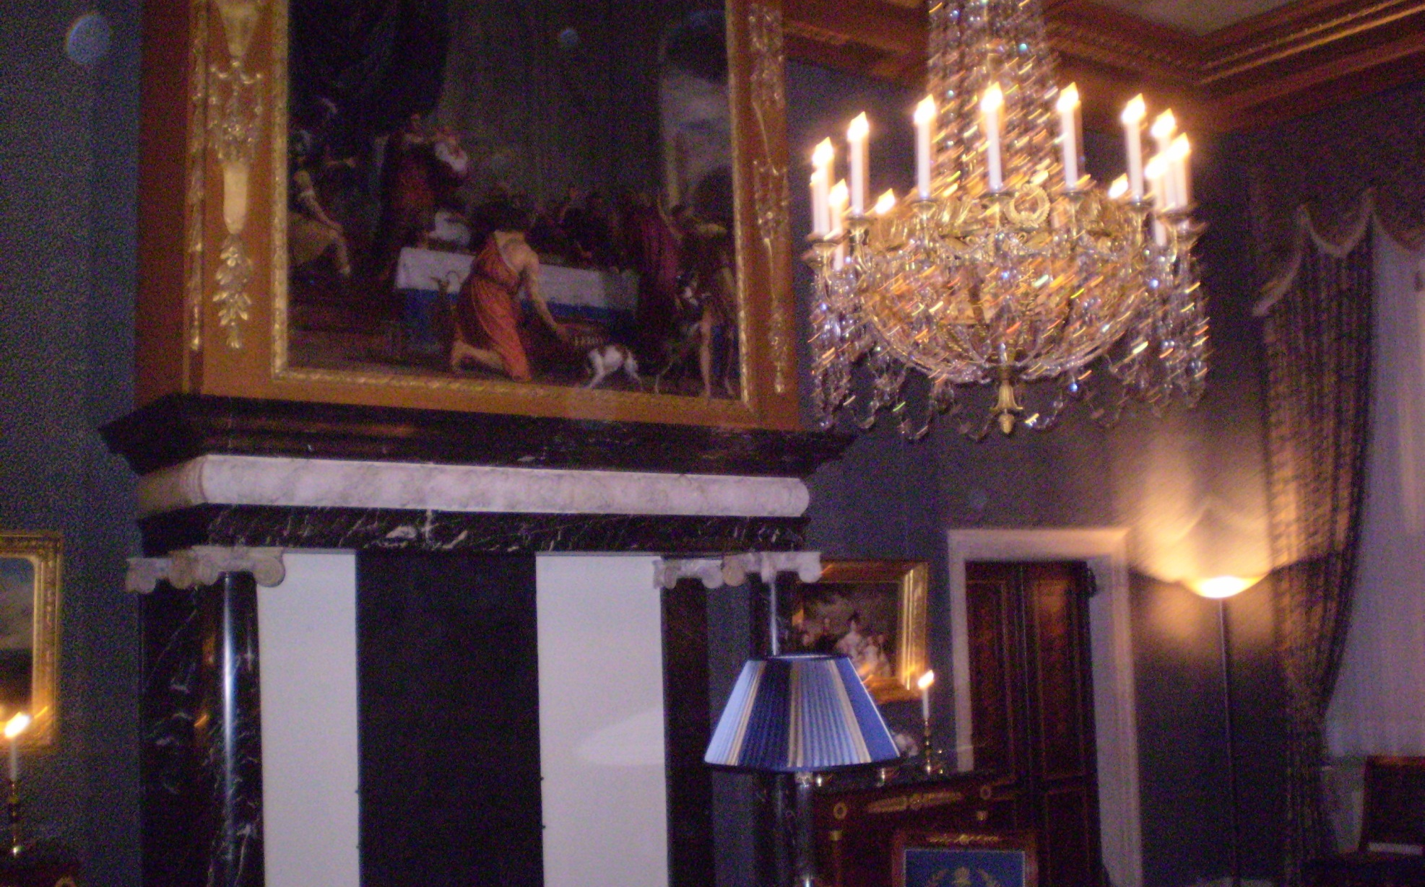
Royal Palace

Slide 20
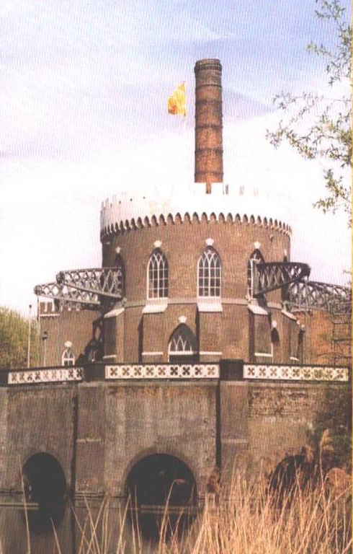
Museum de Cruquius

Slide 21
Other Teaching to North
Friday 25 March: Kids aged 8-12 in Alkmaar: “The Solar System”
Saturday 26 March: Men’s Breakfast in Heiloo: “Presenting the Gospel to Those Who Reject Scripture”
Thursday 7 April: European School in Bergen: “Intelligent Design”

Slide 22
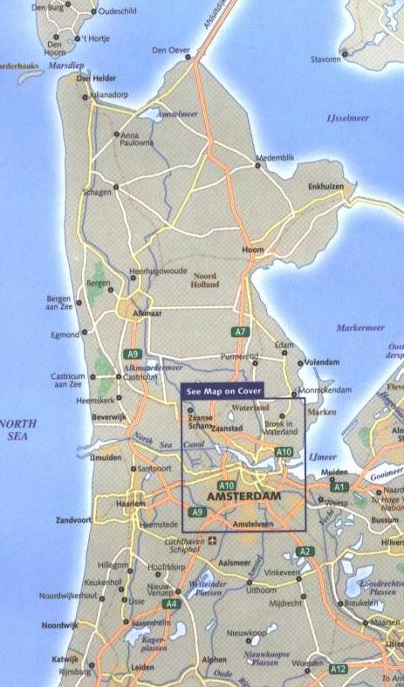
North Holland
Bergen
Alkmaar

Slide 23
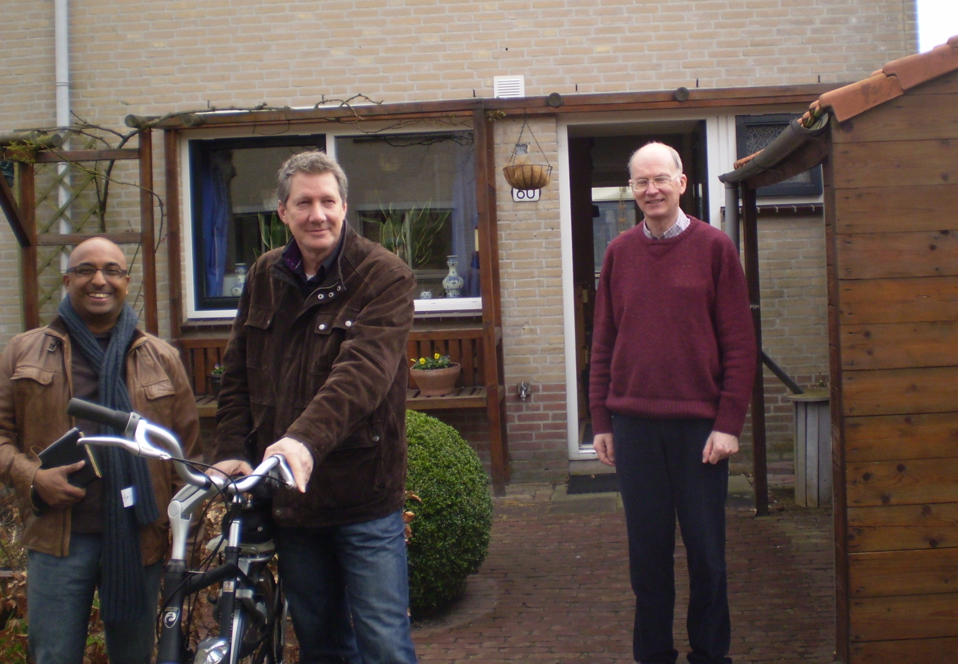
Men’s Breakfast

Slide 24
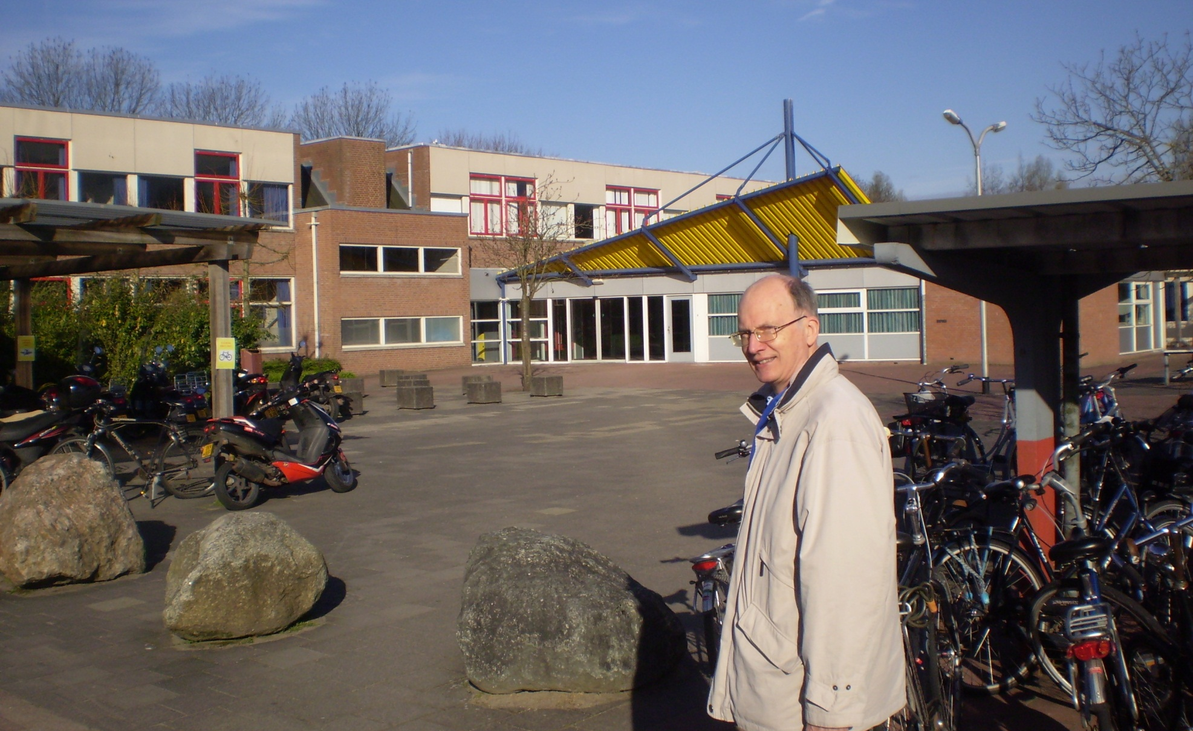
European School, Bergen

Slide 25
Teaching in Rotterdam
Saturday 9 April with Drake Williams
Part of a two-Saturday course on NT Survey at the Scots International Church
For immigrant pastors and Christian workers
I taught about 4-1/2 hours on the Gospels, Letters of John, Jude and Revelation.

Slide 26
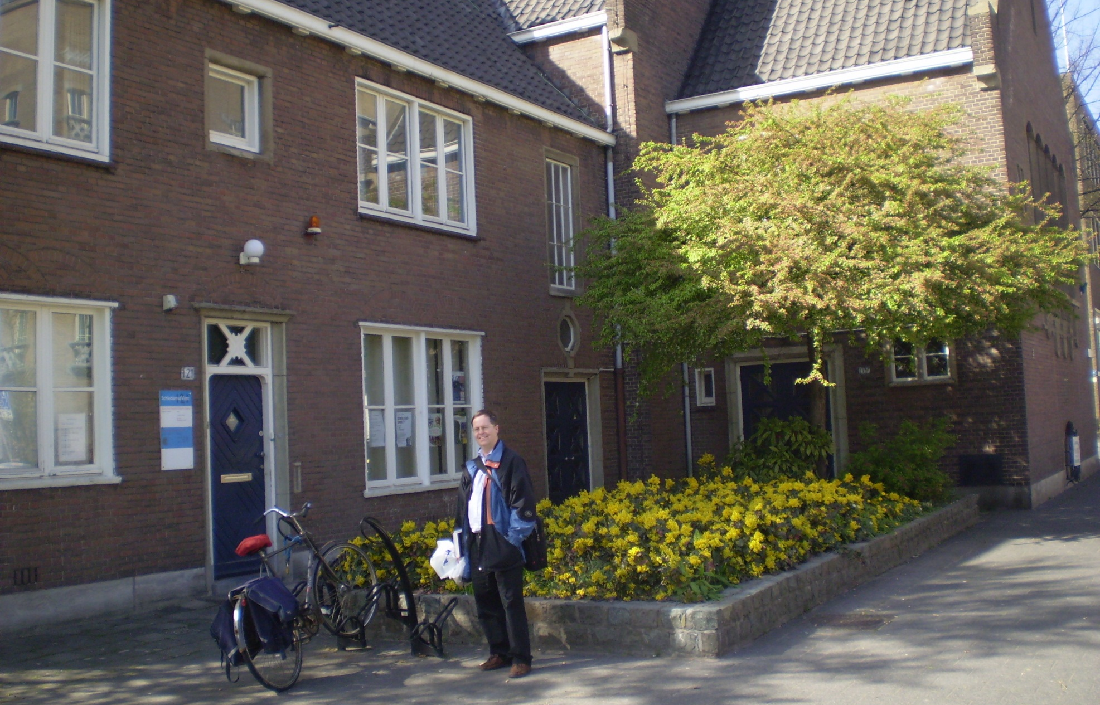
Scots International Church

Slide 27
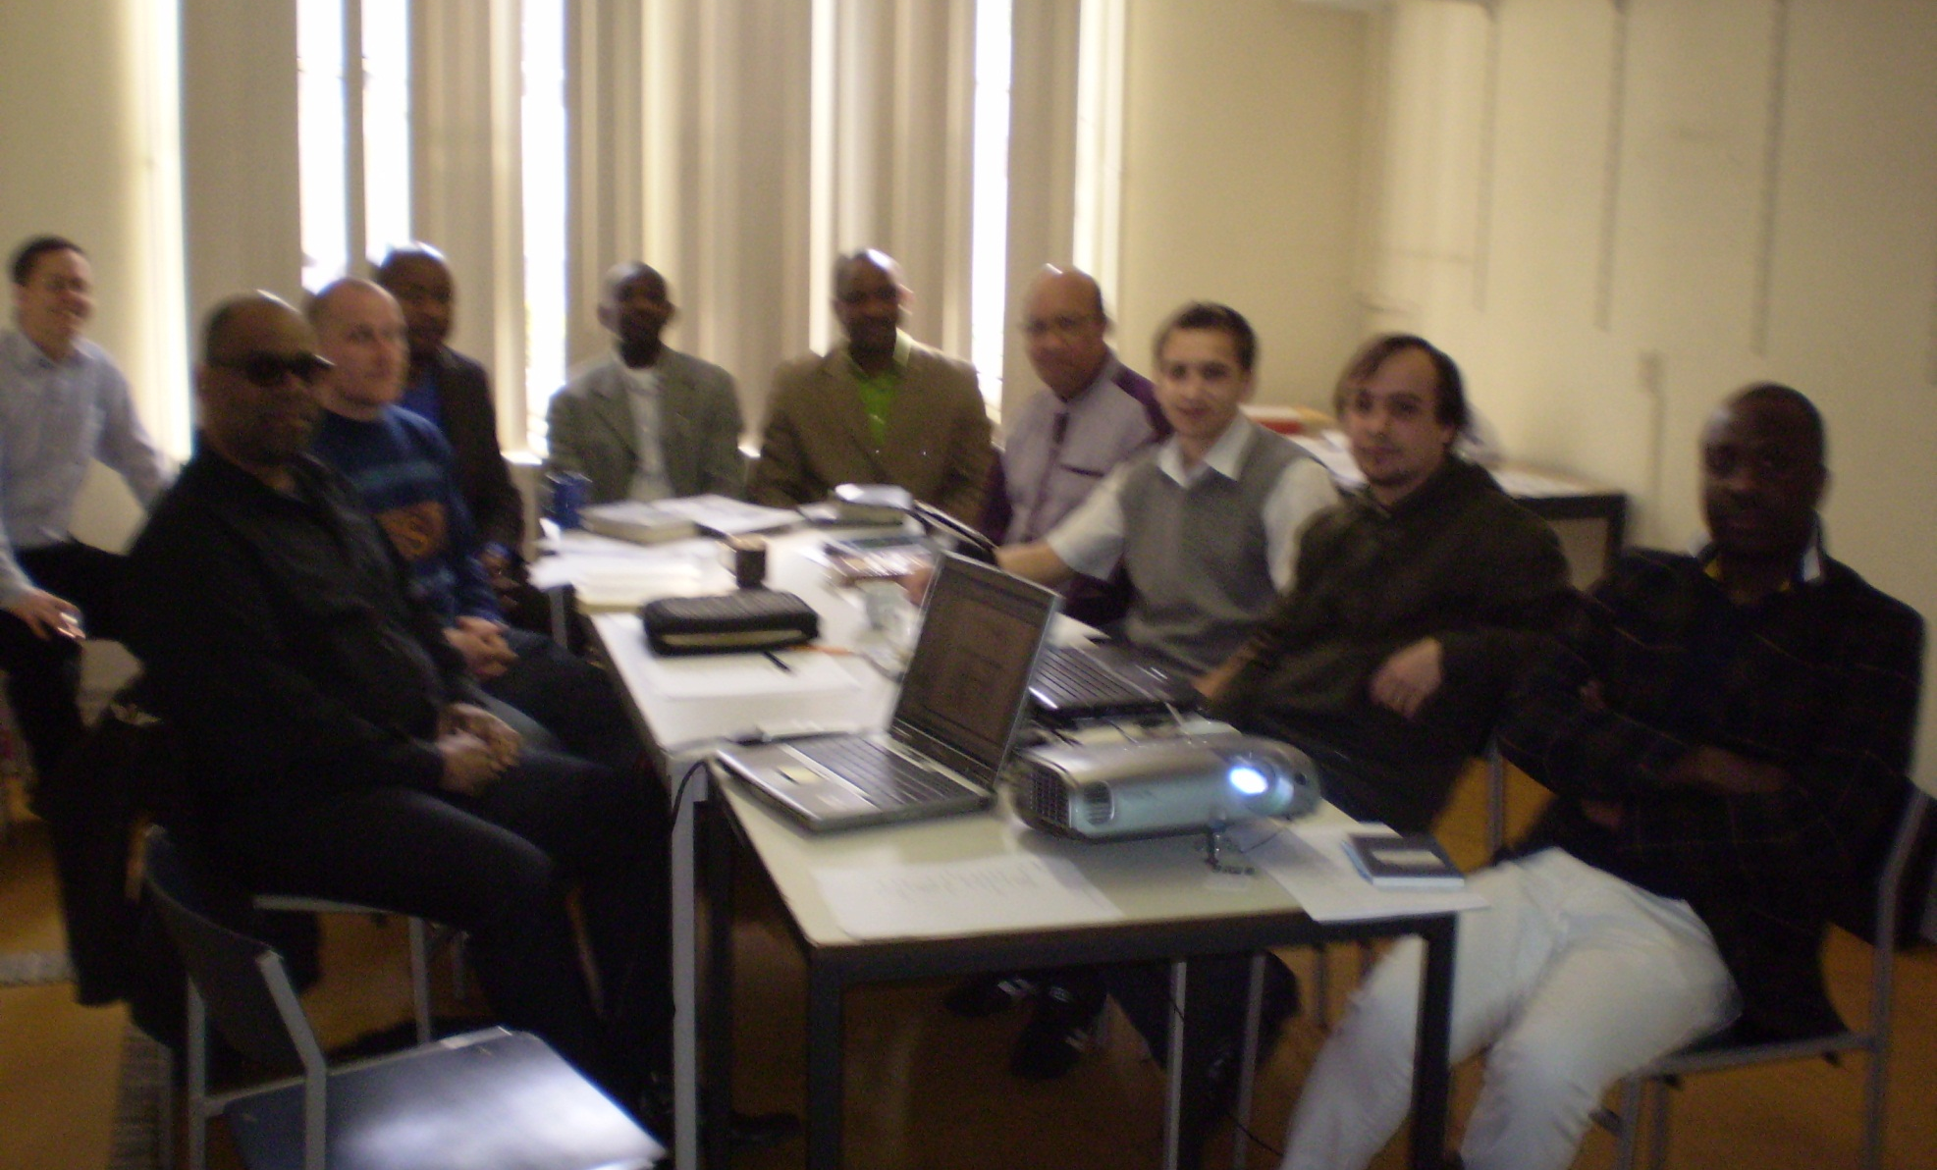
NT Survey, Rotterdam

Slide 28
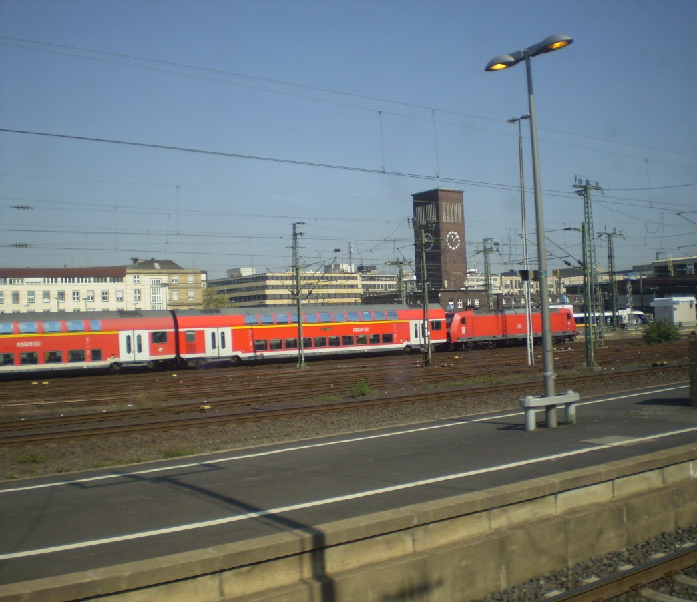
To Cologne
Thursday 14 April by train
Local train from Schiphol Airport to Utrecht
Express train from Utrecht to Cologne

Slide 29
Talk to University Group
Thursday evening, 14 April
Sponsored by Universität Bibel Freundschaft Köln, an evangelical outreach to the University of Cologne
My talk, in English with PowerPoint, was “Intelligent Design”

Slide 30
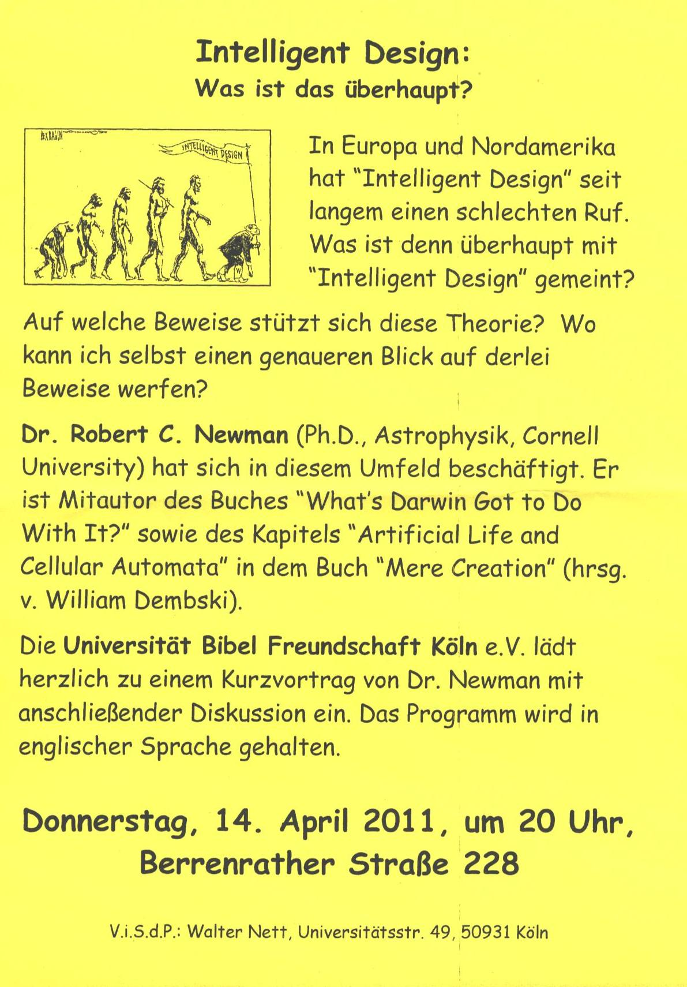
Talk to
University Group

Slide 31
Turkish Small-Group
Friday evening, 15 April, a small-group meeting weekly in a home.
Gave PowerPoint talk “The Crooked Business Manager,” with translation into Turkish.
Answered questions, mostly on divorce and head covering.

Slide 32
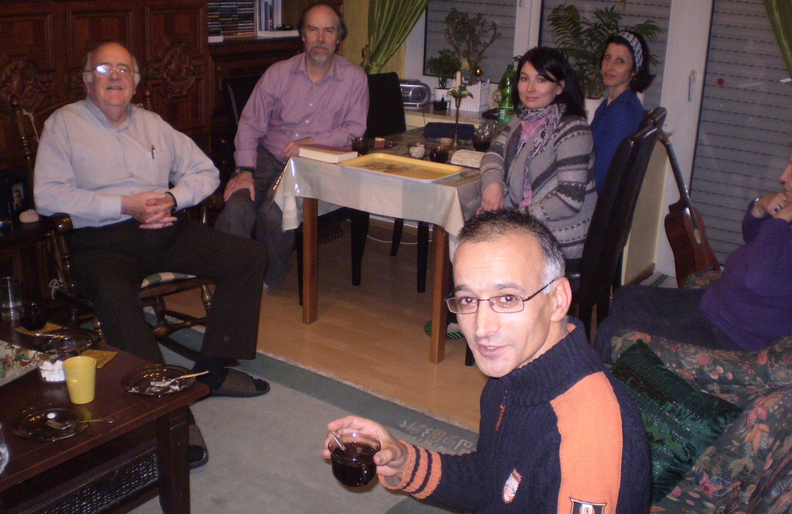
Turkish Small-Group

Slide 33
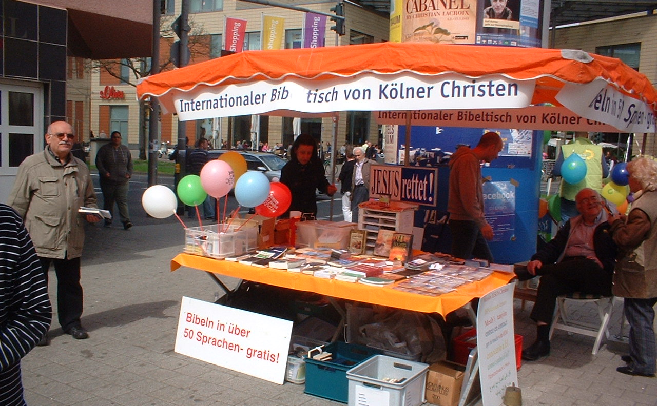
Book Table Ministry

Slide 34
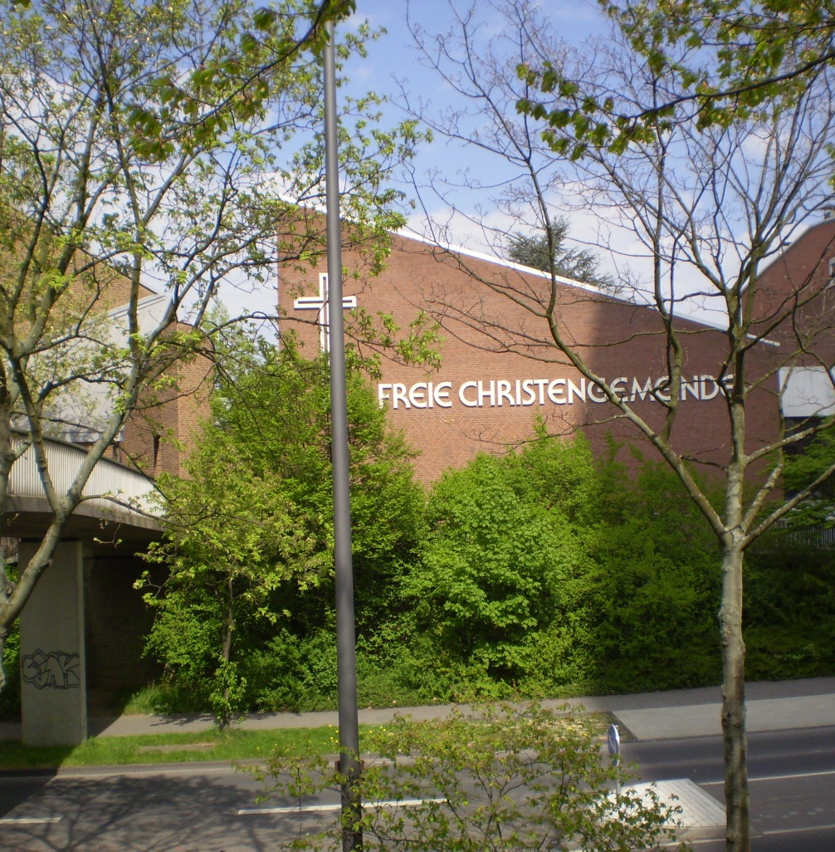
German Church
Sunday morning, 17 April, an evangelical charismatic German-speaking church
I attended as a visitor.

Slide 35
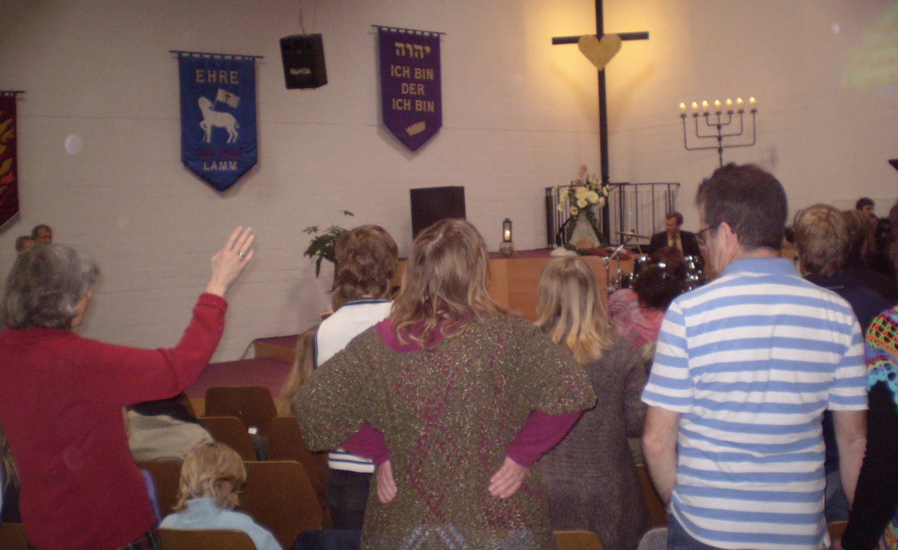
German Church

Slide 36
Turkish Fellowship
Sunday evening, 17 April
One of three Turkish Christian fellowships in the Cologne area
I preached, using PowerPoint, with translation into Turkish (& German) on “A Glimpse Beyond This Life.”
An after-service meal included a vigorous Q & A session on Jesus’ person & work.

Slide 37
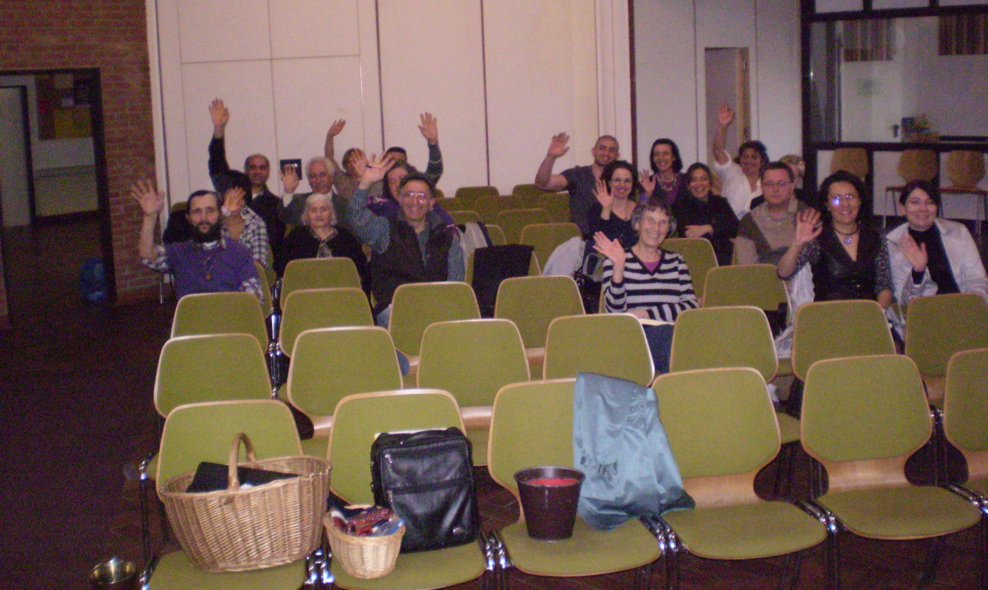
Turkish Fellowship

Slide 38
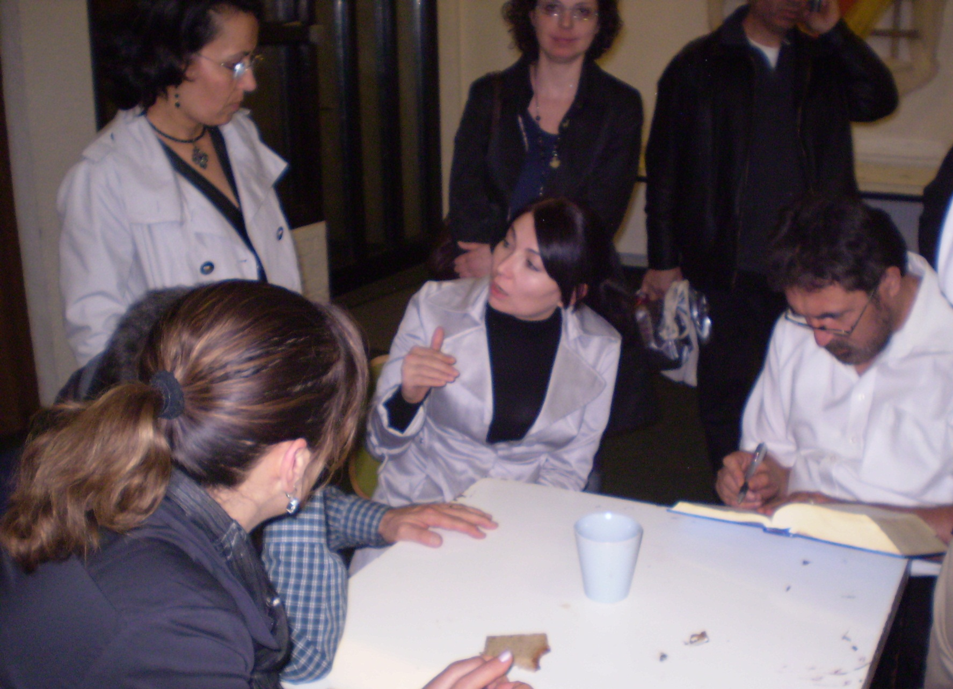
After-Service Discussion

Slide 39
Travel Back
Return to Amsterdam by train Monday, 18 April.
Dinner at a nice Chinese restaurant, courtesy Tyndale Theological Seminary.
Flight from Amsterdam to Atlanta, then to Charlottesville, Tuesday, 19 April.
Home, shortly before midnight!

Slide 40
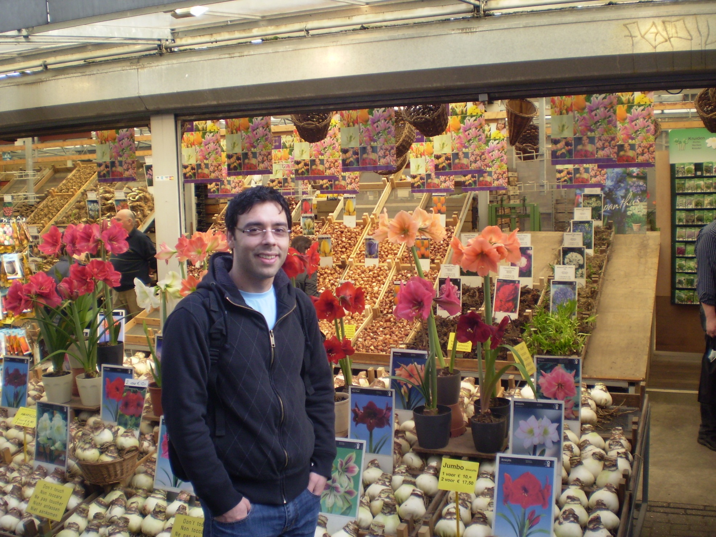
The End
A very satisfying set of opportunities, by God’s grace!

