Slide 1


Costa Rica Trip
2010
Robert C. Newman

Slide 2
Costa Rica Trip
This trip was made in 2010, from the 12th to the 19th of March.
My purpose was to speak at ESEPA Bible College & Seminary in San José, and to see some of the country.
My host was Dr Gary Shogren
  graduate of Biblical Seminary,
  former colleague on our Biblical faculty,
  Professor of New Testament at ESEPA.

Slide 3
Costa Rica Trip
I gave two series of talks at ESEPA:
  Morning lectures mostly on biblical prophecy
  Evening lectures on science & creation
I also gave a lecture to Gary’s parables class on the parables of the rabbis.
I also spoke twice Sunday morning at the Iglesia Biblica Nazareth.

Slide 4
Some Information
Costa Rica is located in Central America, just south of Nicaragua and north of Panama.
Its population (2009 estimate) is about 4.2 million.
Costa Rica is bordered on the east by the Caribbean Sea, and on the west by the Pacific Ocean.
Its capital San José is located in a high valley with a rather pleasant climate.

Slide 5
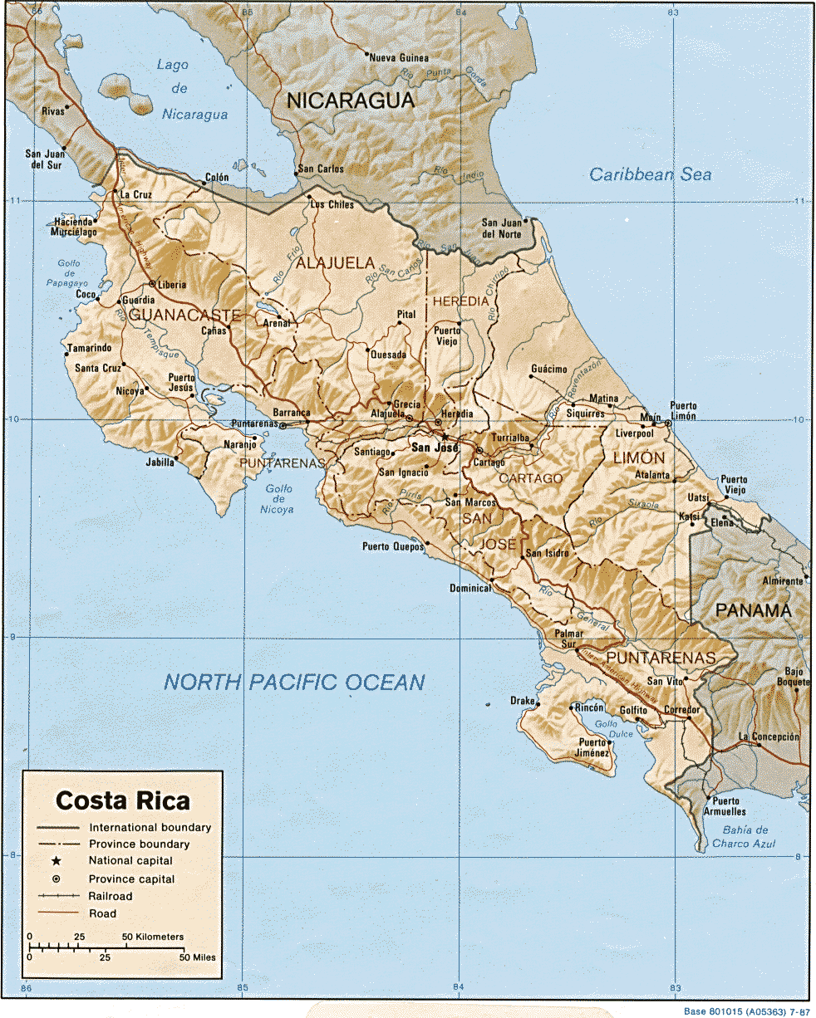
Costa
Rica
San José

Slide 6
Flag of Costa Rica

Slide 7
Religion in Costa Rica
The largest religious group is Roman Catholic, 70.5%
Next is Evangelical Protestant, 13.8%
No religion, 11.4%
Other religions, 4.3%

Slide 8
More on Costa Rica
There is freedom of religion in Costa Rica.
About 1/3 of the Costa Rican Catholics consider themselves non-practicing.
The government is a constitutional democracy, the only one in Latin America that is listed as one of the 22 Older Democracies.
The country permanently abolished its army in 1949.

Slide 9
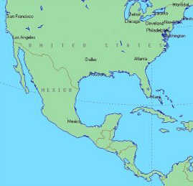
The Trip Down
Friday, March 12:
Leave Charlottesville 6:39 am.
Arrive Atlanta 8:04.
Leave Atlanta 9:55 (8:55 CR time).
Arrive San José, Costa Rica 12:30 pm.
Meet Gary, rest of day at his place.

Slide 10
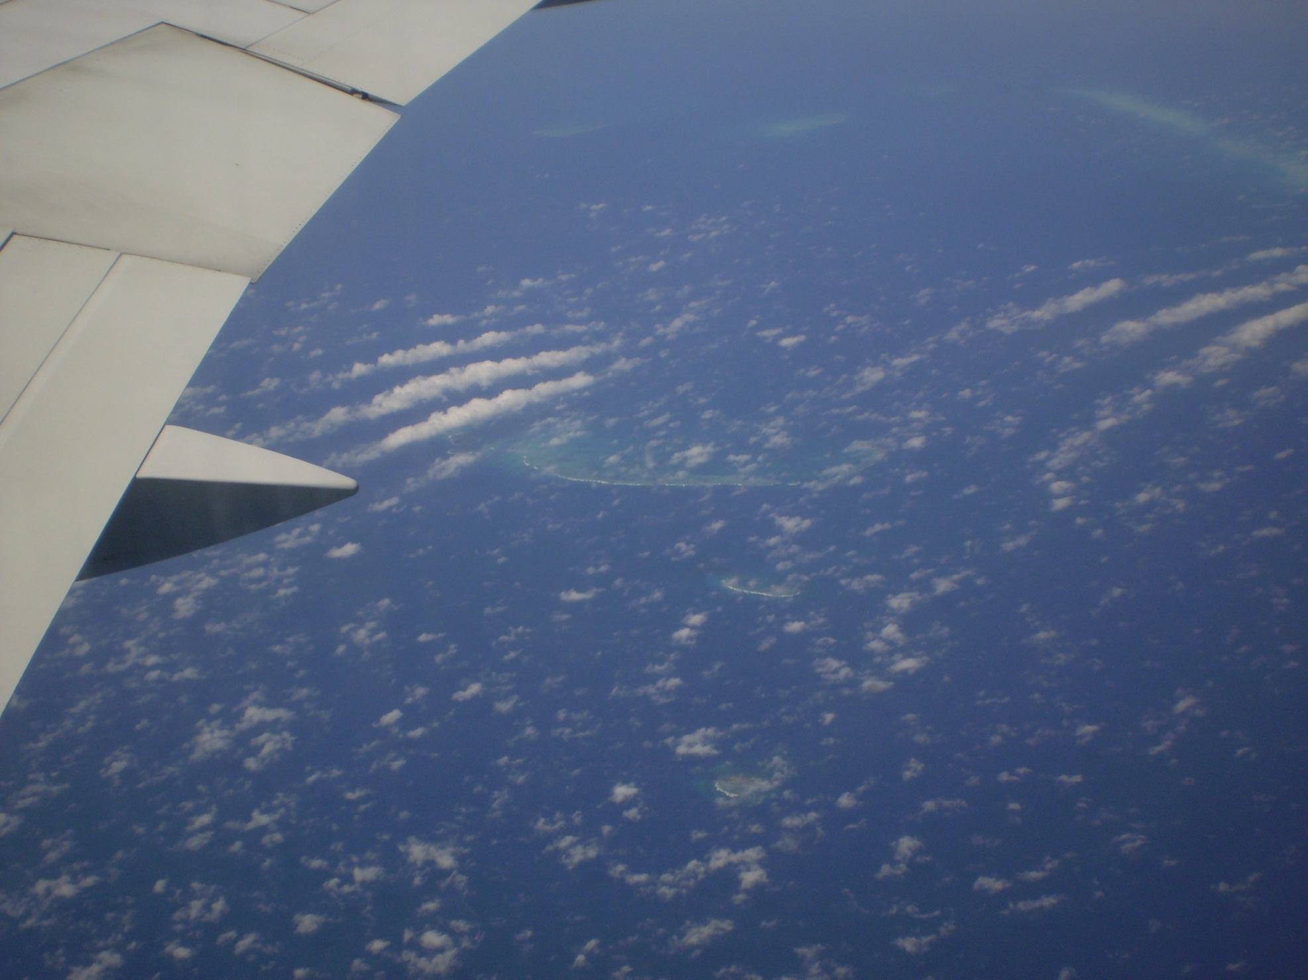
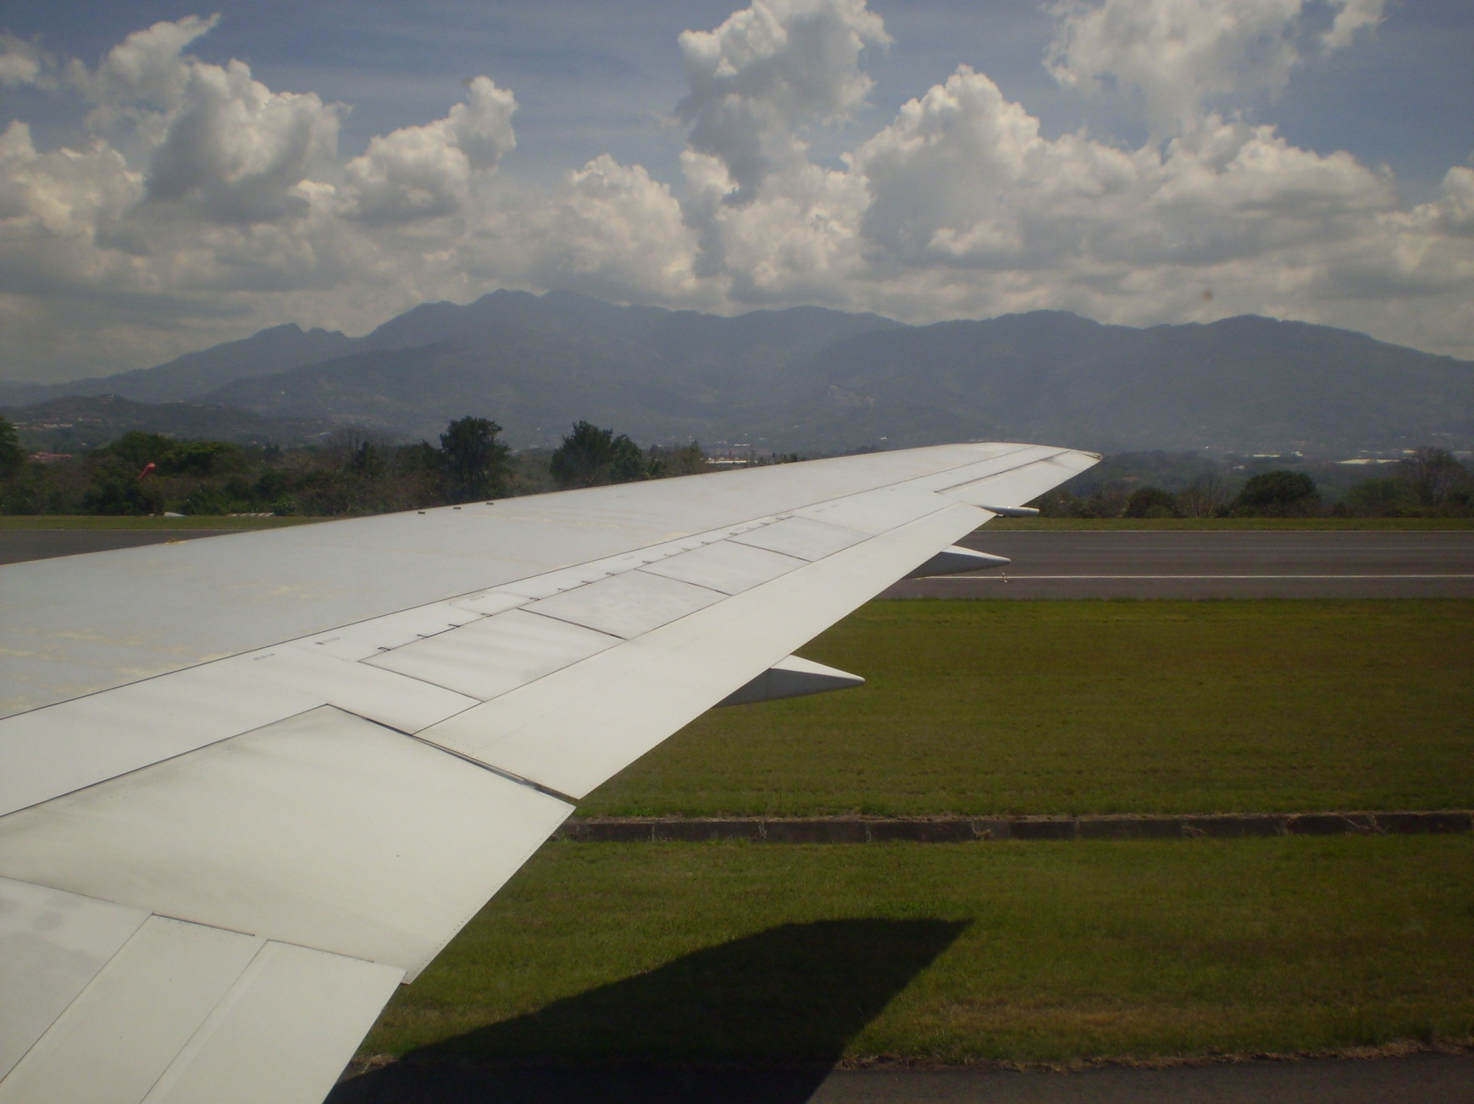

Slide 11
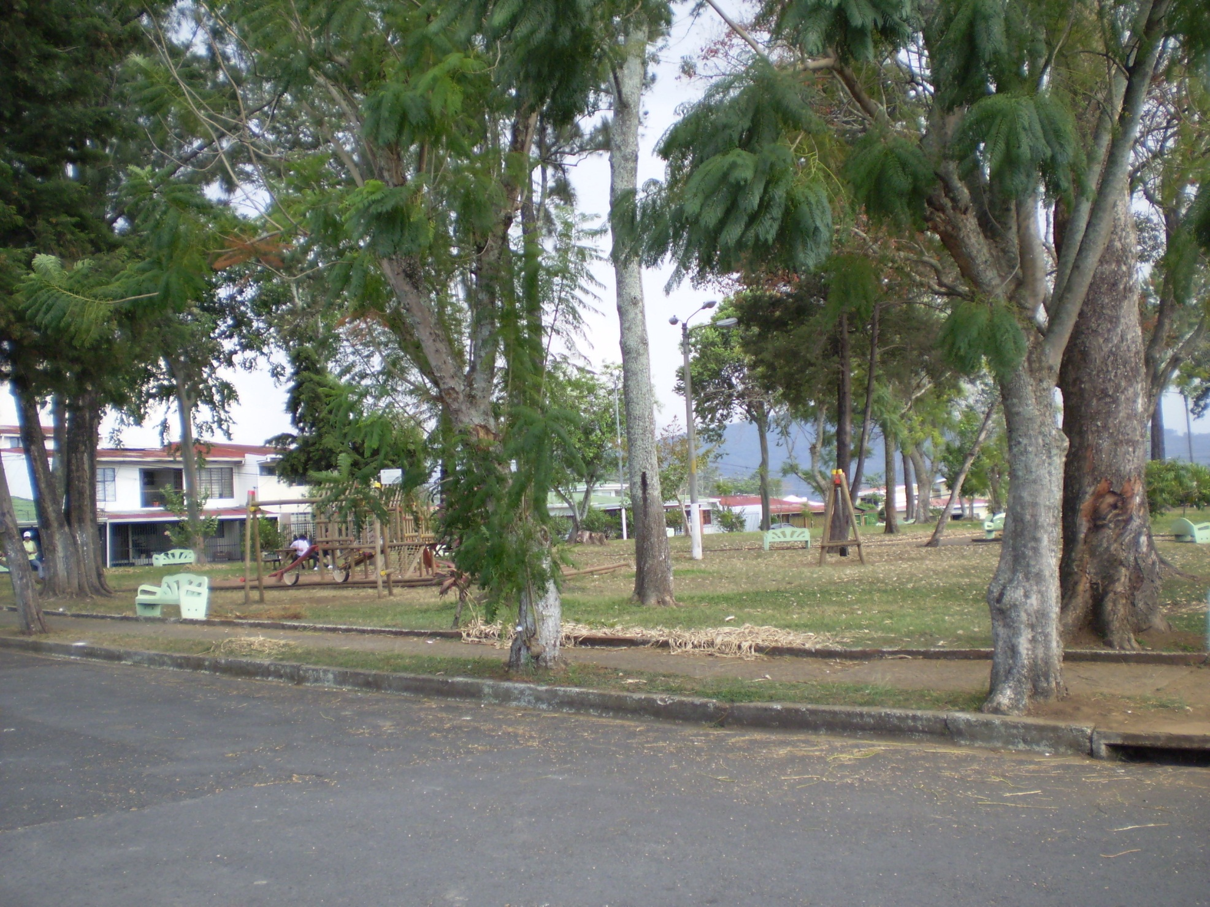
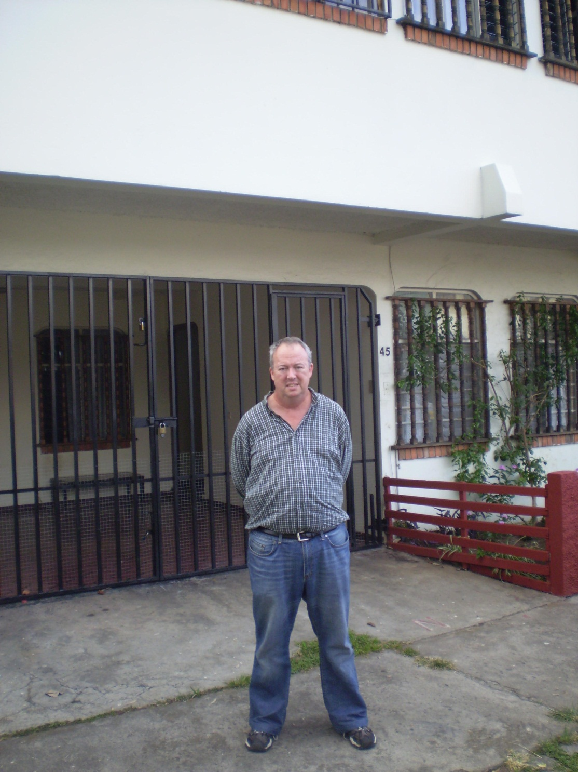

Slide 12
Saturday, March 13
Morning:
  walk to Farmers’ Market
  get copies of handout for Sunday sermon
Afternoon: sightseeing
  Cartago
  Paraiso
Evening:
  back at Gary’s
  going over talk for Sunday

Slide 13
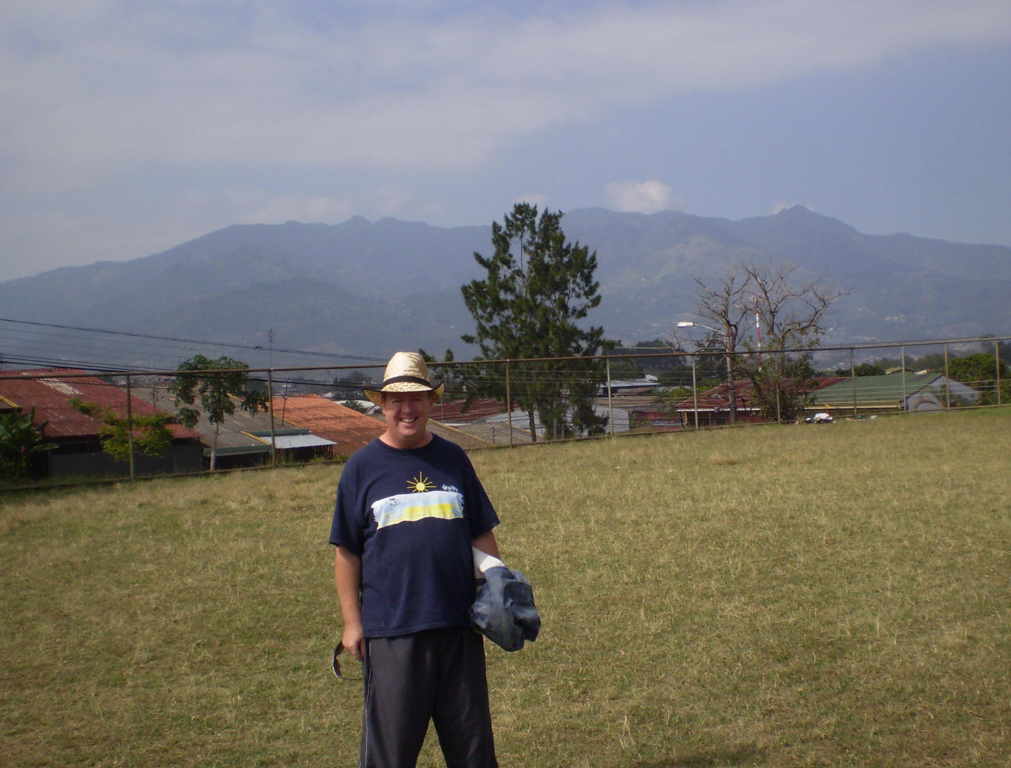
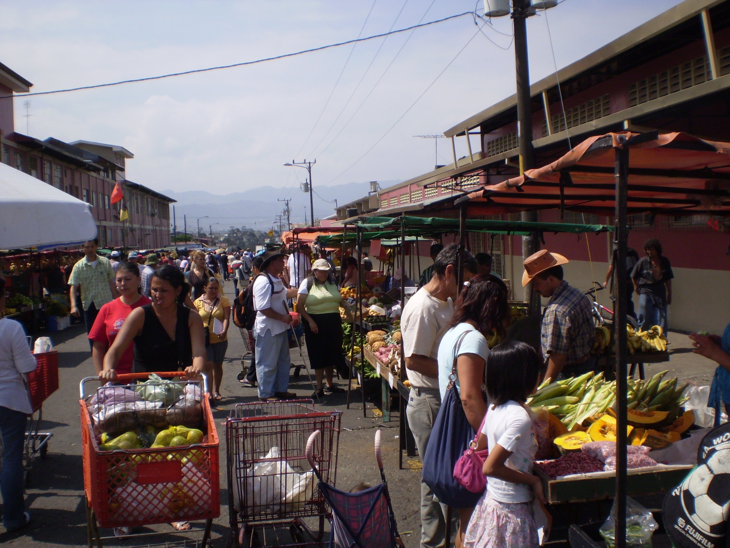

Slide 14
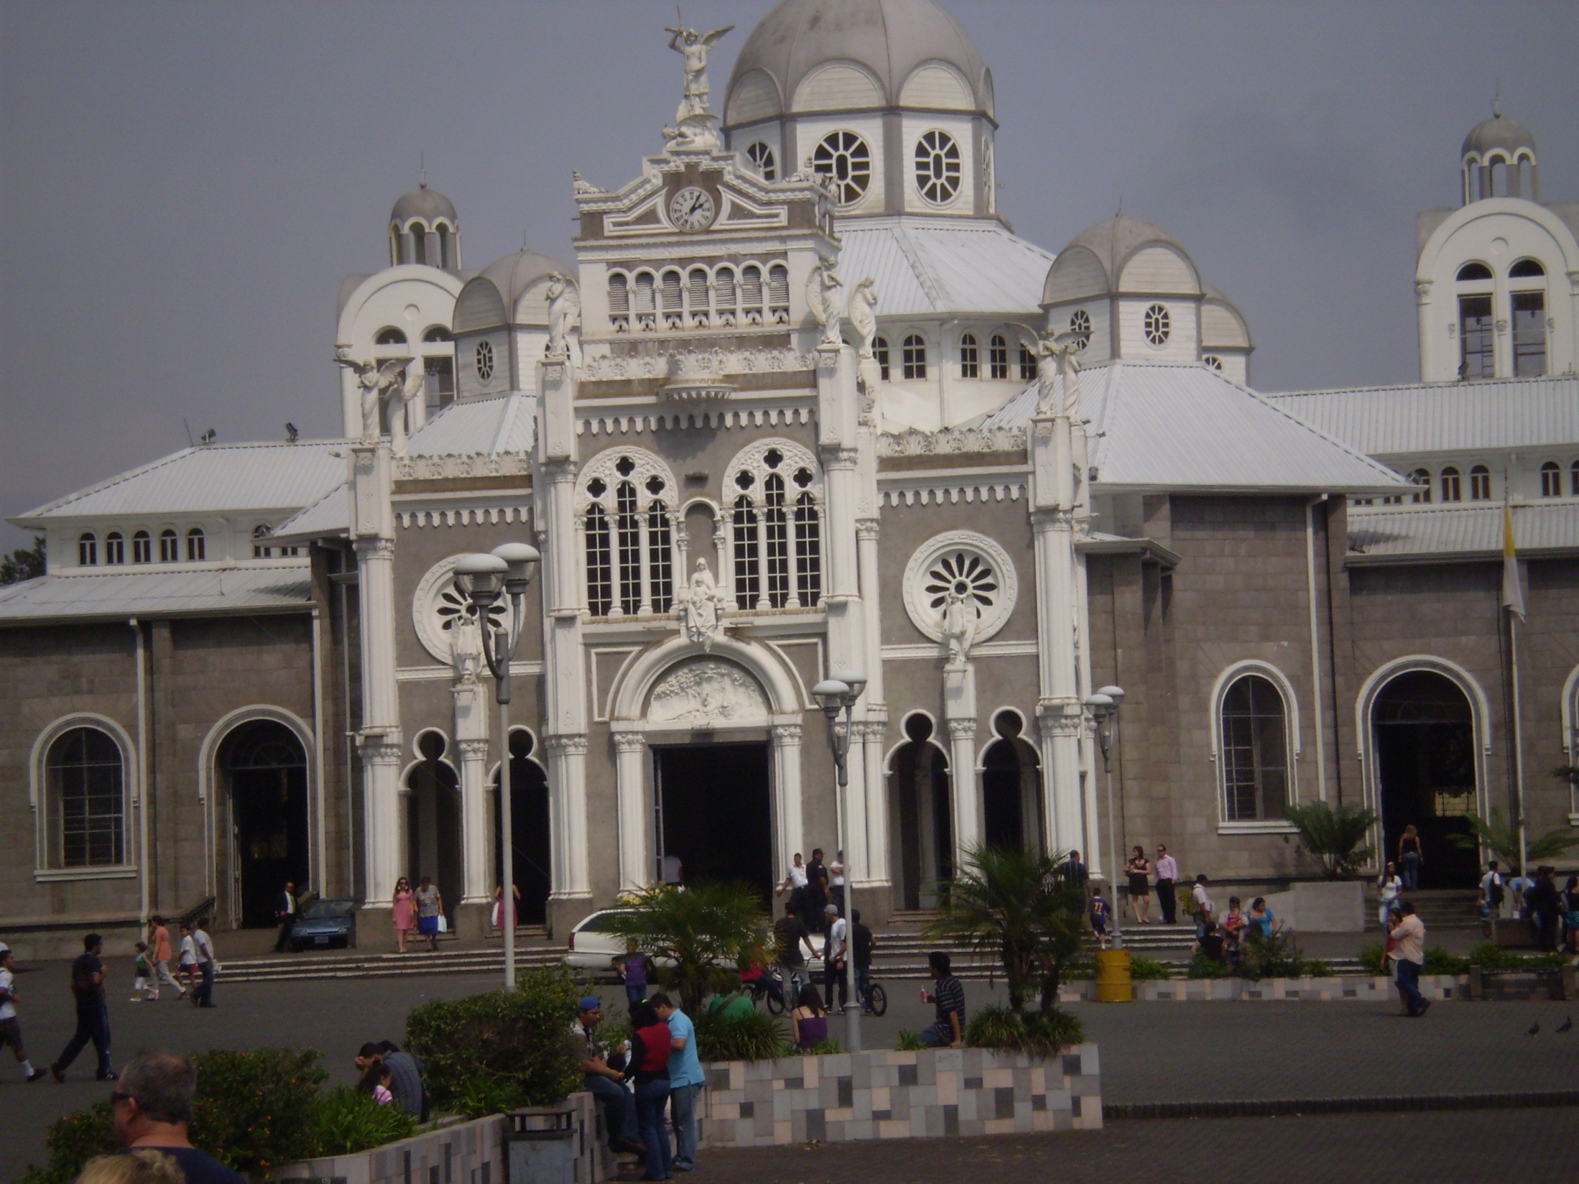
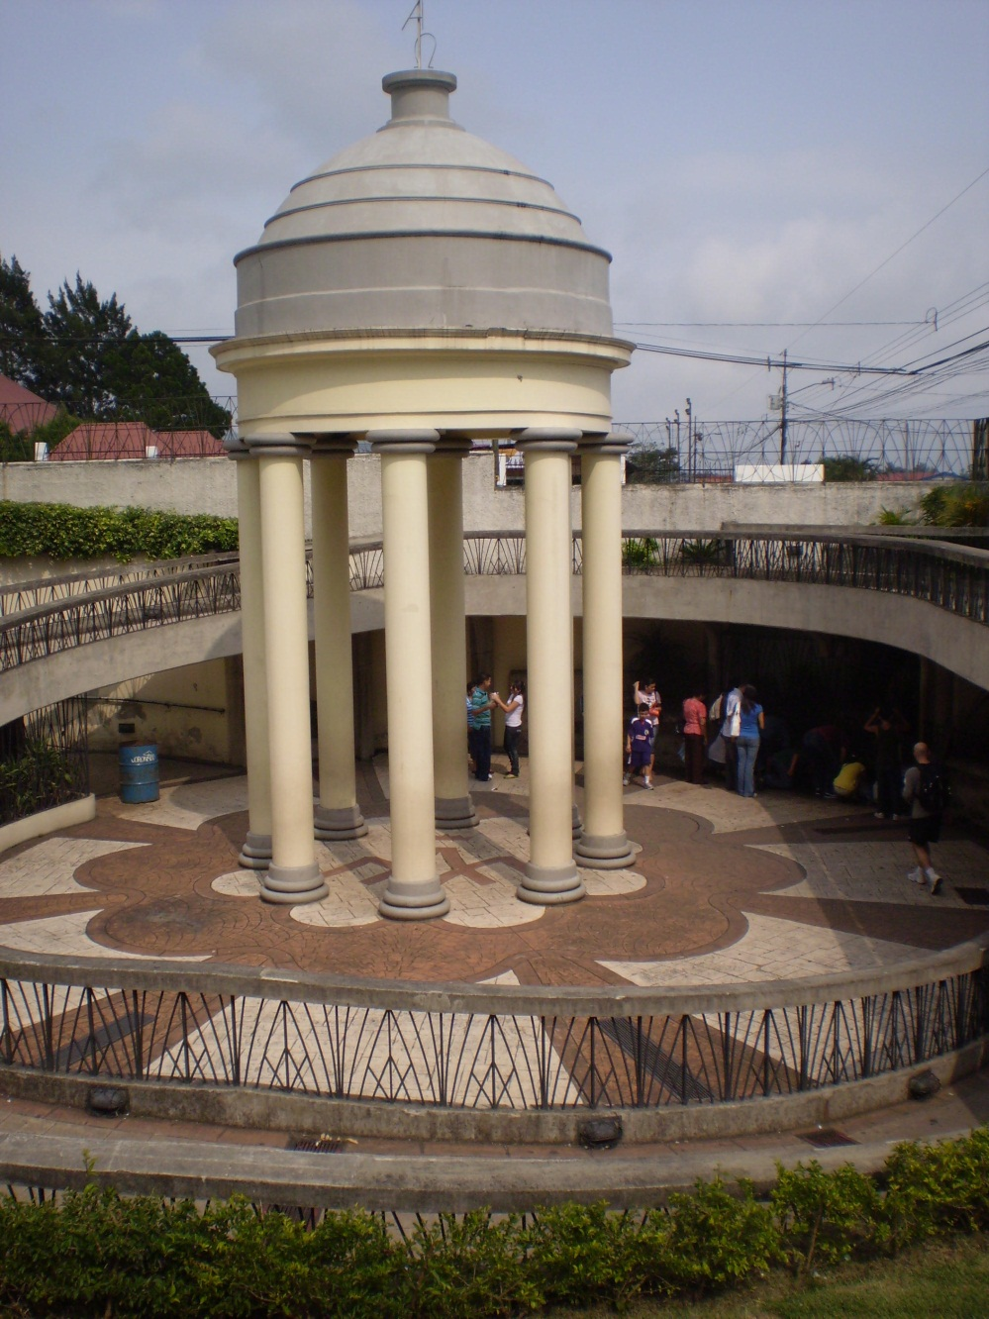

Slide 15
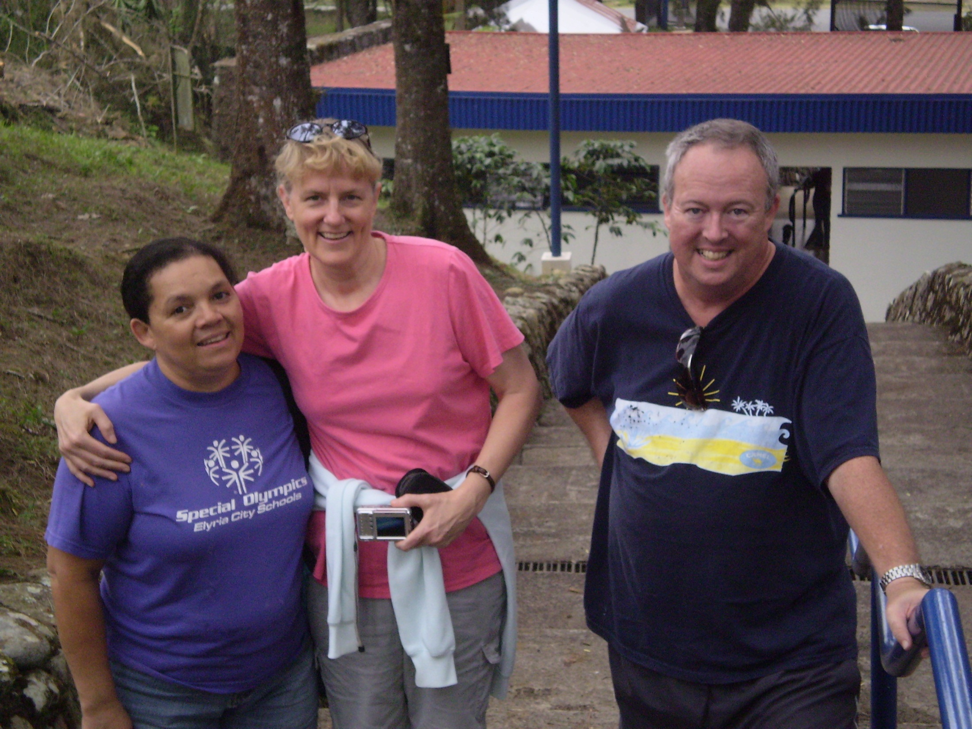
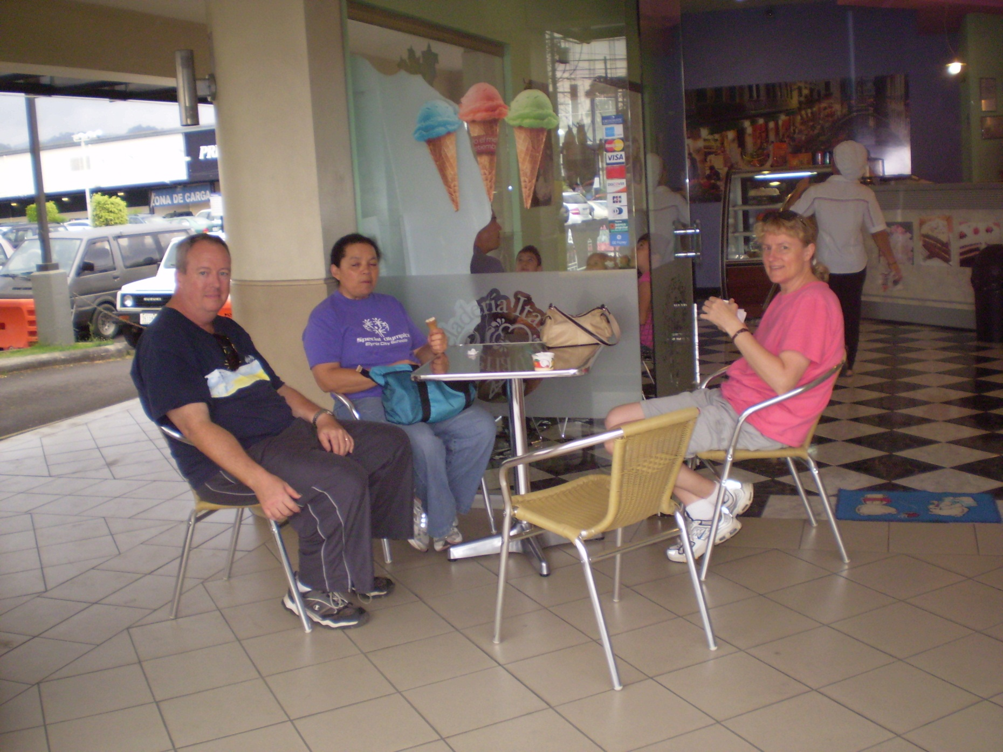

Slide 16
Sunday, March 14
To Iglesia Biblica Nazareth
  Meet pastor Marvin Leandro
  My PowerPoint “Nostradamus & the Bible” at both services; one of the translators Paul Mauger
Afternoon
  Napping
  Walk
  Going over Monday talks
Evening
  Dinner
  Reading

Slide 17
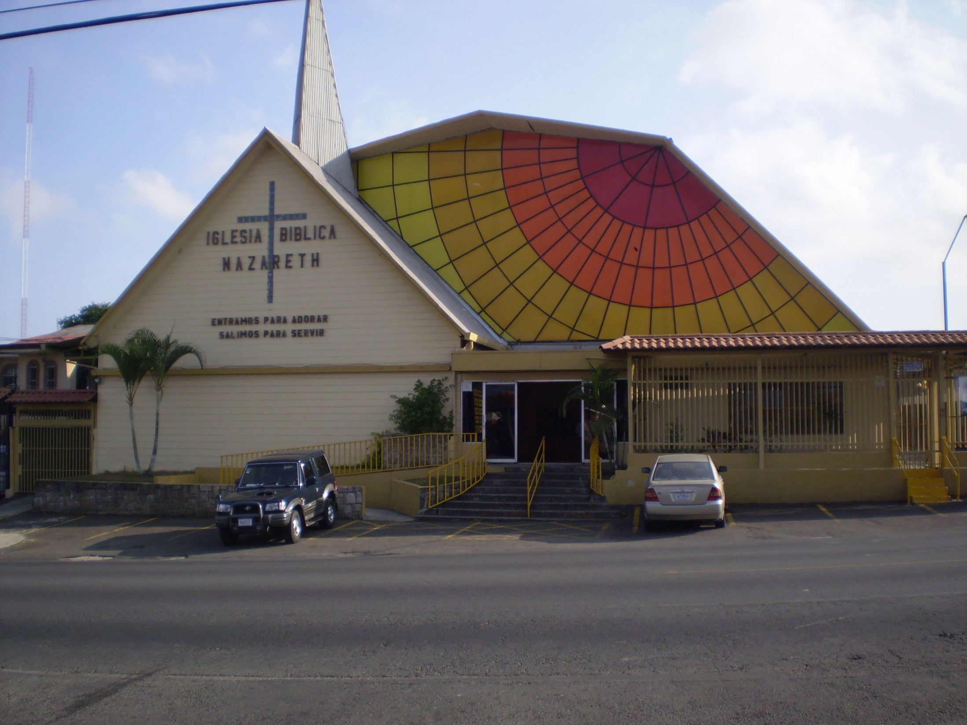
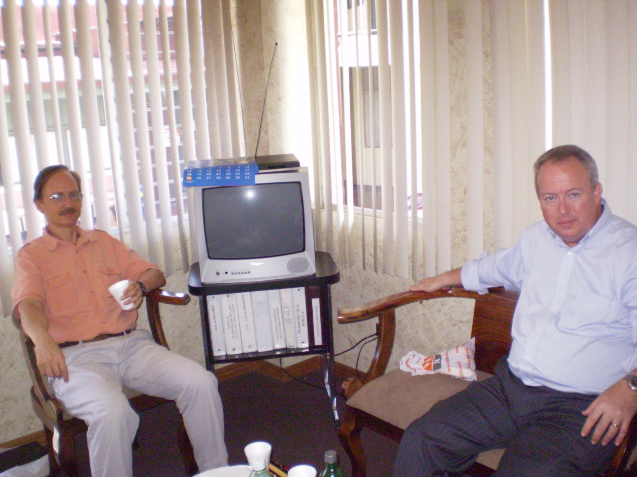

Slide 18
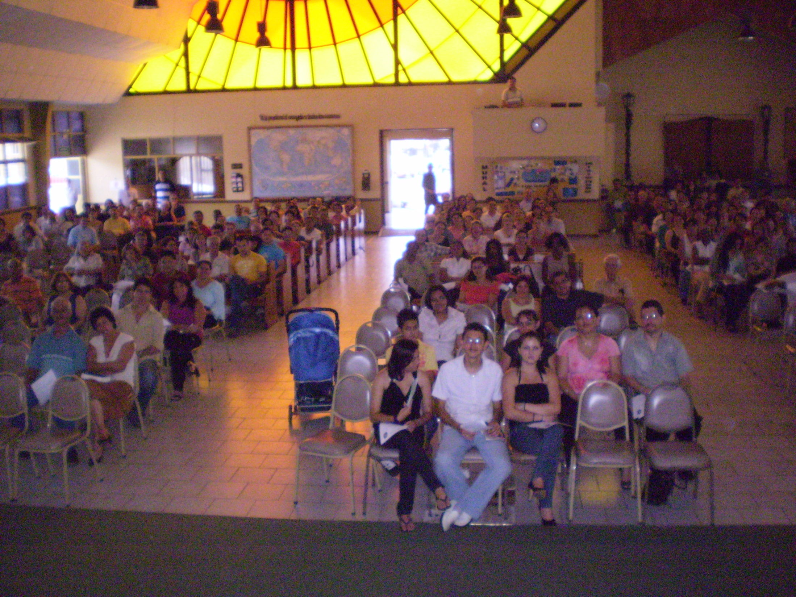

Slide 19
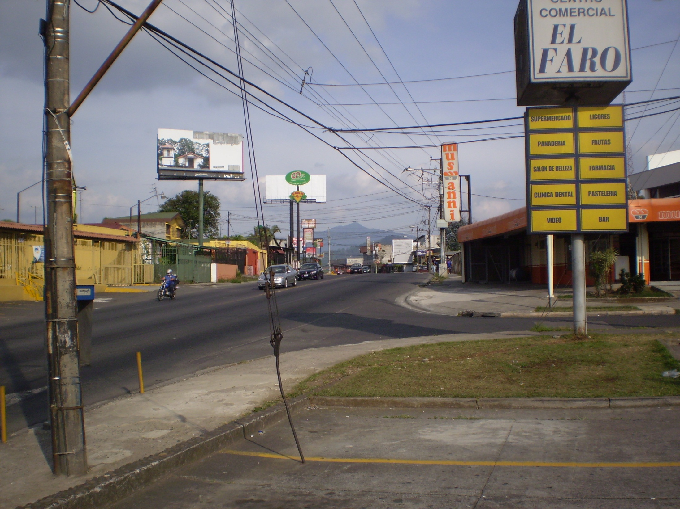
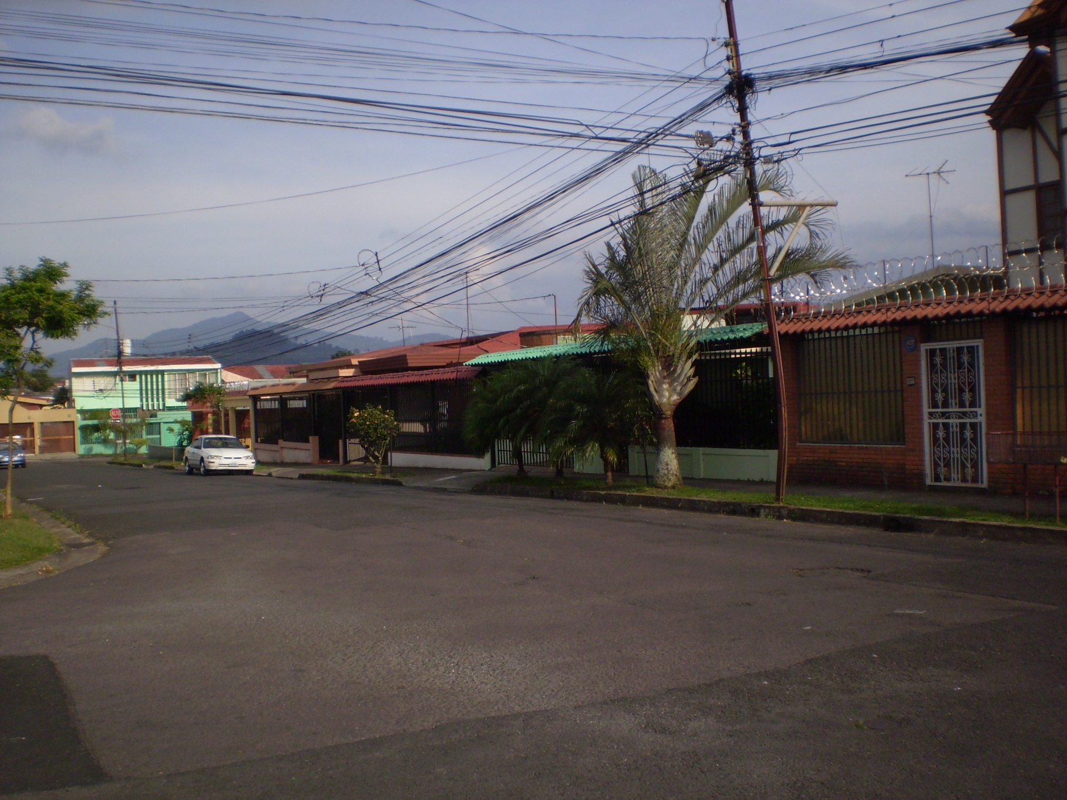

Slide 20
Monday, March 15
Morning:
  Breakfast at ESEPA
  Talk “Prophecy Ancient & Modern”
  Visit Hipermas discount department store
Afternoon free
Evening
  Sit in on part of Psalms course
  Talk “Genesis One & the Origin of the Earth”

Slide 21
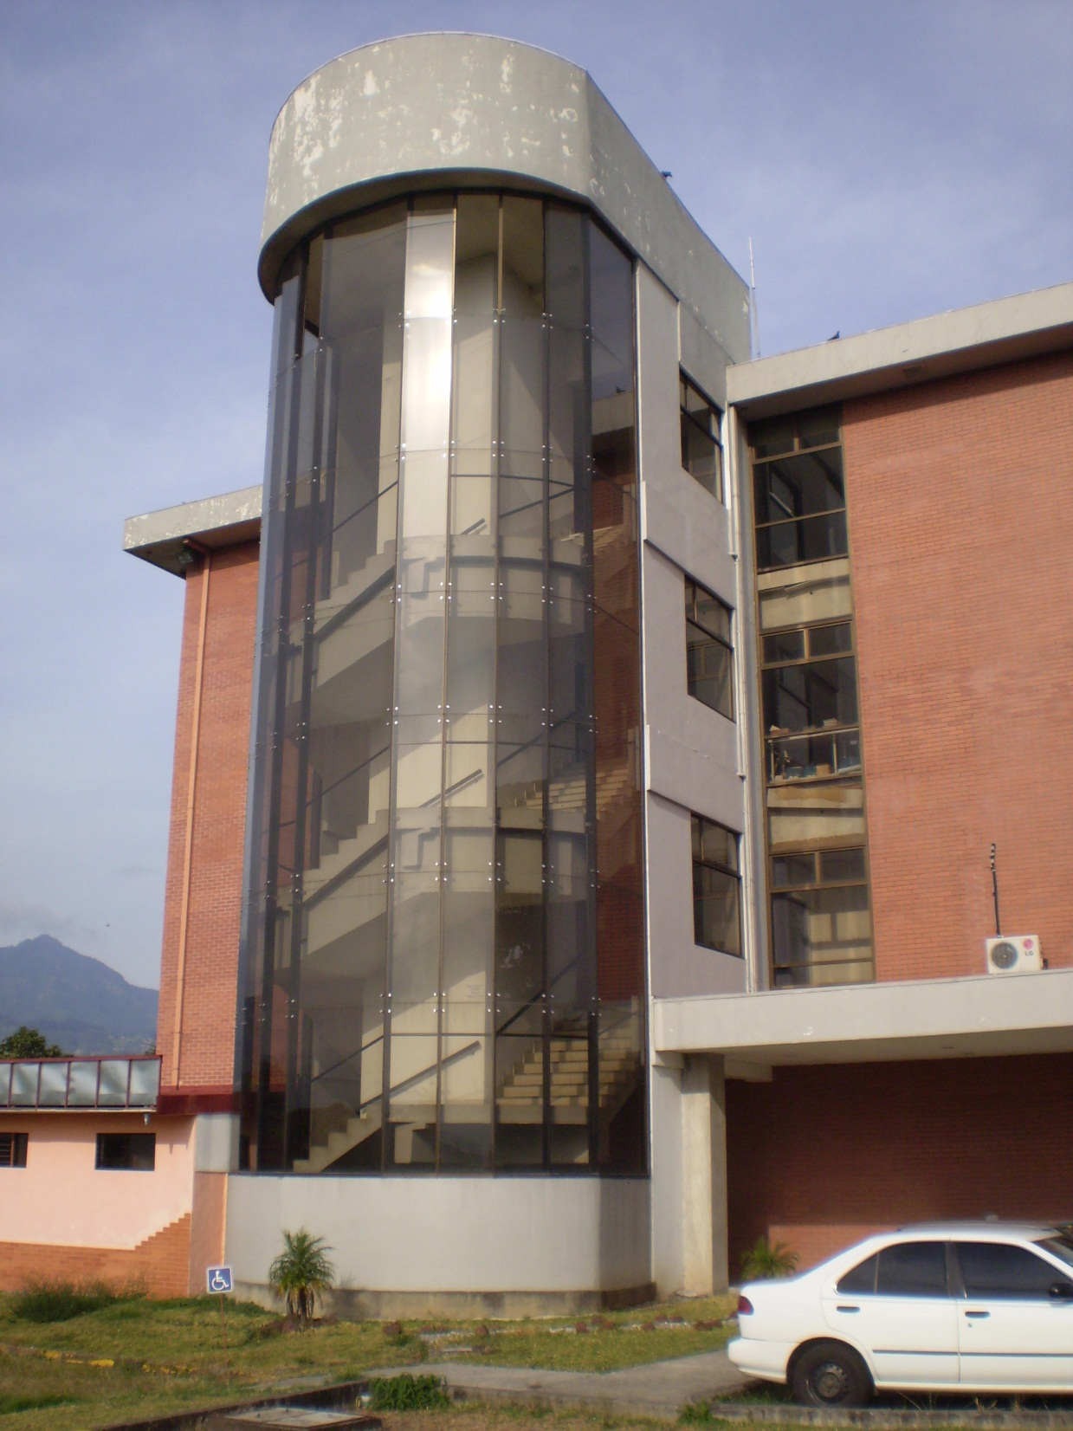
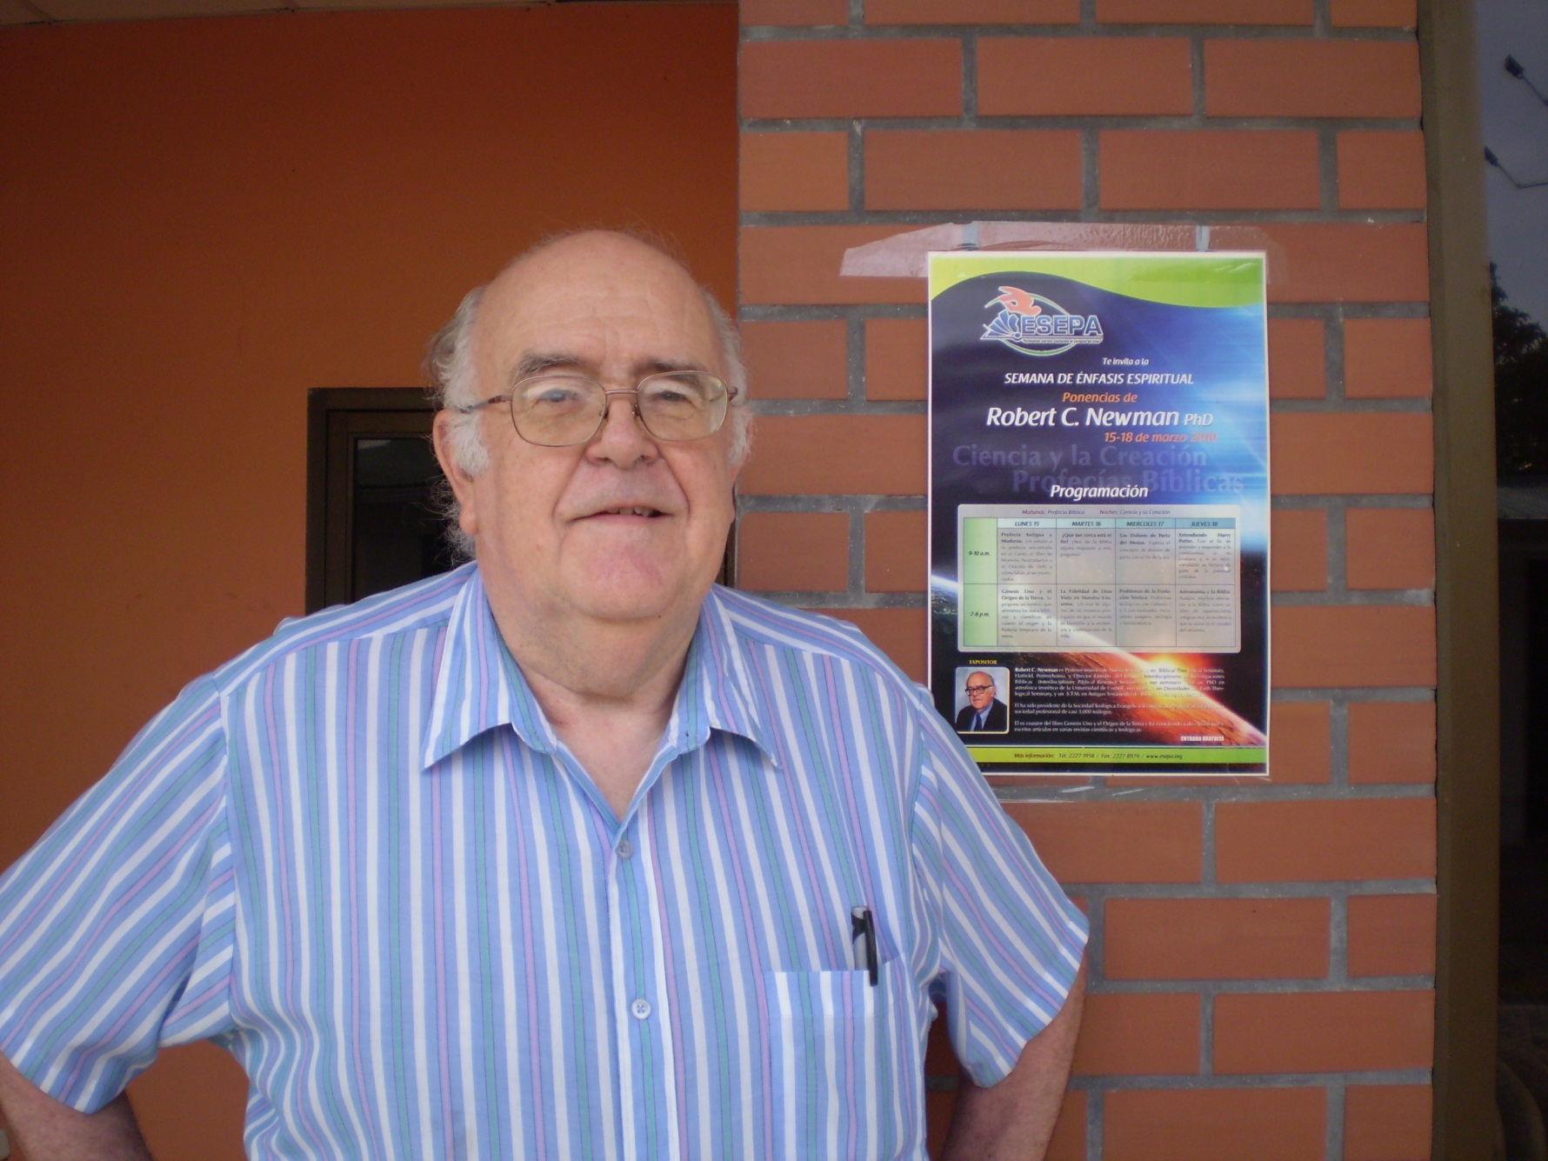
ESEPA Bible College & Seminary

Slide 22
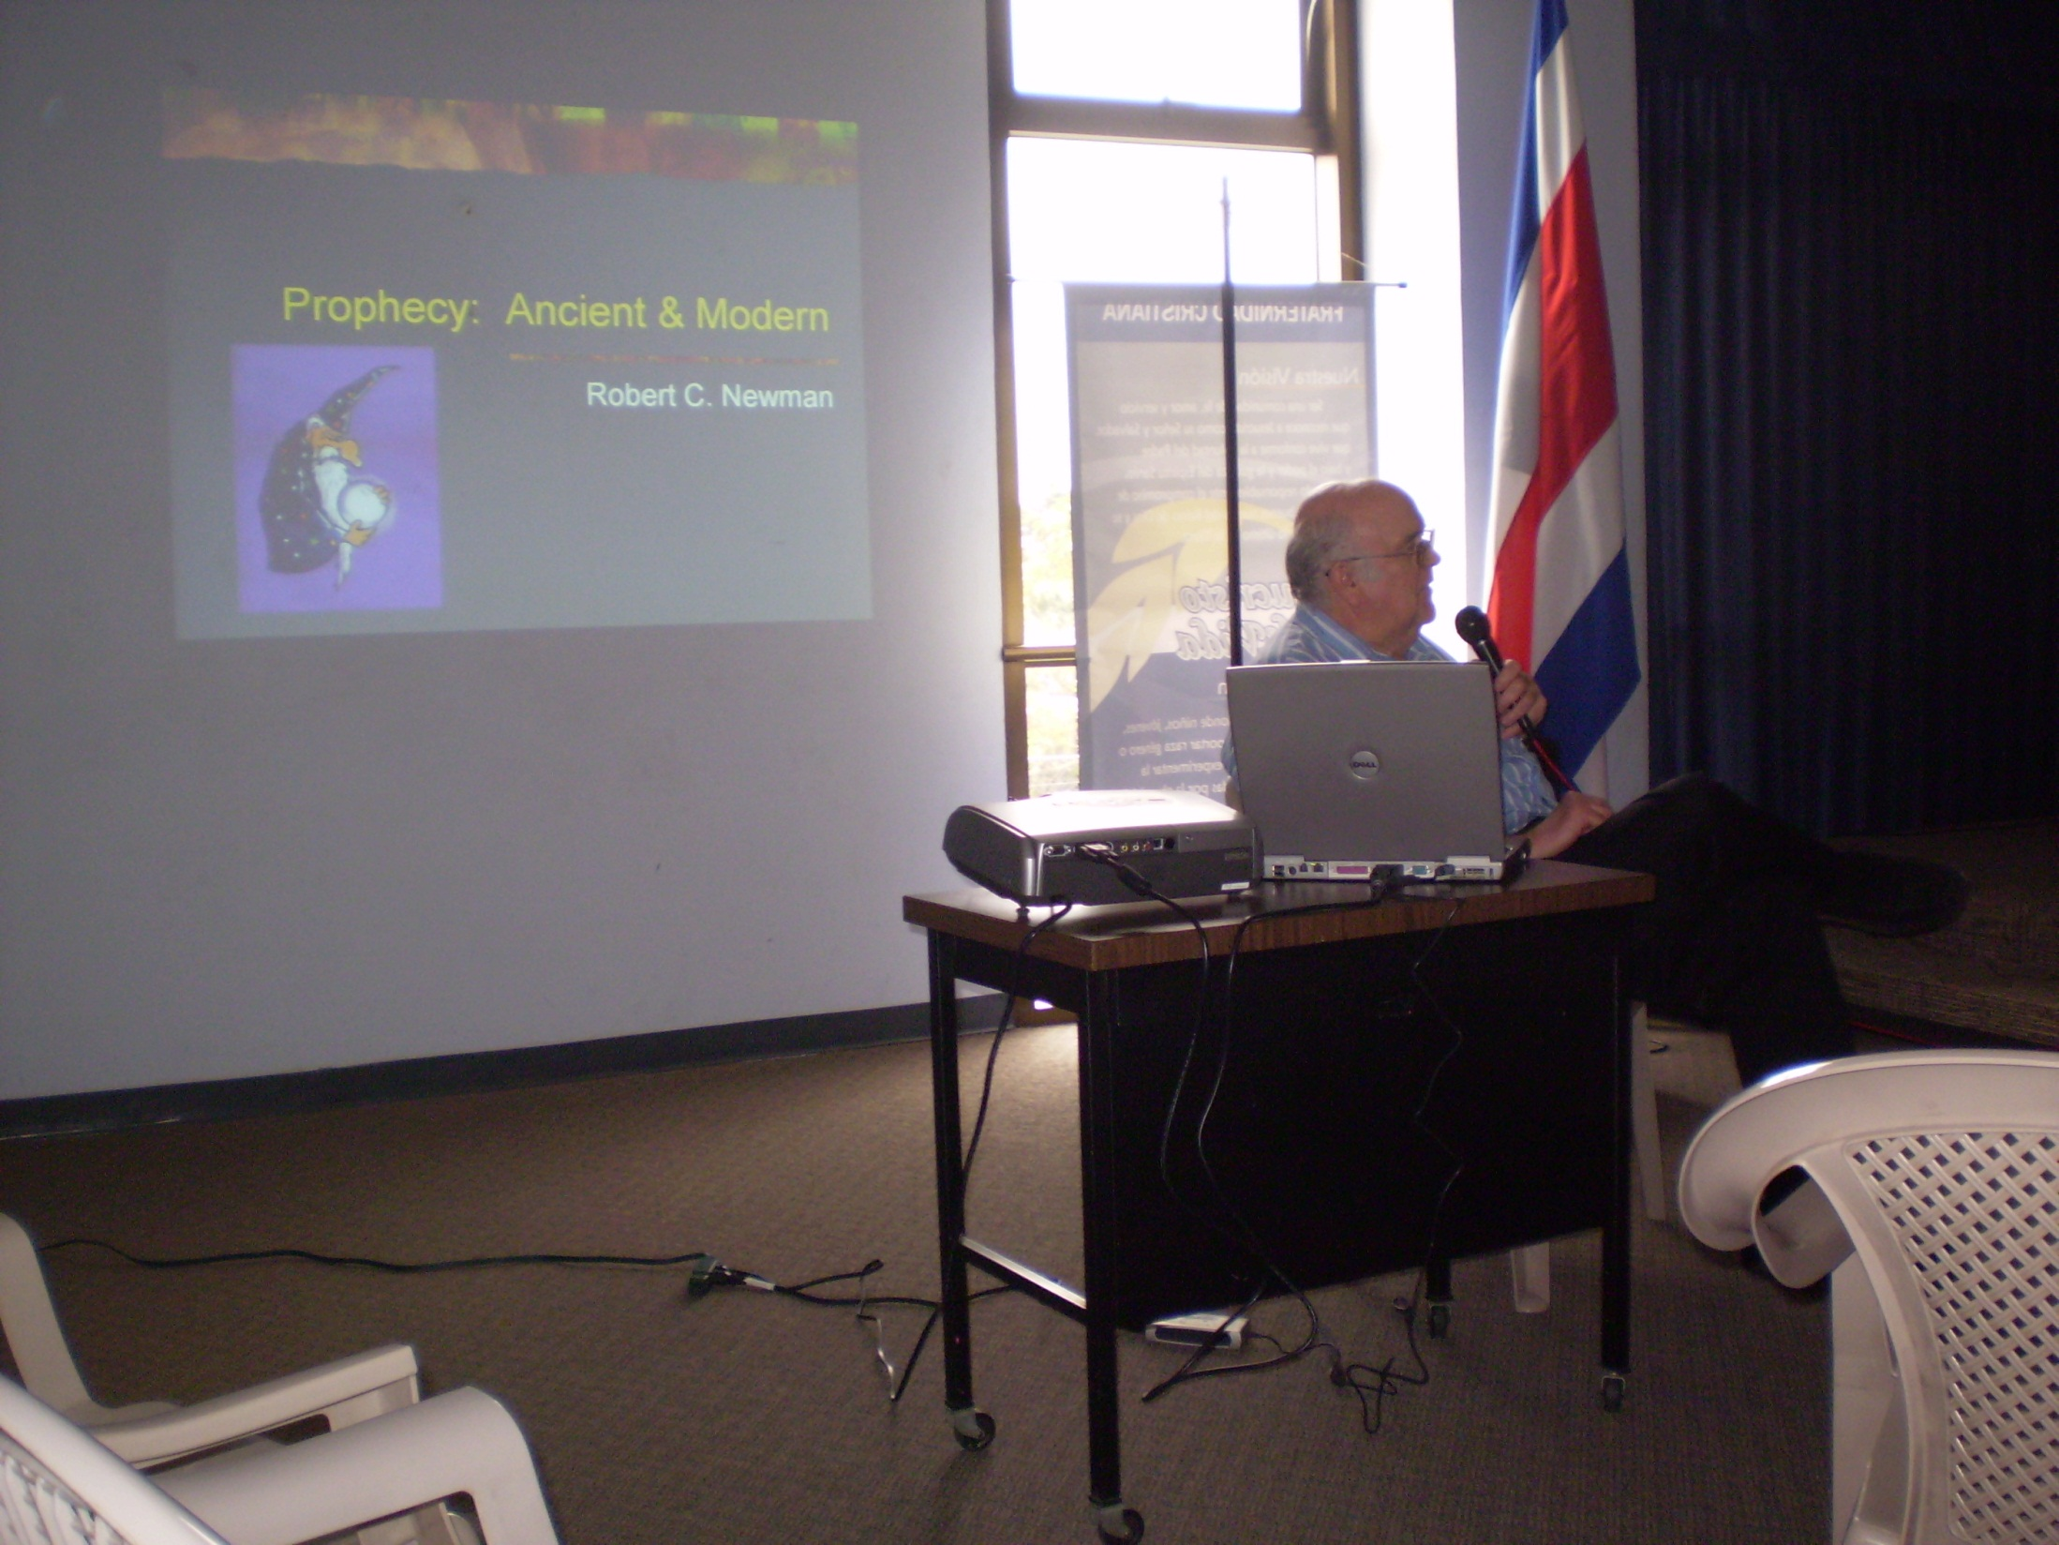
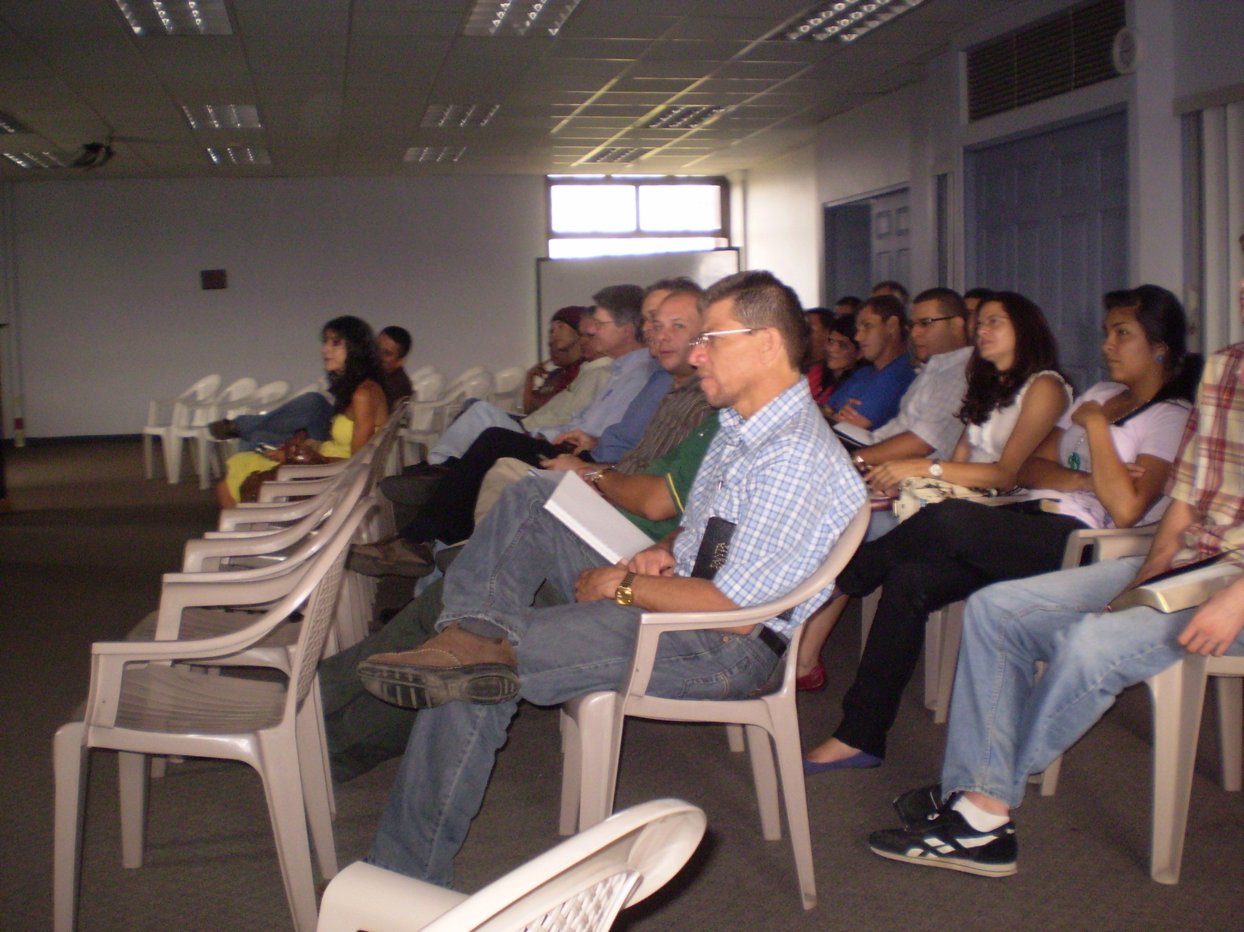

Slide 23
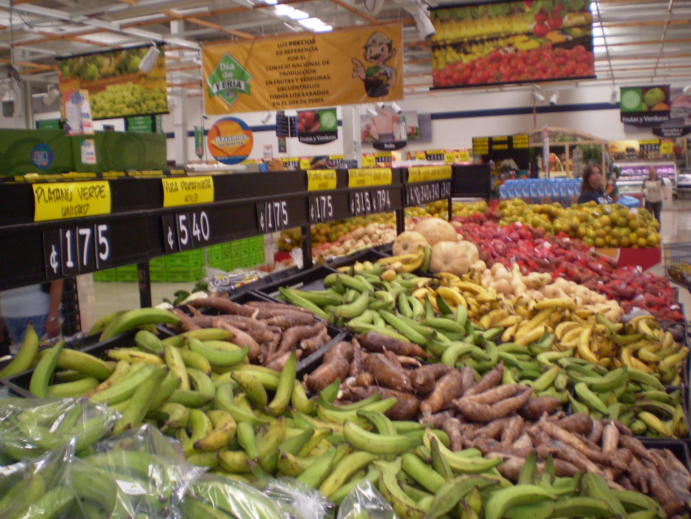
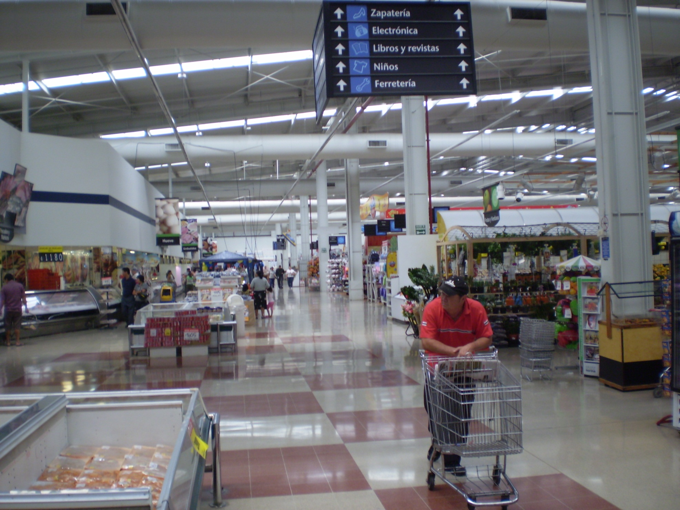

Slide 24
Tuesday, March 16
Morning
  Talk “How Near Is the End?”
Afternoon
  Parables class, lecture “Rabbinic Parables”
Evening
  Talk “God’s Faithfulness as Seen in Our Universe”

Slide 25
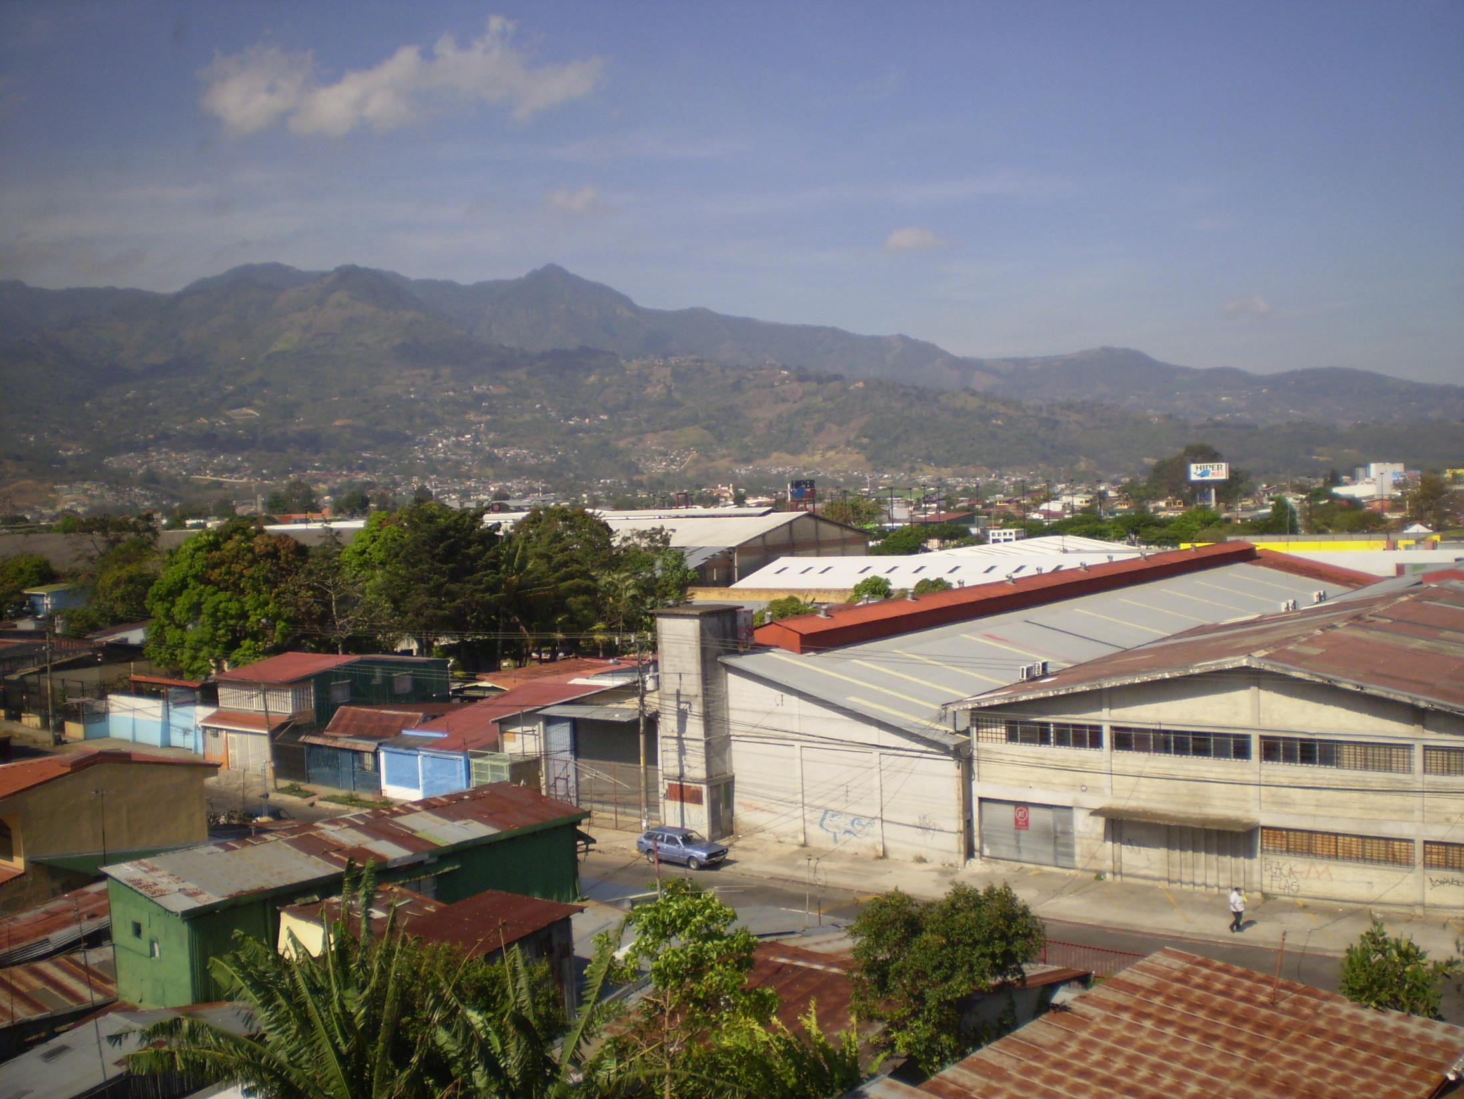
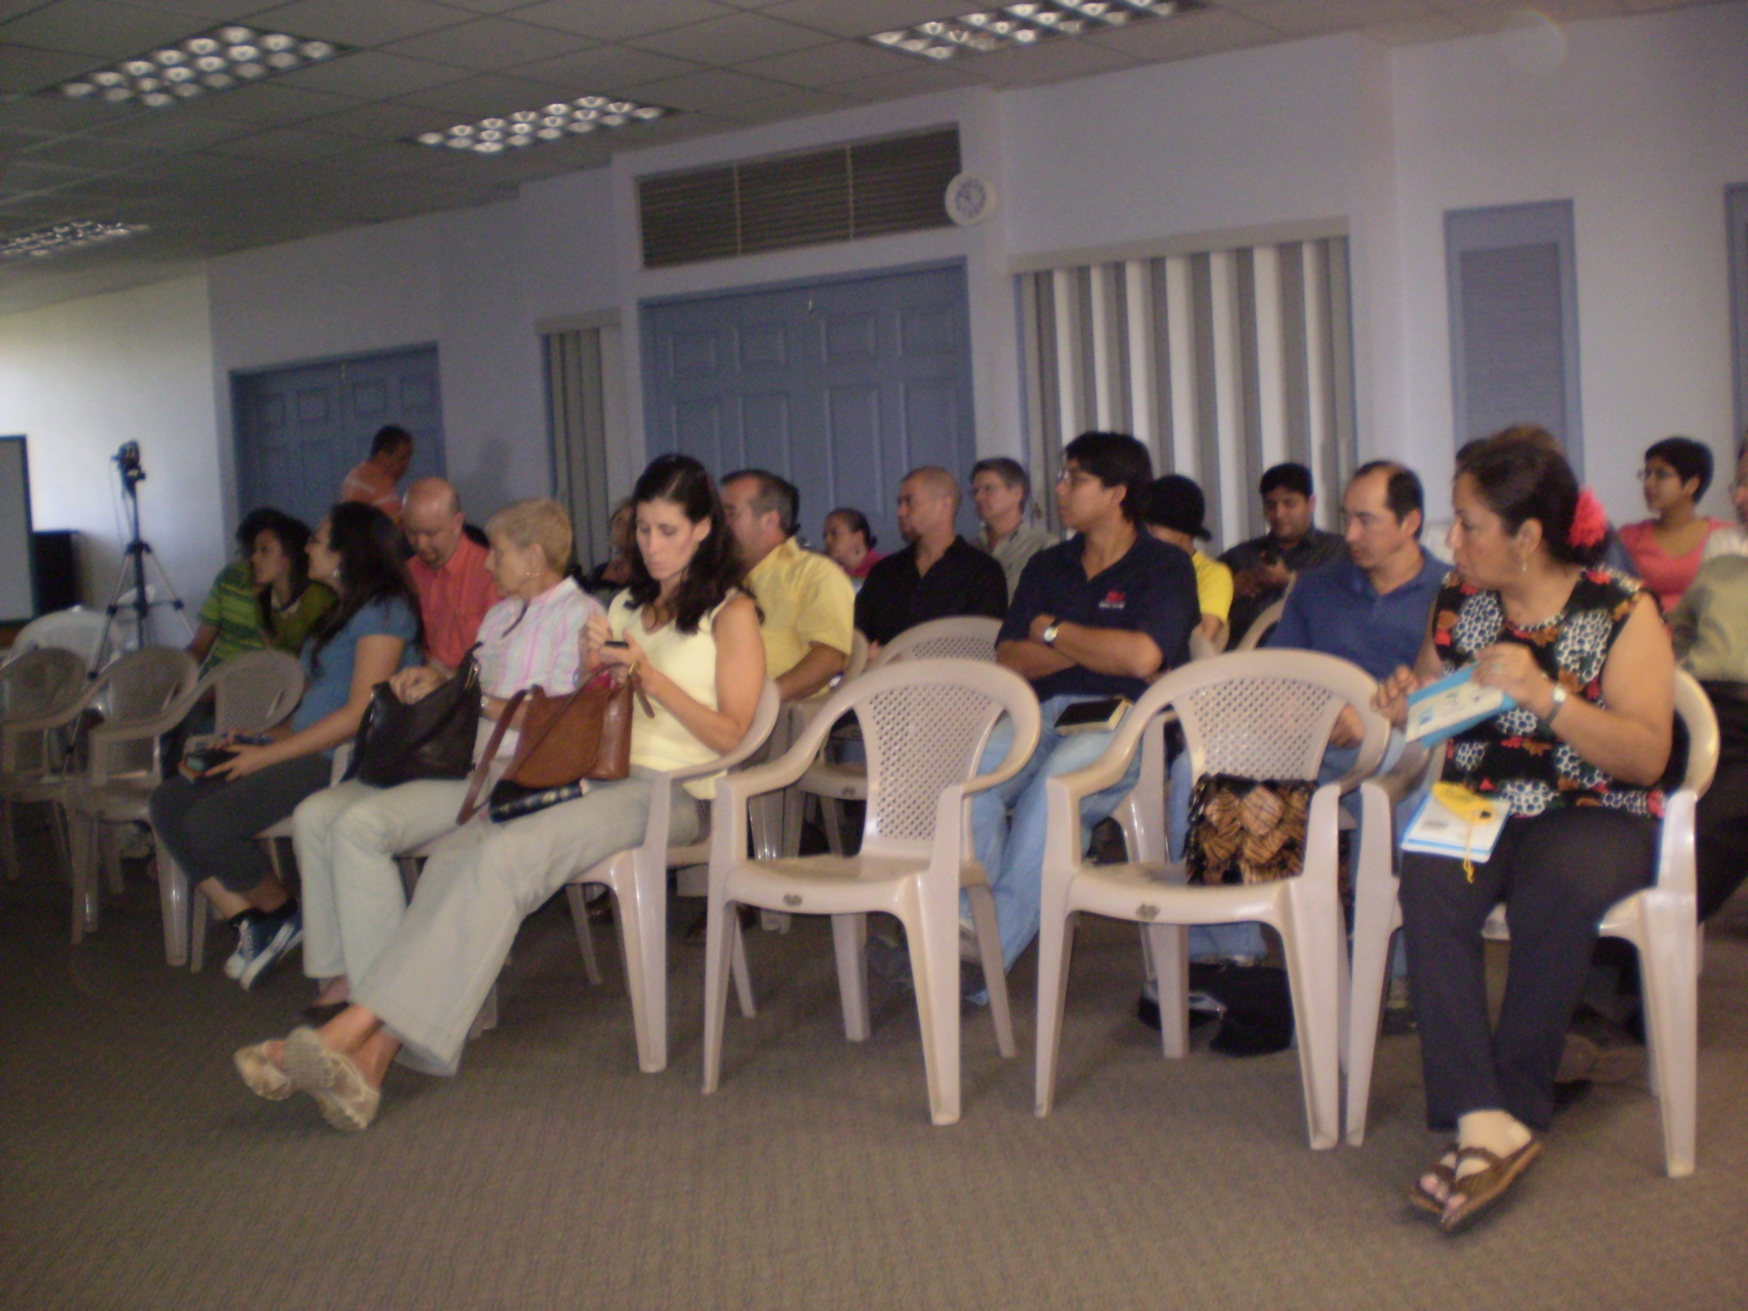

Slide 26
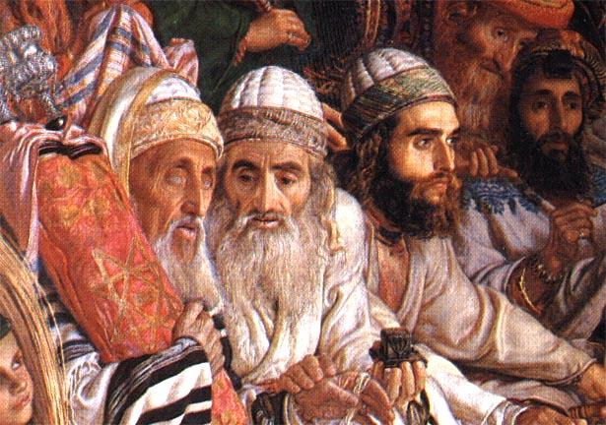
Las parábolas rabínicas
Robert C. Newman

Slide 27
Wednesday, March 17
Morning
  Talk “Birth Pains of the Messiah”
  Road trip up mountain
Afternoon
  Lunch at Tai Jo Asiatic Restaurant
Evening
  Talk “Some Problems for Theistic Evolution”

Slide 28
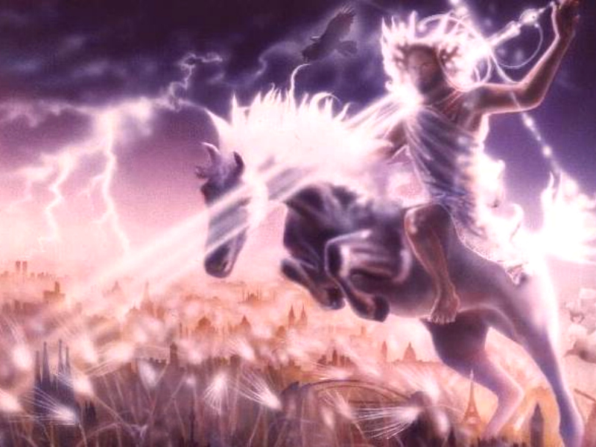
Los Dolores de Parto del Mesías
¿Ya comenzaron?
Robert C. Newman
www.ibri.org
Notes:
28

Slide 29
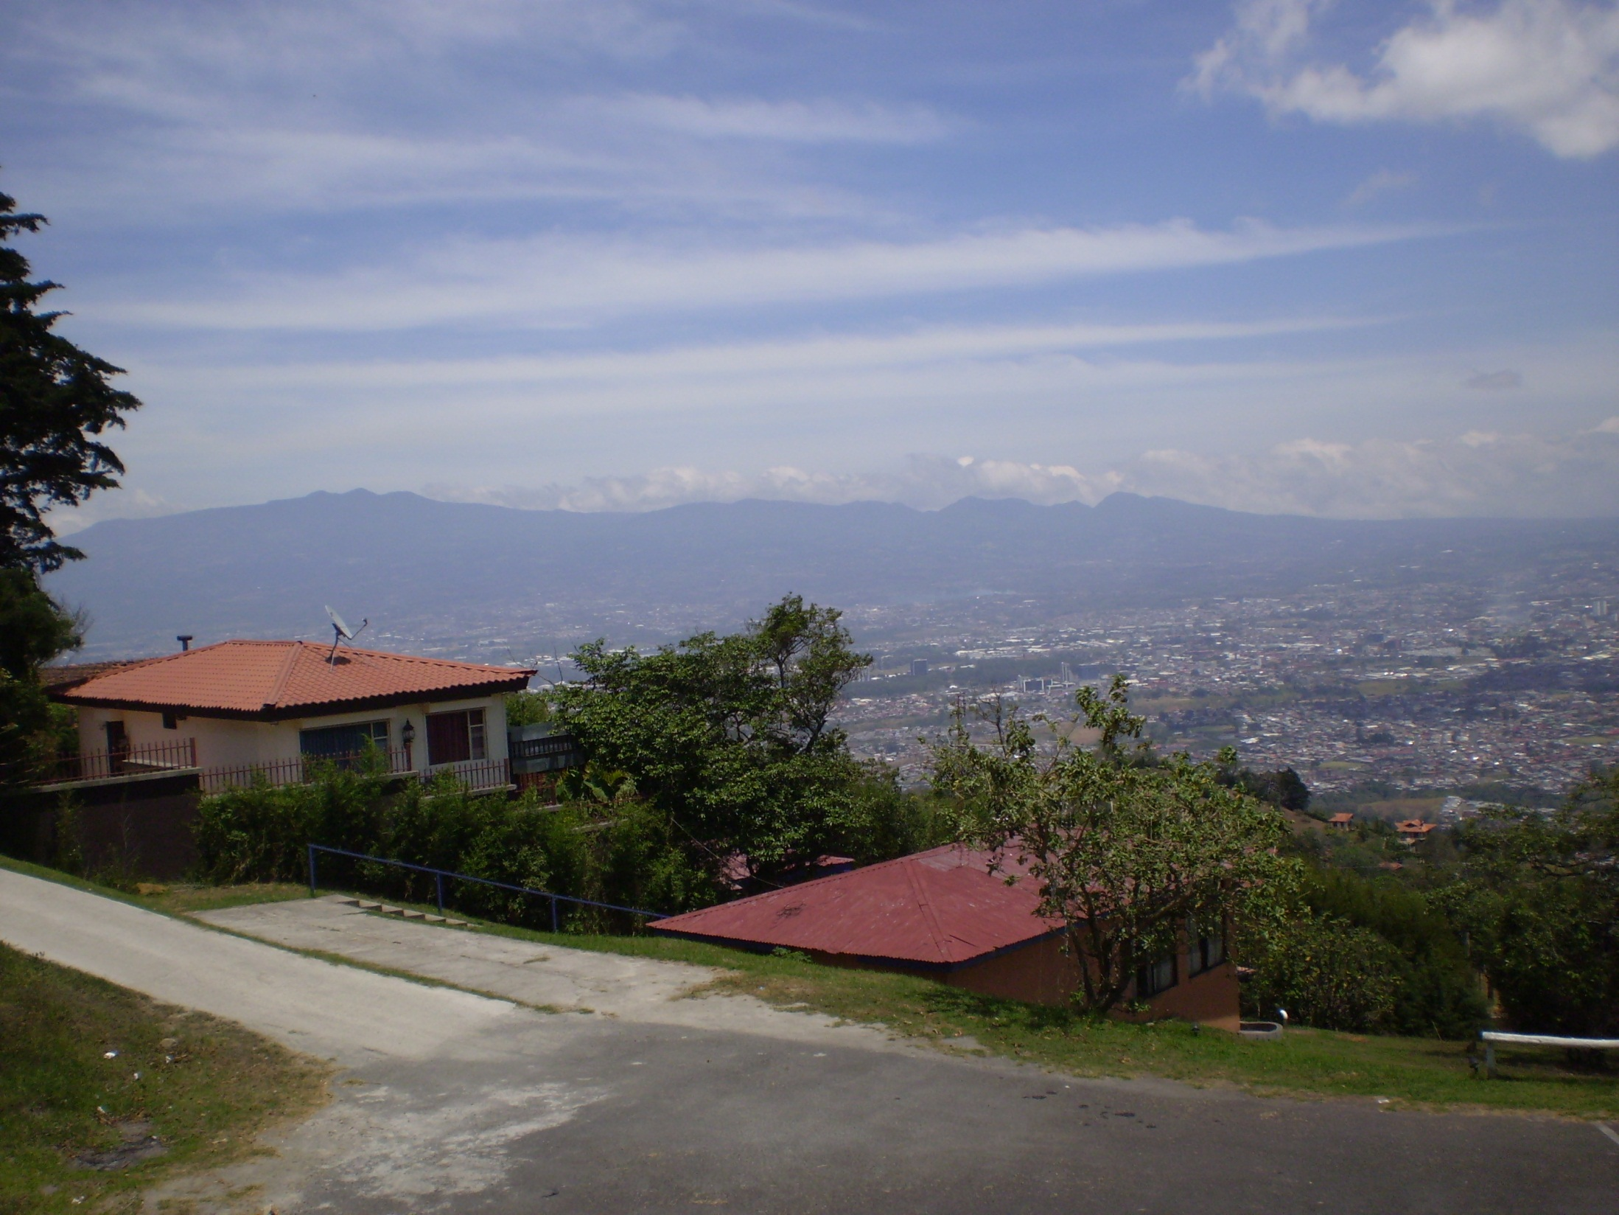
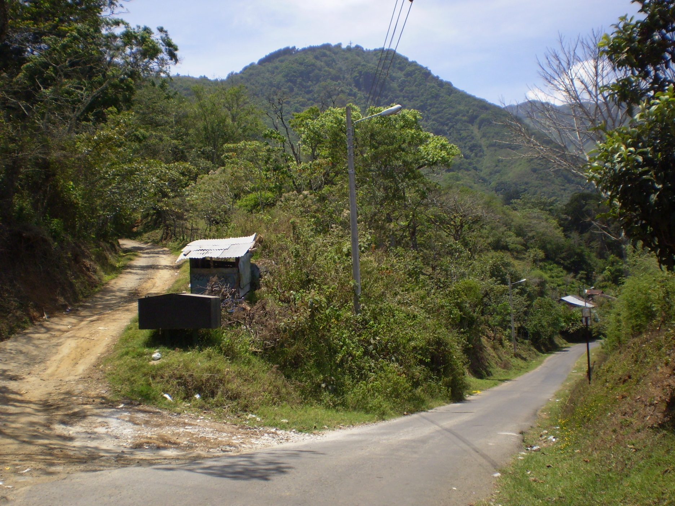

Slide 30
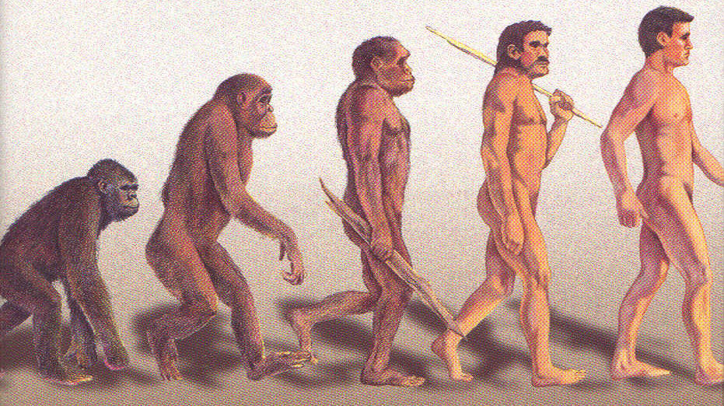
Algunos Problemas con la
Evolución Teística
Robert C. Newman
www.ibri.com
Notes:
30

Slide 31
Thursday, March 18
Morning
  Talk “Understanding Harry Potter”
  Sightseeing in downtown San José
Afternoon
  Resting, going over tonight’s talk
Evening
  Talk “Astronomy and the Bible”

Slide 32

Entendiendo
Harry Potter
Robert C. Newman
www.ibri.org
Notes:
32

Slide 33
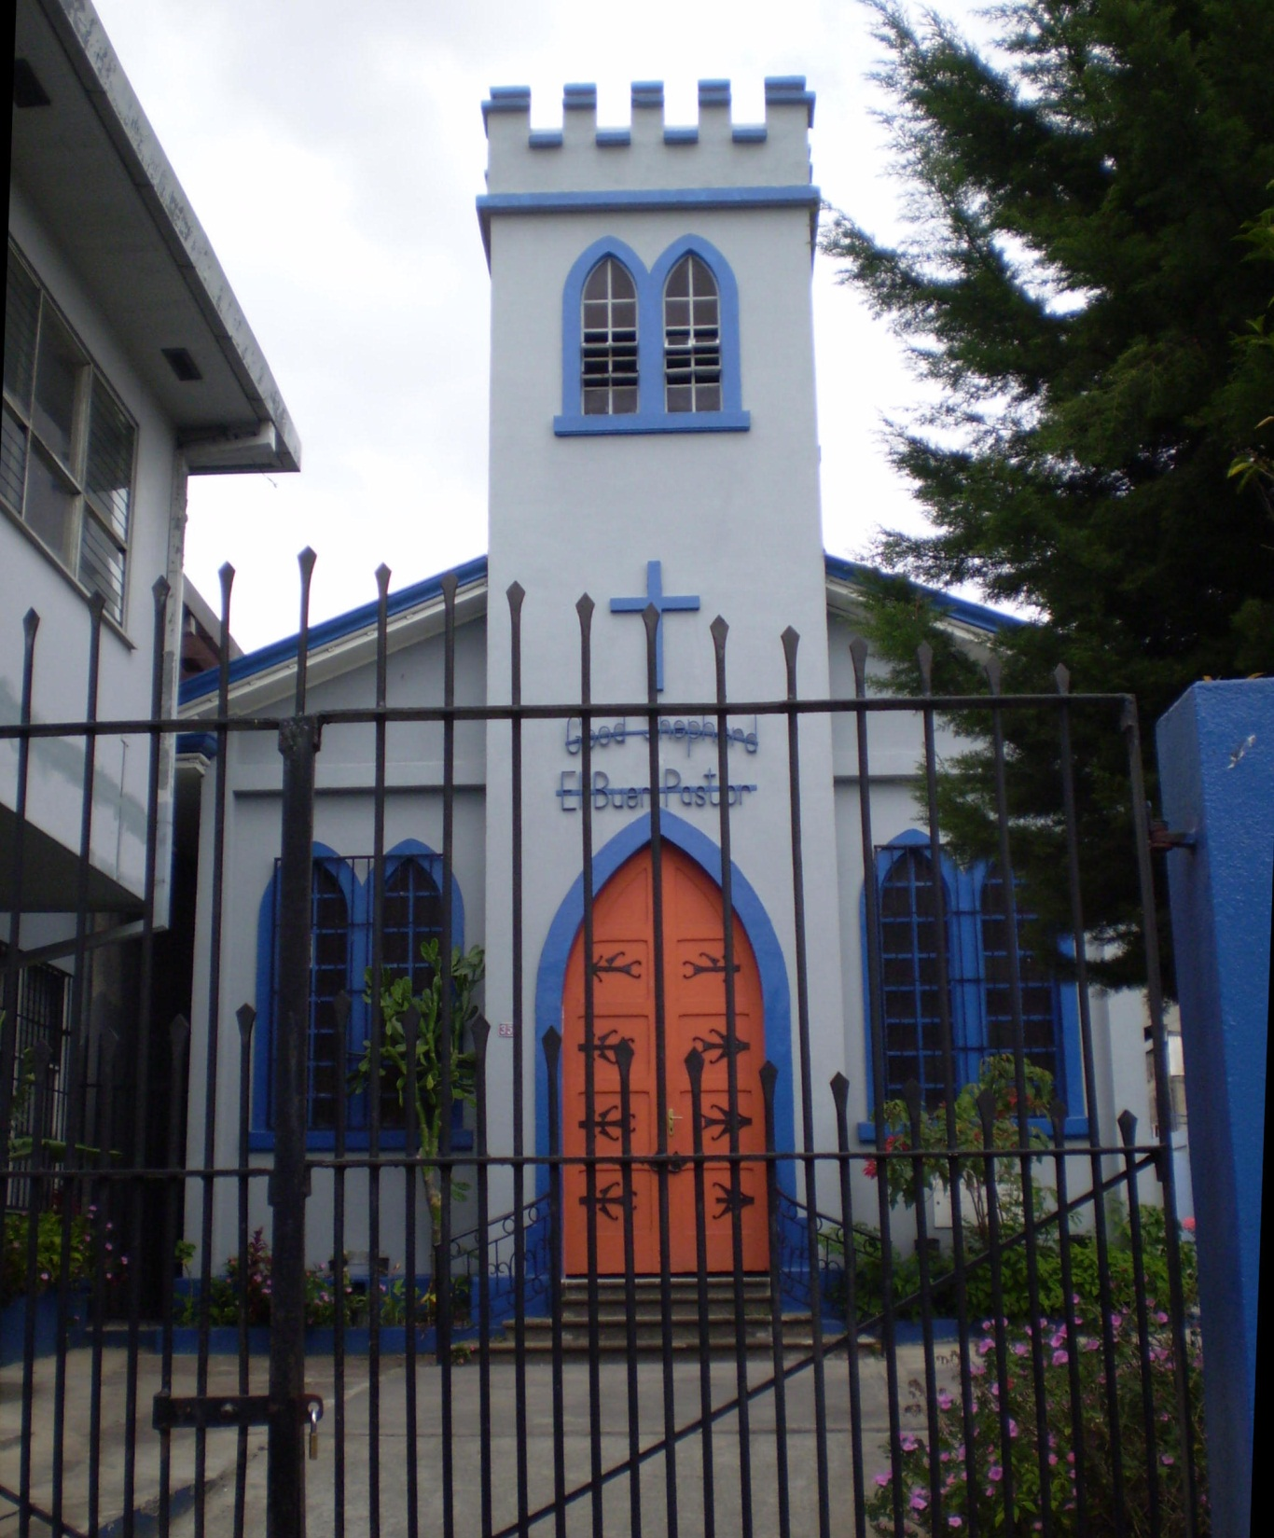
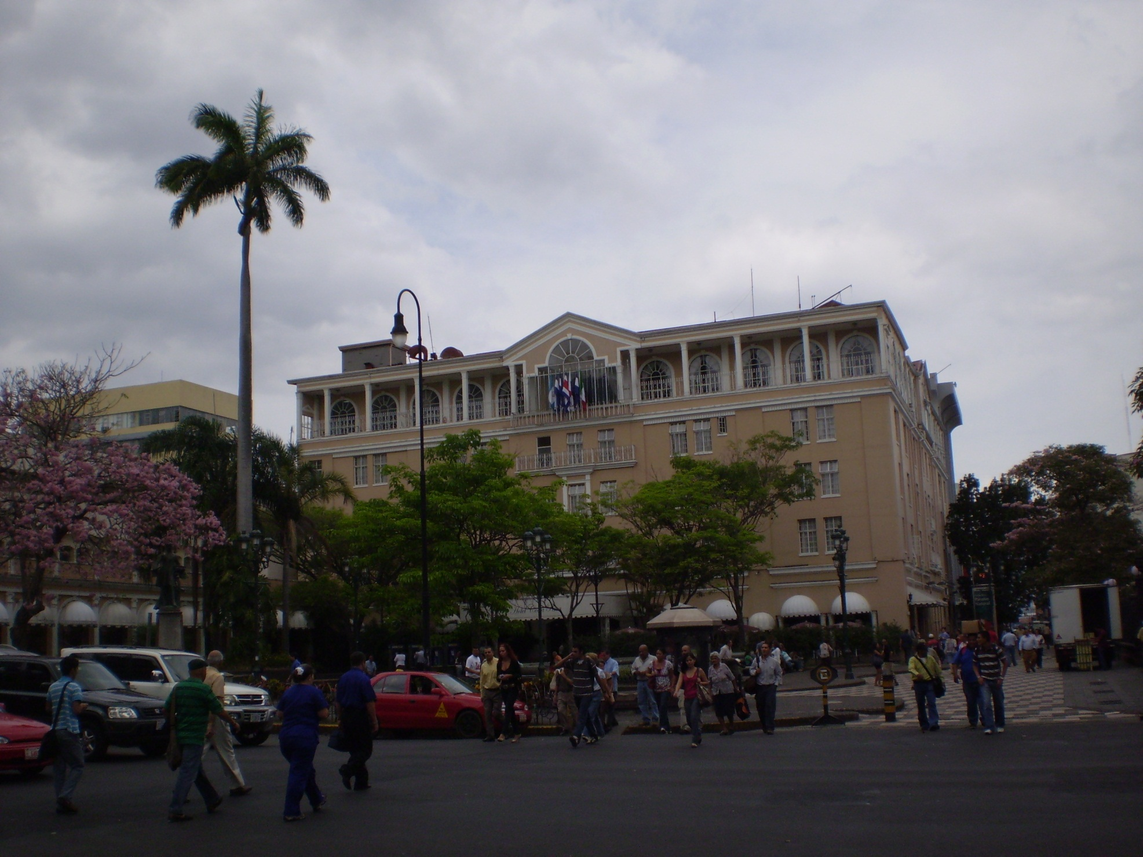
Oldest Protestant Church in San José

Slide 34
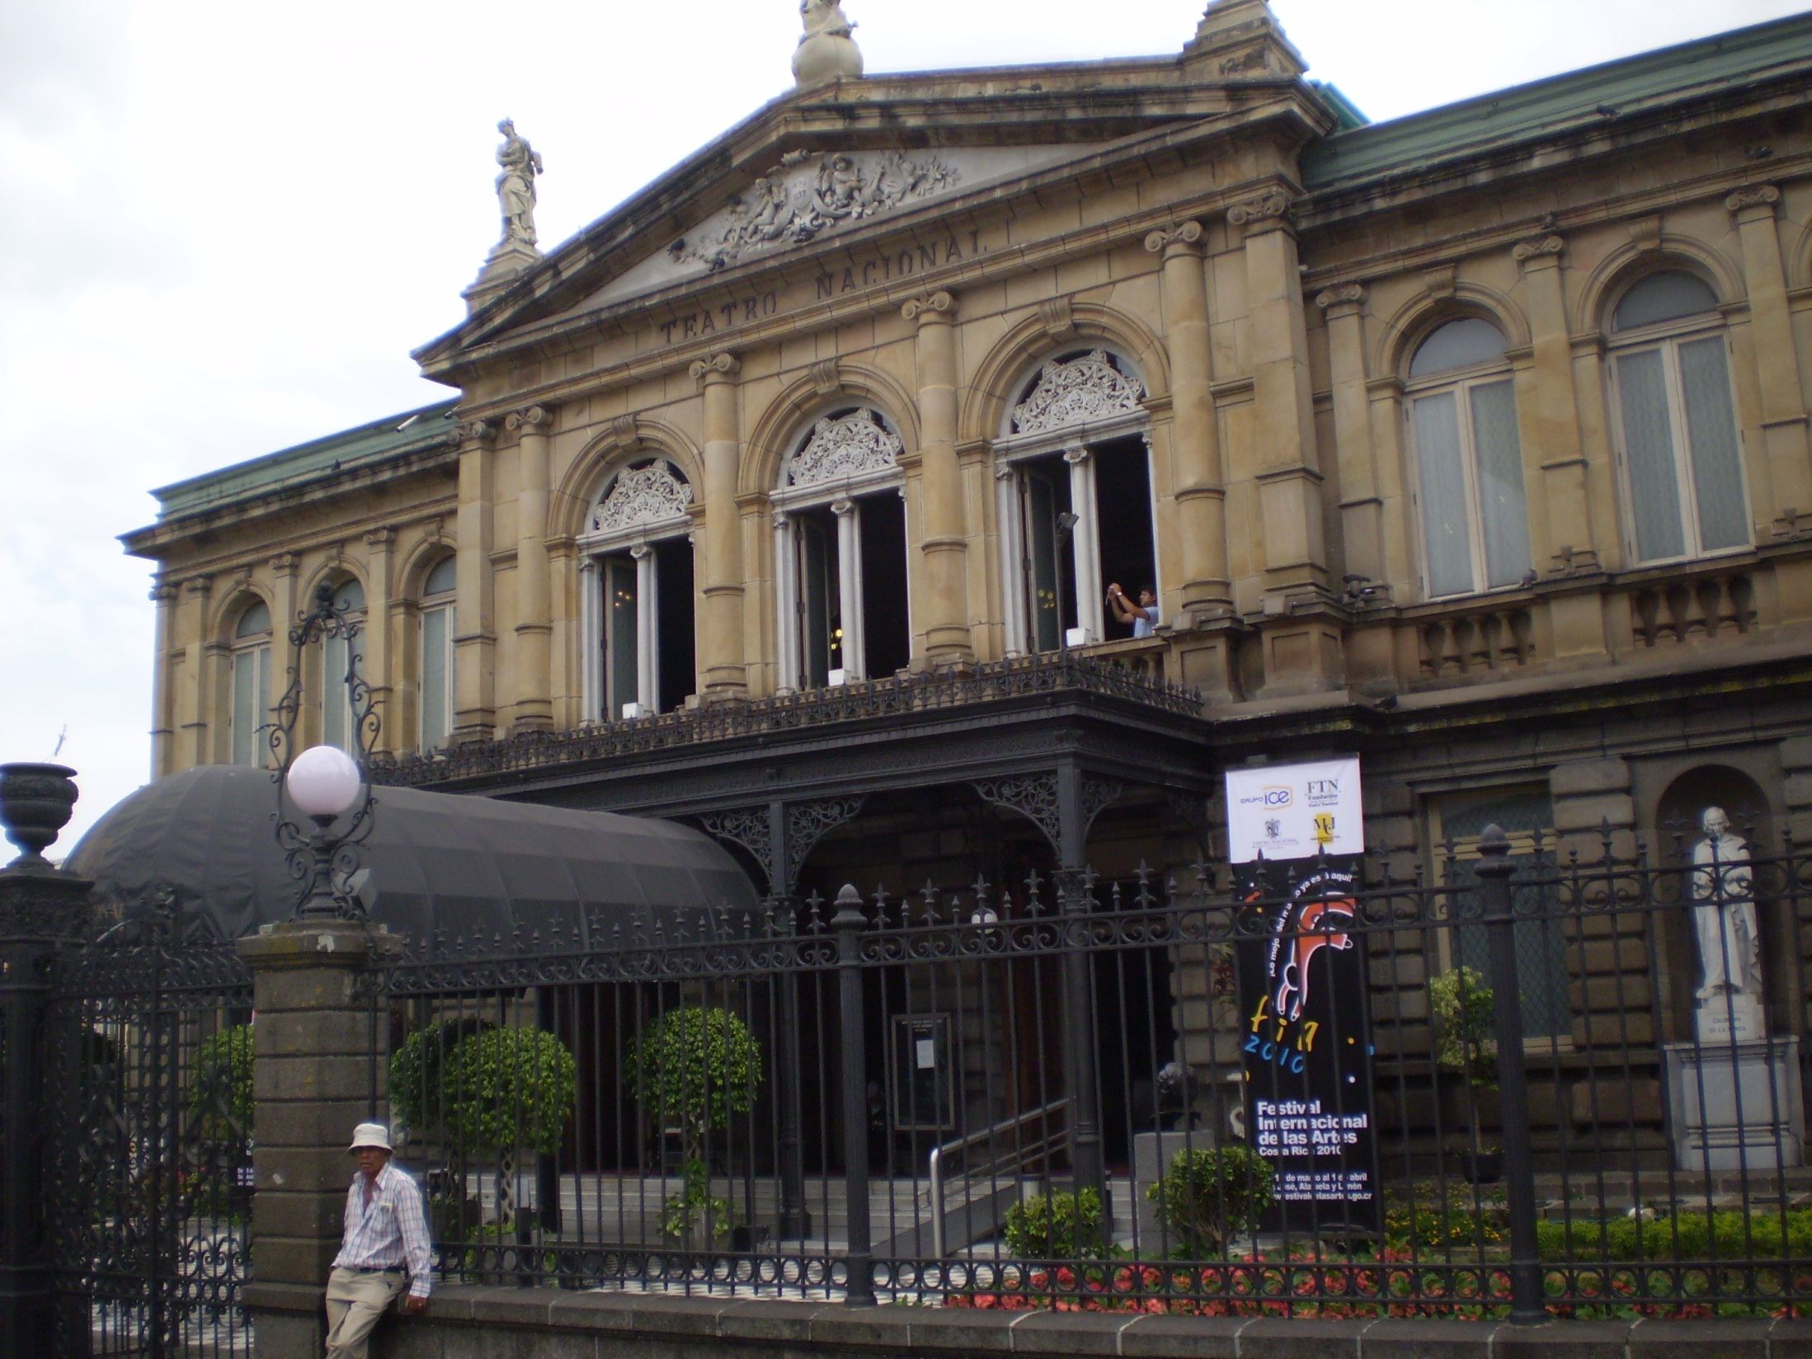
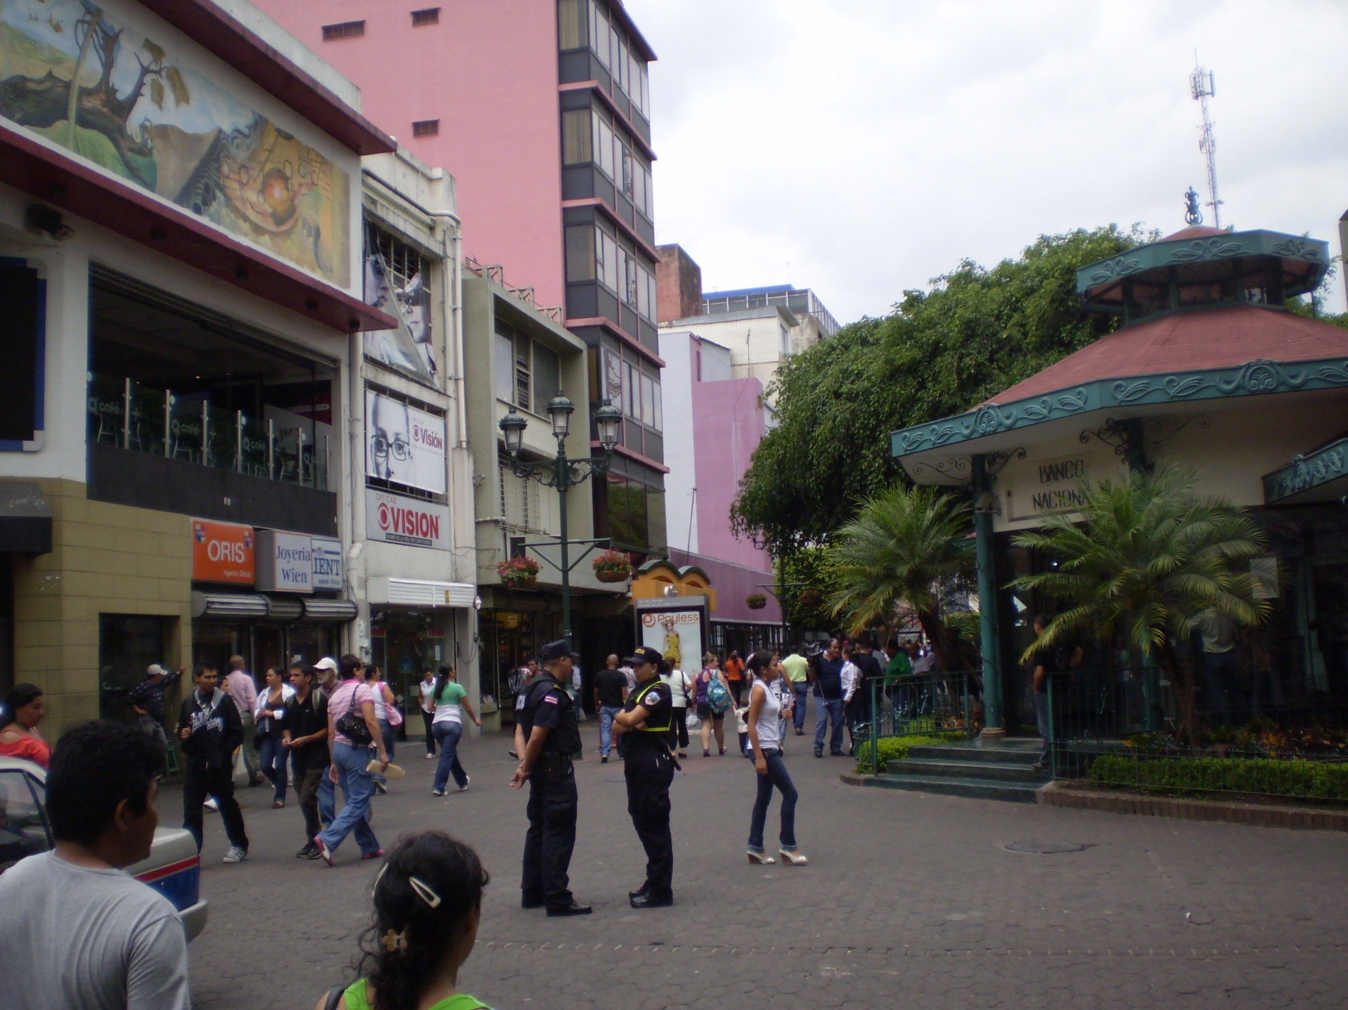

Slide 35
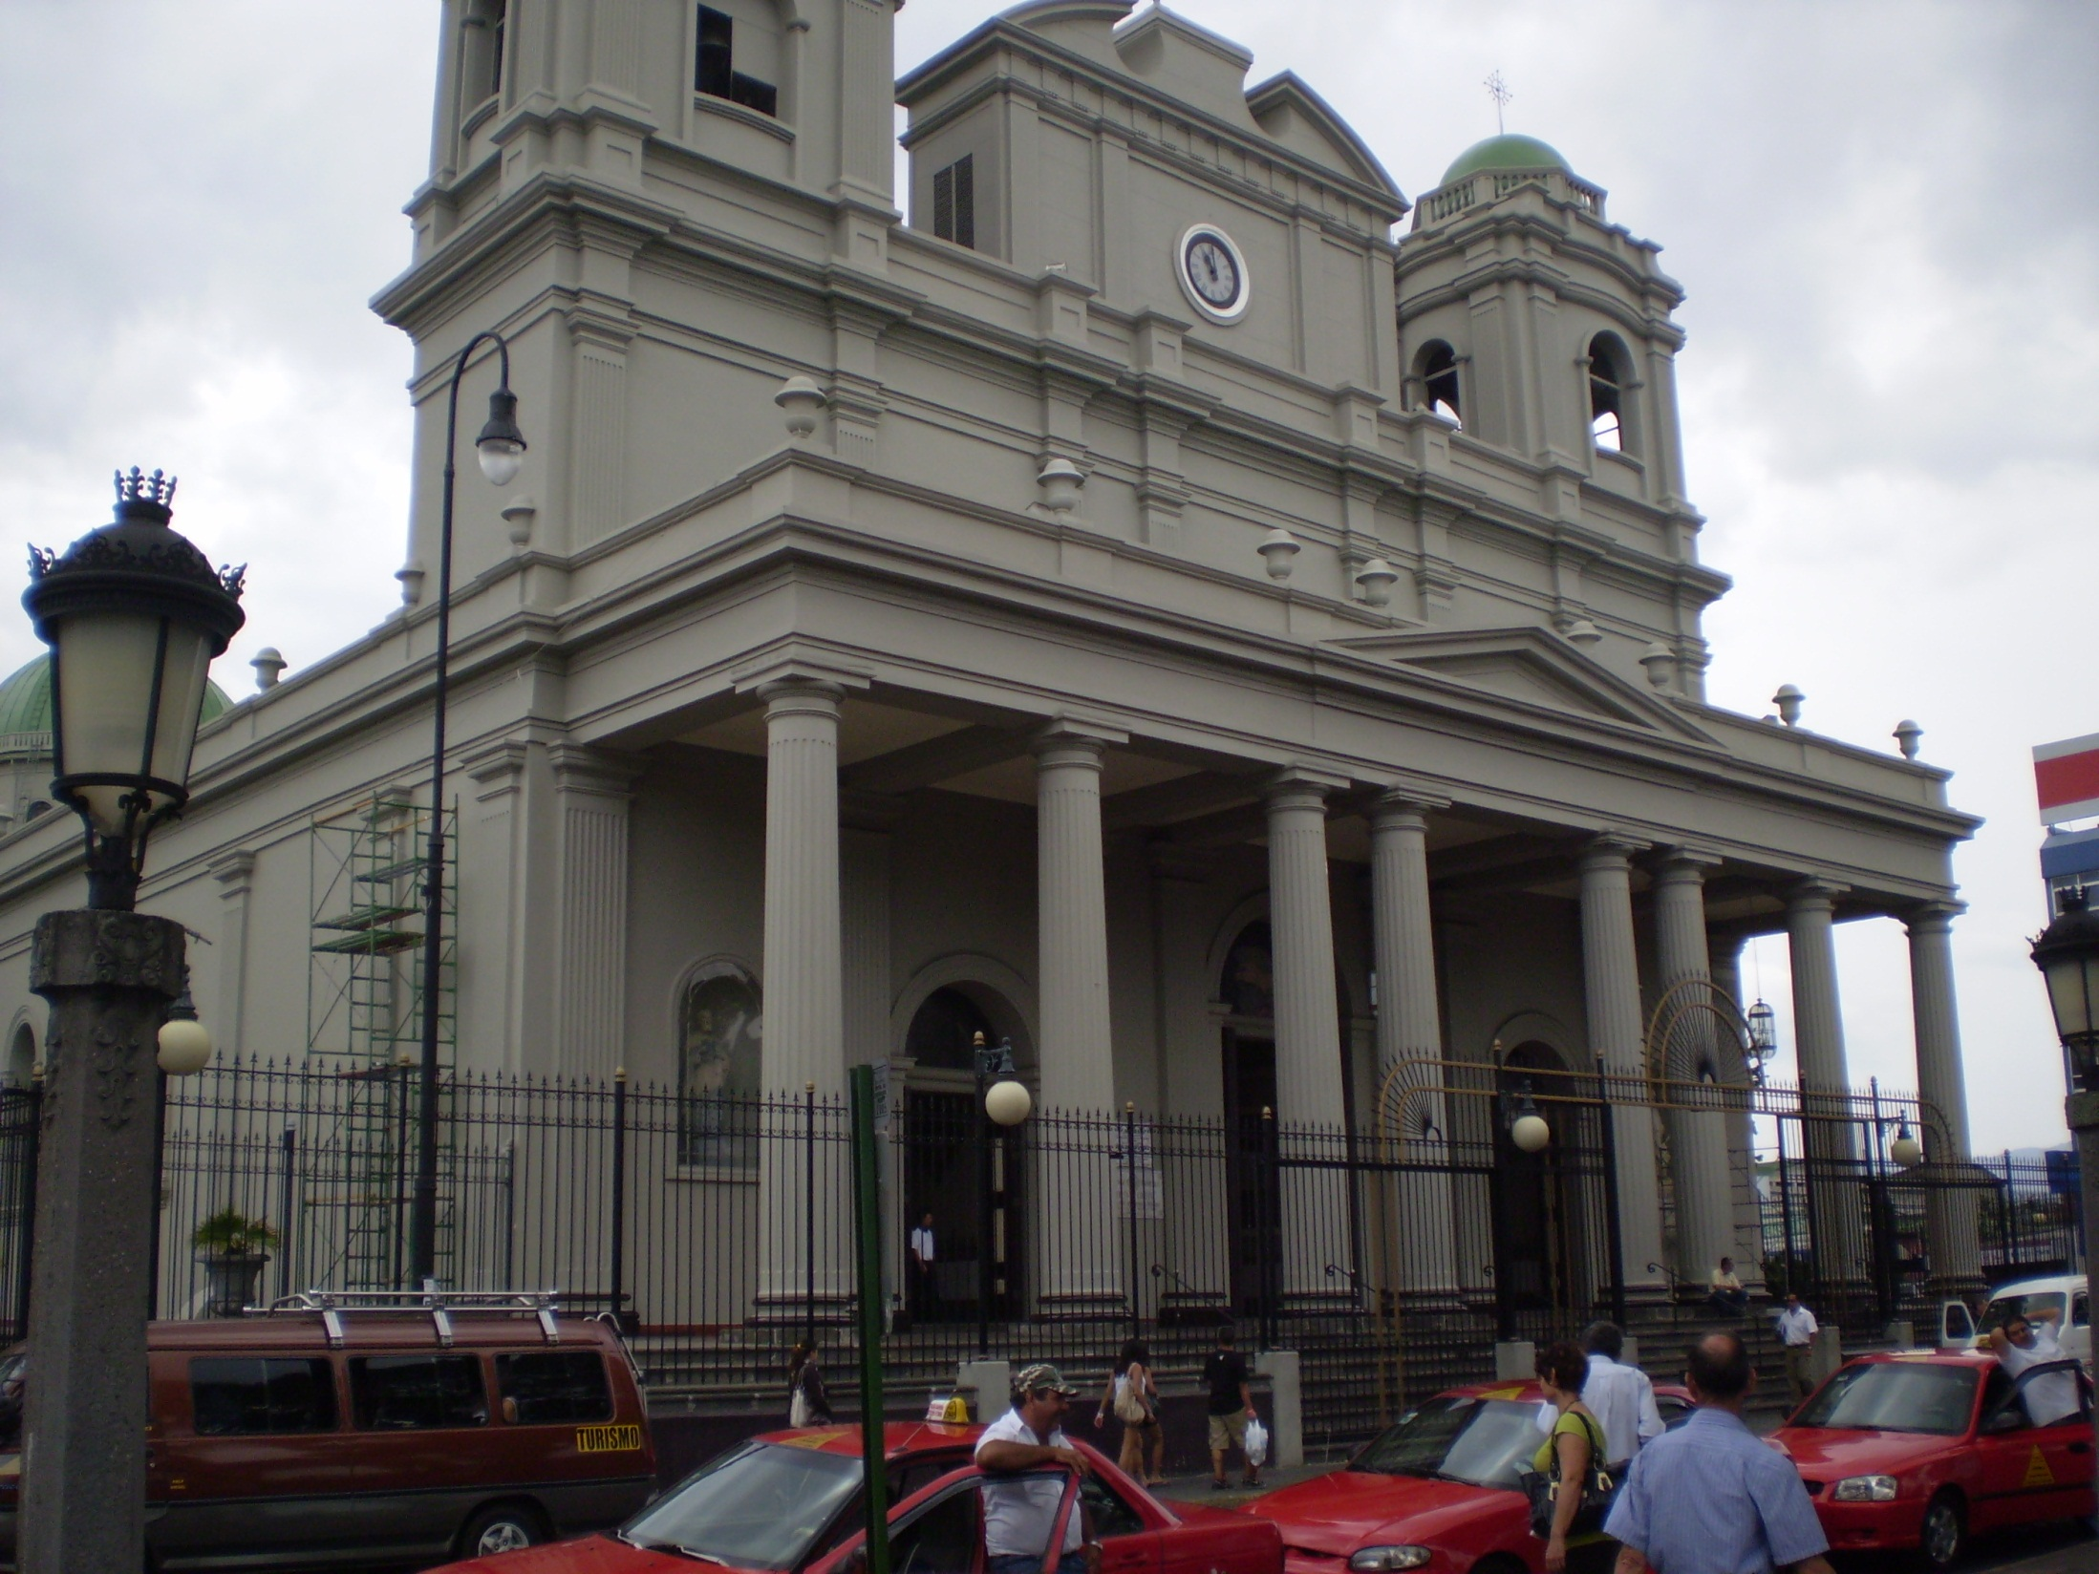
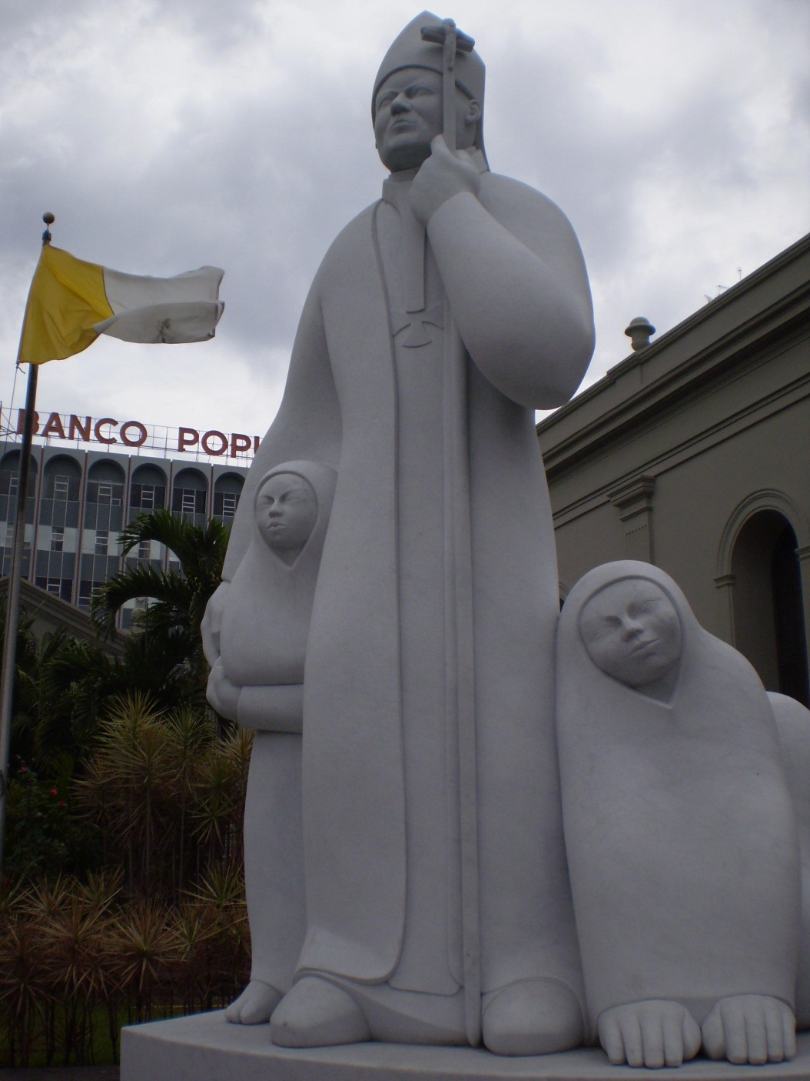

Slide 36
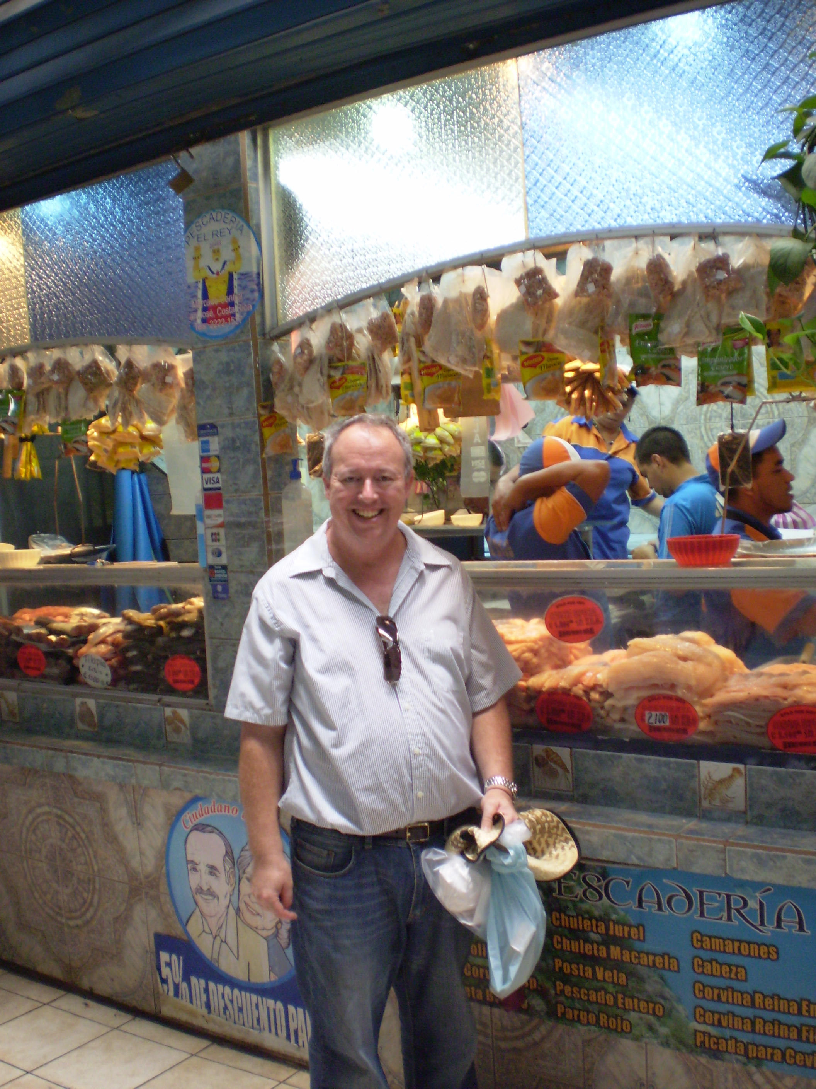
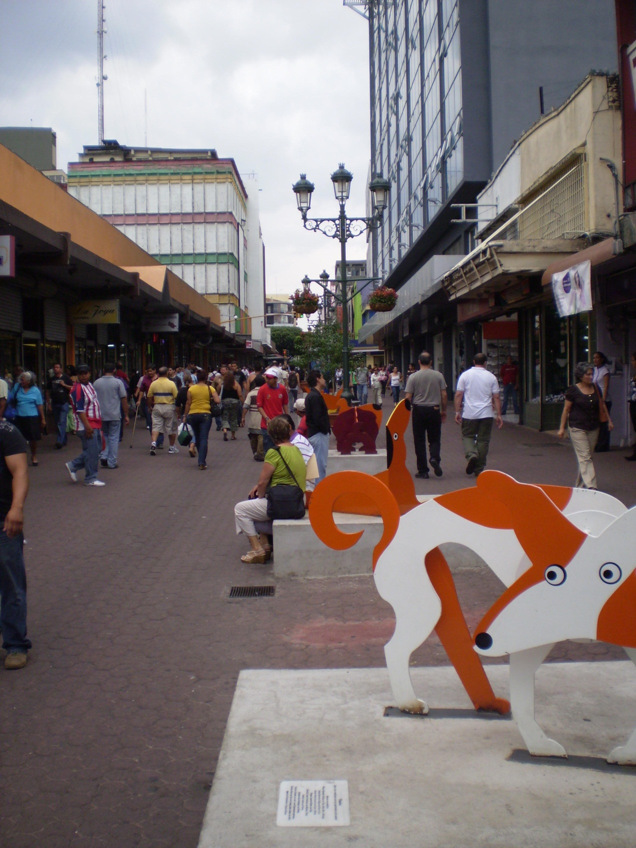

Slide 37
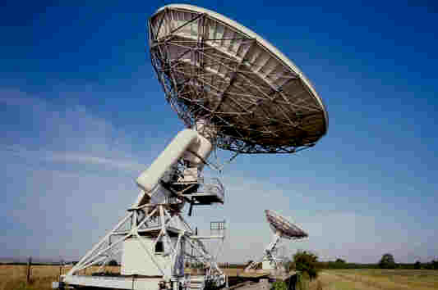
Astronomía y la Biblia
Robert C. Newman
www.ibri.org
Notes:
37

Slide 38
Friday, March 19
Depart San José 7:32 am (= 9:32 EDT)
Arrive Atlanta 12:55 pm
Depart Atlanta 3:33 pm
Arrive Charlottesville 4:39 pm
Home 6:12 pm

Slide 39
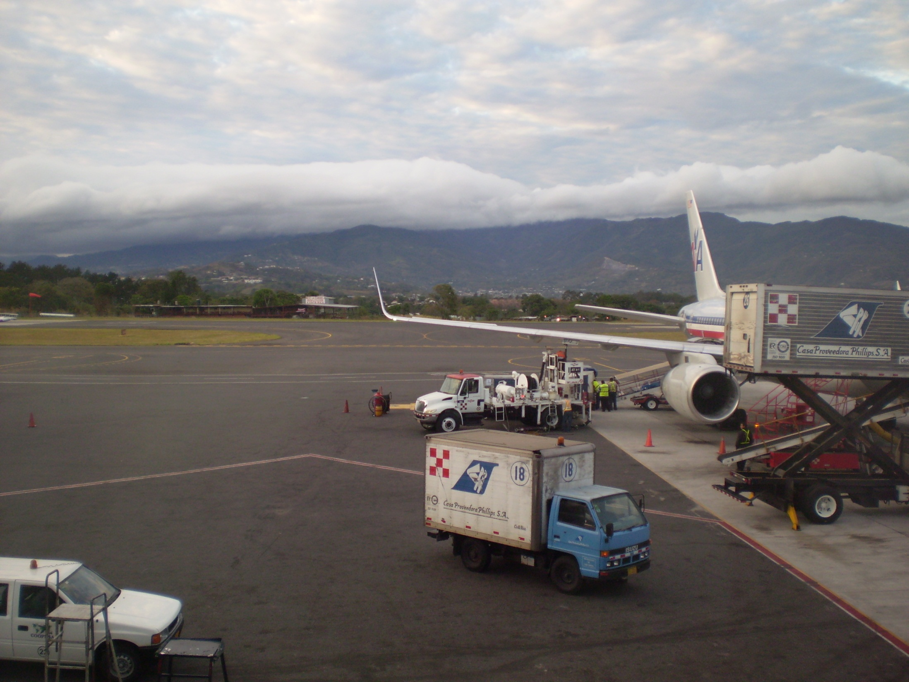
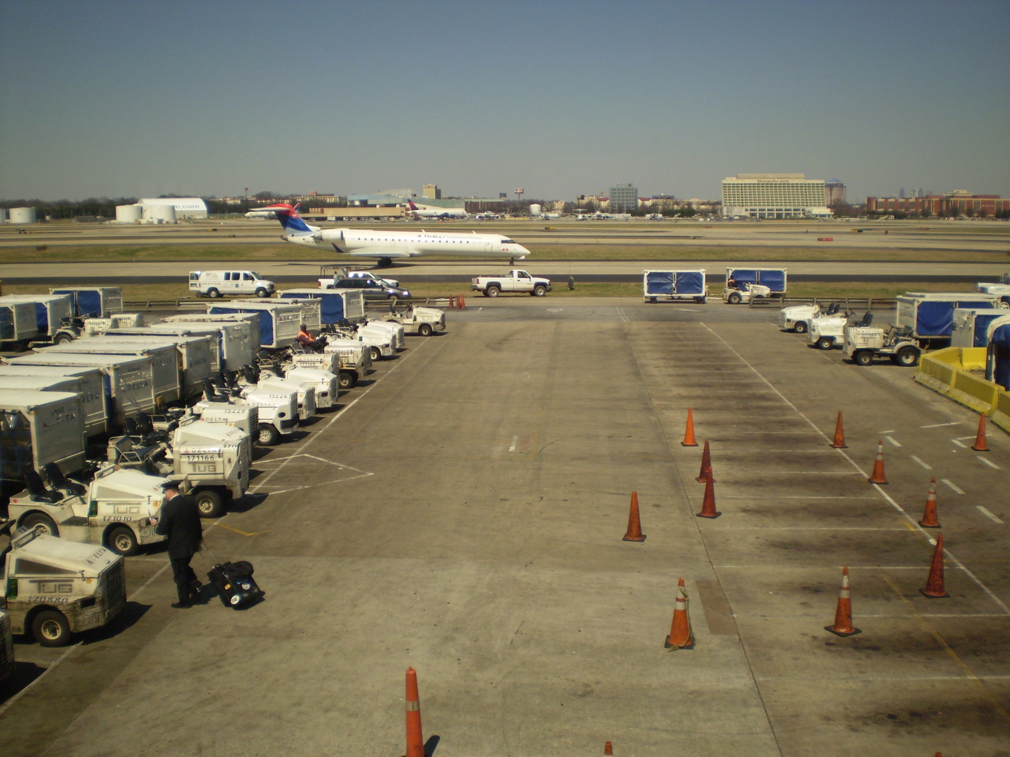

Slide 40
The End
Pray for Costa Rica

