Slide 1


2009 Ukraine Trip
Robert C. Newman

Slide 2
My Ukraine Trip
November 3-12, 2009
All my time was in Kiev area
Hosts: Biblical grad and PCA missionary Jon Eide & wife Traci (& kids)
Purposes:
  Speaking
  Seeing Ukraine
  Meeting believers, seekers, missionaries

Slide 3
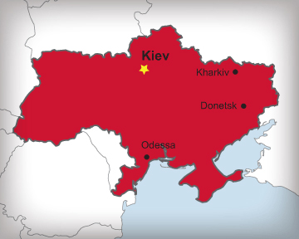
Ukraine
Belarus
Russia
Poland
Slovakia
Hungary
Moldova
Romania
BLACK SEA

Slide 4
Ukraine Population Statistics
Population: 52 million
Kiev: 2.6 million
Ethnicity:
  Ukrainians 73%
  Russians 22%
  Others 5%
    Jews
    Belarussians
    Moldovans
Other 5%
Russian 22%
Ukrainian 73%

Slide 5
Ukraine Religion Statistics
Various Orthodox: 84%*
* % of religious
Ukrainian Greek Catholic: 8%
Roman Catholic: 2.2%
Protestant: 2.2%
Jewish: 0.6%
Other: 3.2%
Orthodox

Slide 6
Ukrainian Belief Statistics
Atheist 20%
Agnostic 15%
Deist 35%
New Age 1%
Neodoukhobor 25%
Orthodox 4%
Catholic 1%

Slide 7
Swine Flu
Just a week before I headed for Ukraine, the Prime Minister closed all schools and cancelled all public meetings for three weeks to slow the spread of the flu.
As a result, I had three talks at universities cancelled, as well as two talks at an Orthodox seminary.

Slide 8
The Trip Over
Tuesday November 3
  Depart Charlottesville 4:38 pm
  Arrive Detroit 5:50 pm
  Depart Detroit 10:19 pm
Wednesday November 4
  Arrive Amsterdam 10:52 am
  Depart Amsterdam 1:48 pm
  Arrive Kiev 4:36 pm
  At Eide’s 6:51 pm

Slide 9
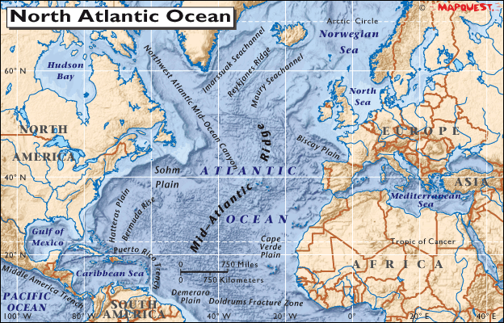
The Trip Over

Slide 10
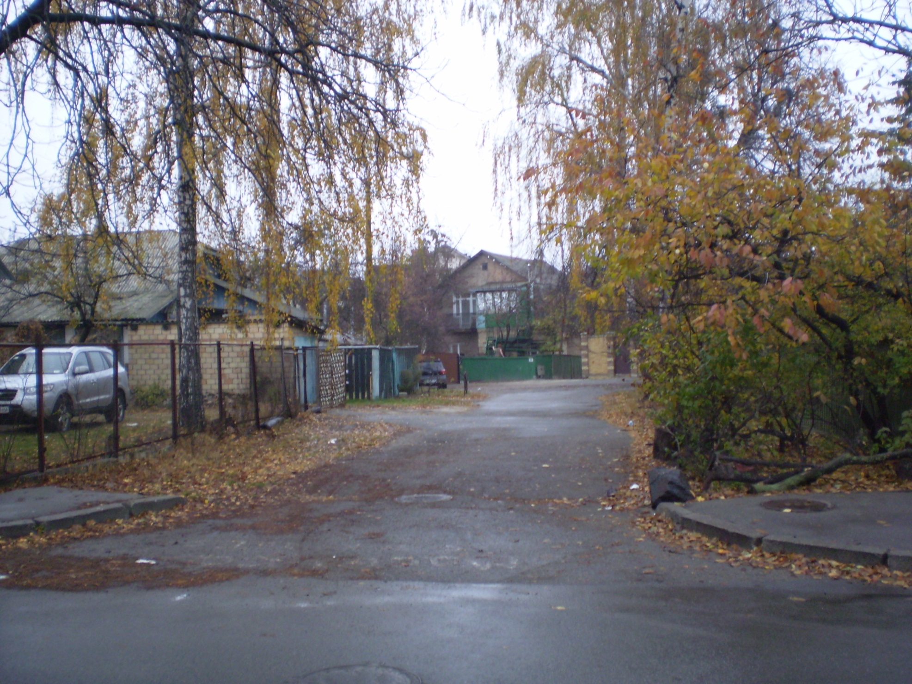
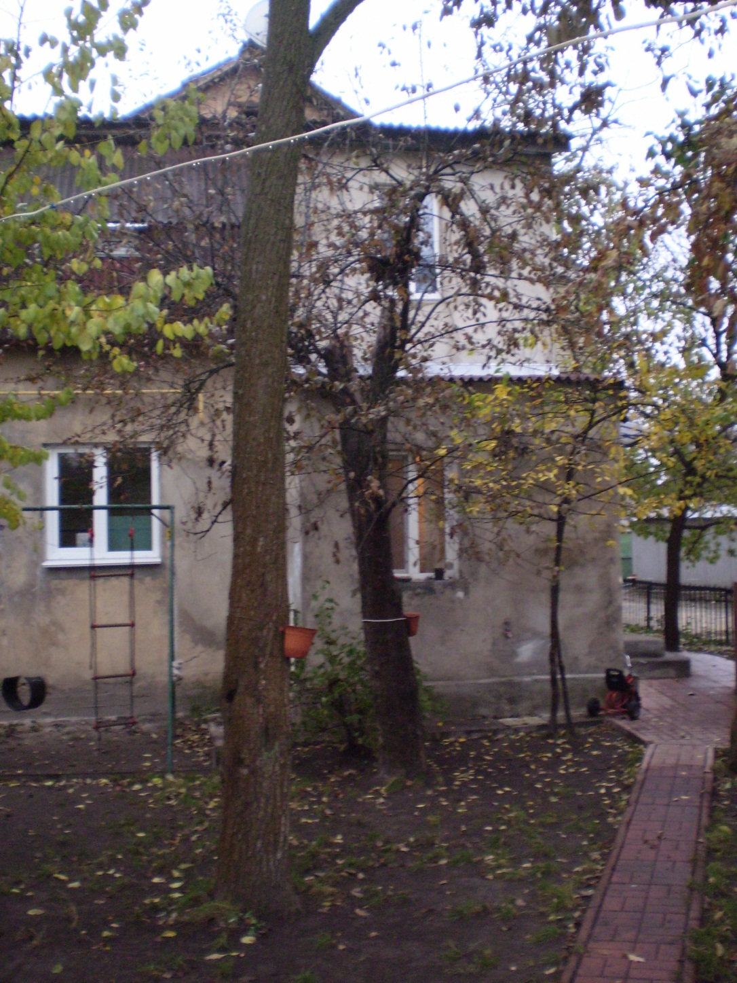

Slide 11
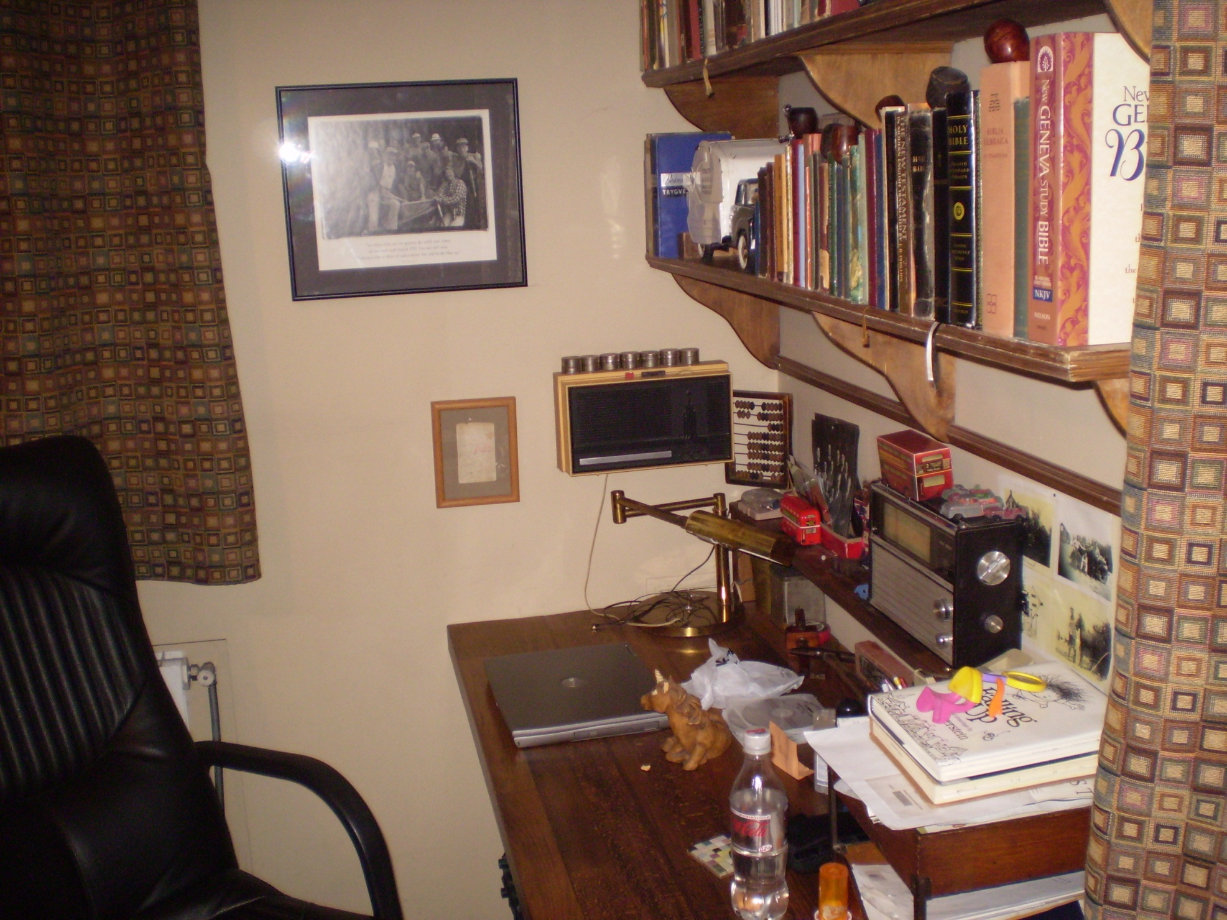
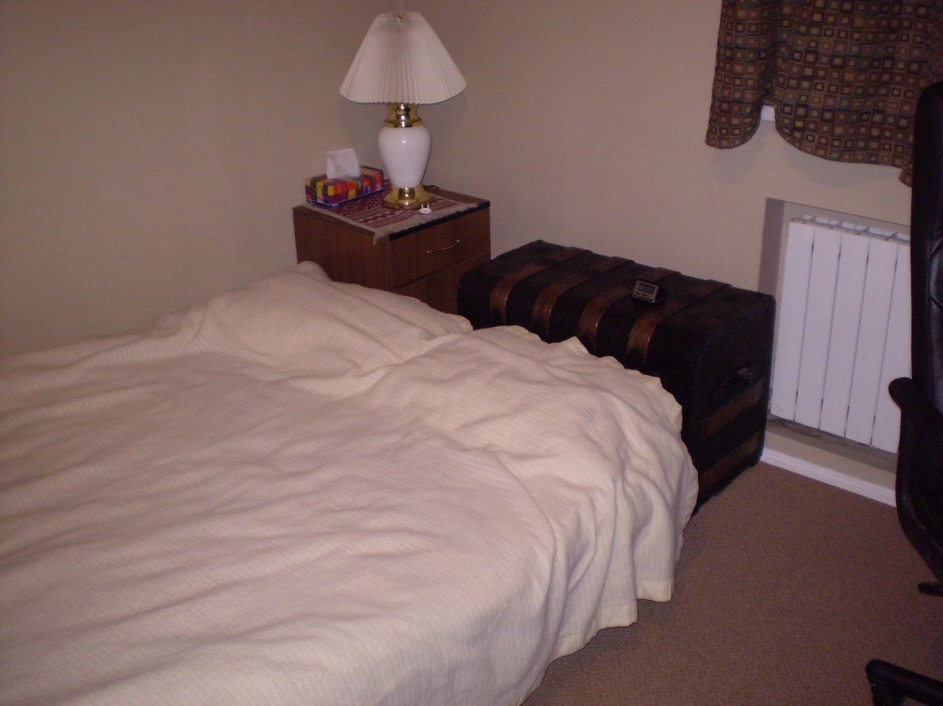

Slide 12
Thursday November 5
Talking with Jon Eide & Sasha Bukovietski, a Christian book publisher
At Book Exposition, where Sasha’s firm “Colloquium” has a booth
Lunch with Jon & Eric Huber, country director for PCA
At offices of Presbyterian Church of Holy Trinity & MTW; tea with Jon & Max Tikonov, pastor of Solomensky P-R Ch

Slide 13
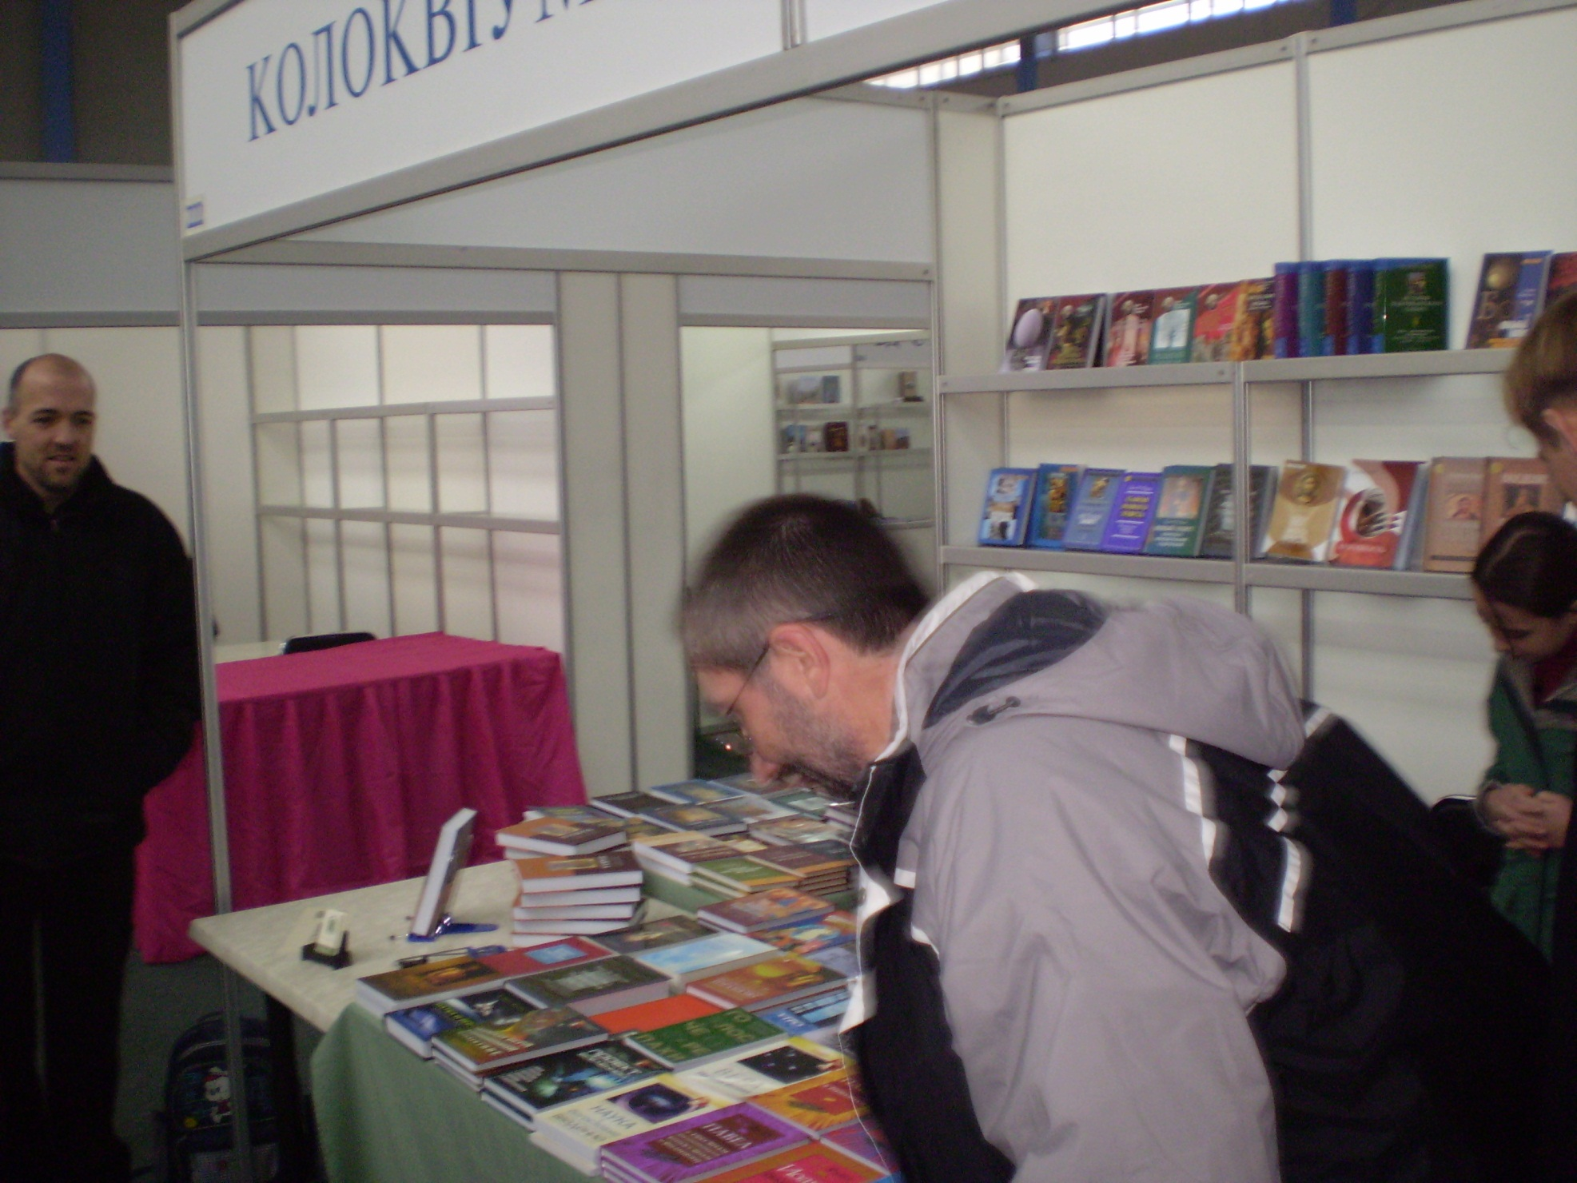
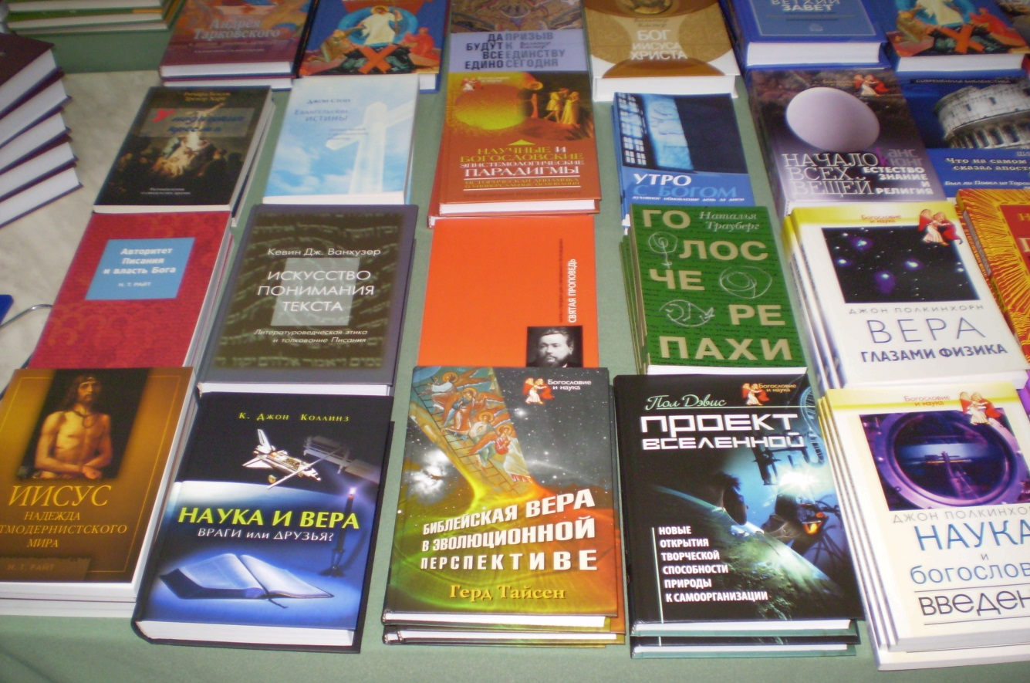

Slide 14
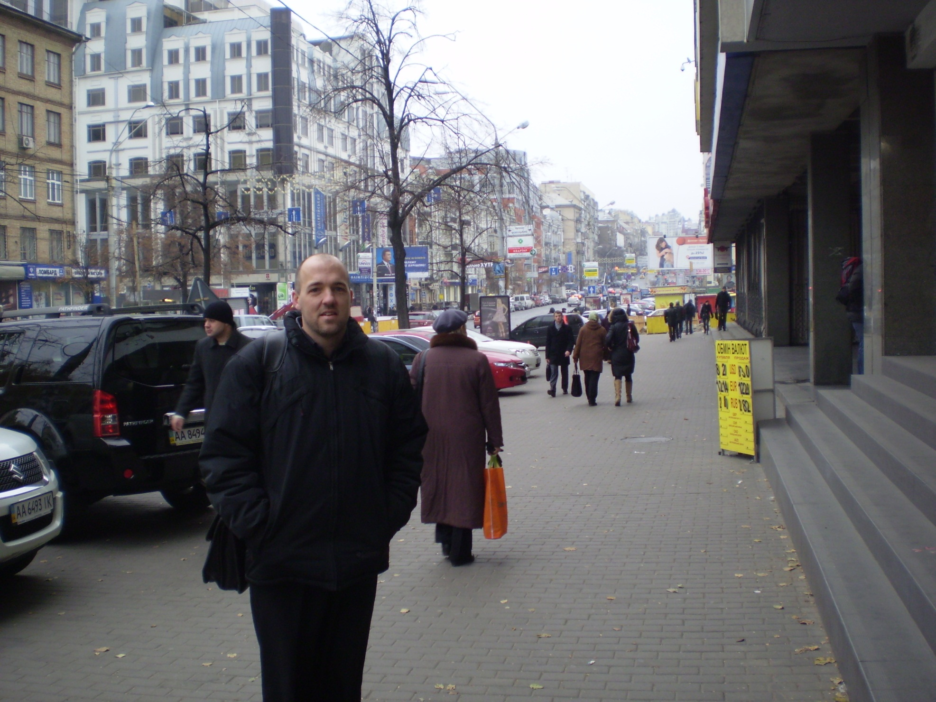

Slide 15
Friday November 6
Sightseeing with Jon & daughter Natalie
  Funicular (inclined RR) down to River Dnieper
  St Michael’s Cathedral & Bell Tower
  Bessarabia Market
Lunch with Ivan Bespalov, pastor of Church of the Holy Trinity
Dinner at Ukraine Strabu Restaurant with the Eides

Slide 16
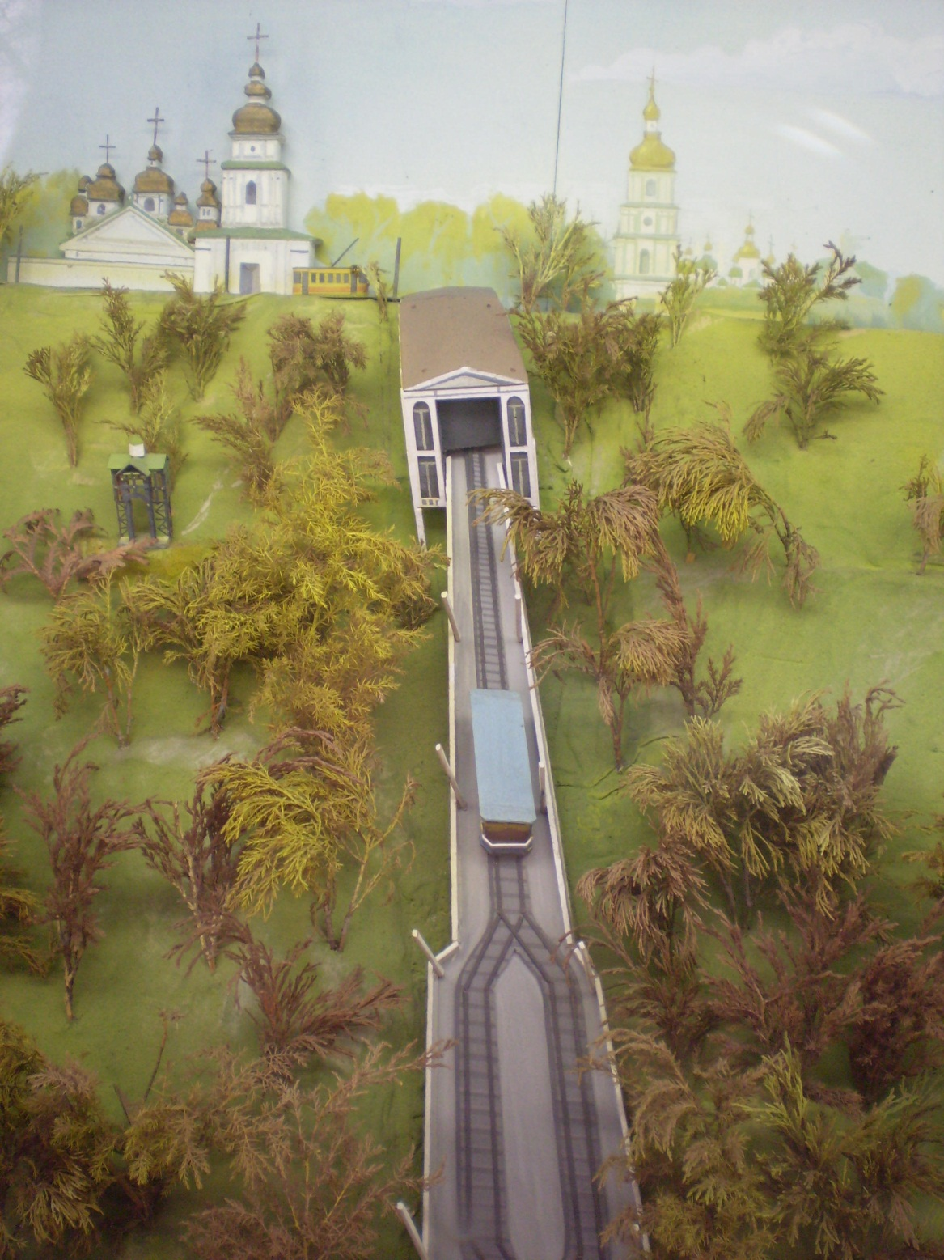
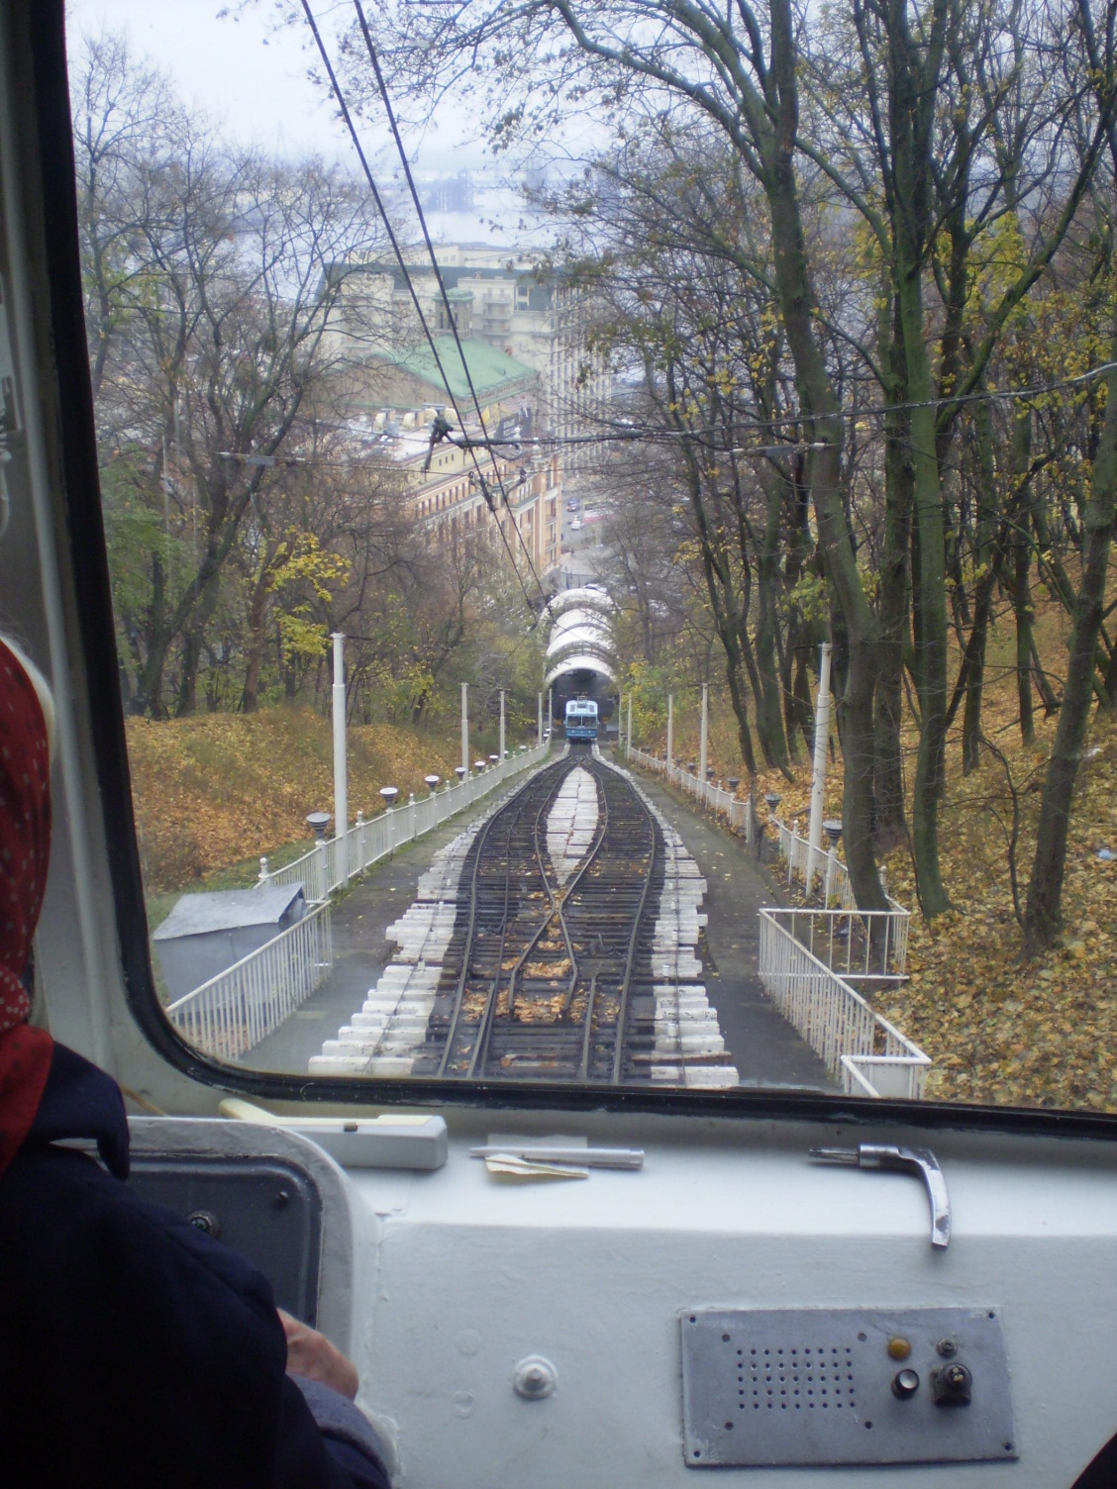
Funicular (Inclined Railway)

Slide 17
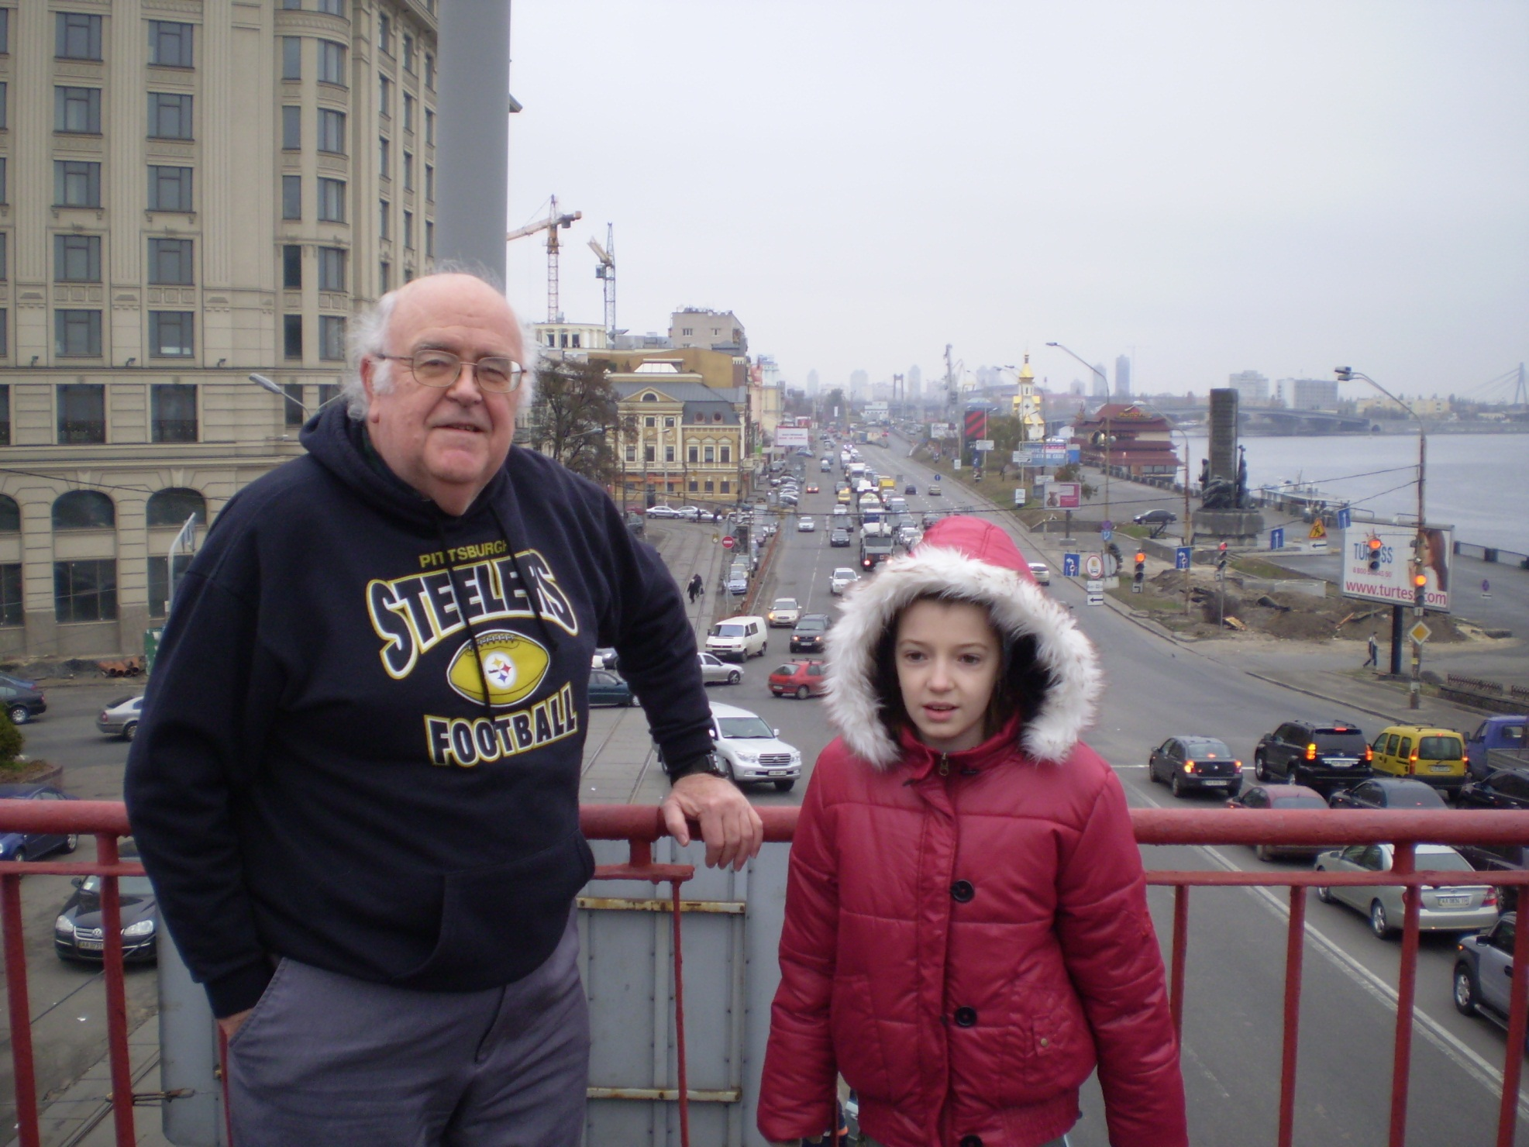

Slide 18
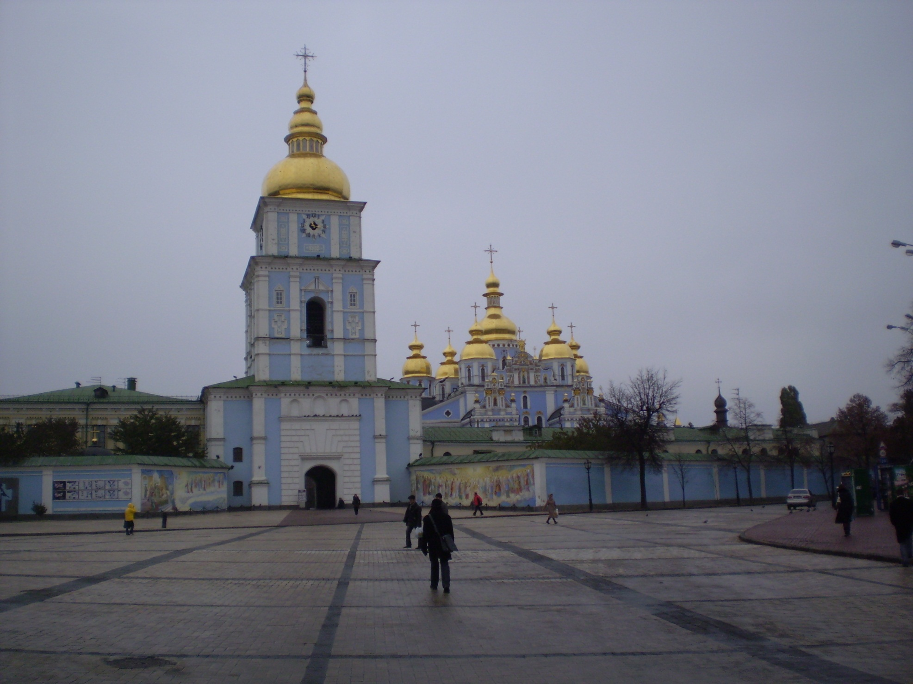
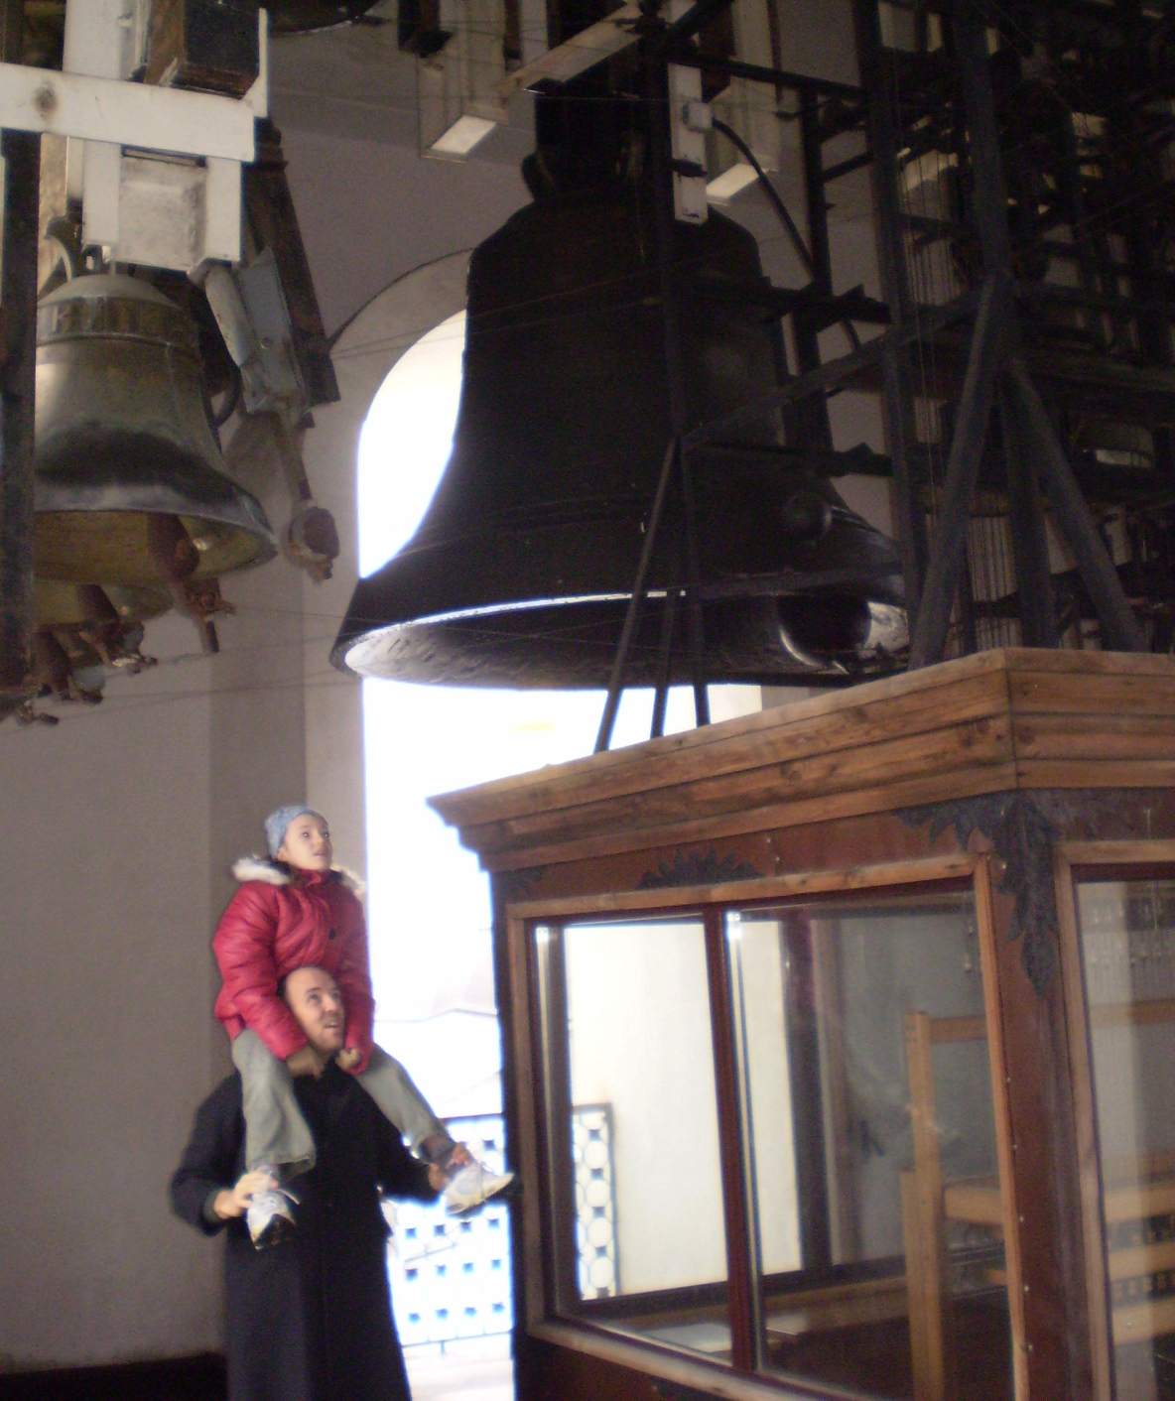

Slide 19
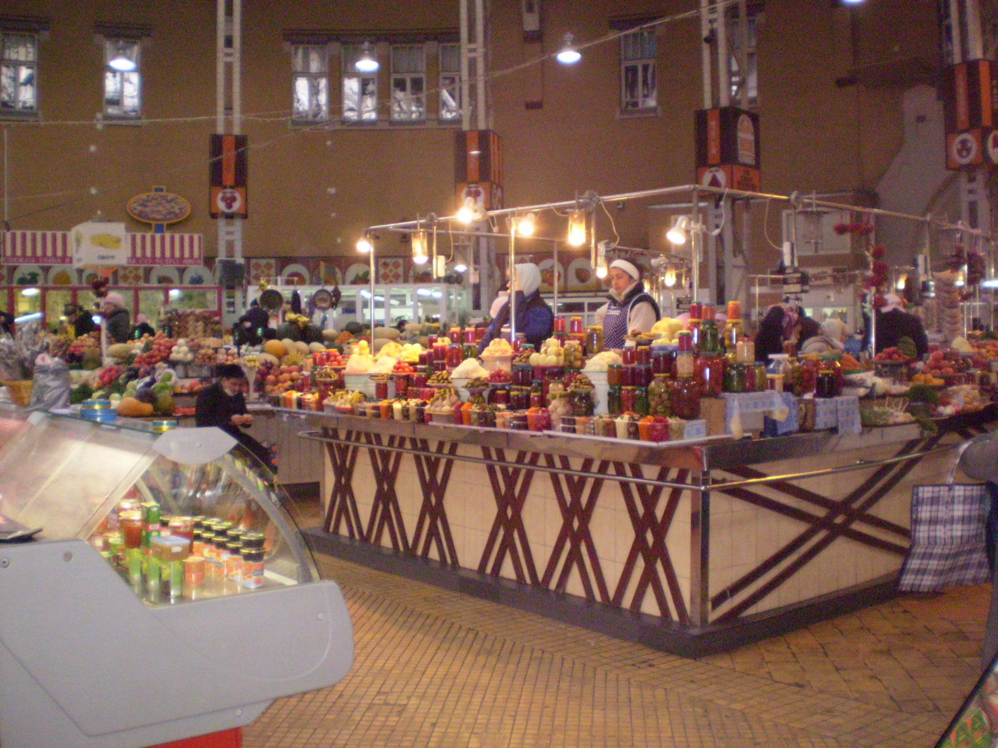

Slide 20
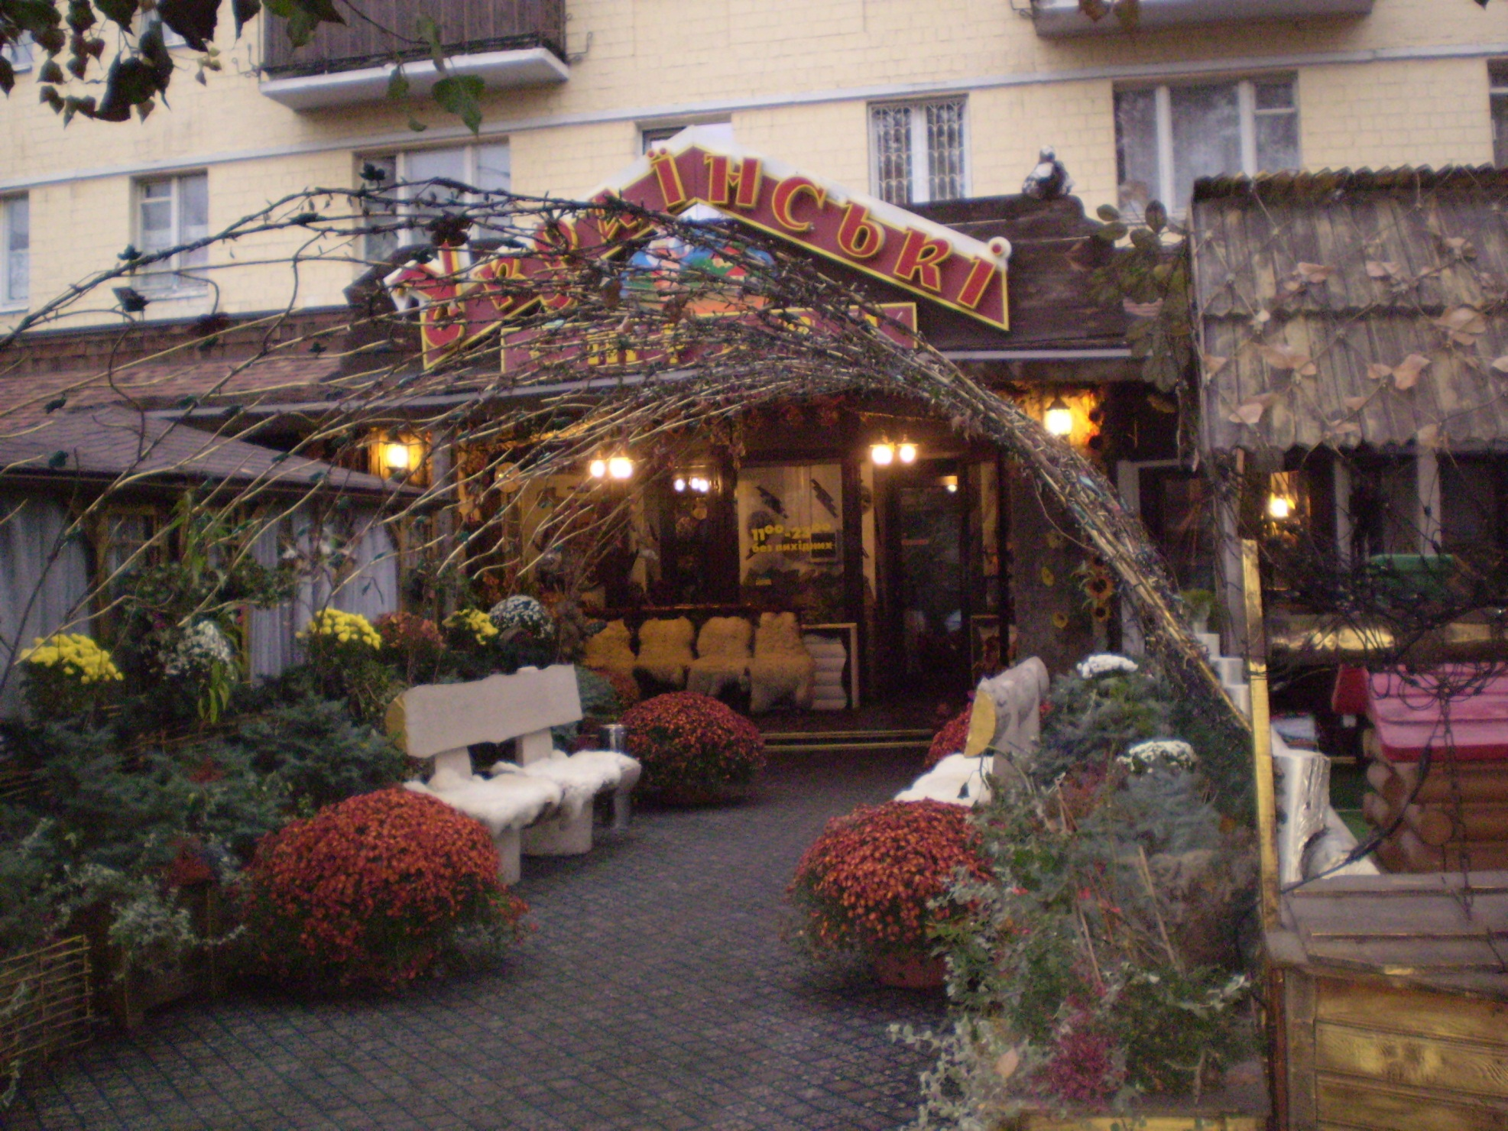
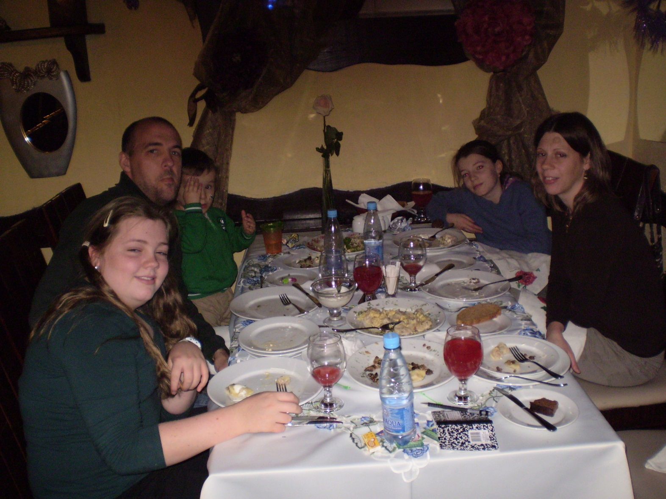

Slide 21
Saturday November 7
Out walking, taking pictures
Sightseeing at Kiev Pechersk Lavra, oldest monastery in Ukraine or Russia, with catacombs, with Jon & Ira Basenko
At St Vladimir’s Church, saw part of service with choir and Patriarch

Slide 22
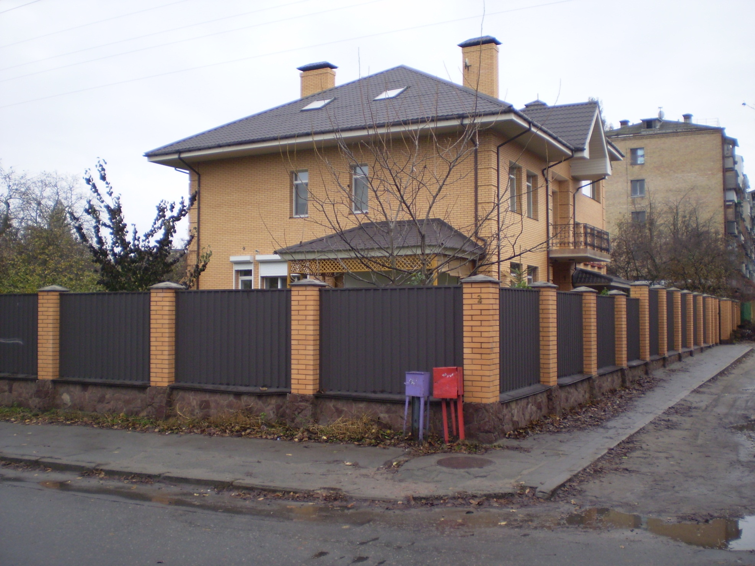
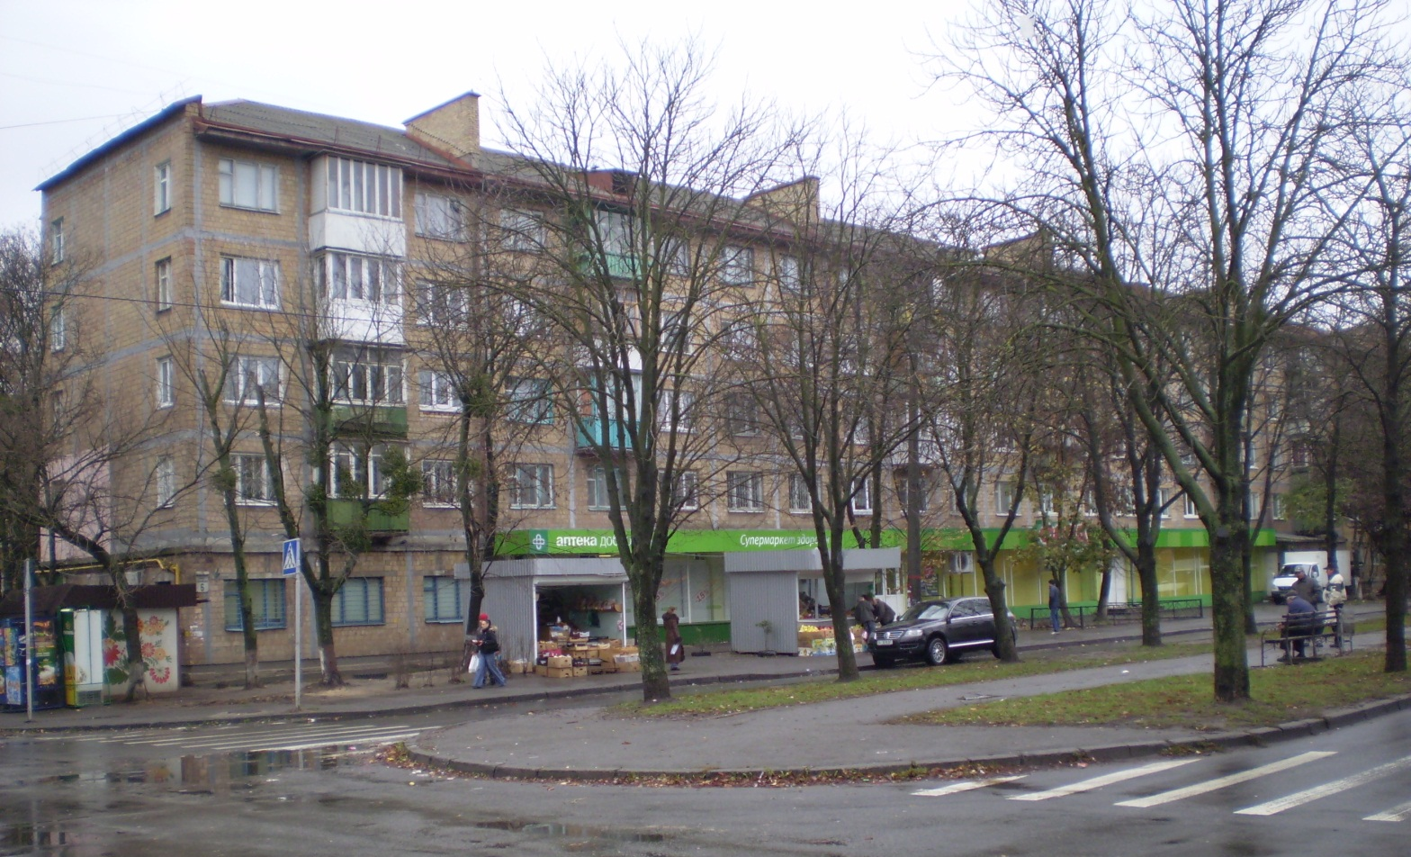

Slide 23
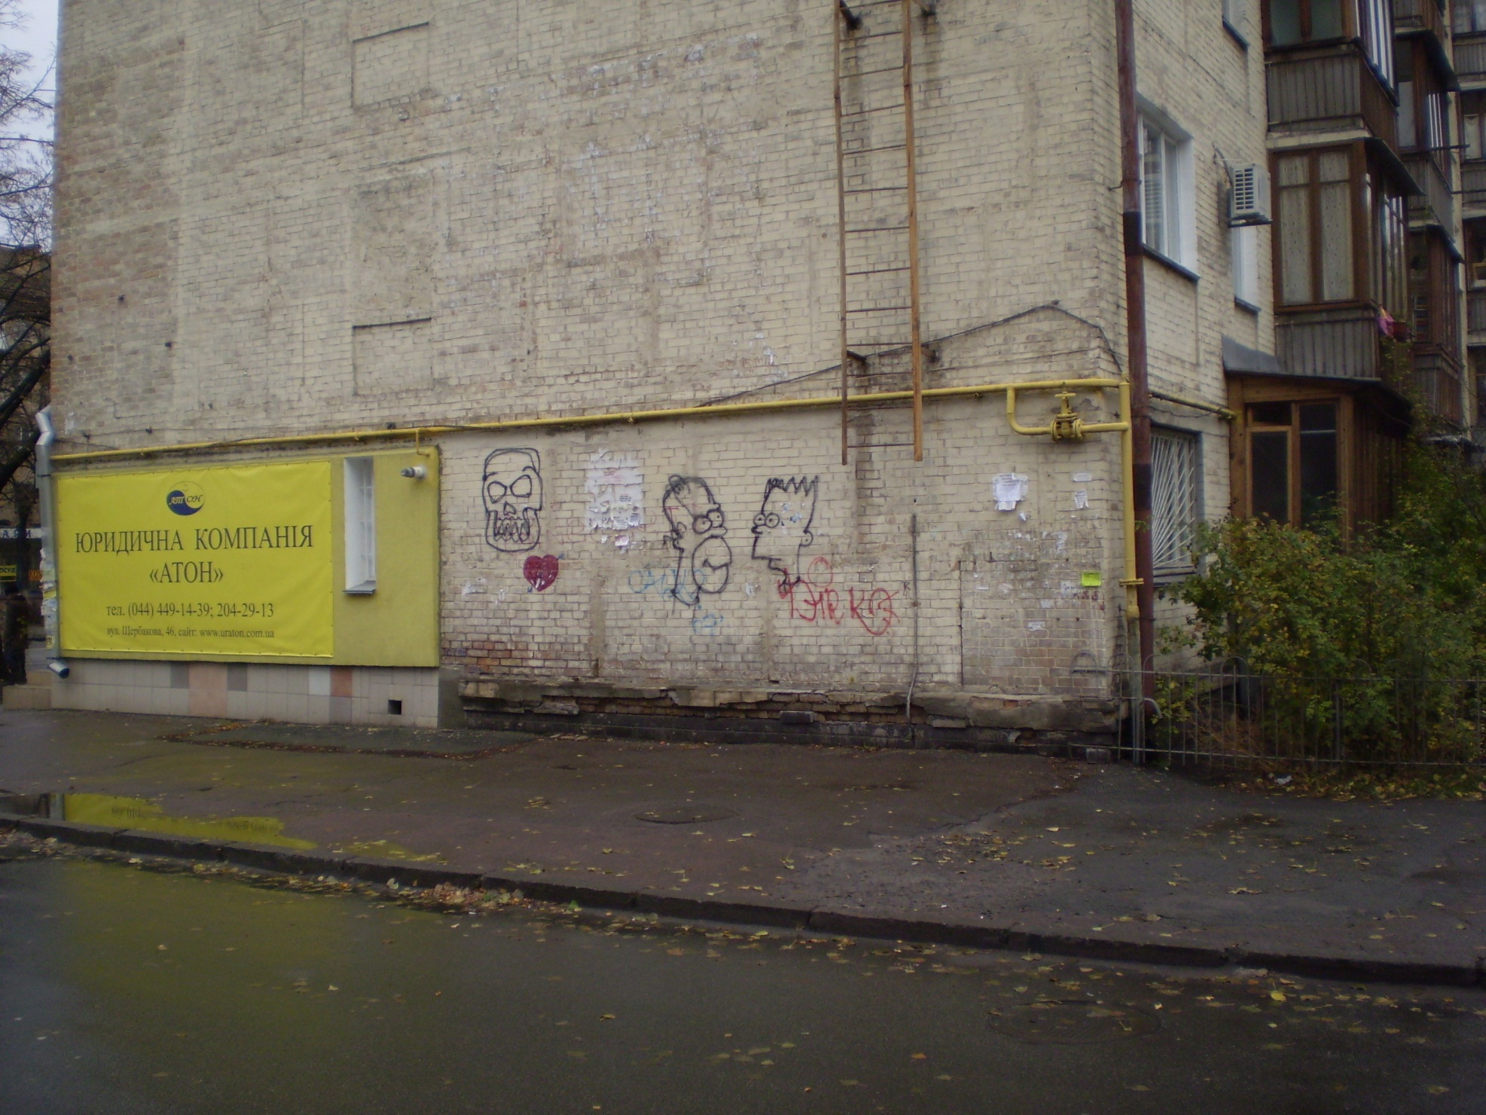
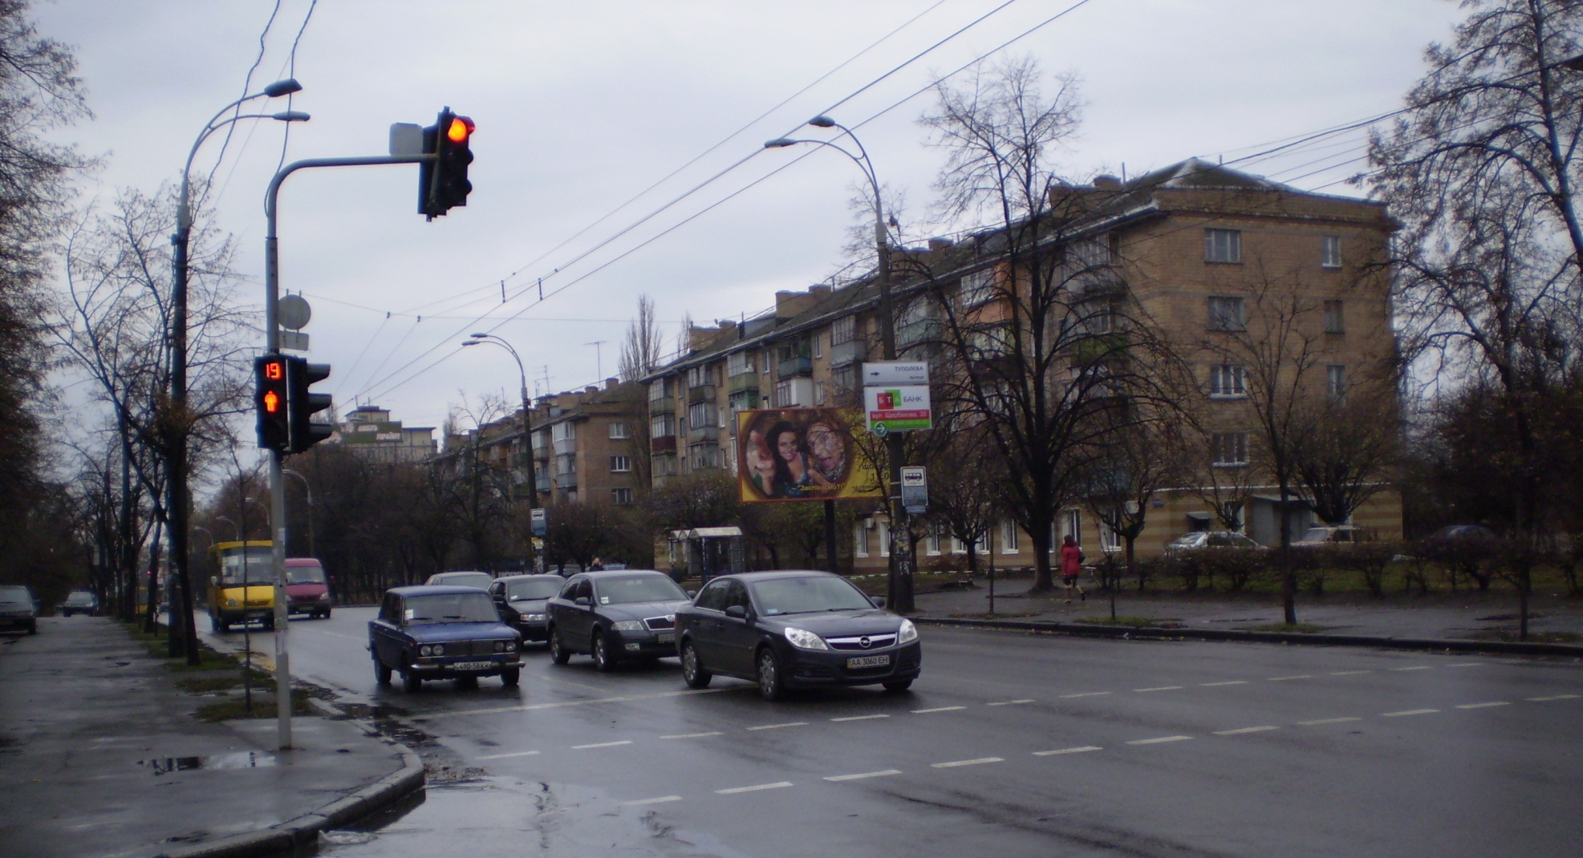

Slide 24
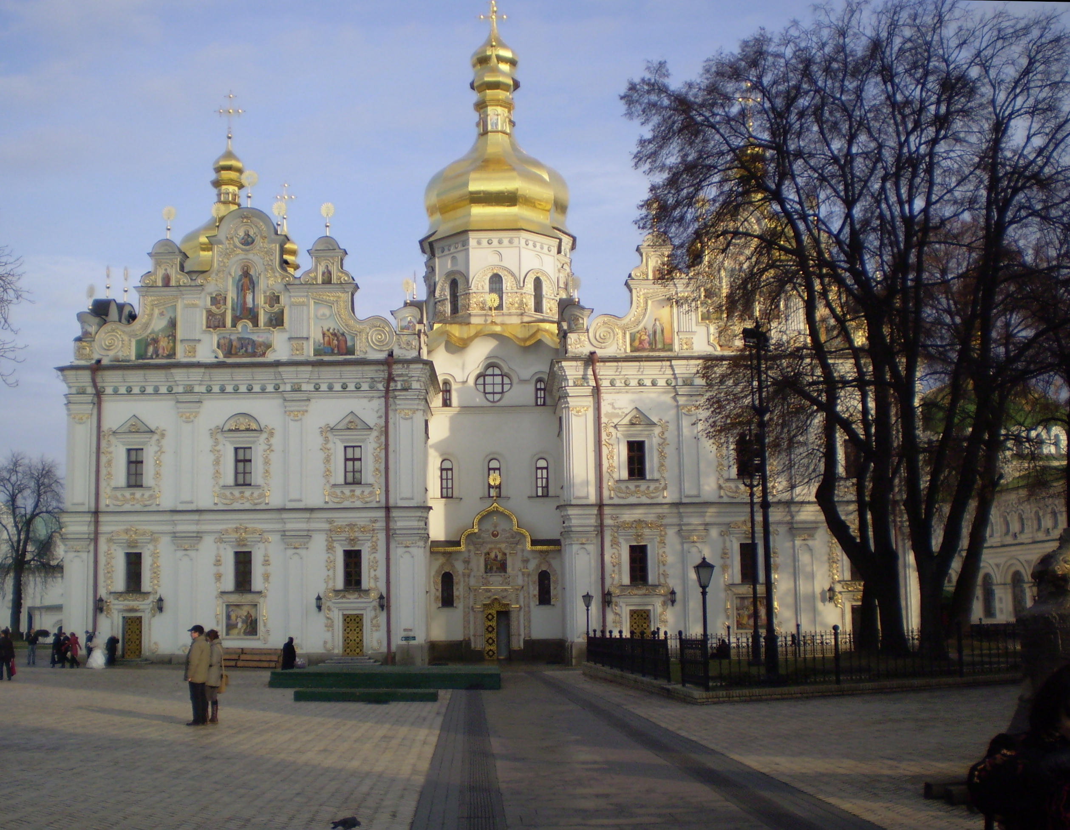
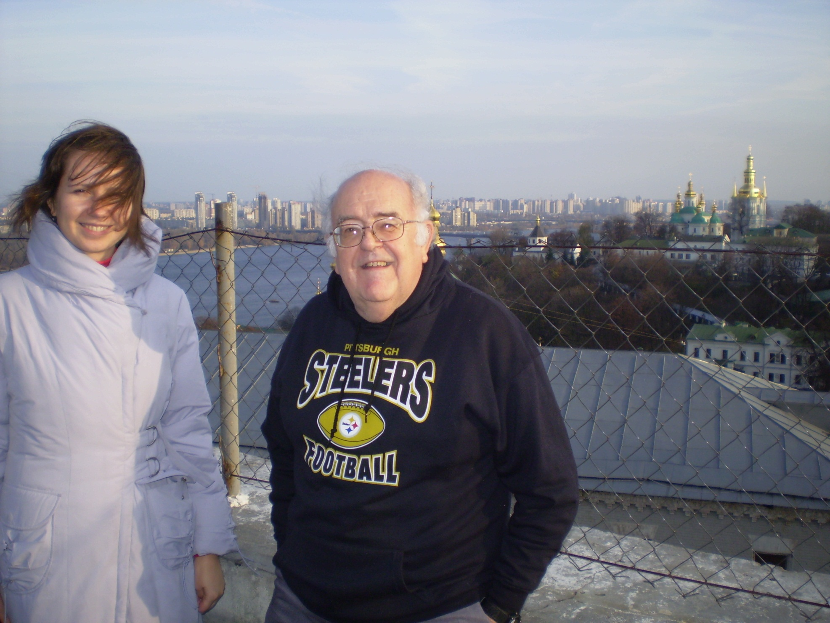

Slide 25
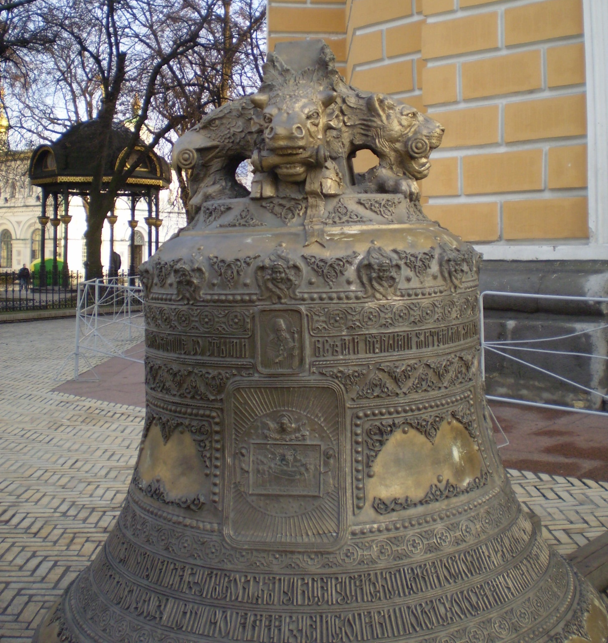
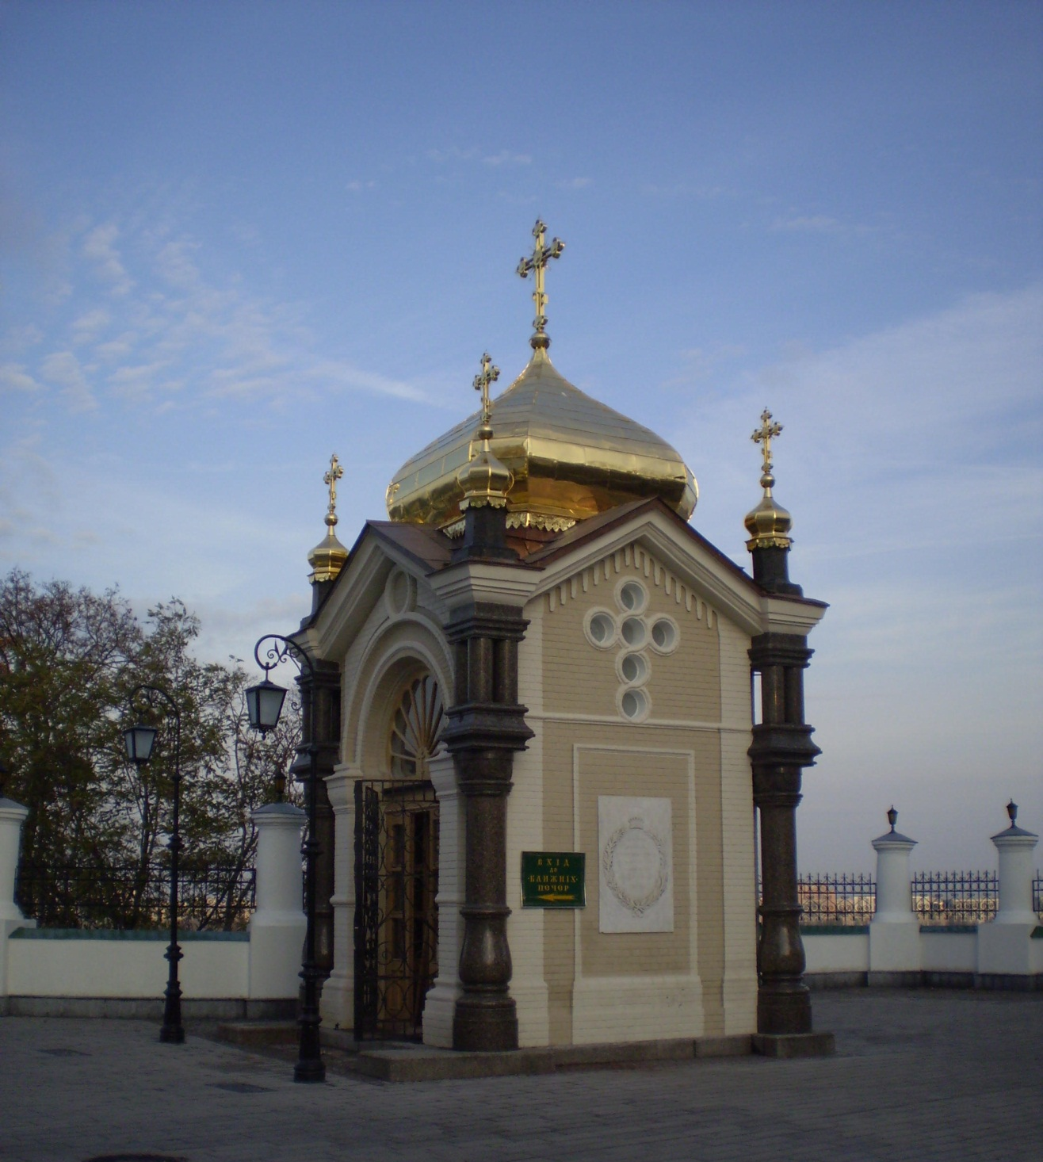

Slide 26
Sunday November 8
Preaching at Solomenski Presbyterian Reformed Church, using my Power-Point talk “Job”
Evening talk for members of Solomenski RC and Church of the Holy Trinity, using my Power-Point talk “Genetic Engineering and Cloning”

Slide 27
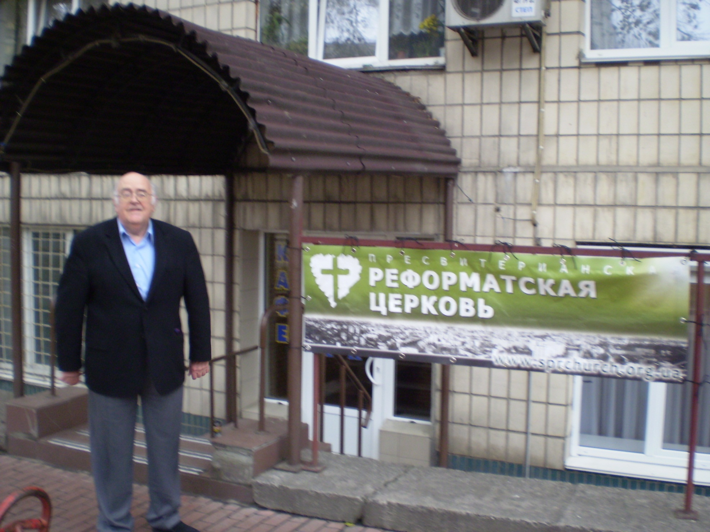
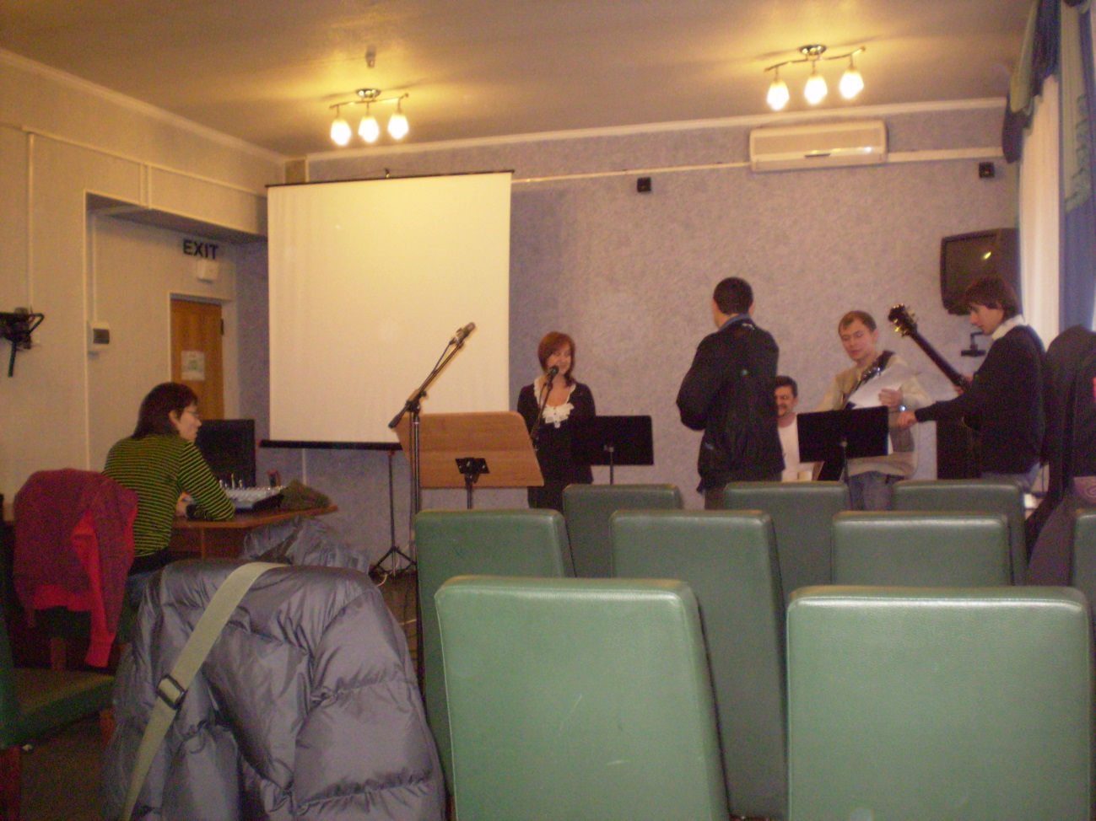

Slide 28
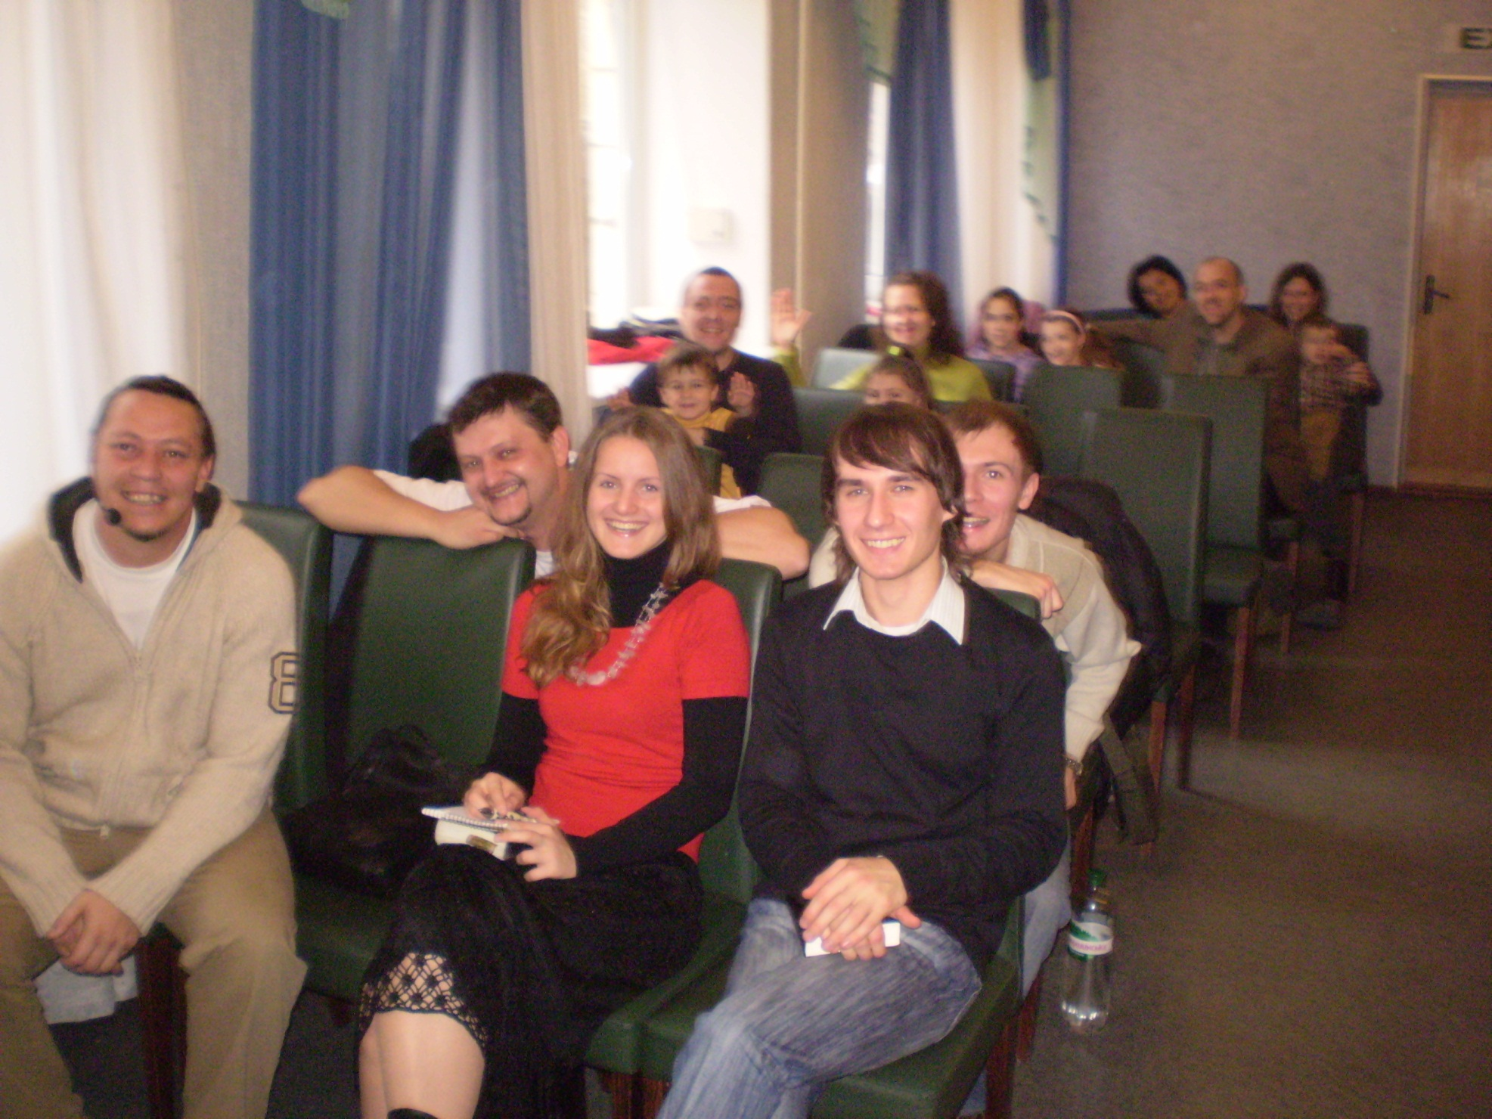
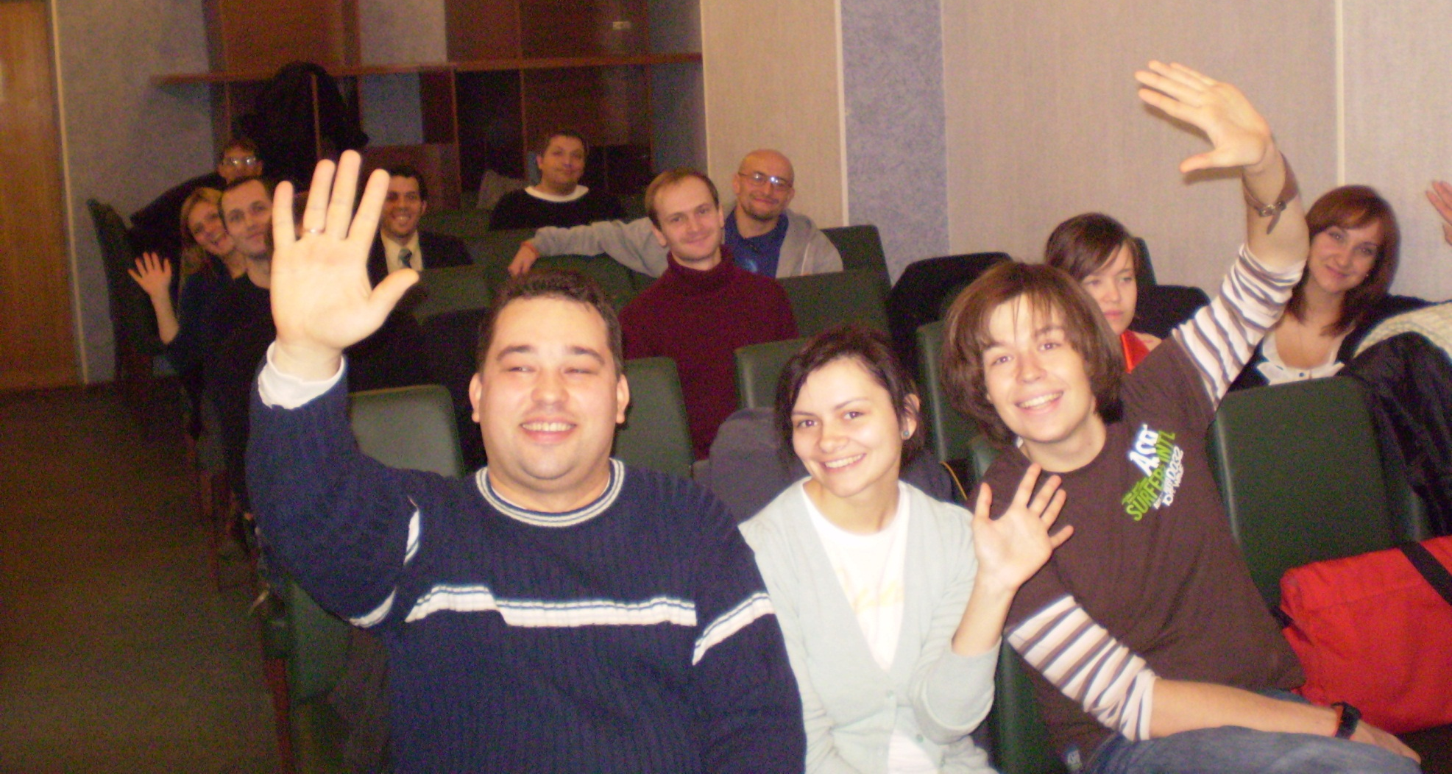

Slide 29
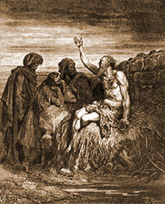
The Book of Job
Understanding Suffering
Robert C. Newman

Slide 30

Genetic Engineering & Cloning
Robert C Newman
& Bartholomew J Votta

Slide 31
Monday November 9
Visit with Nancy & Matthew Westerhal
  Matthew (son) a senior at Kiev Christian Academy, to talk about science study in US
  Mother Nancy is a doctor
  Father Tom teaches at Pentecostal Seminary
Afternoon visit with Dara Reshitina, recent HS grad, very fluent in English
Dinner at home of Jos, Marlies & Christian Colijn; Jos is academic dean of Evangelical Reformed Seminary Ukraine

Slide 32
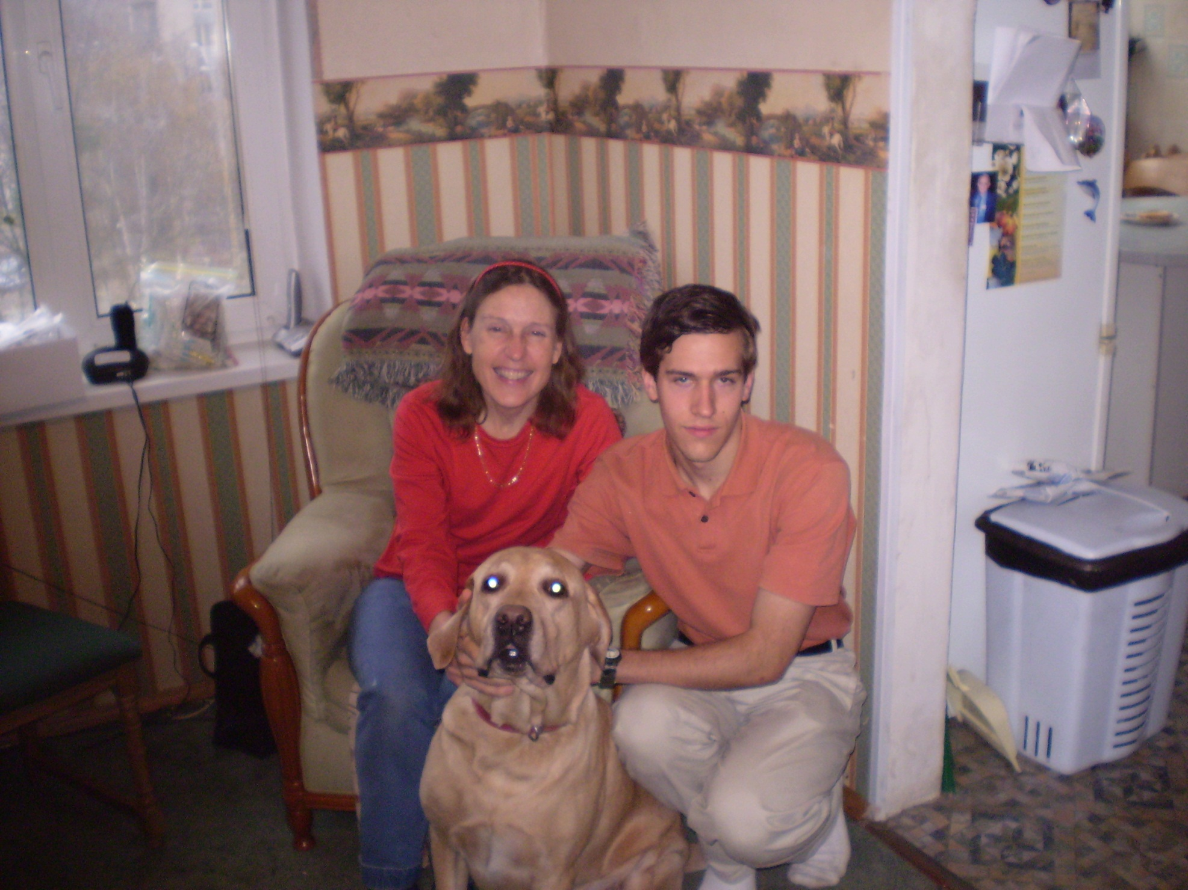

Slide 33
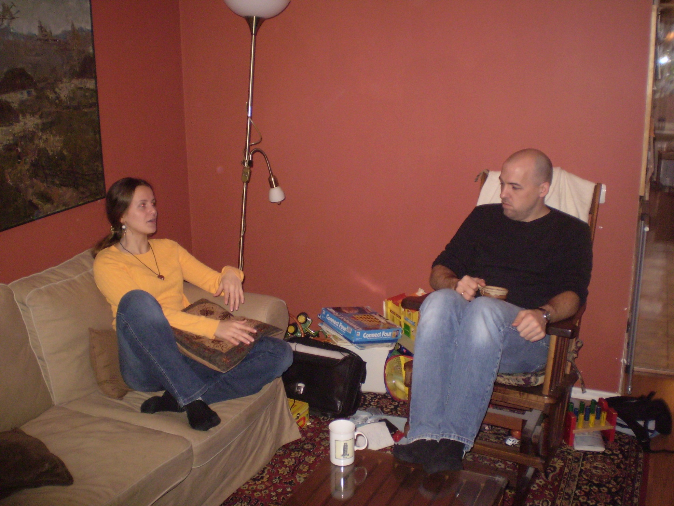

Slide 34
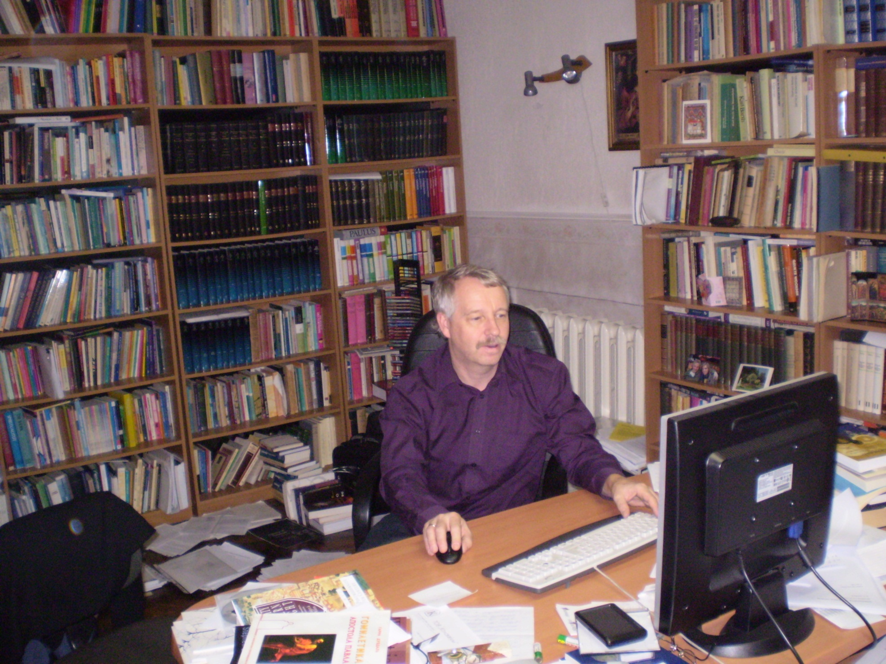
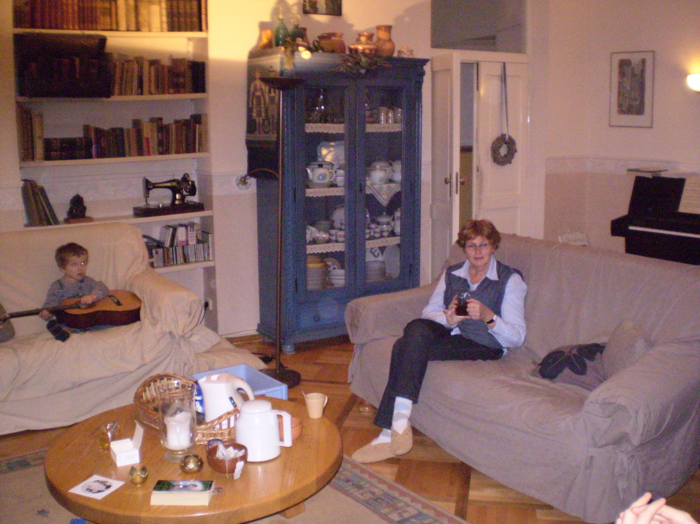

Slide 35
Tuesday November 10
Sightseeing:
  St Andrew’s Descent
  Lunch at Cafeteria
English Club at Clemmer’s apartment
  About 15 present
  Talked about popular superstitions, both Ukrainian and American
  Gave my Power-Point talk “Astrology”

Slide 36
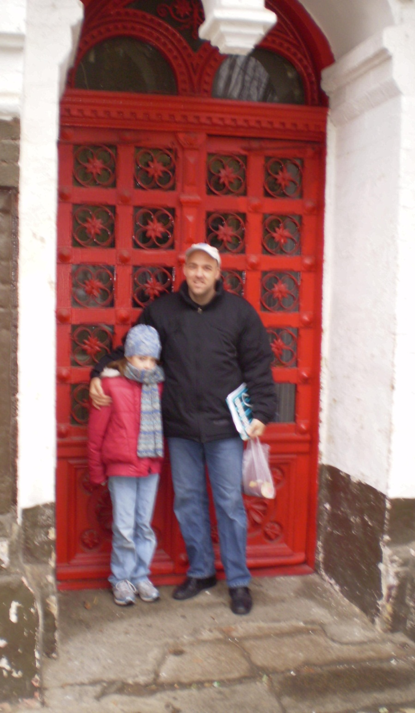
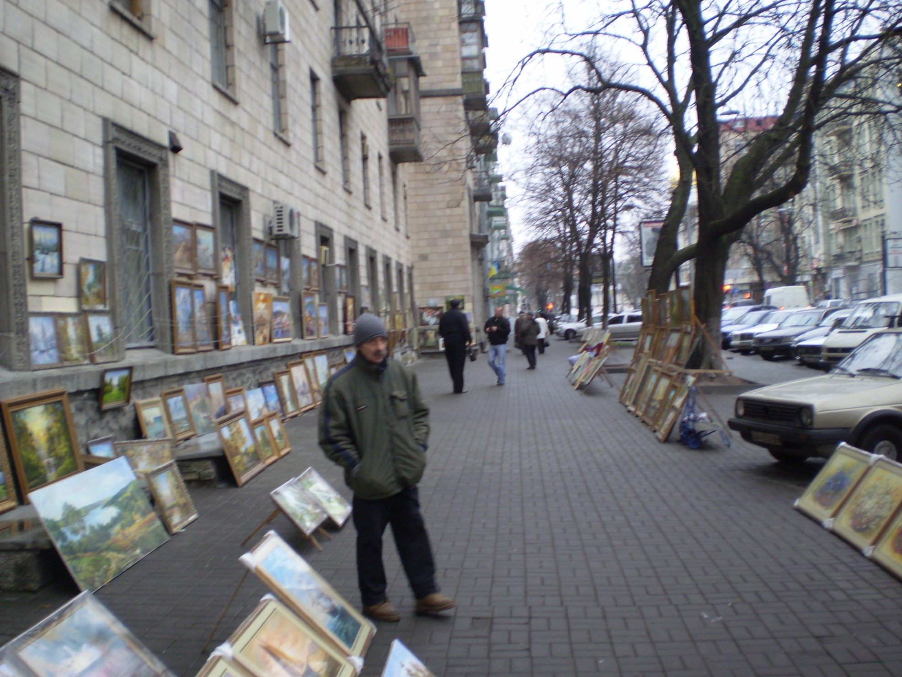

Slide 37
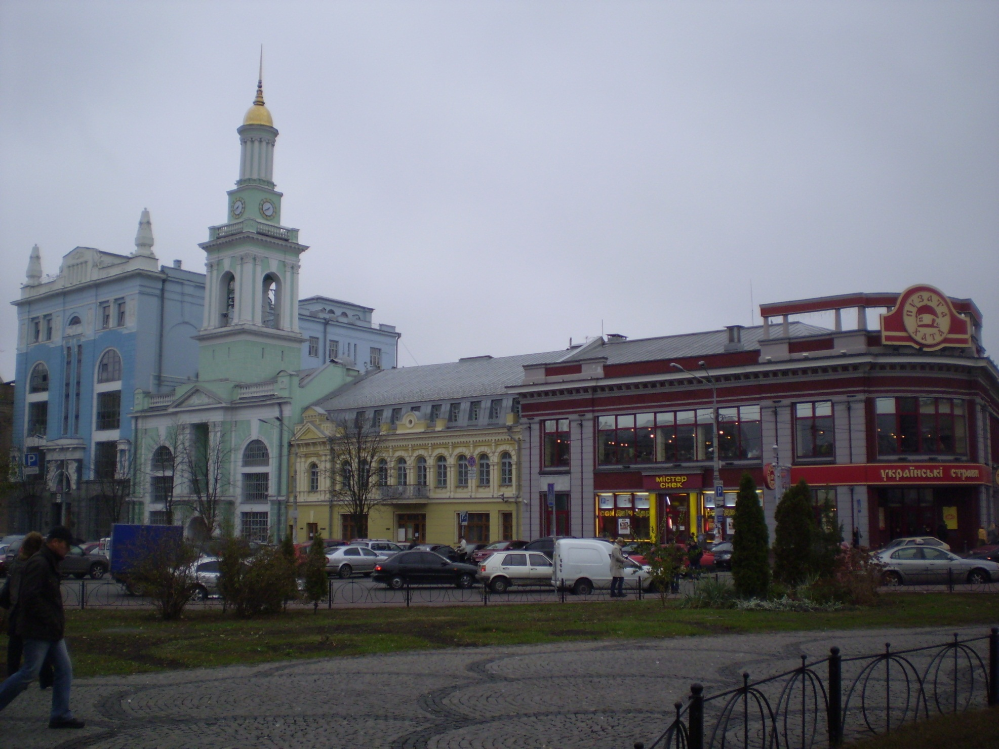
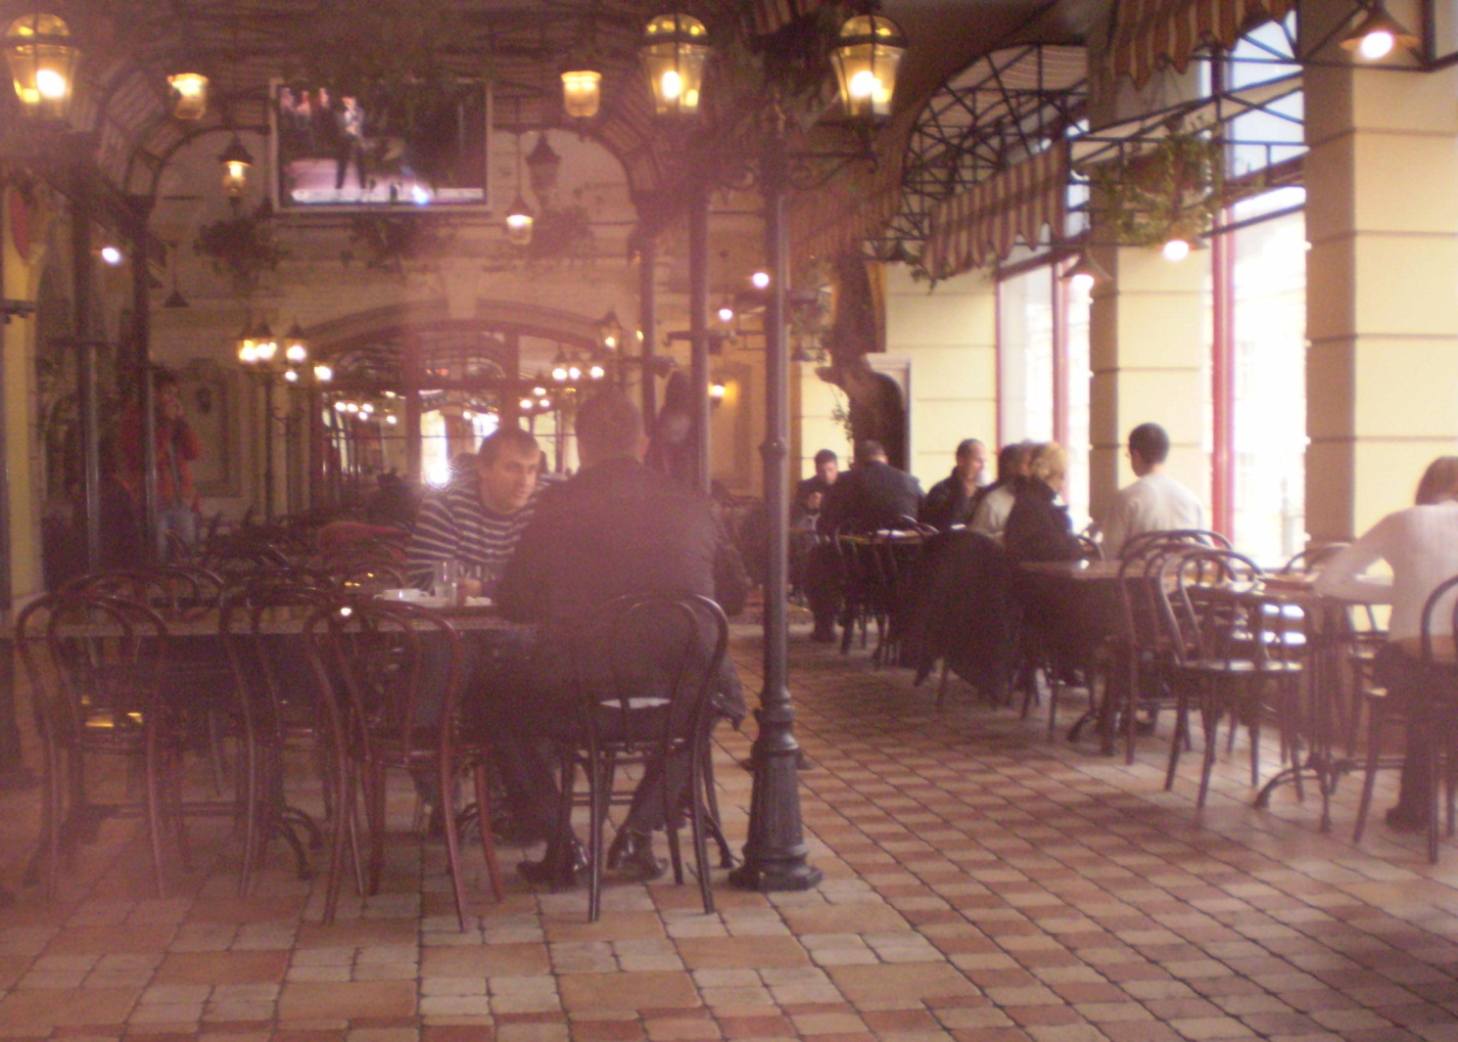

Slide 38
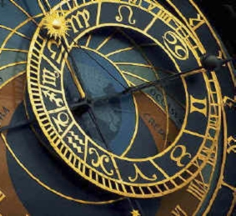
Astrology:
Is Your Destiny in the Stars?
Robert C. Newman
Biblical Seminary

Slide 39
Wednesday November 11
Visit to Stitenko Cemetery with Jon & Zhenya Nestra
Stopped by Babi Yar Memorial
  Over 100 thousand people killed here by Nazis: Jews, Ukrainians, Gypsies, etc.
Tour of Chernobyl Museum
  Where nuclear power station blew up in April 1986
  Site is abandoned, along with 20 mi radius around it, reaching to 40 mi from Kiev

Slide 40
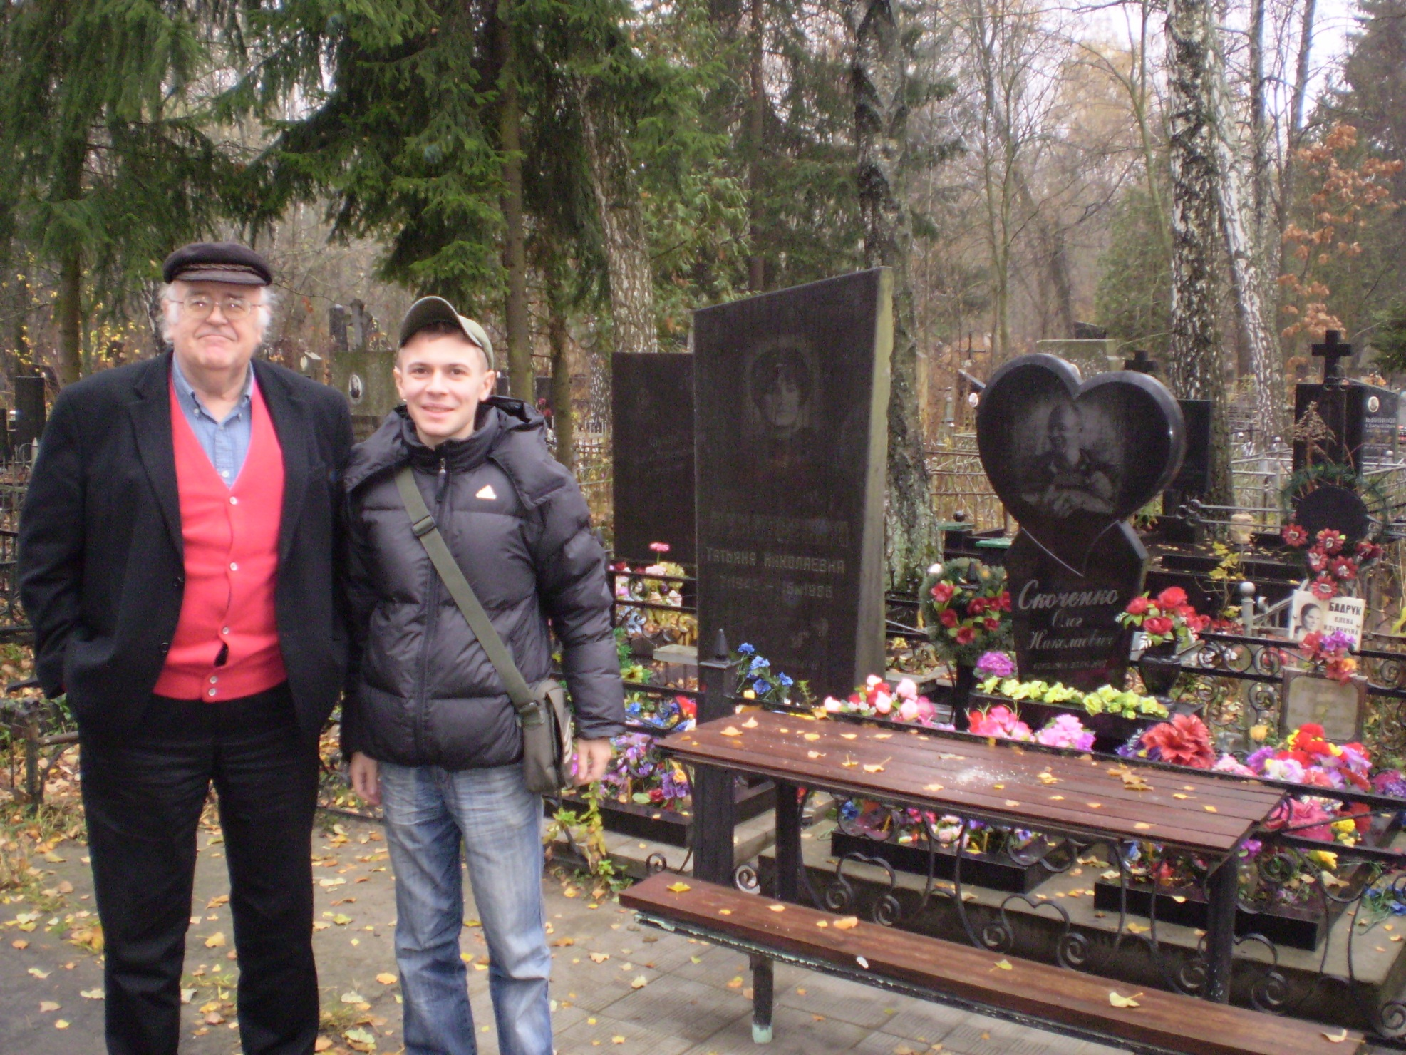
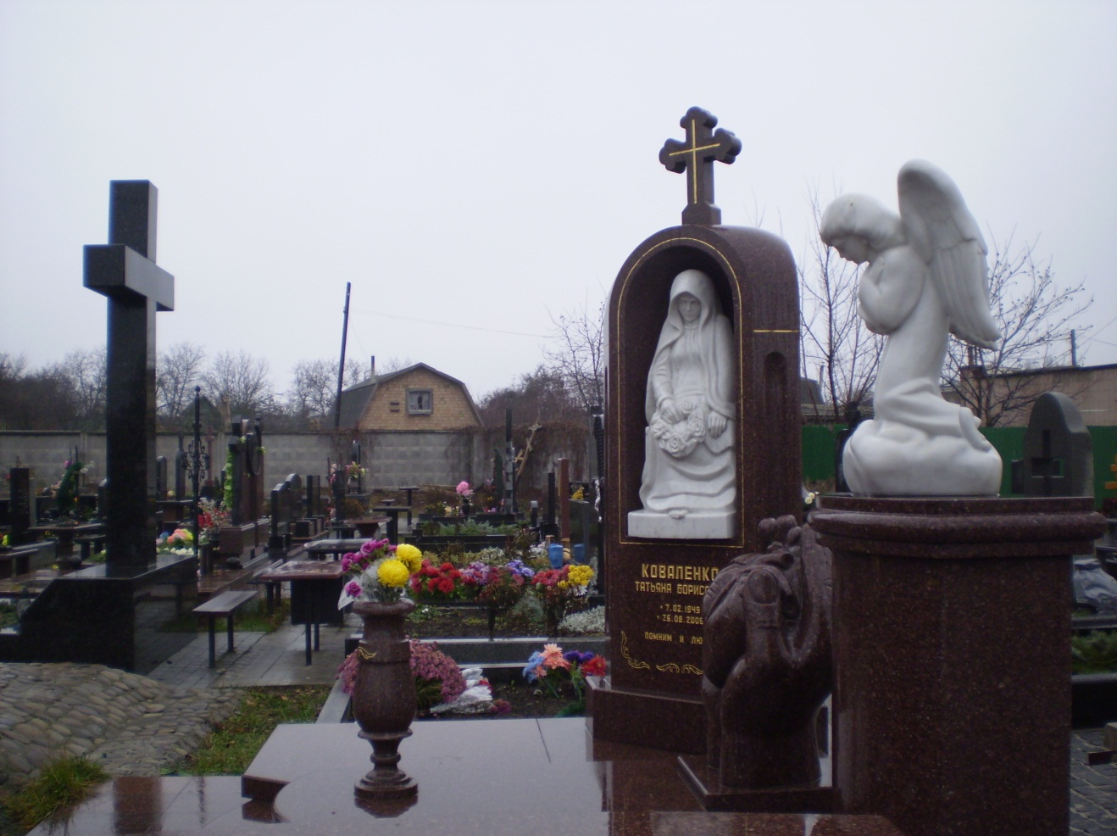

Slide 41
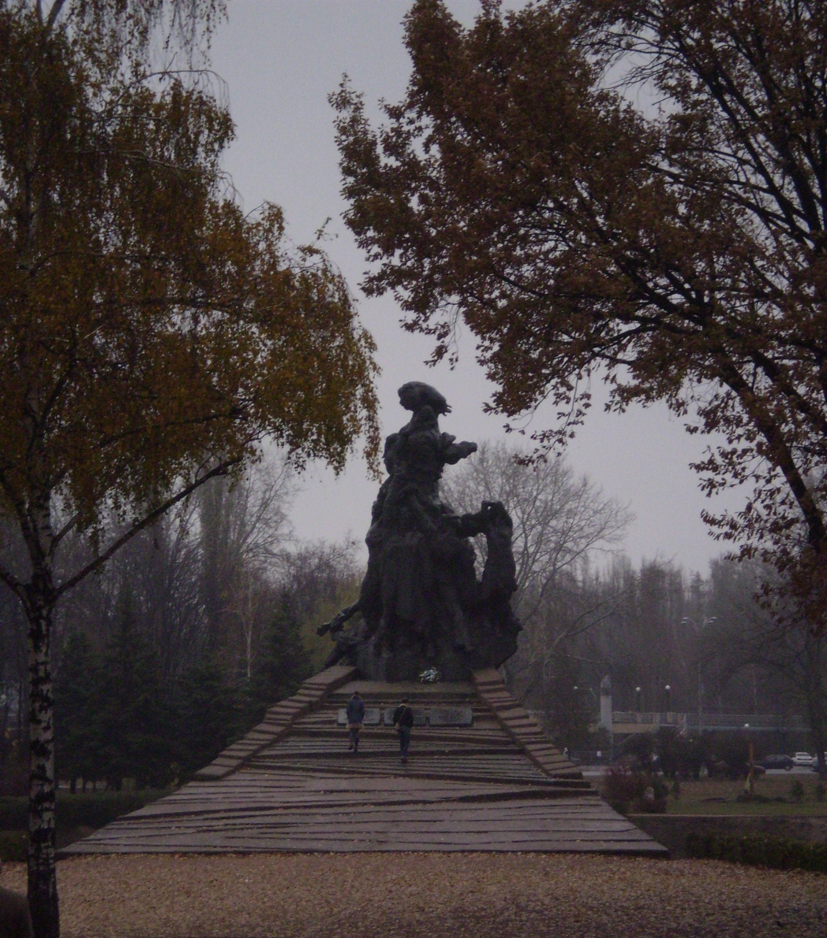
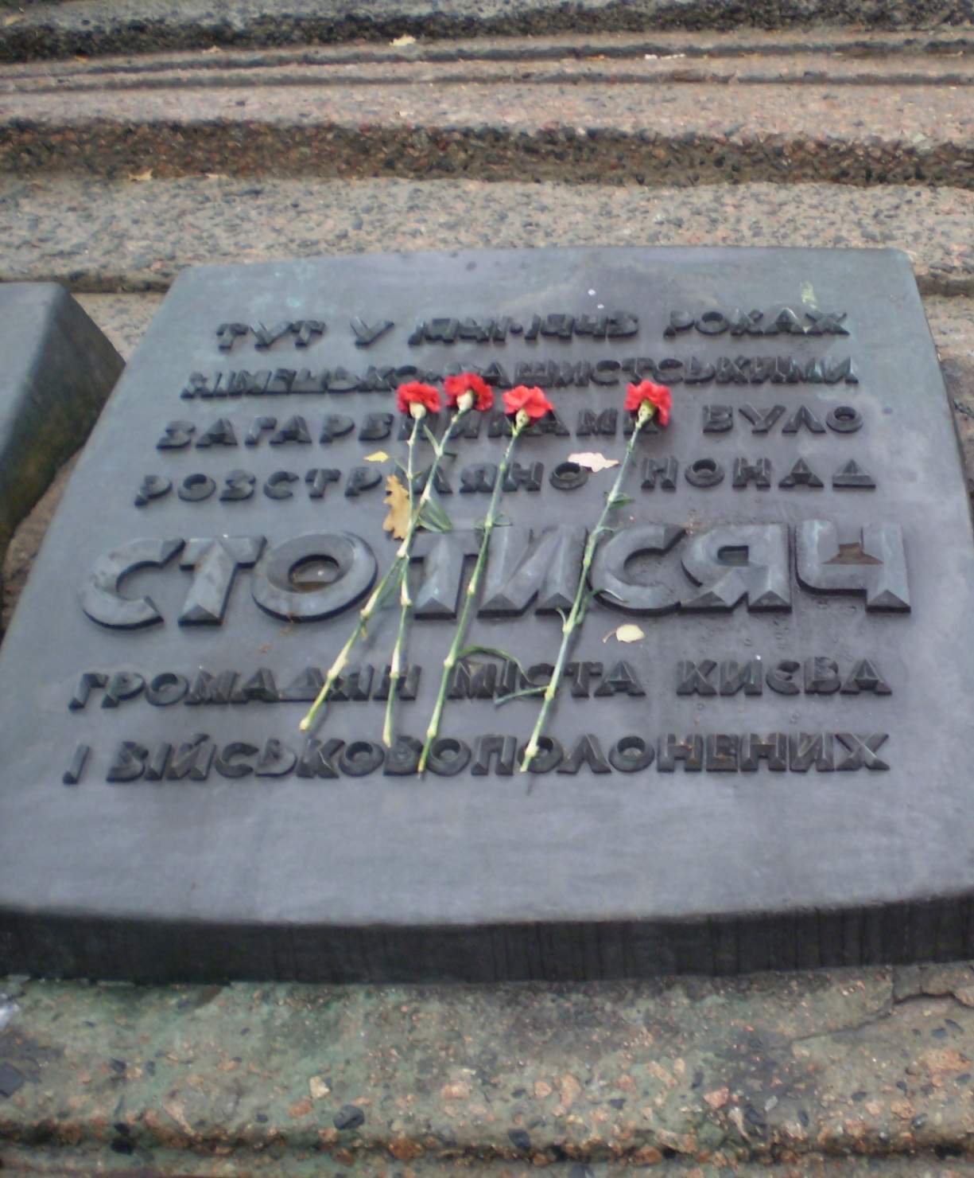

Slide 42
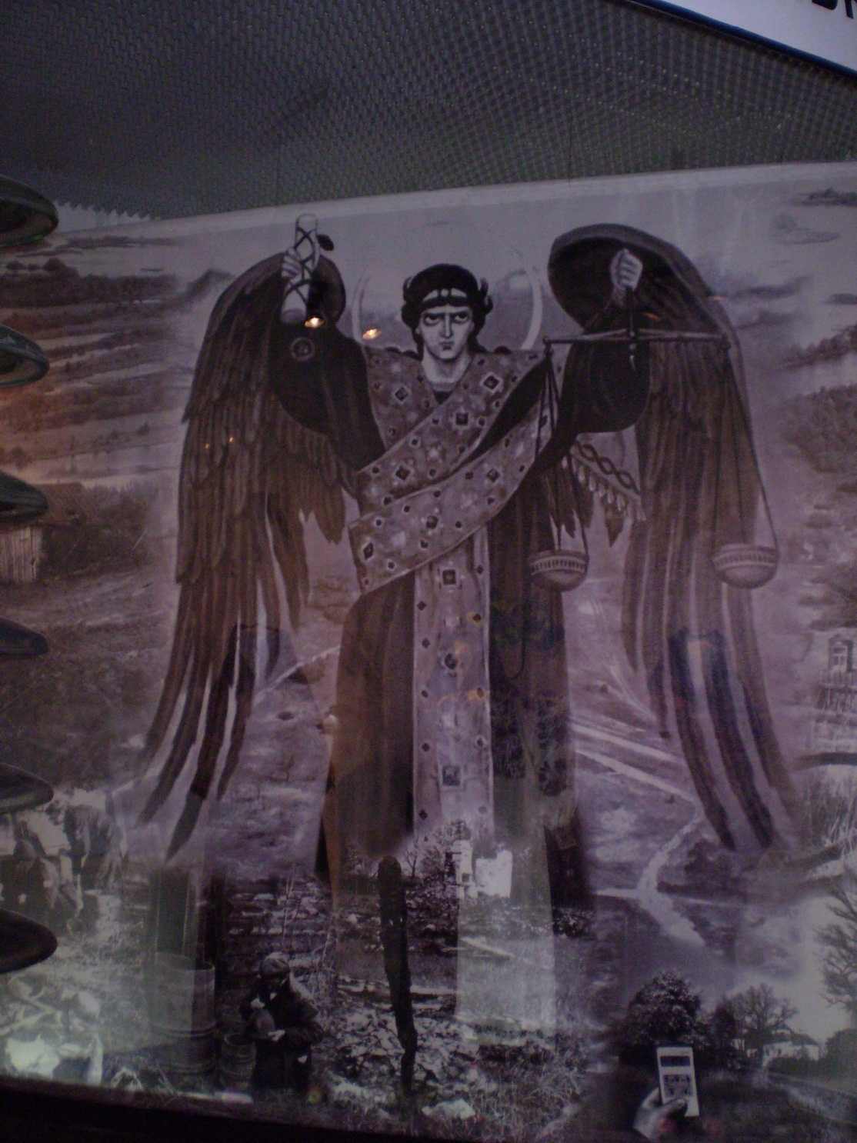
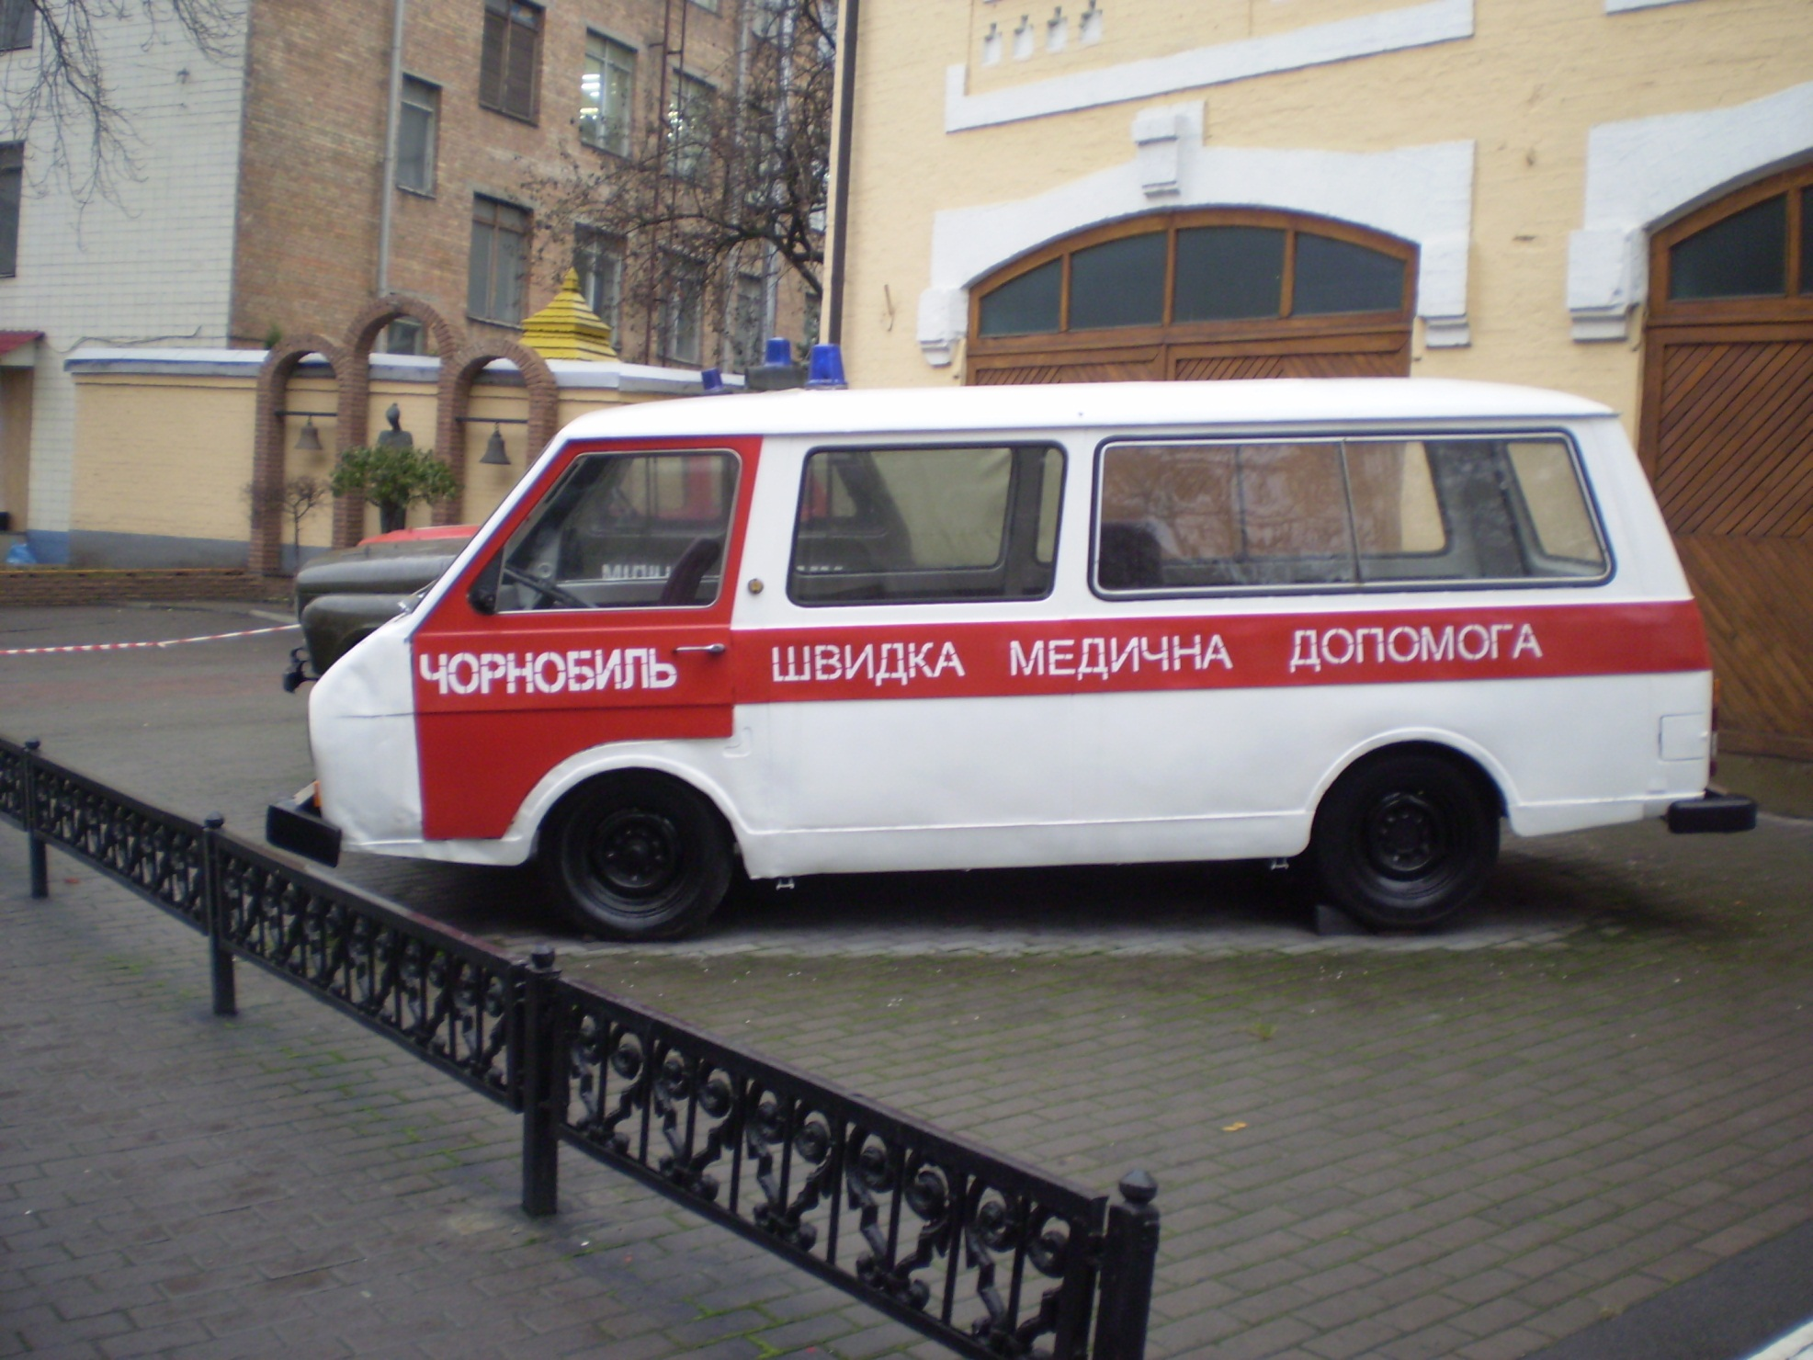

Slide 43
Thursday November 12
Up 2:45 am
Depart Kiev 7:08 am
Arrive Amsterdam 8:46 am
Depart Amsterdam 1:48 pm
Arrive Atlanta 4:55 pm
Depart Atlanta 8:29 pm
Arrive Charlottesville 10:01 pm

Slide 44
The End
Pray for the Ukraine

