Slide 1
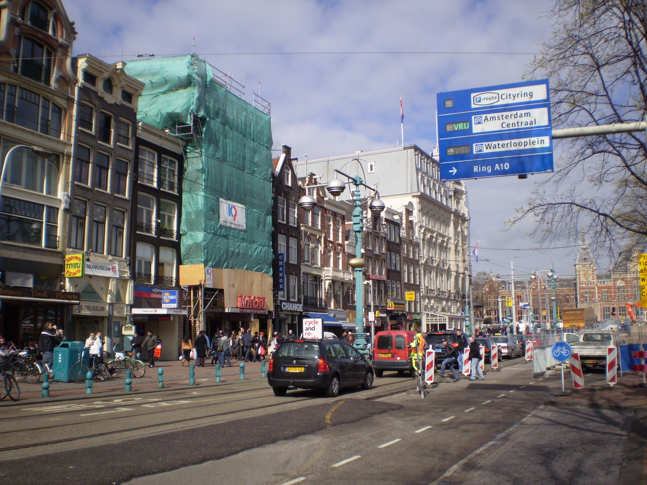

2008 Europe Ministry
Robert C. Newman

Slide 2
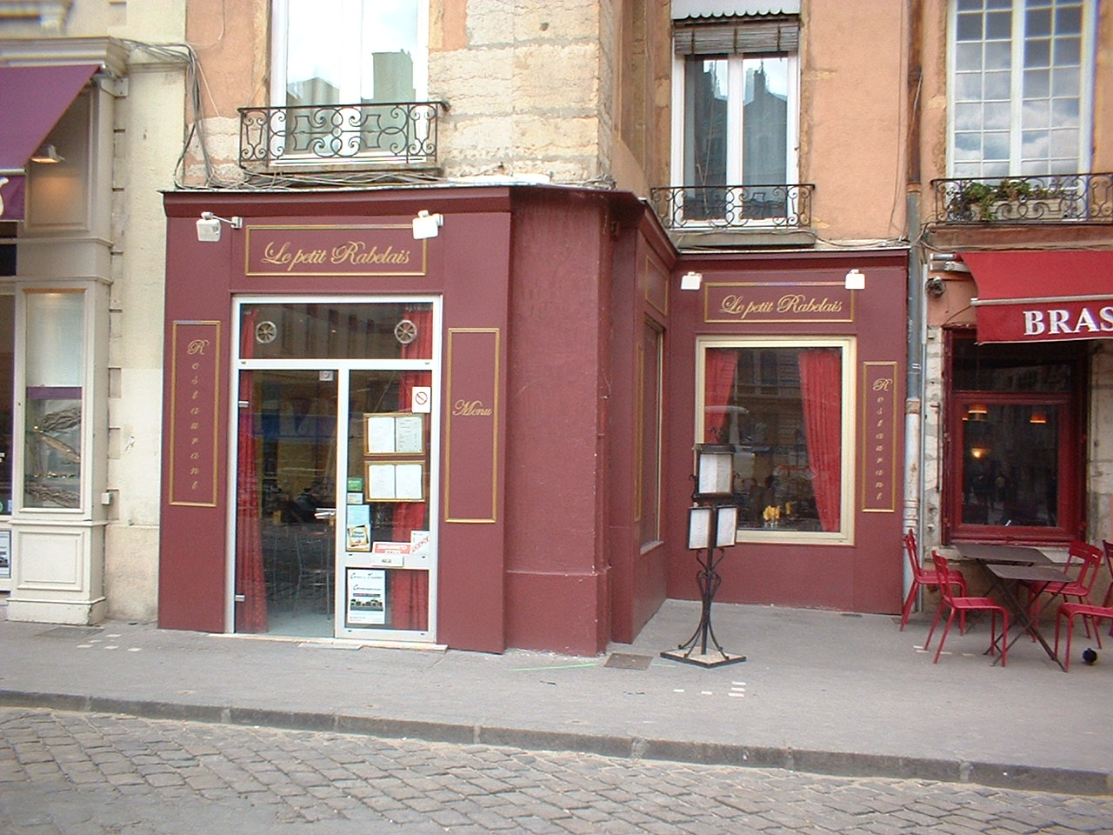
Europe Ministry
International Christian Community, Lyon, France
L’Abri, Switzerland
Tyndale Theological Seminary, Amsterdam, Netherlands
Turkish Fellowship, Cologne, Germany

Slide 3
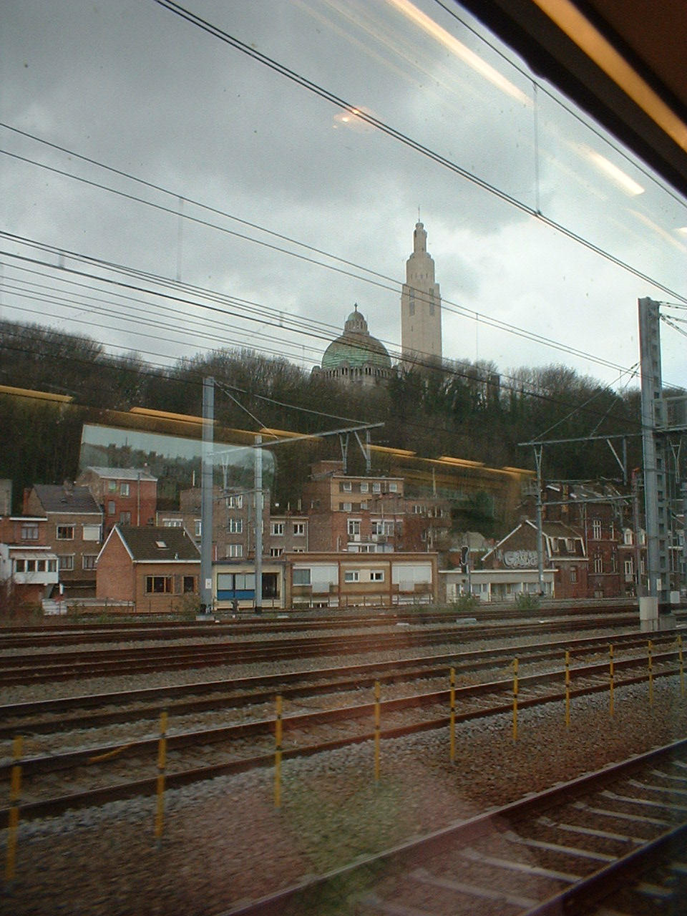
Charlottesville to Lyon
March 17: Charlottesville to Dulles (air)
March 17-18: Dulles to Munich (air)
March 18: Munich to Cologne (air)
March 18: Cologne to Lyon via Paris (train)

Slide 4
Lyon, March 18-24
March 19: Tour of Lyon
March 20-21: Seminar for professional, educated non-Christians
March 22: Breakfast at home of Pastor Florent Varak w/ scientists
March 22: Evening with youth group on origins issues
March 23: Easter Sunrise Service
March 24: Depart for Switzerland

Slide 5
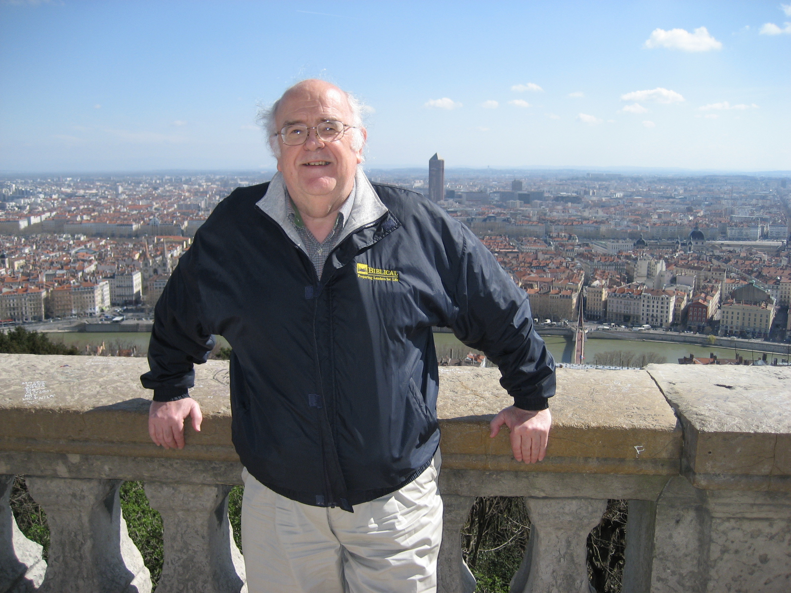
March 19: Tour of Lyon

Slide 6
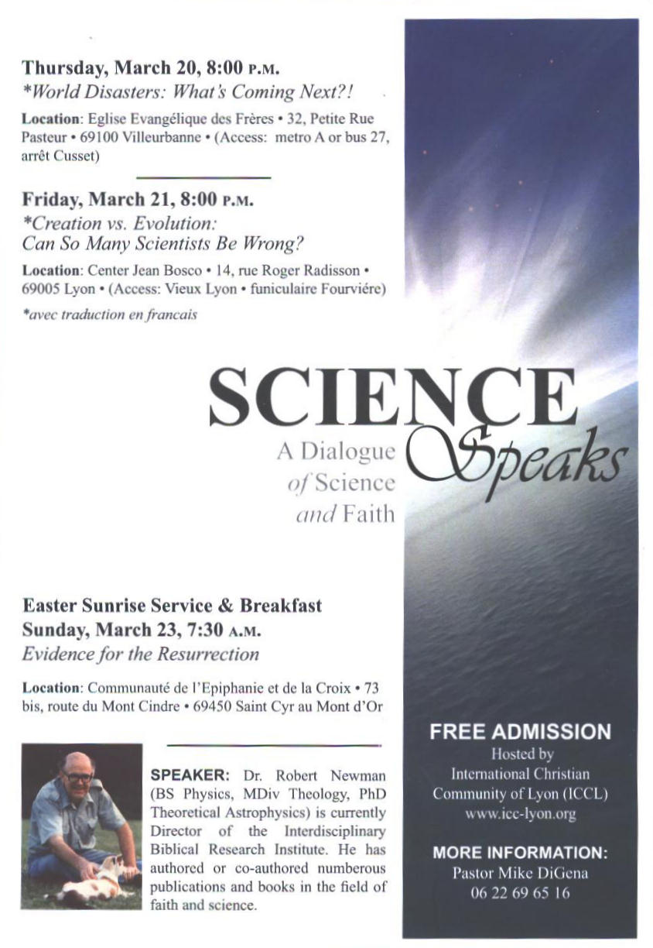
Science Speaks Seminar

Slide 7
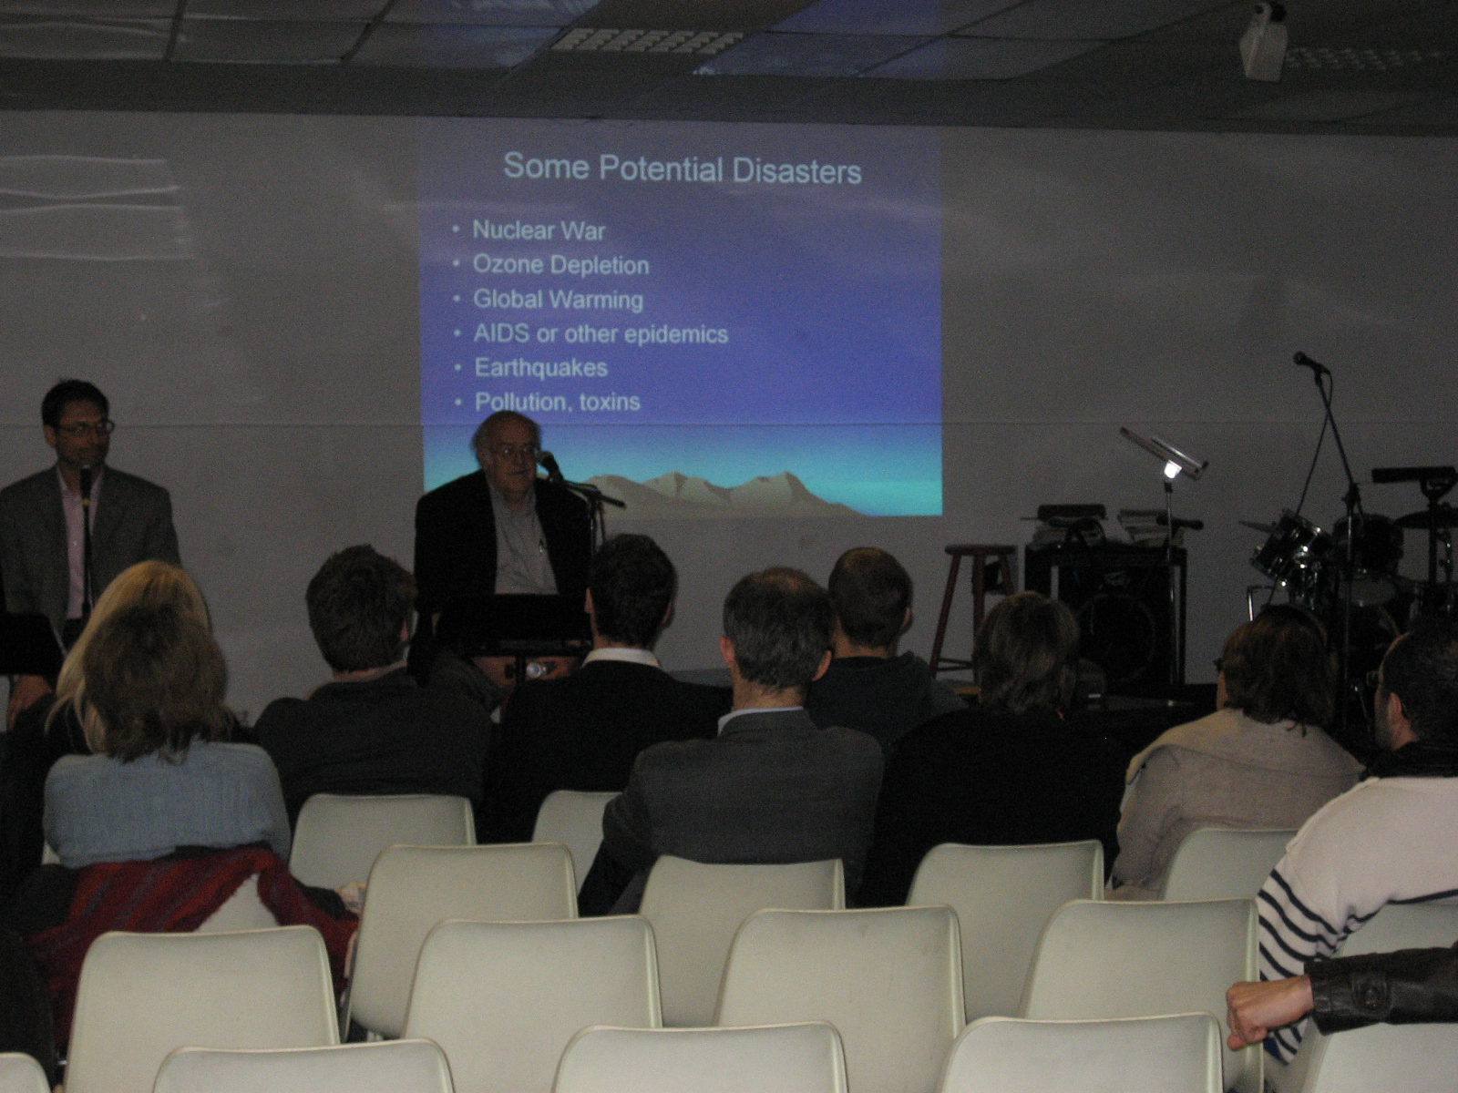
March 20: "World Disasters"

Slide 8
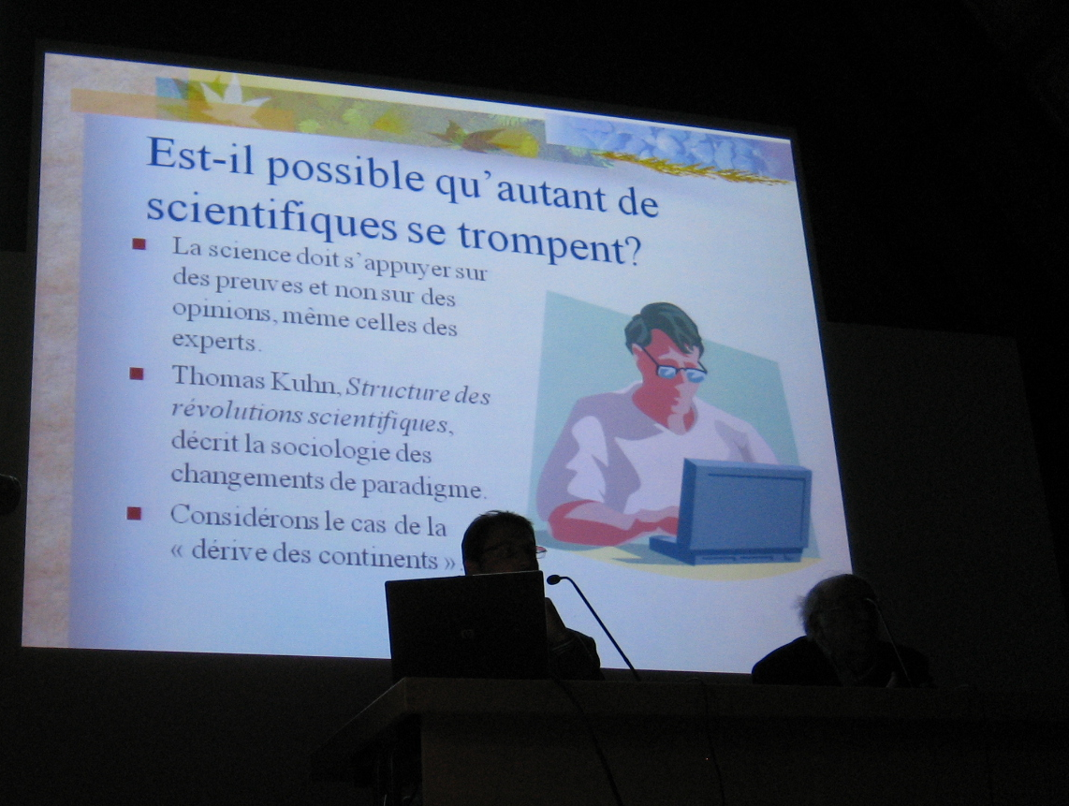
March 21: "Creation vs Evolution"

Slide 9
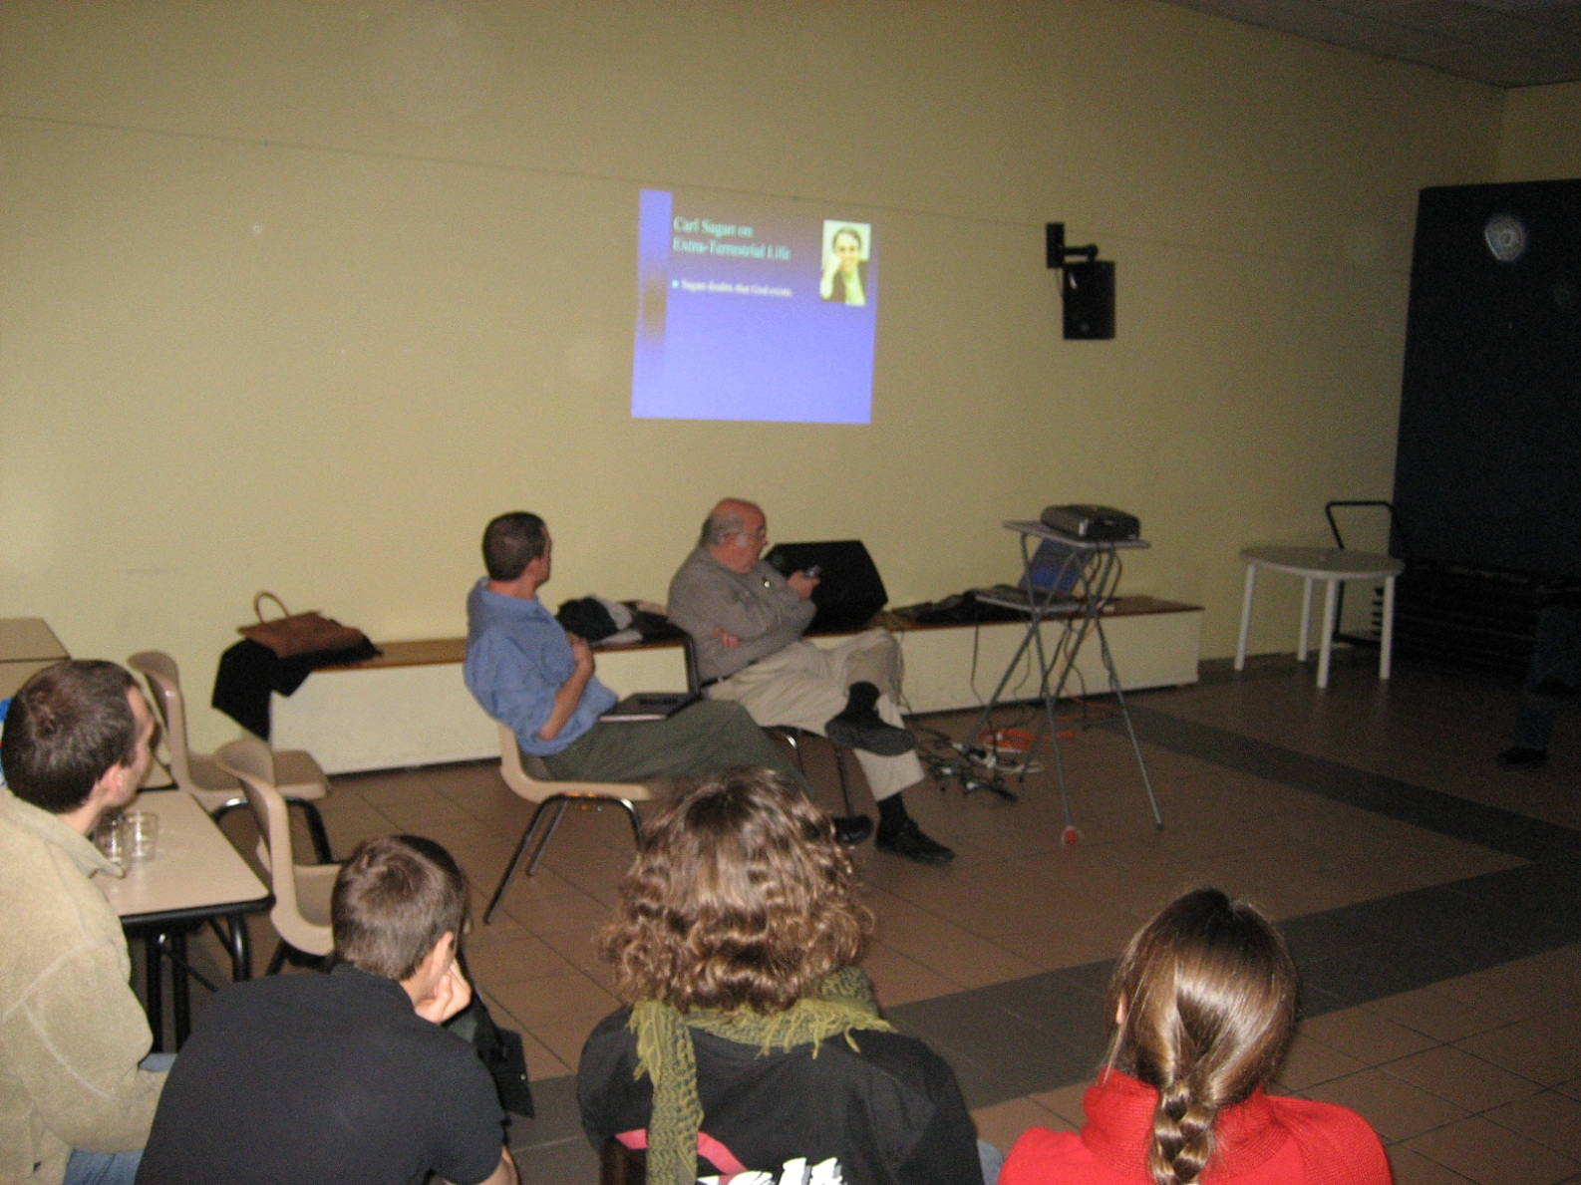
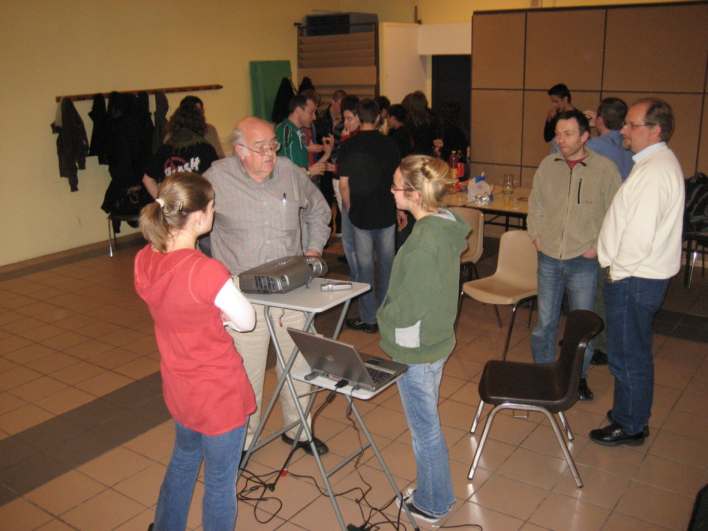
March 22: Youth Group

Slide 10
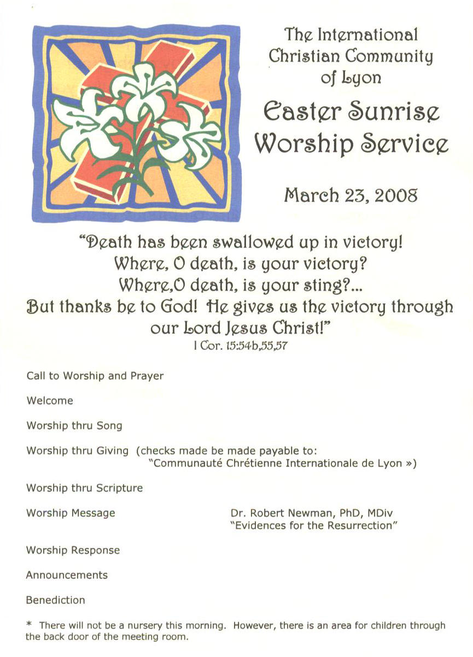
Easter Sunrise Service

Slide 11
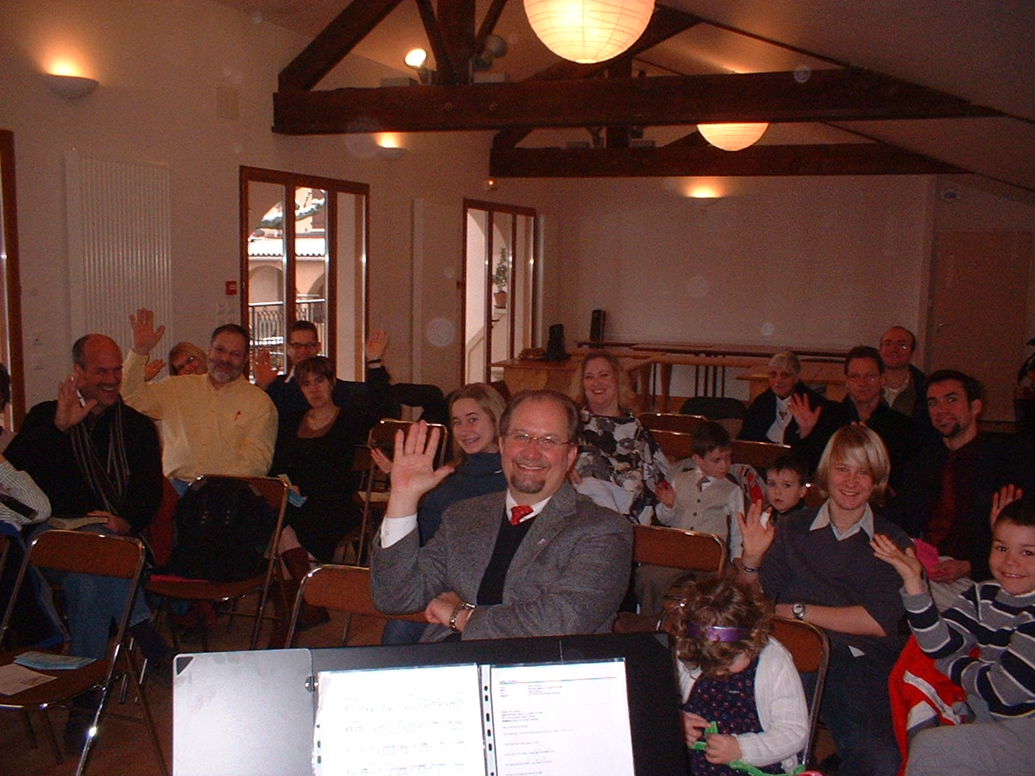
March 23: Easter Sunrise

Slide 12
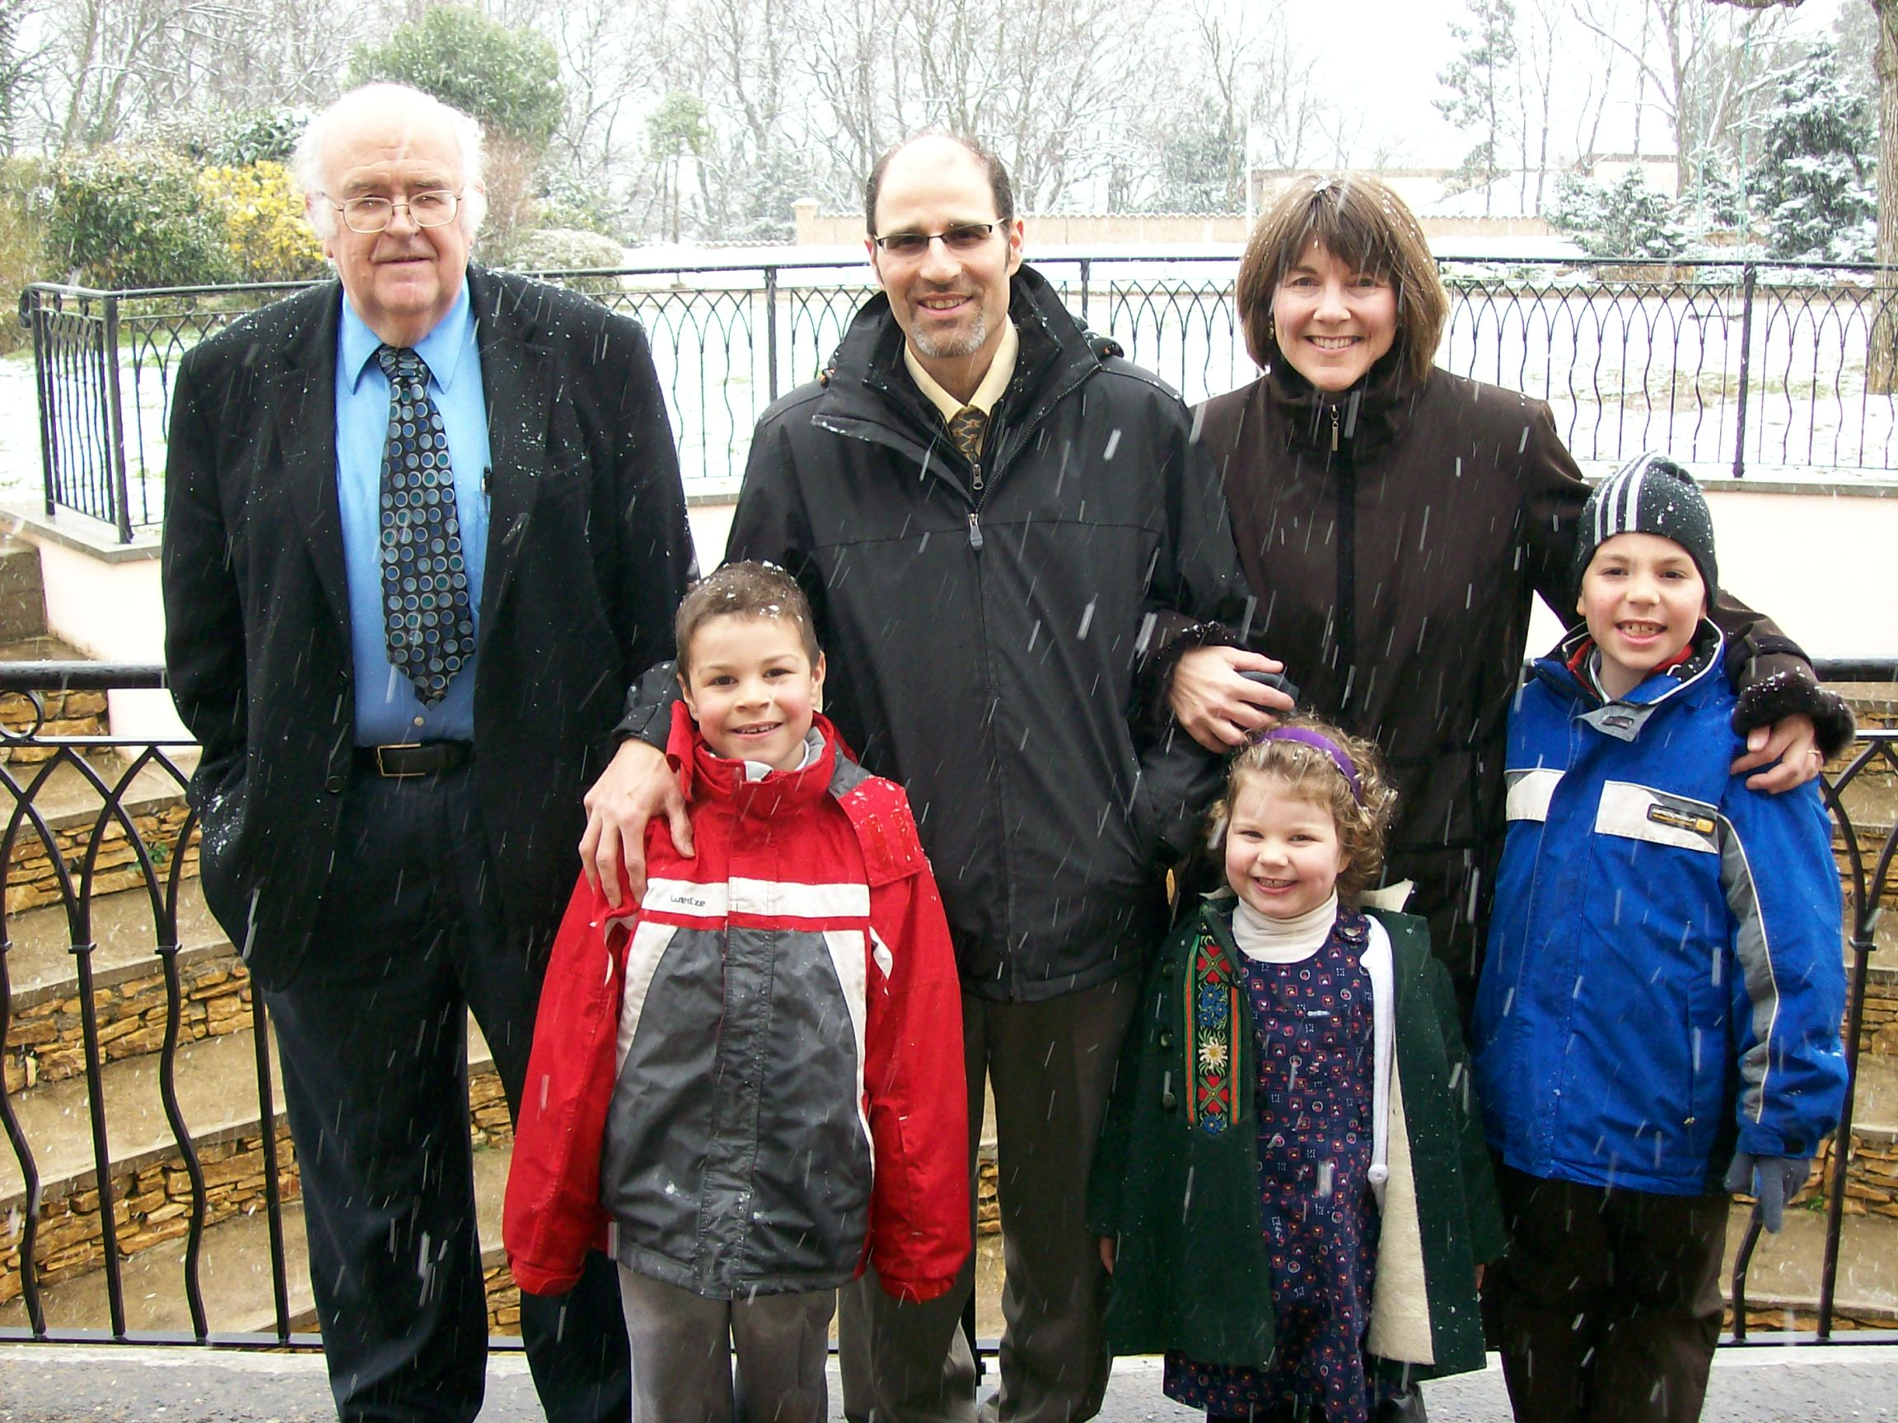
DiGena Family

Slide 13
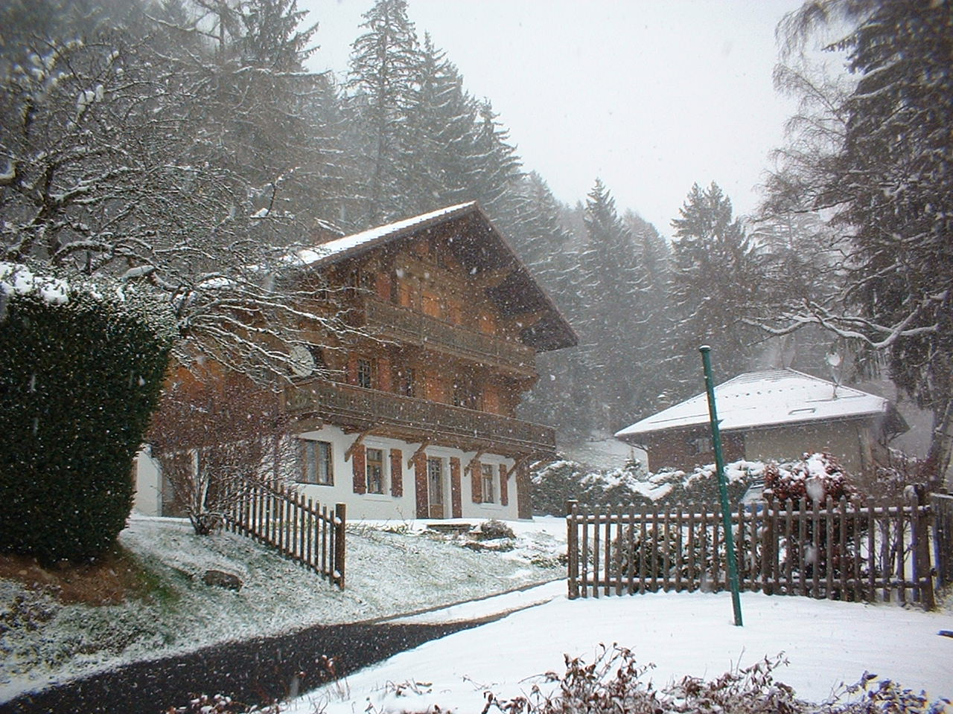
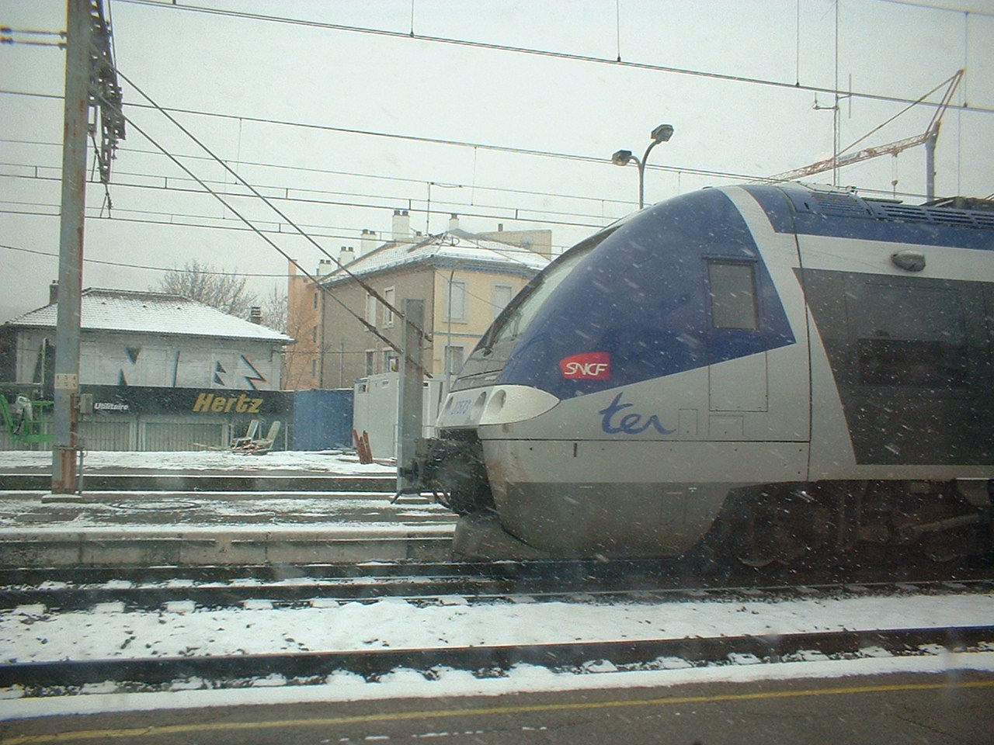
Lyon to L'Abri

Slide 14
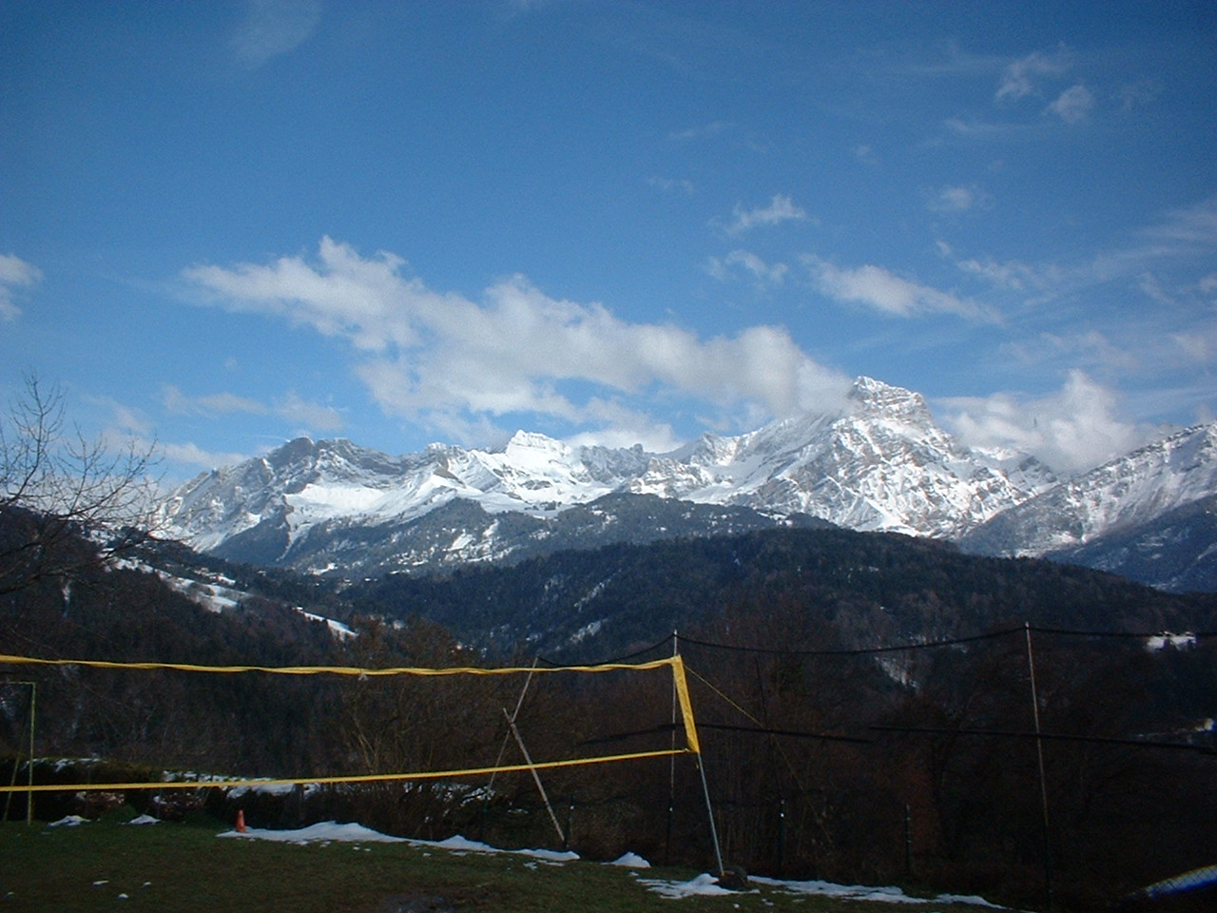
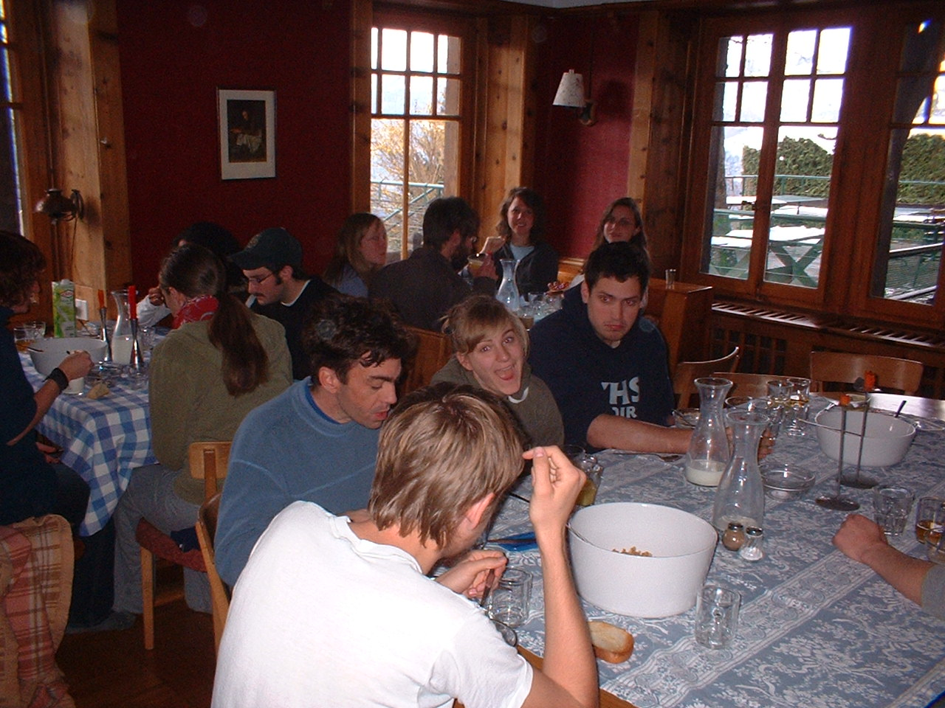
March 25-27: L'Abri

Slide 15
March 27 – April 4
Amsterdam
March 28-29: Bible & Science Seminar
March 30: Preaching at Christ Church, South
March 31: Lecture on Gnostic Gospels
April 1 & 3: Speaking in Chapel
April 2: Tour Harlem & Amsterdam
April 4: Amsterdam to Cologne

Slide 16

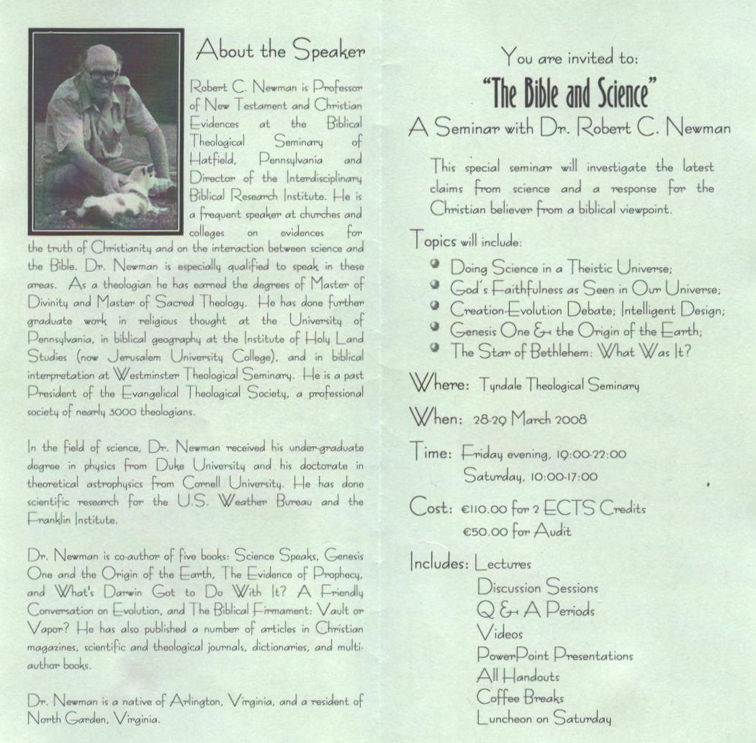

Slide 17
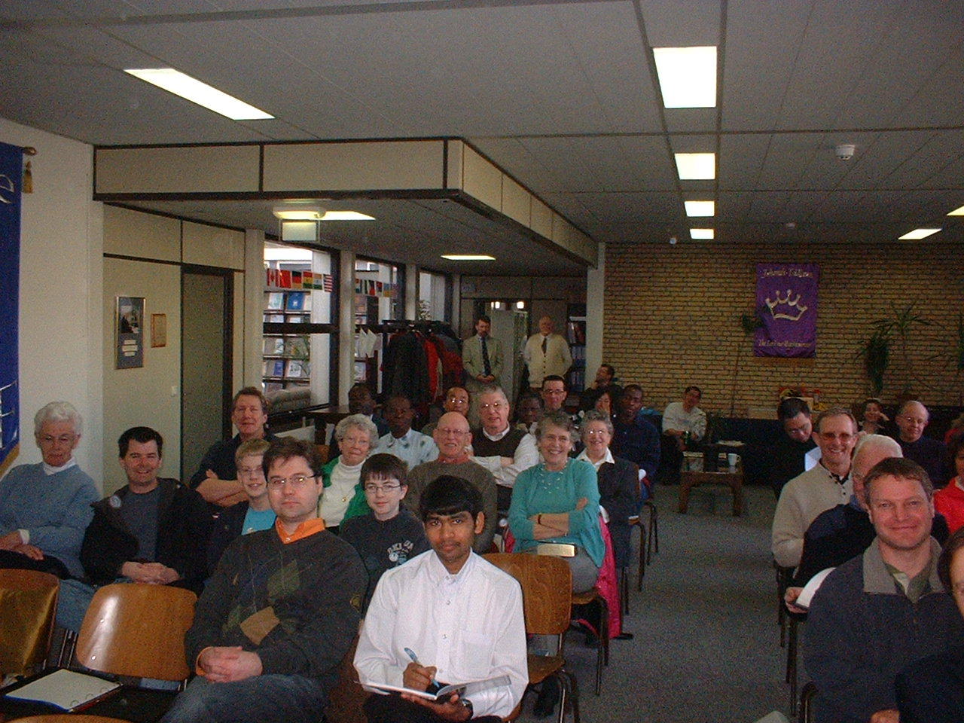
Bible & Science Seminar

Slide 18
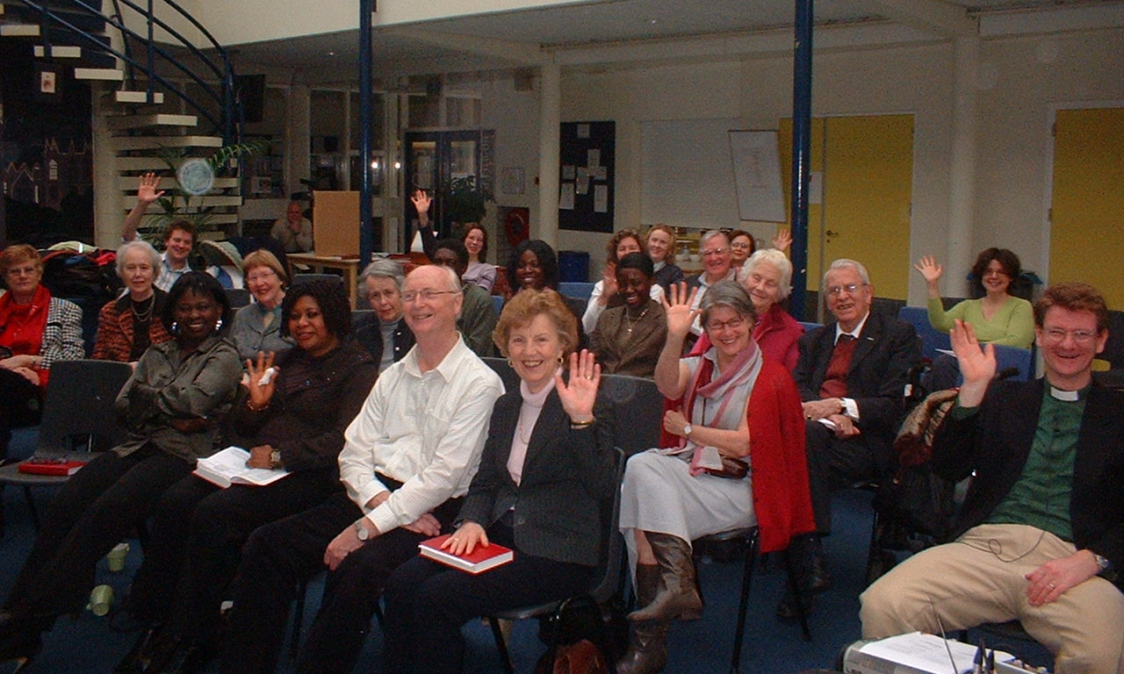
Christ Church, South

Slide 19
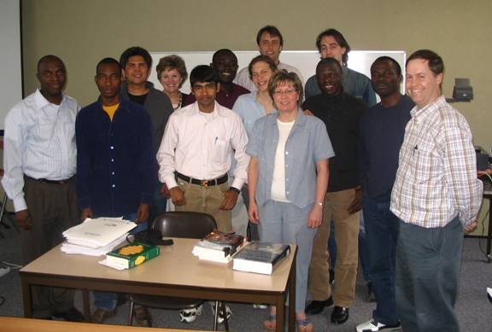
Gnostic Gospels Lecture

Slide 20
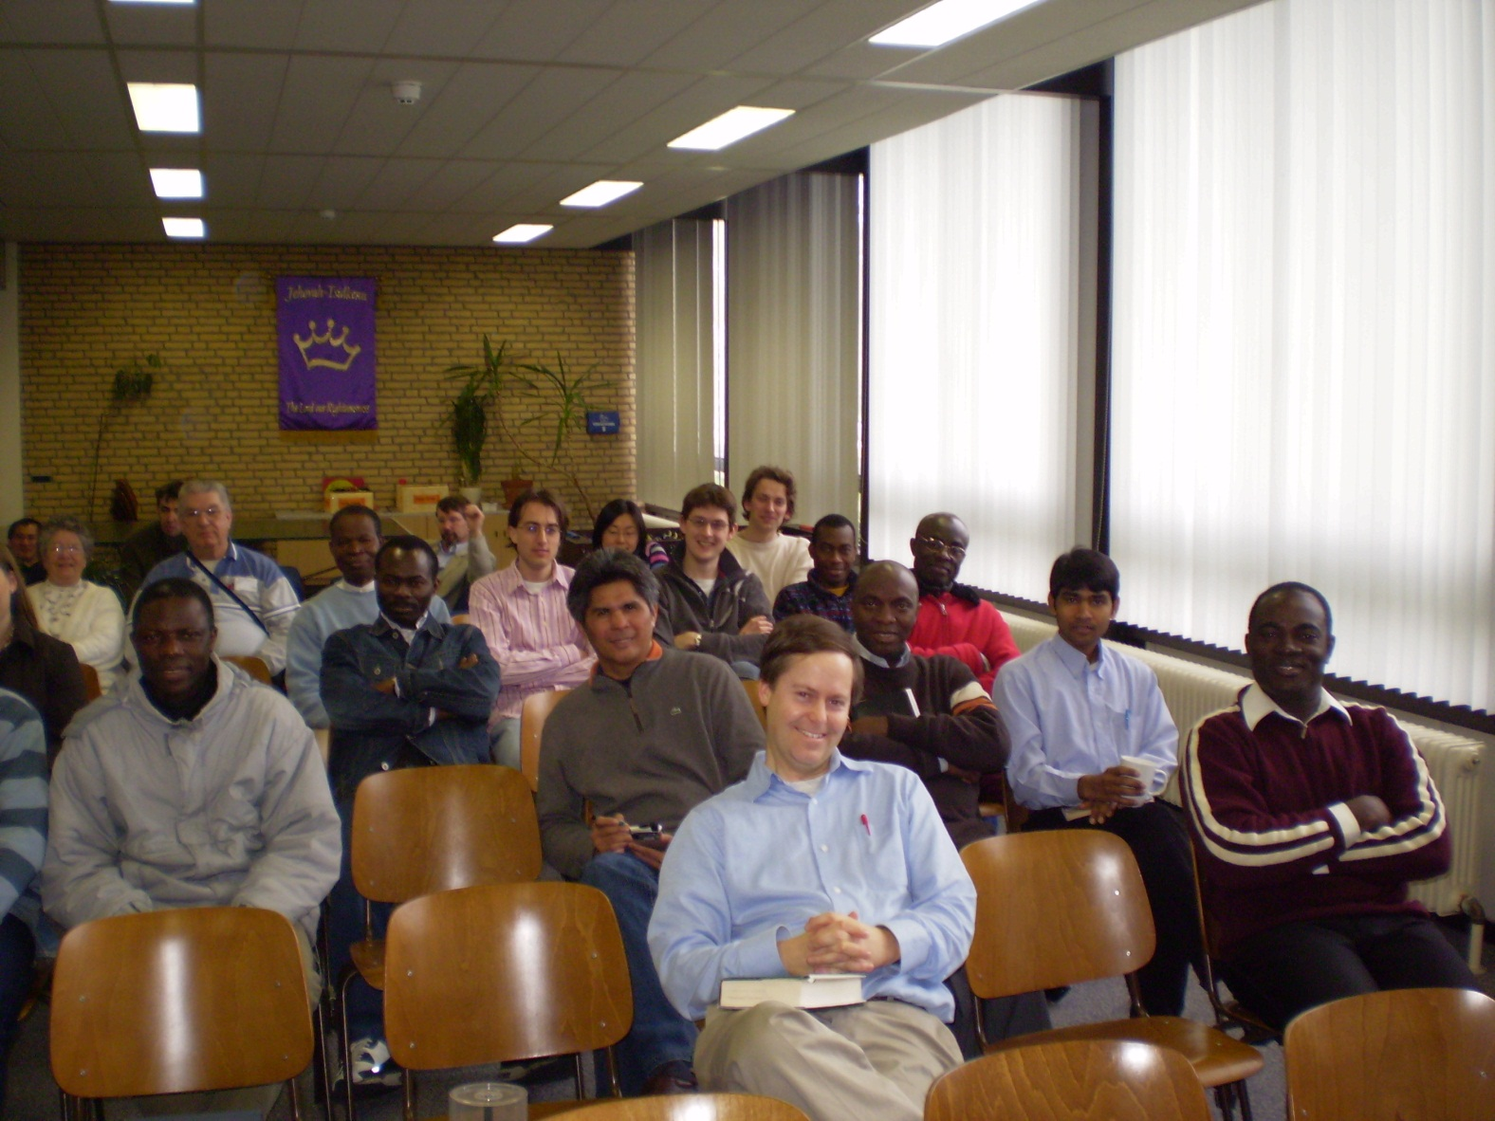
Chapel at Tyndale

Slide 21
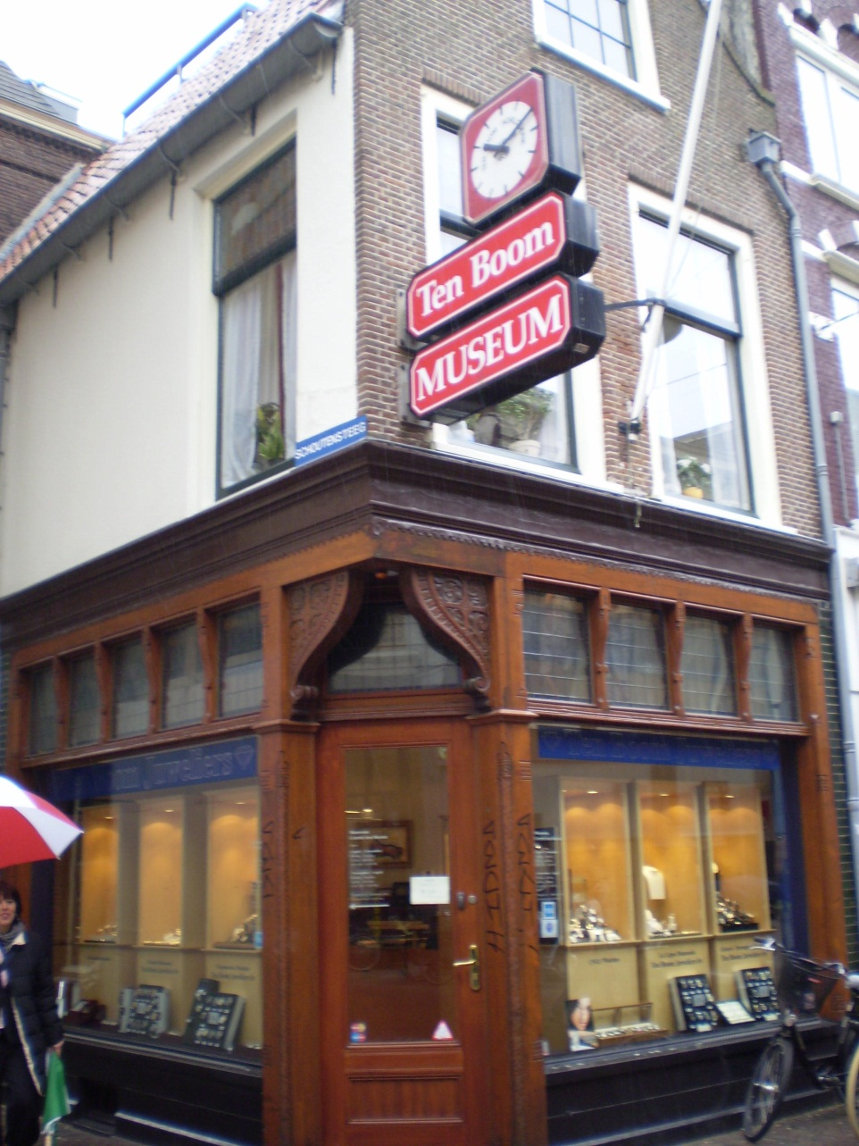
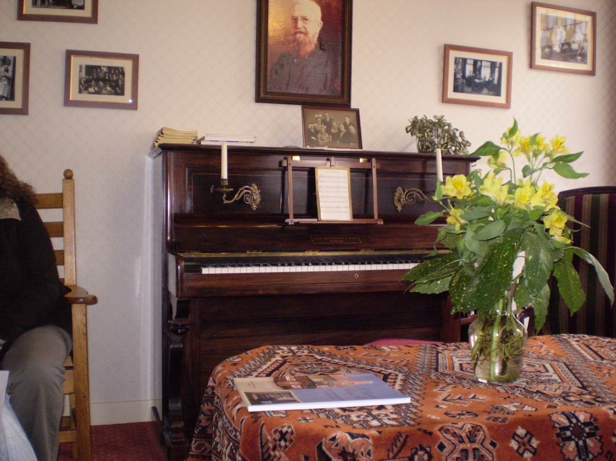
Harlem

Slide 22
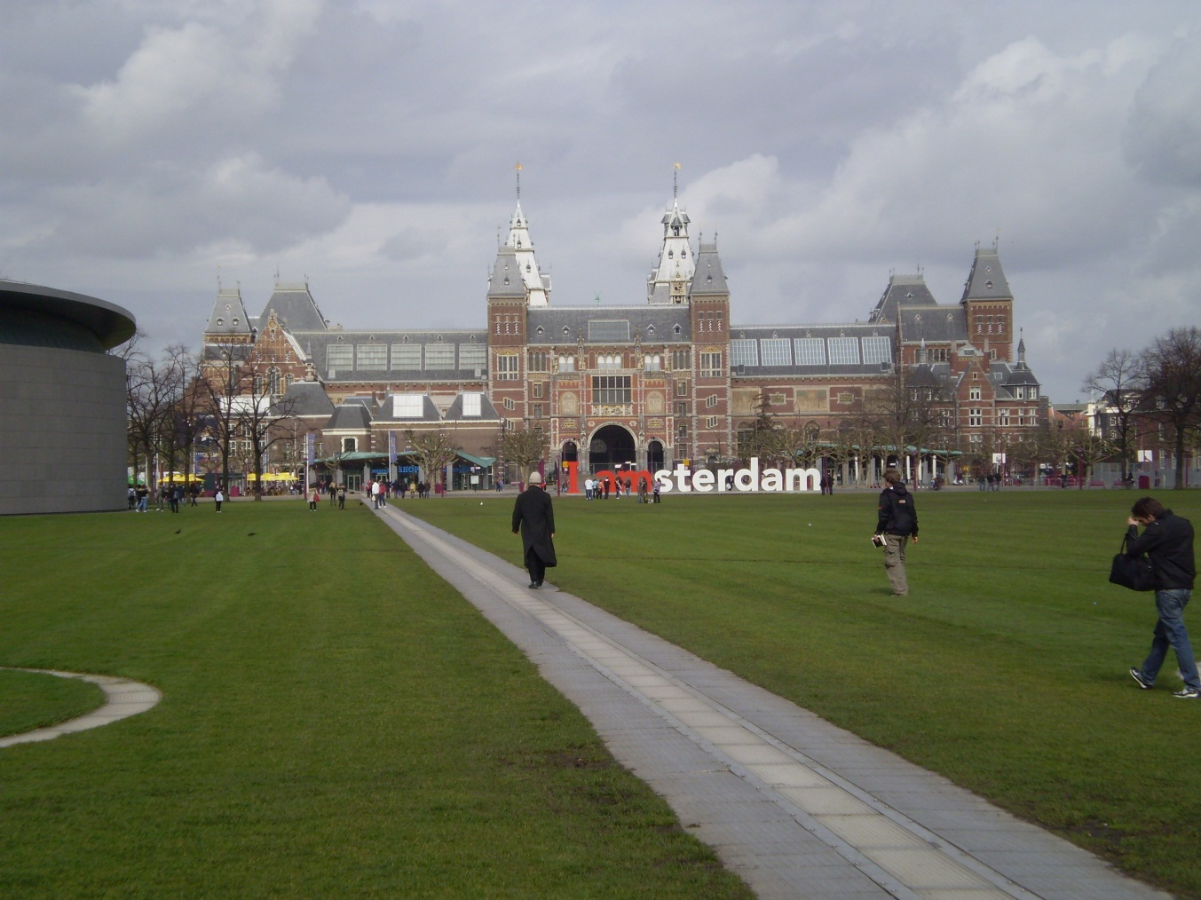
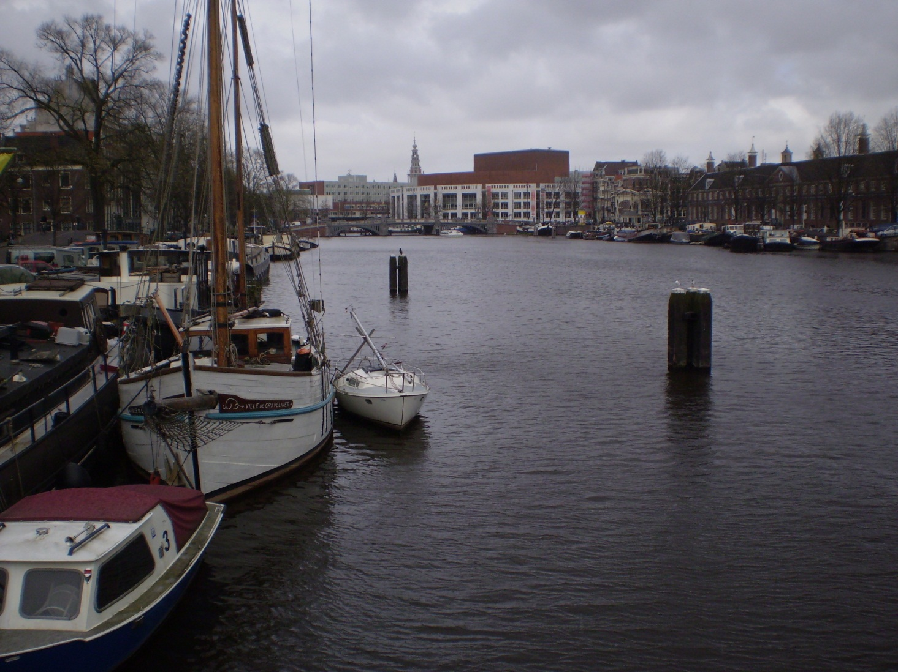
Amsterdam

Slide 23
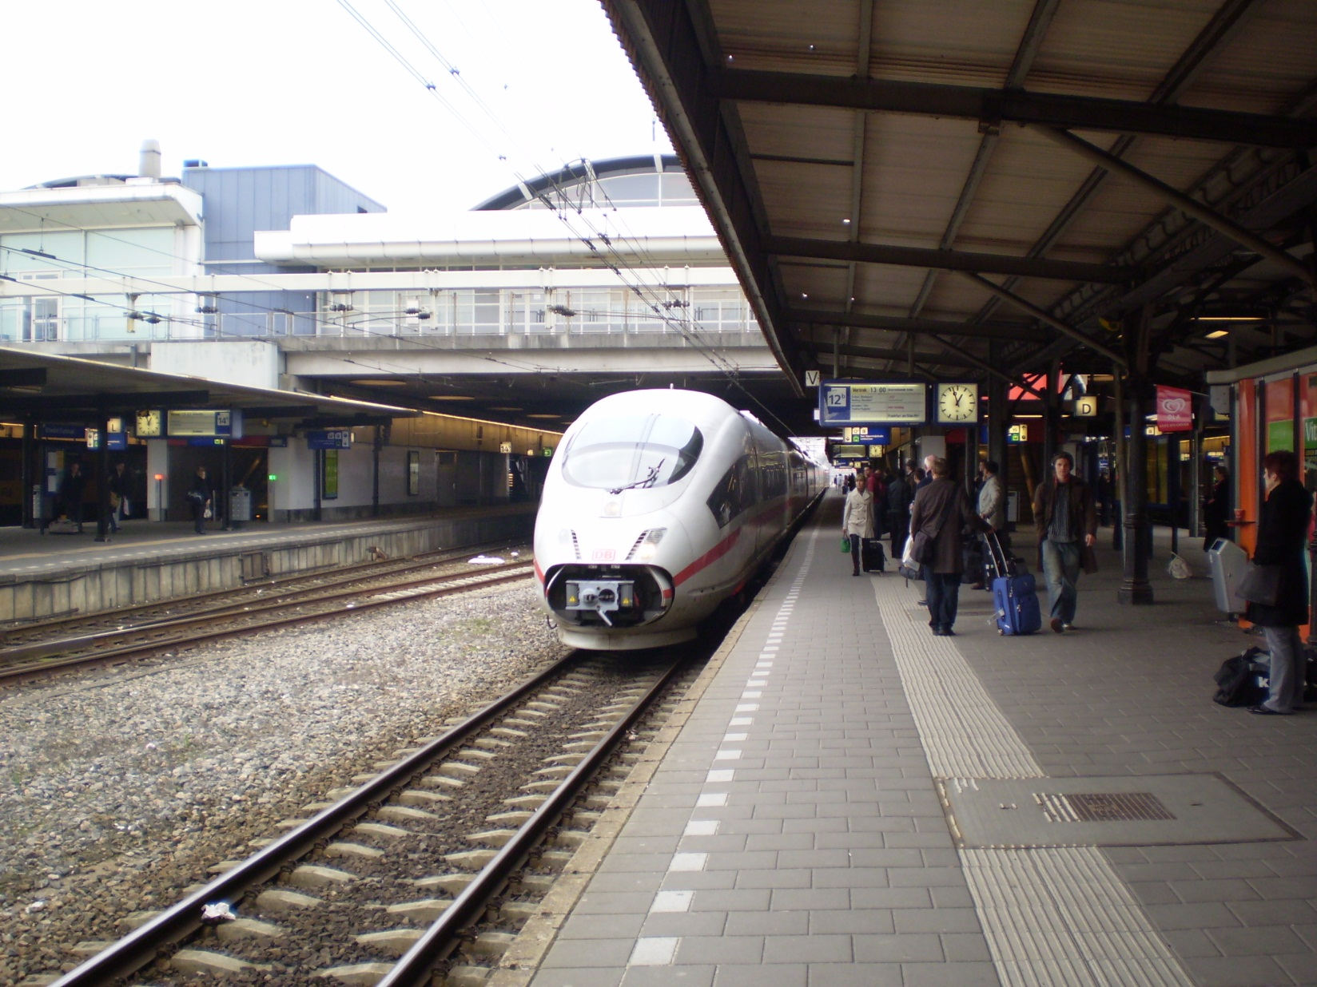
Amsterdam to Cologne

Slide 24
Cologne and Area
April 4: Turkish Home Fellowship
April 5: Tour of Linz
April 6: Sunday School and Service
April 7: Free Day
April 8: Univ of Cologne & Dr Lueschcke
April 9: Tour of Münster

Slide 25
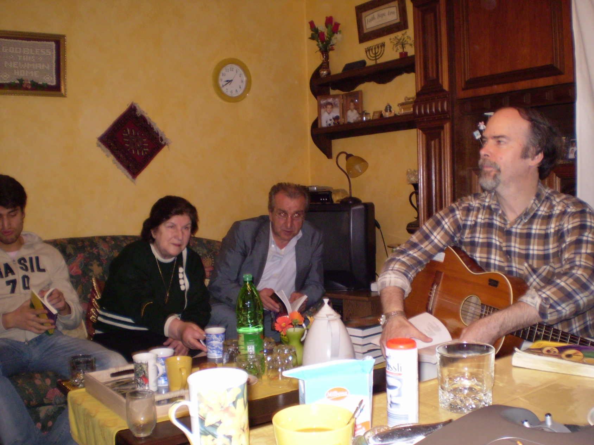
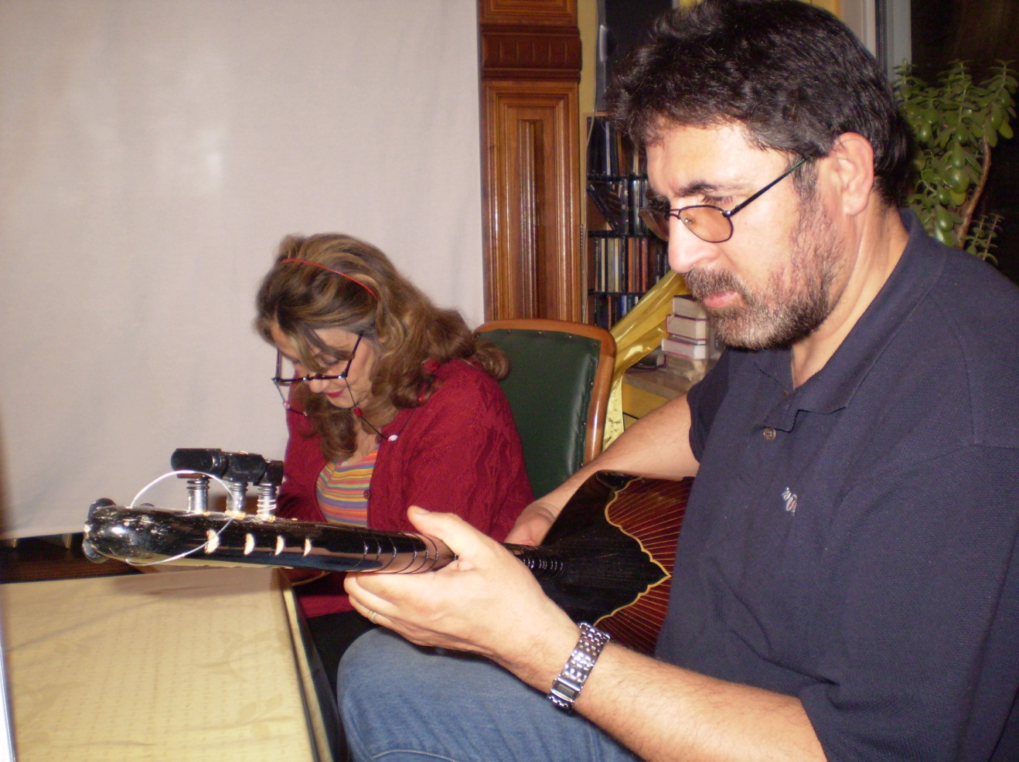
Turkish Fellowship

Slide 26
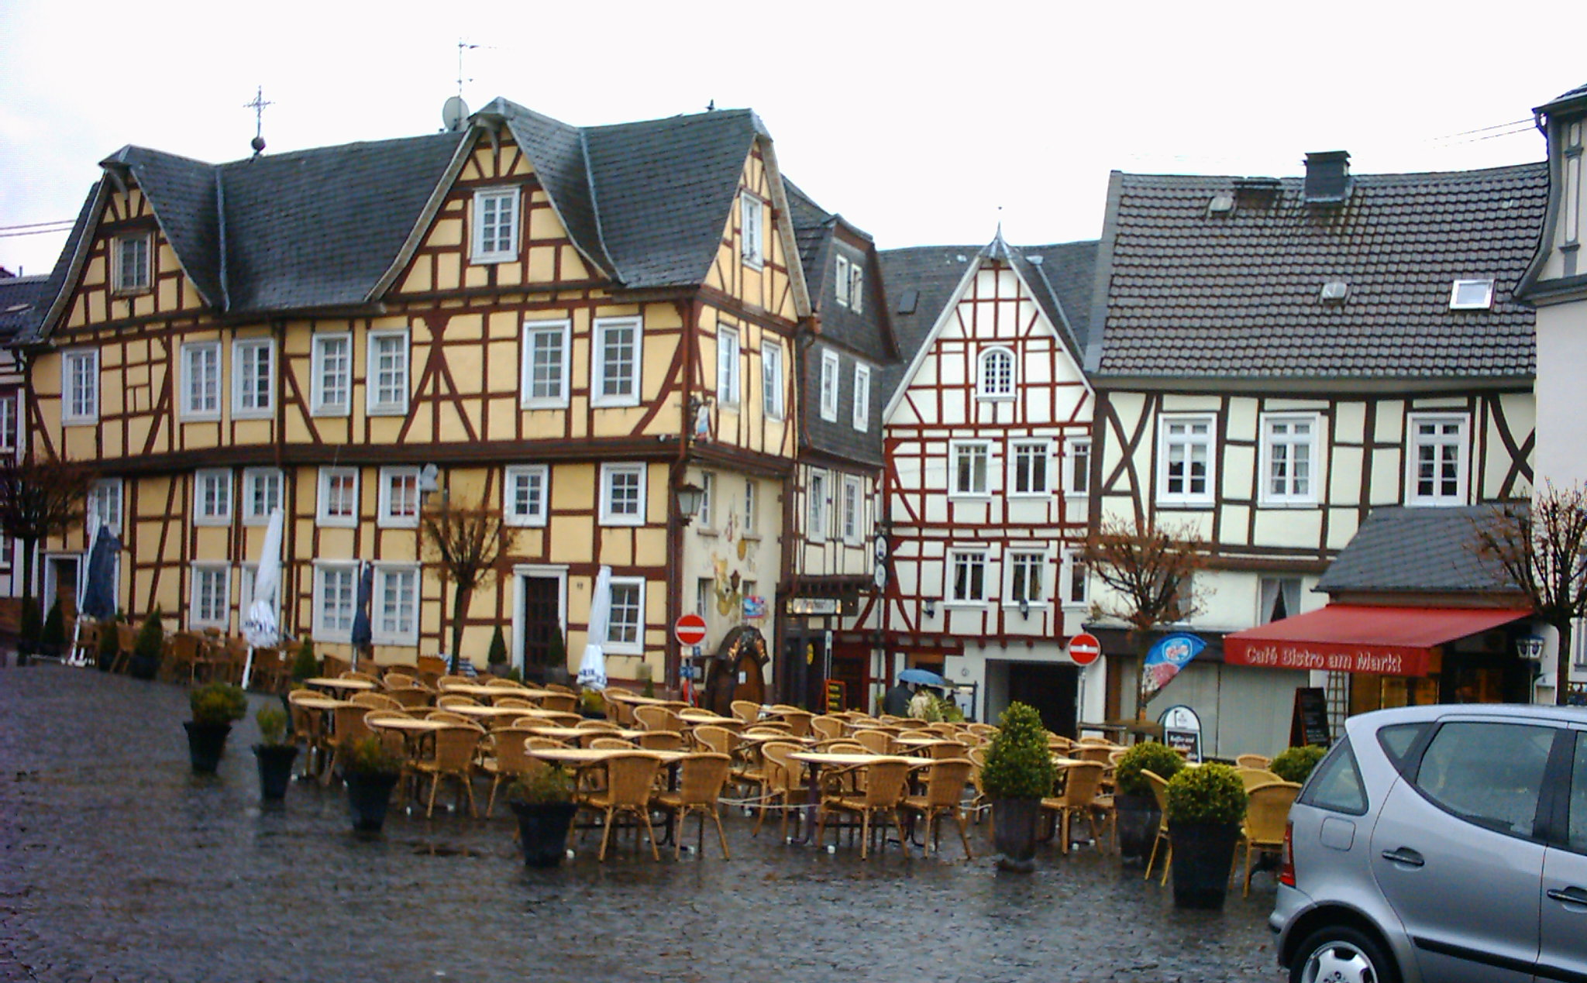
Linz

Slide 27
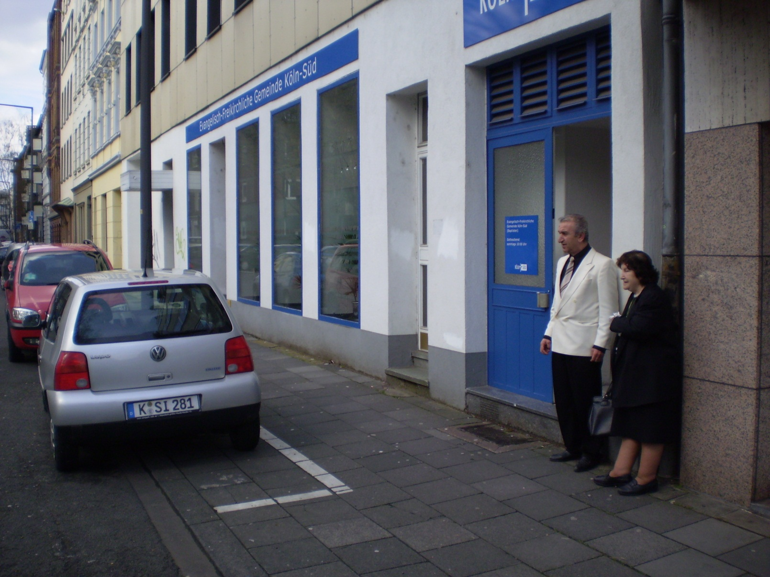
Sunday Service

Slide 28
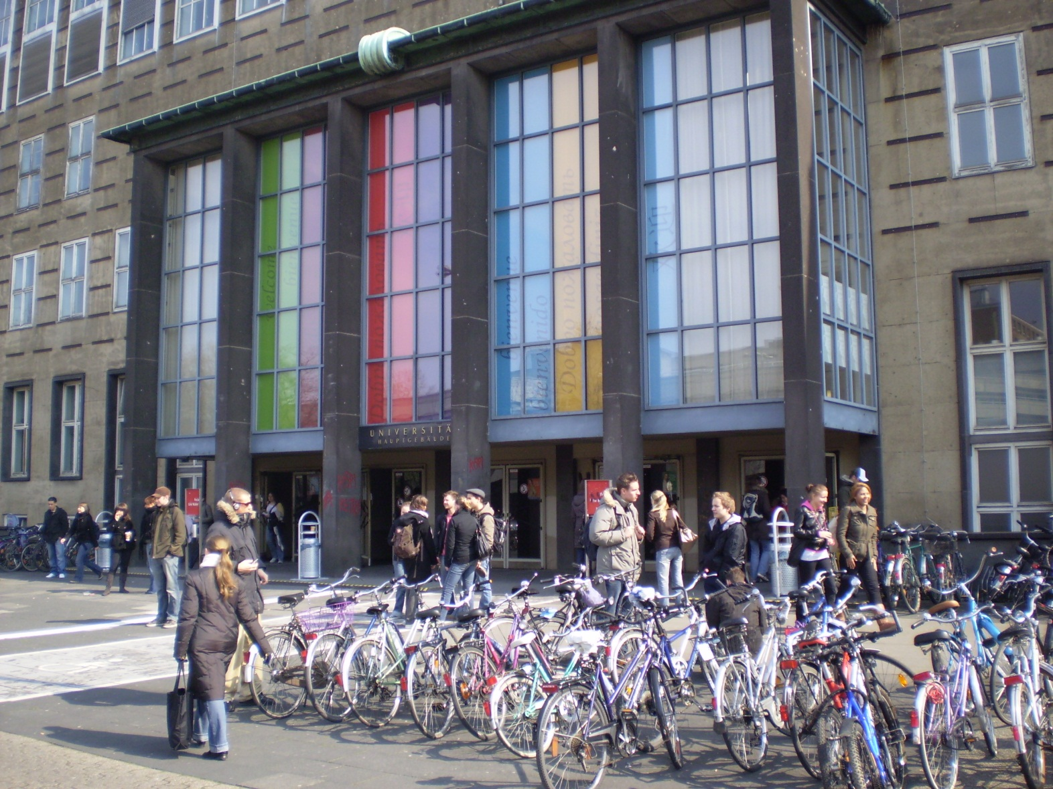
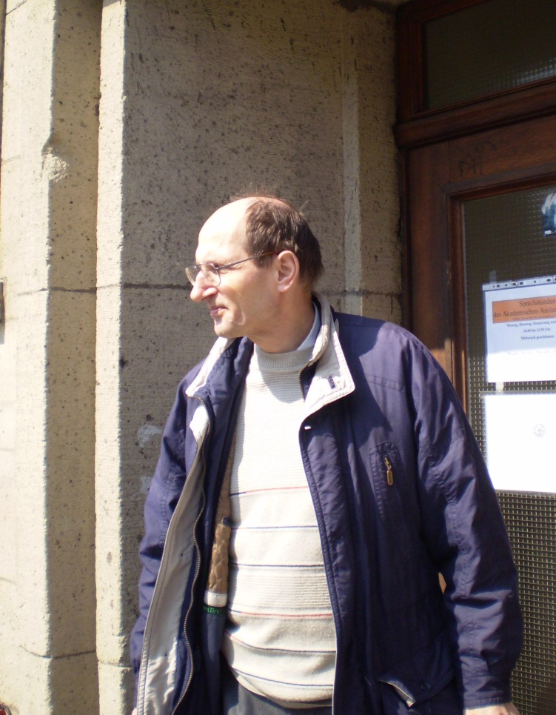
University of Cologne

Slide 29
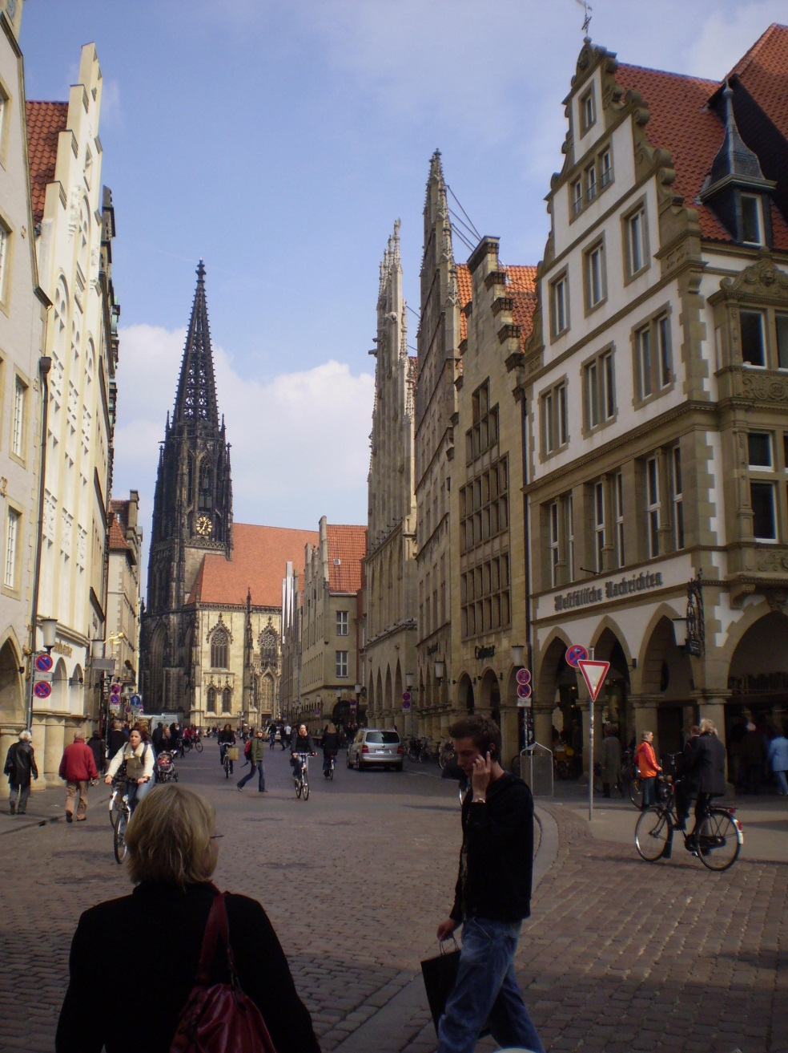
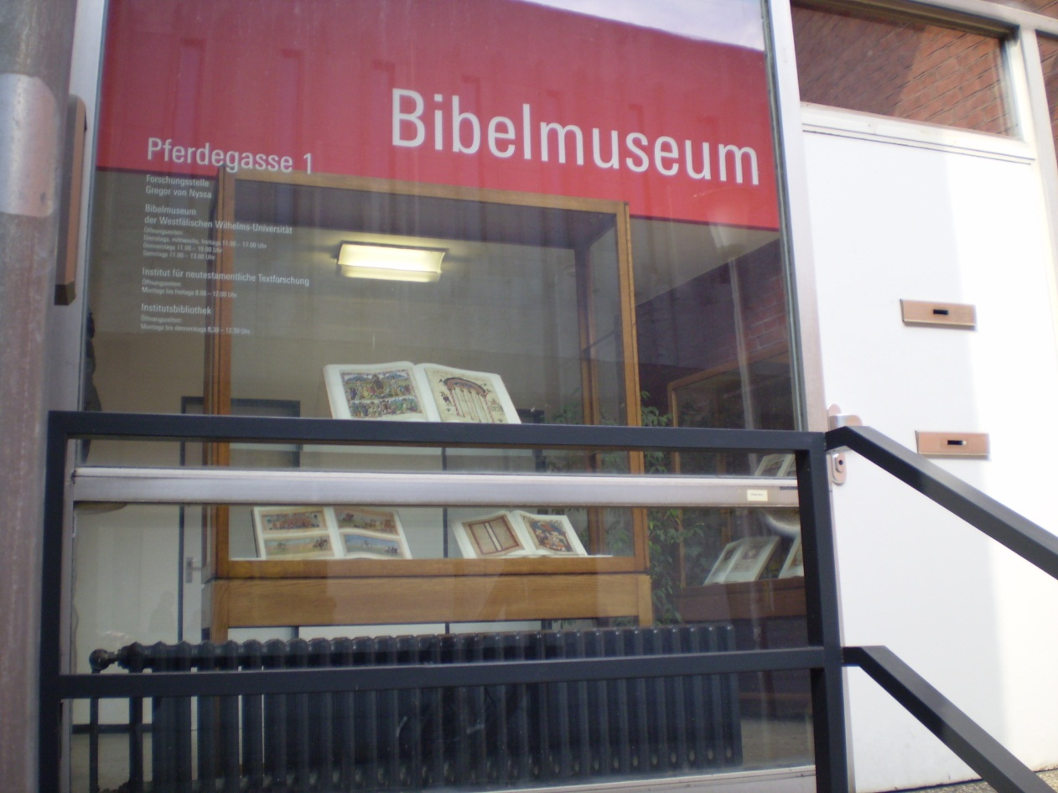
Münster

Slide 30
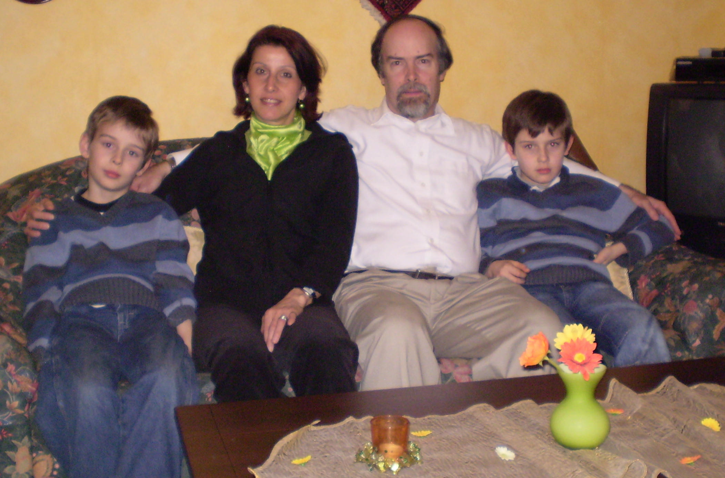
Neal Newman Family

Slide 31
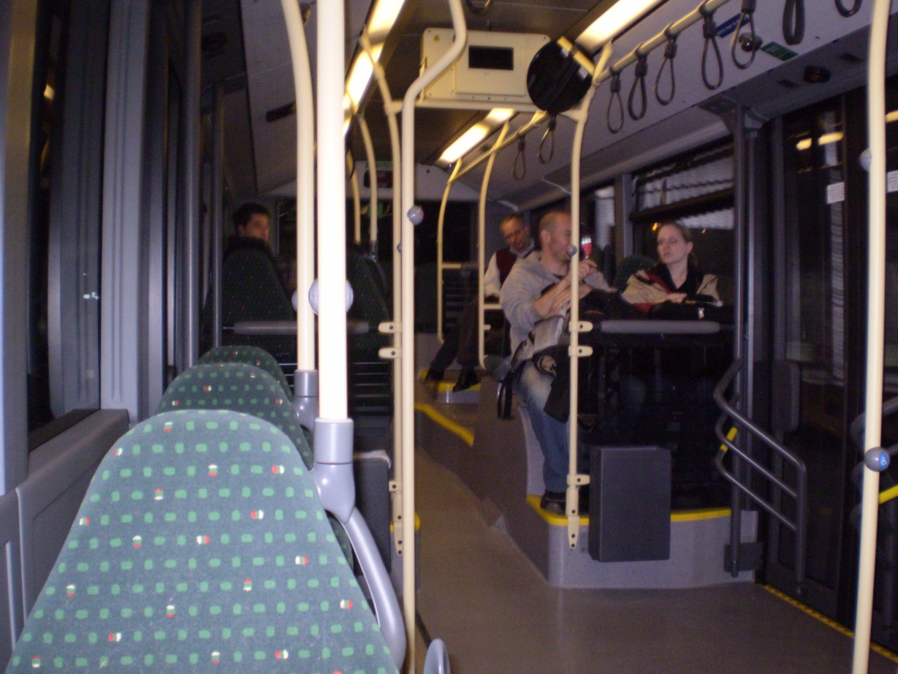
Head Home April 10
Cologne to Heathrow
Heathrow to Dulles
Dulles to C-ville

Slide 32
The End
Europe is very much
a mission field

