Slide 1
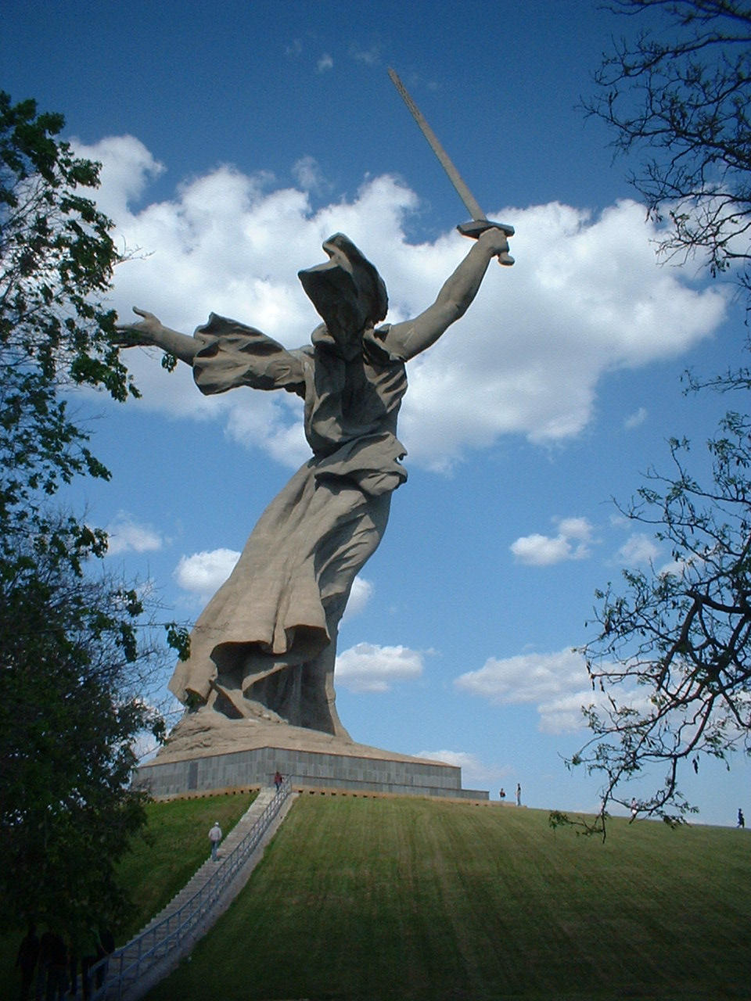

Trip to Volgograd, Russia
May 10-24, 2007
Robert C. Newman

Slide 2

Introduction
A sketch of my visit to Russia in May 2007
This was under the auspices of the International School Project.
The ISP is a spin-off from the Jesus film, Campus Crusade, and the Co-Mission in the 1990s.

Slide 3
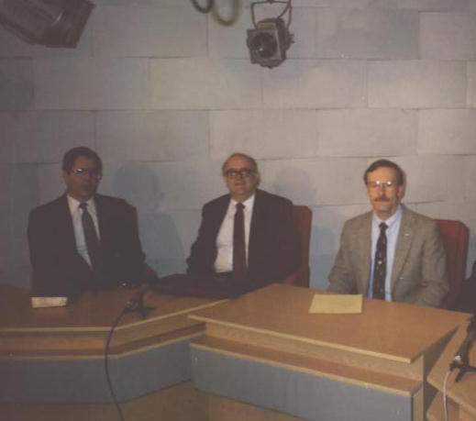
Introduction
Our leader was Bart Trowbridge…
… with whom Dave Dunbar and I made a trip to Russia back in October 1992.
Here we are shown making a TV program on that trip 15 years ago.

Slide 4
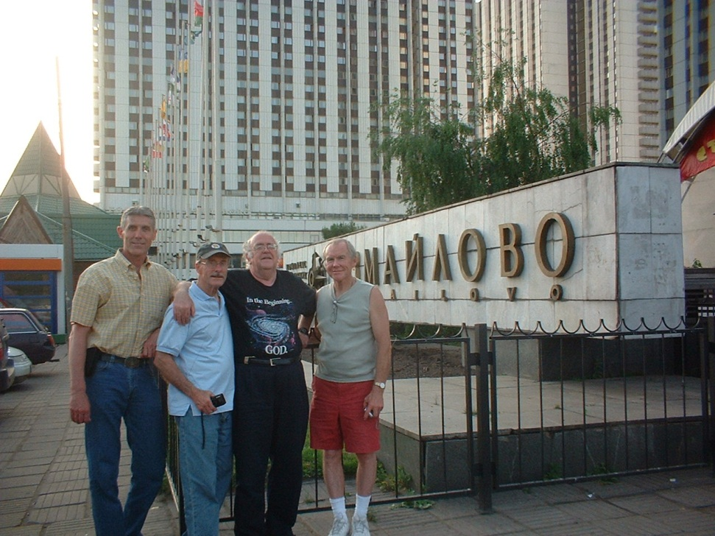
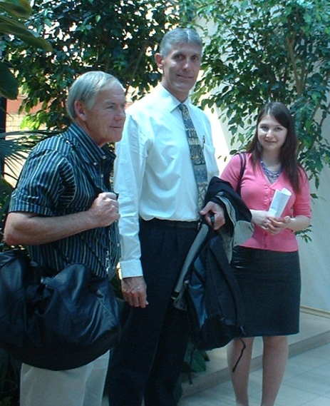
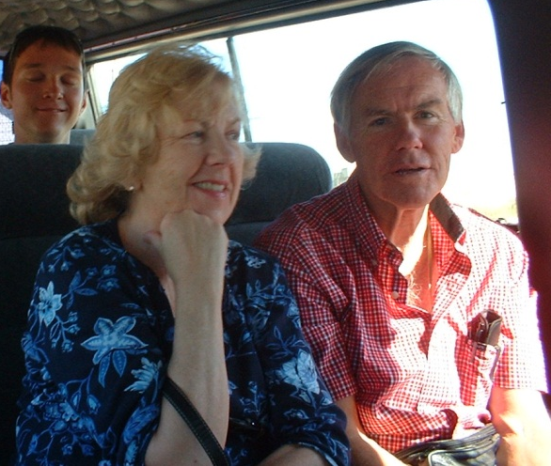
Our Team
This time our Team consisted of:
Bart Trowbridge
Dick & JoAnne Hinrichs
Dwight Steen
Myself
Sasha Tychkovska, our translator from the Ukraine

Slide 5
Our Purposes
To encourage the Christian Teachers Association of Volgograd
To aid the evangelical churches of the area & encourage them to work on common projects
To reach out to the universities and secondary schools
To draw students and others to consider the claims of Jesus

Slide 6
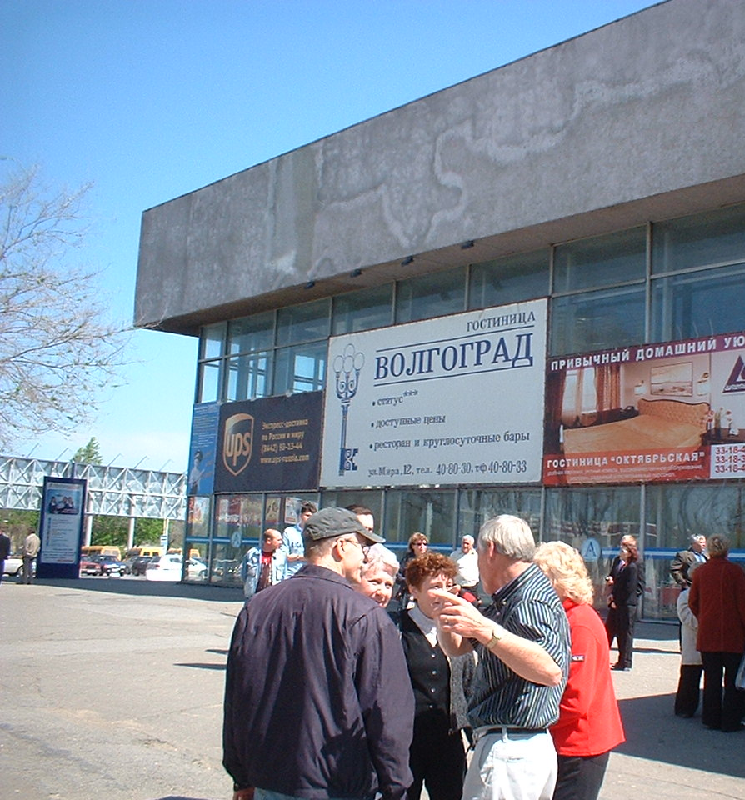
Arrival at Volgograd
After one day in Moscow, we flew down to Volgograd, about 600 miles SE.
Here we were met by Ludmilla Chernichkina from the CTA and Valery Patkevich, our host and pastor of the local Methodist Church.

Slide 7
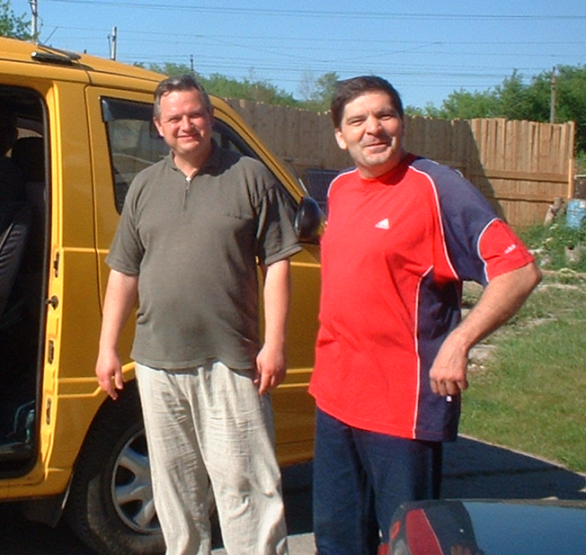
Pastors & Drivers
Here we see Pastor Valery Patkevich of the Methodist Church, who was our host and one of our drivers.
To the right is Pastor Valodya Ilyechin, another pastor and our other driver.

Slide 8
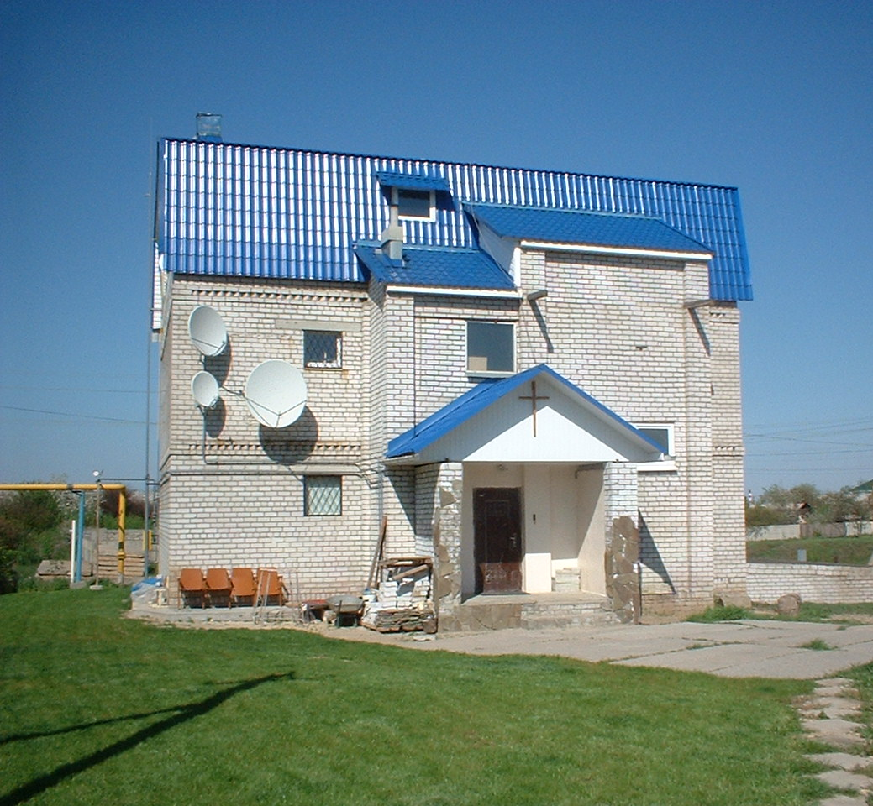
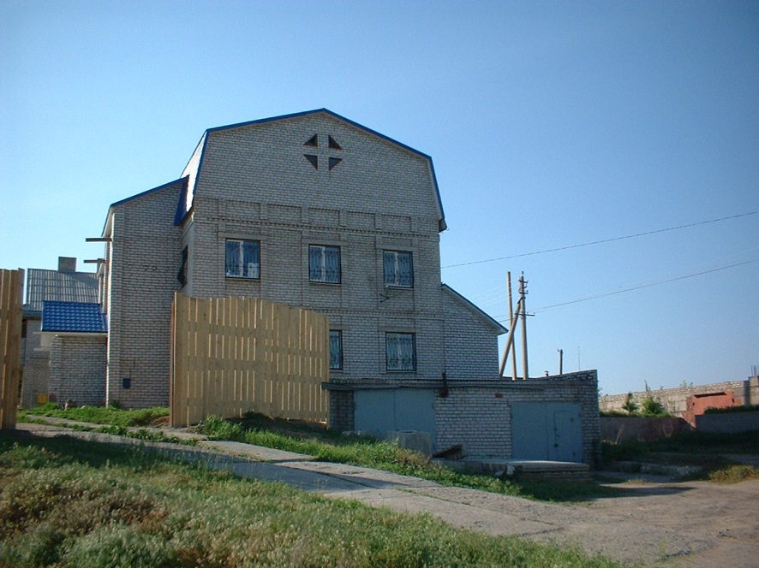
Accomodations
Though staying in 3 different locations, the team usually ate its meals at the Methodist Church of the Transfiguration, home of Pastor Valery and several men and women.

Slide 9
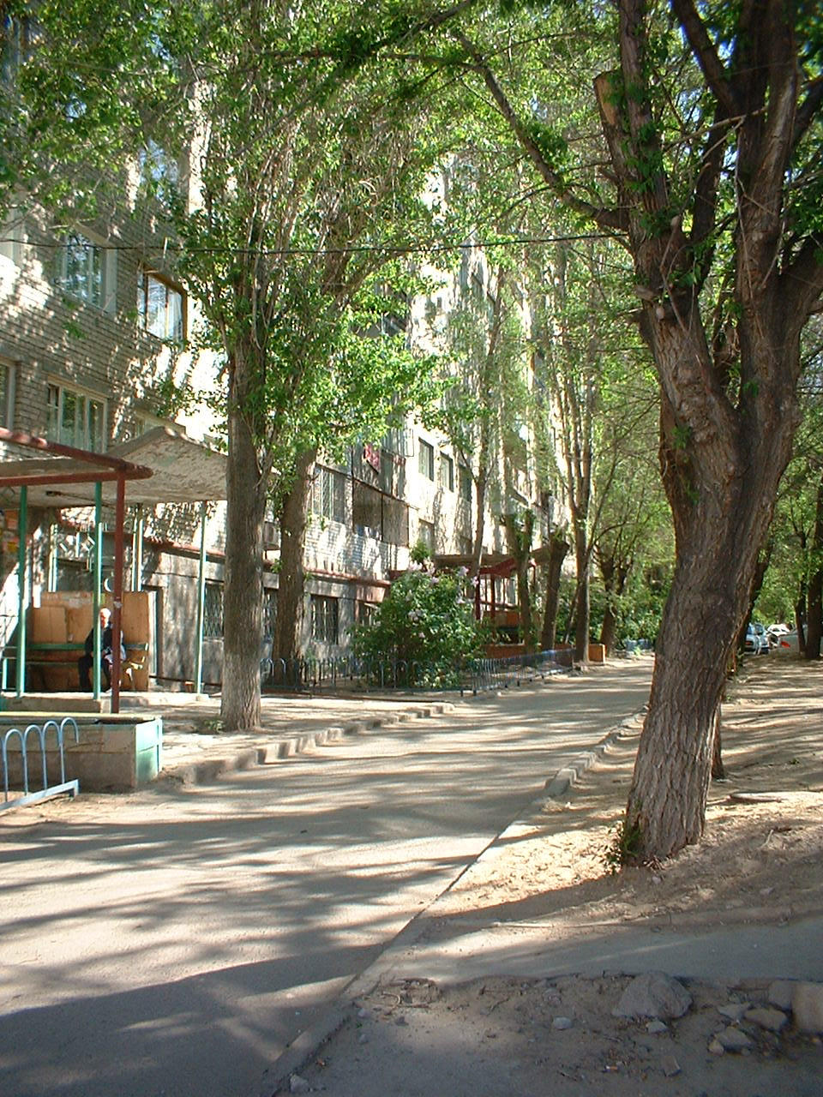
Accomodations
Dwight and I stayed in a rented, furnished apartment a few miles away.
Dick and JoAnne stayed with a widow Katya, who spoke no English.
Bart & Sasha stayed at the church.

Slide 10
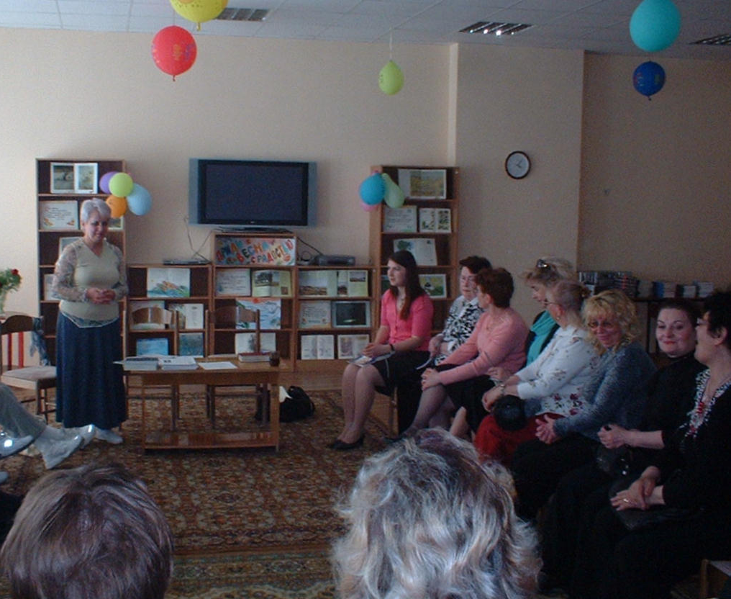
Christian Teachers Association
The CTA was formed by believing teachers as a result of the Jesus film, and the follow-up seminars training teachers in a curriculum of ethics and values for the public schools.

Slide 11
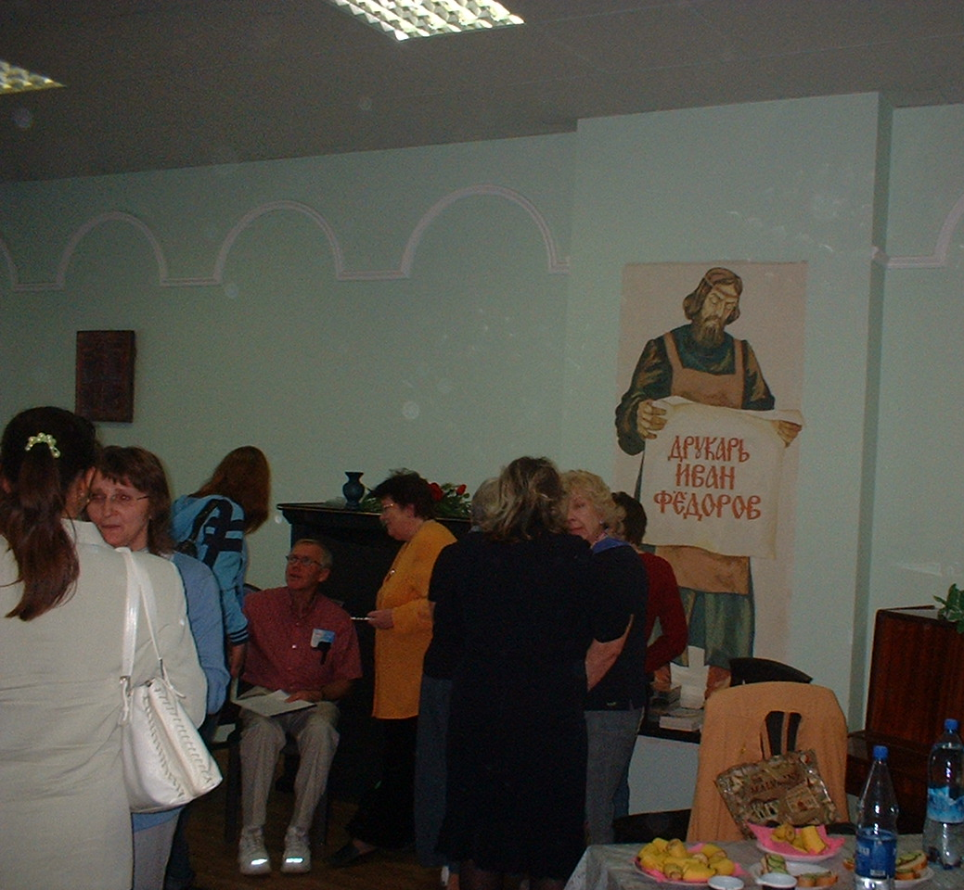
Christian Teachers Association
We assisted this group in a seminar they held for teachers of English by giving talks on family values and teaching.

Slide 12
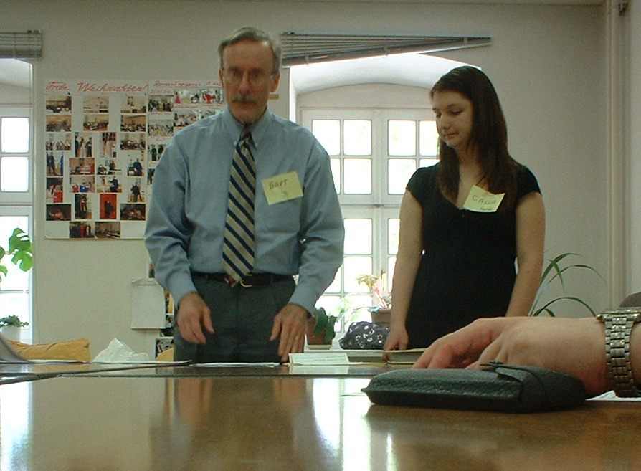
Christian Teachers Association
We also presented a sample of the Dream Makers & Dream Breakers curriculum, to be taught next fall in the Volgograd area.

Slide 13
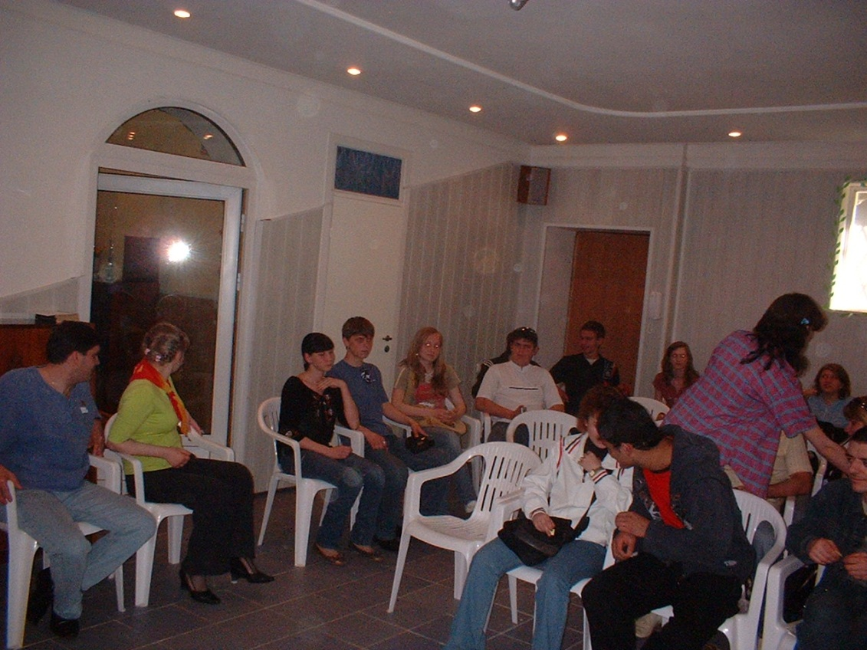
Evangelical Churches
Each of us spoke on various occasions in several of the churches or to youth groups and home fellowship groups.
Here we are meeting with youth from 3 churches at the Methodist Church.

Slide 14
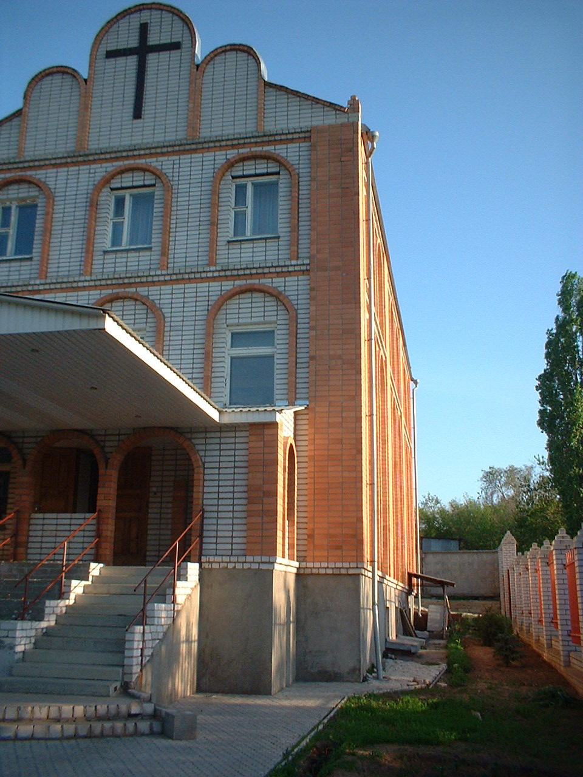
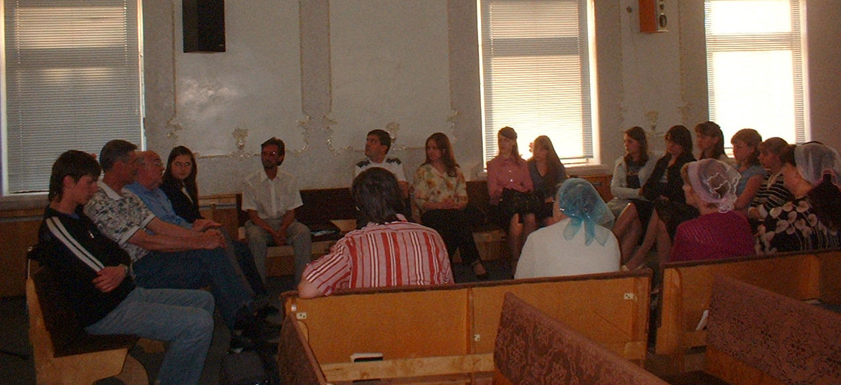
Evangelical Churches
This is South Baptist Church, where Dwight, Sasha & I spoke to youth (teen to age 30) & some older adults.

Slide 15
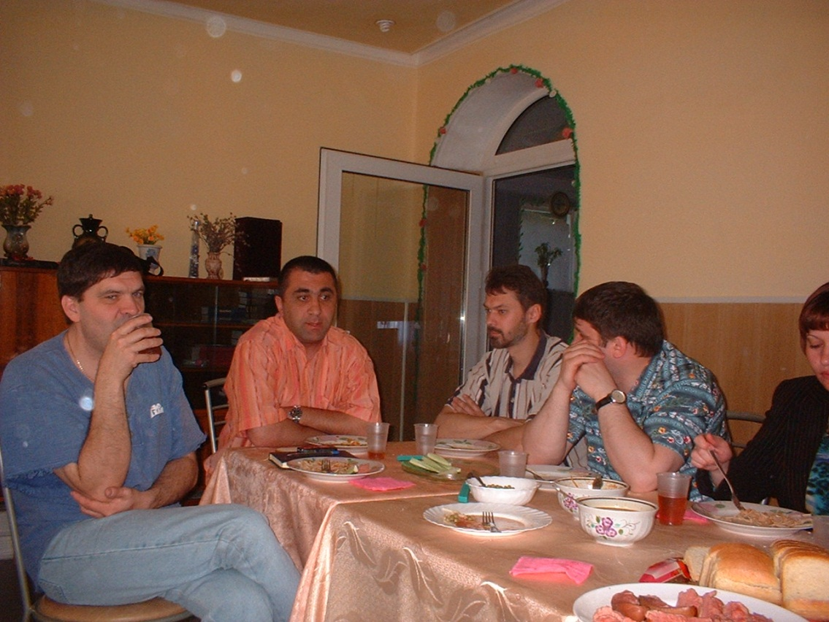
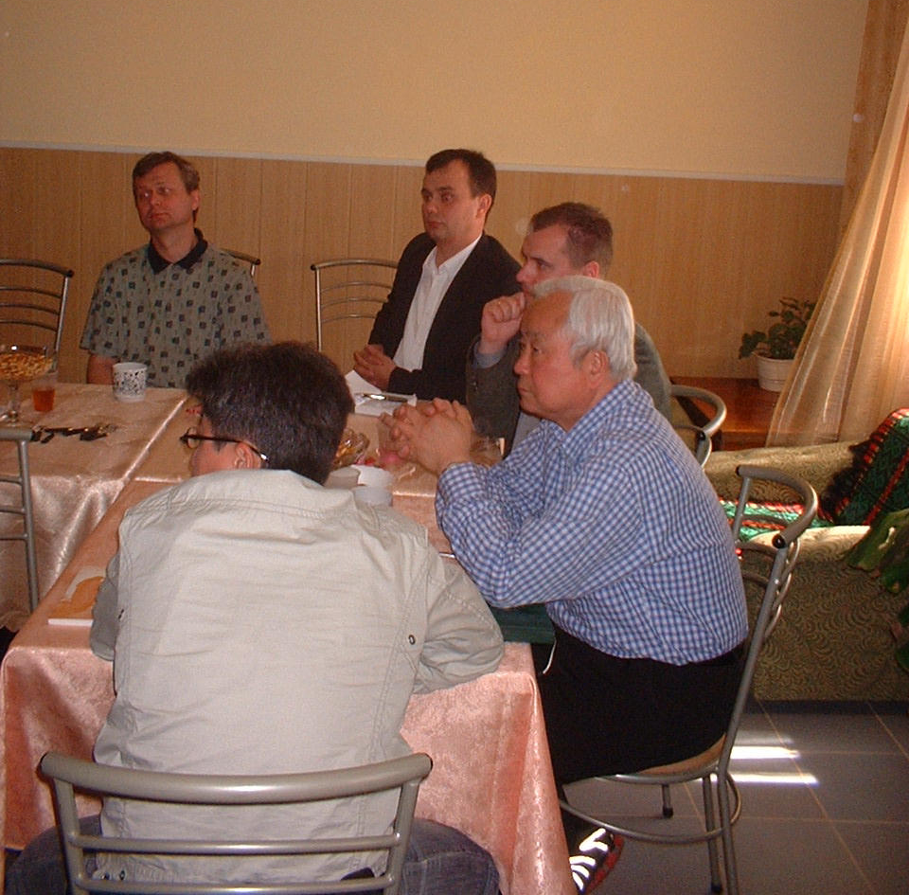
Evangelical Churches
We also met with about a dozen evangelical pastors, telling them about our trip and our personal ministries.

Slide 16
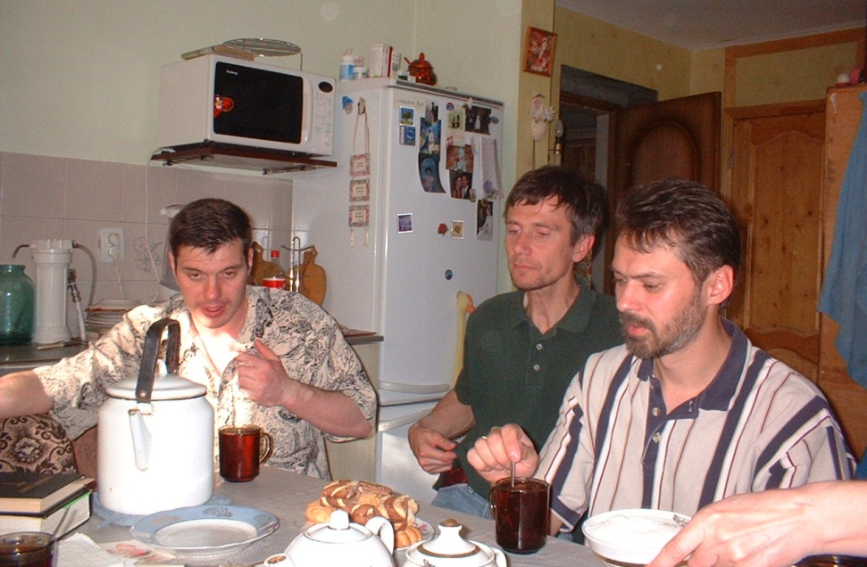
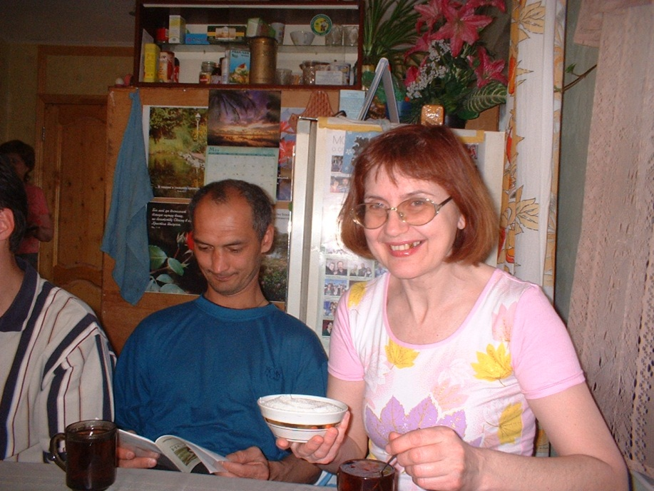
Evangelical Churches
This is a home fellowship group that Sasha and I visited.
These people were from the Christian Missionary Union.
They had lots of questions for us, including creation, last things, and UFOs.

Slide 17

Schools
Various members of our team spoke in three universities and at a number of secondary schools.
This is Dick, Dwight and our translator Sasha at VAGS, the Volgograd Academy of Government Service.

Slide 18
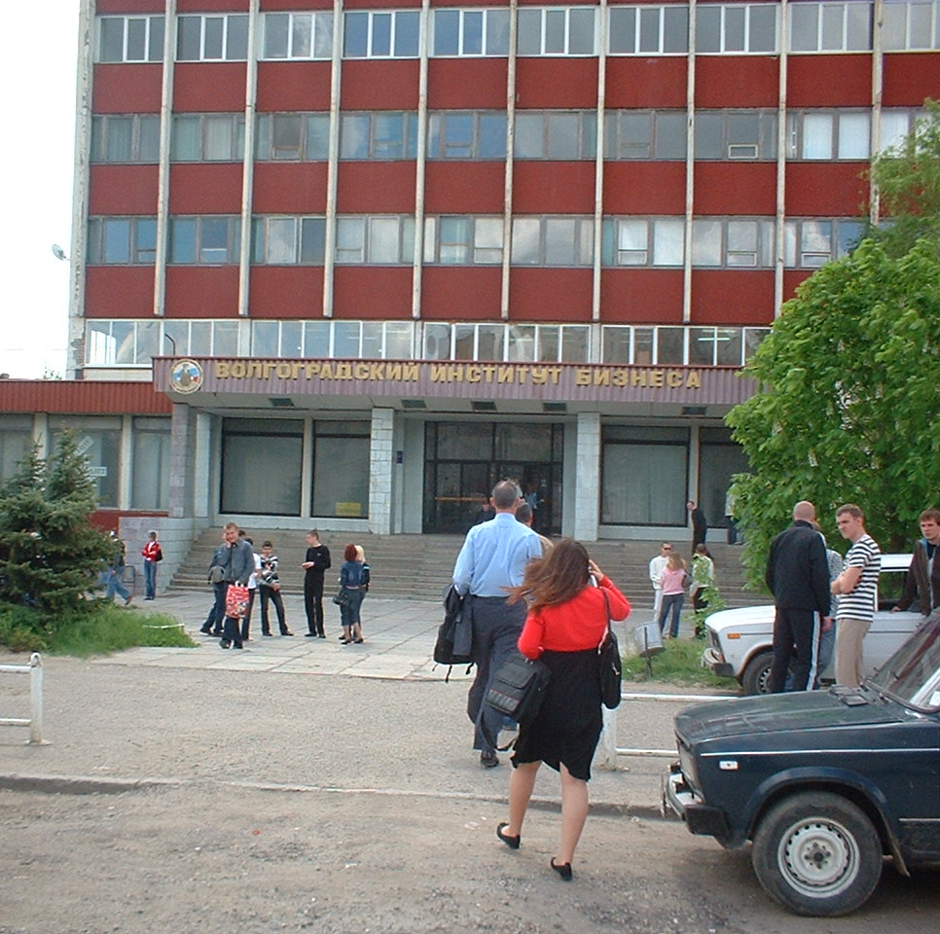
Schools
This is VIB, the Volgograd Institute of Business.
Here Dwight & Sasha are headed for the entrance of VIB.

Slide 19
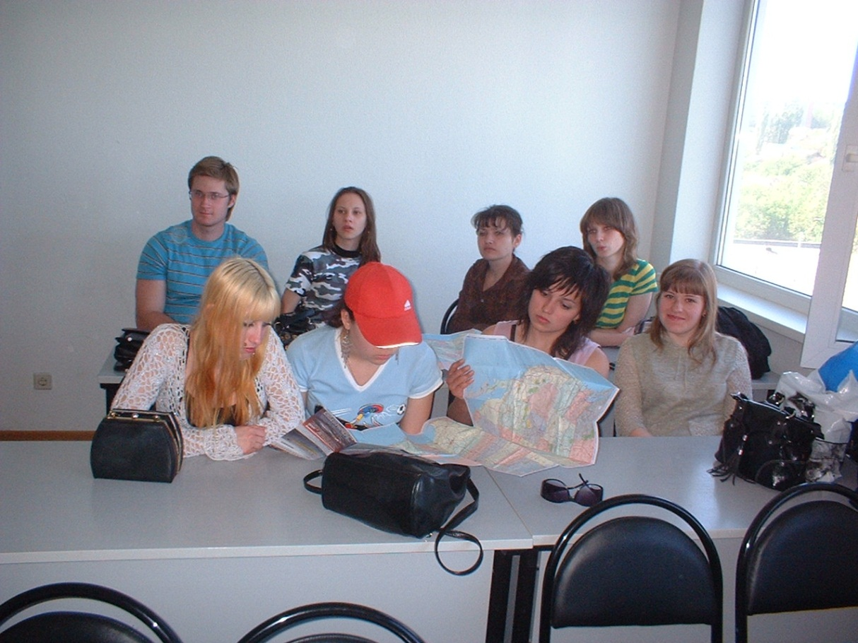
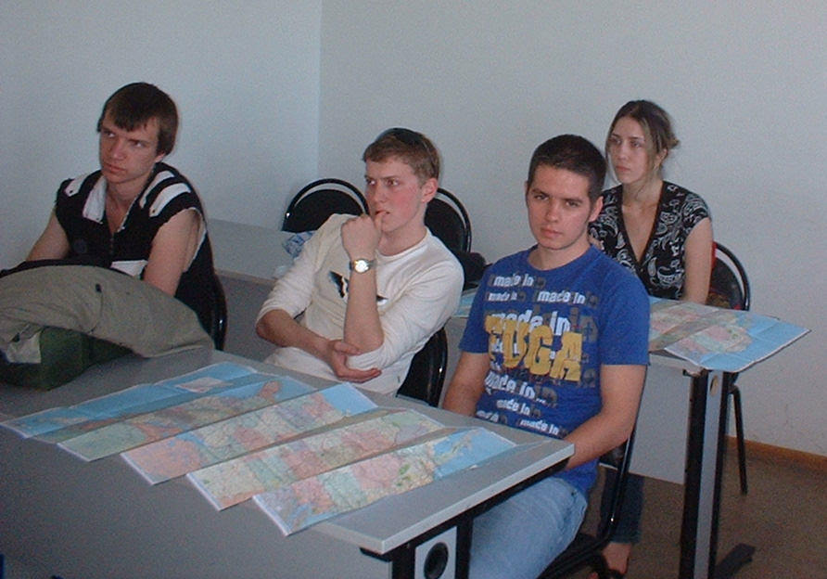
Schools
Here is a class studying English that I spoke to in VAGS.
I have just given them US maps so they can see where I come from.

Slide 20
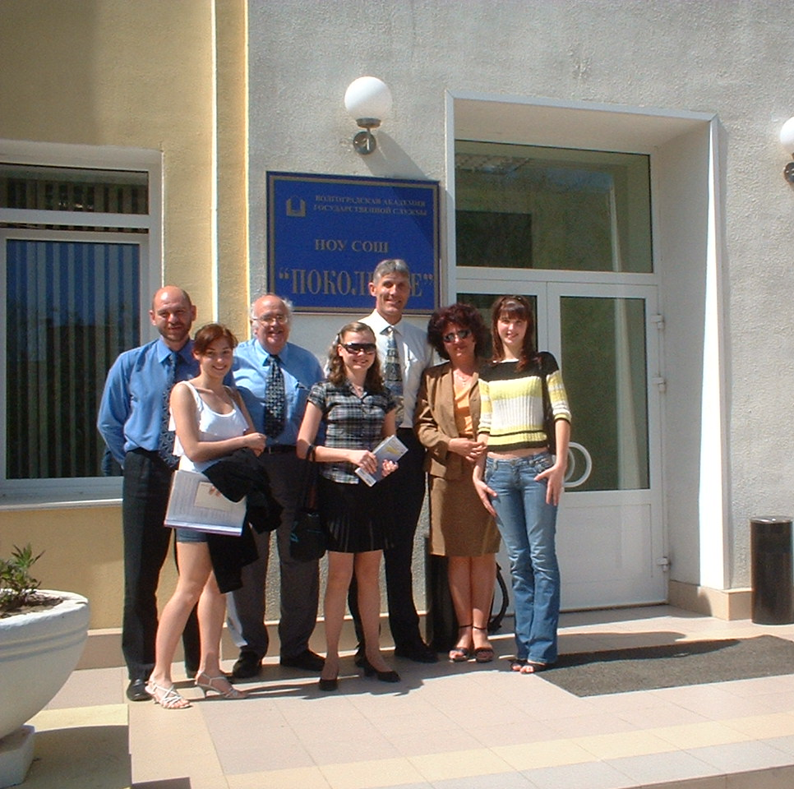
Schools
This is a new secondary school, called New Generation School.
It is a prep-school for VAGS, partly funded by NATO.
Here we met with about 30 students & several teachers.

Slide 21
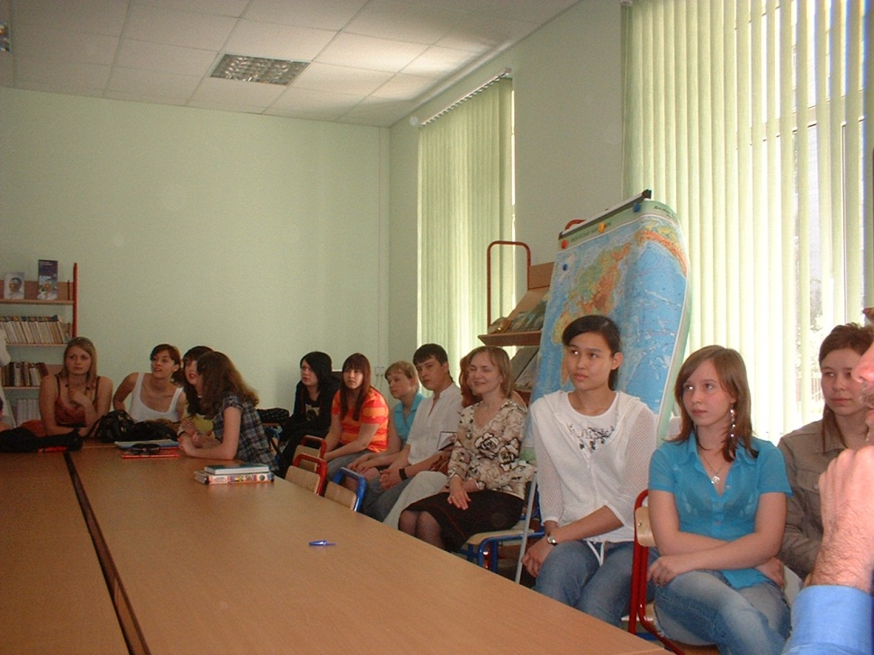
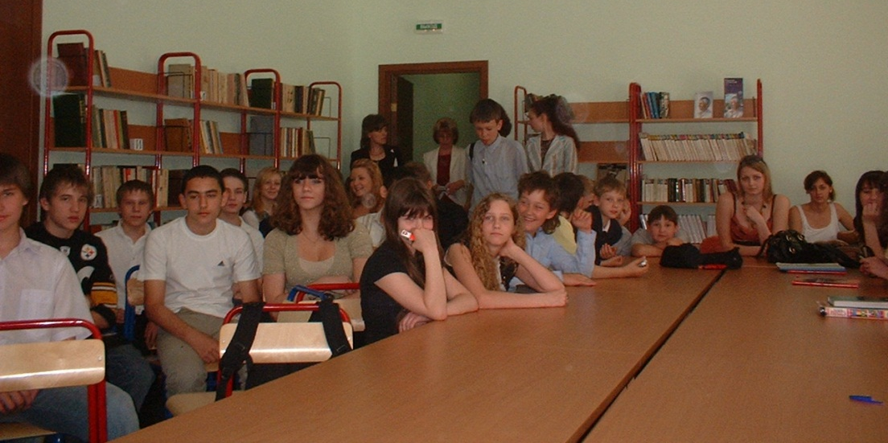
Schools
Here are a couple shots of the students.
Dwight and I (with translator Sasha) answered lots of questions they had for us, including what we thought of President Bush.

Slide 22
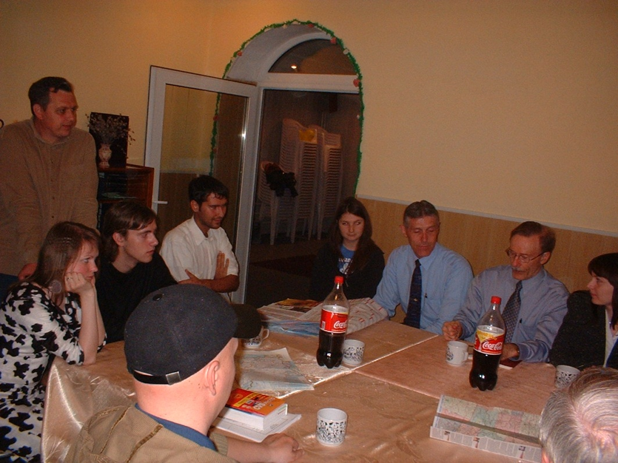
English Clubs
In the evenings, several of us would meet with students for an English Club, in which they could hear & practice English.
We were also free to speak about Jesus in these informal contexts.

Slide 23
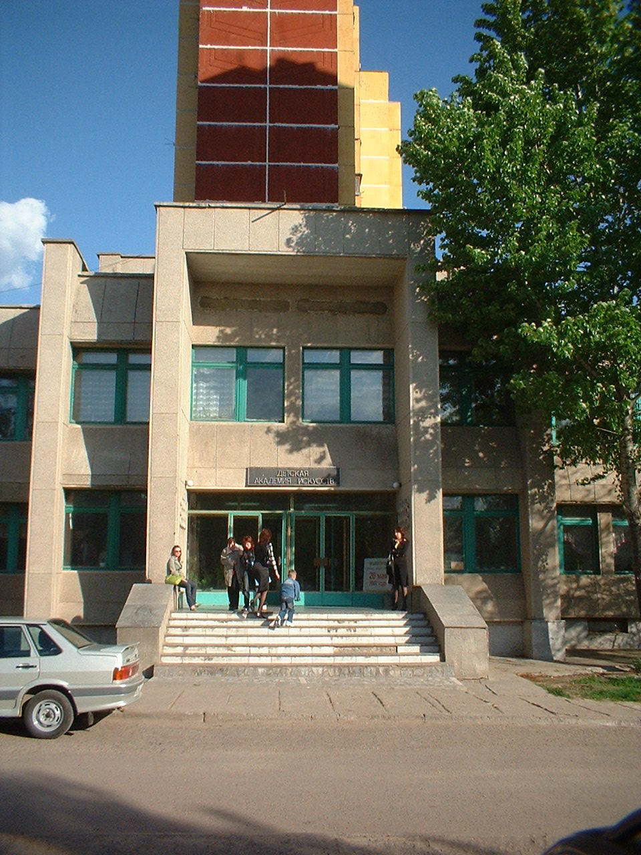
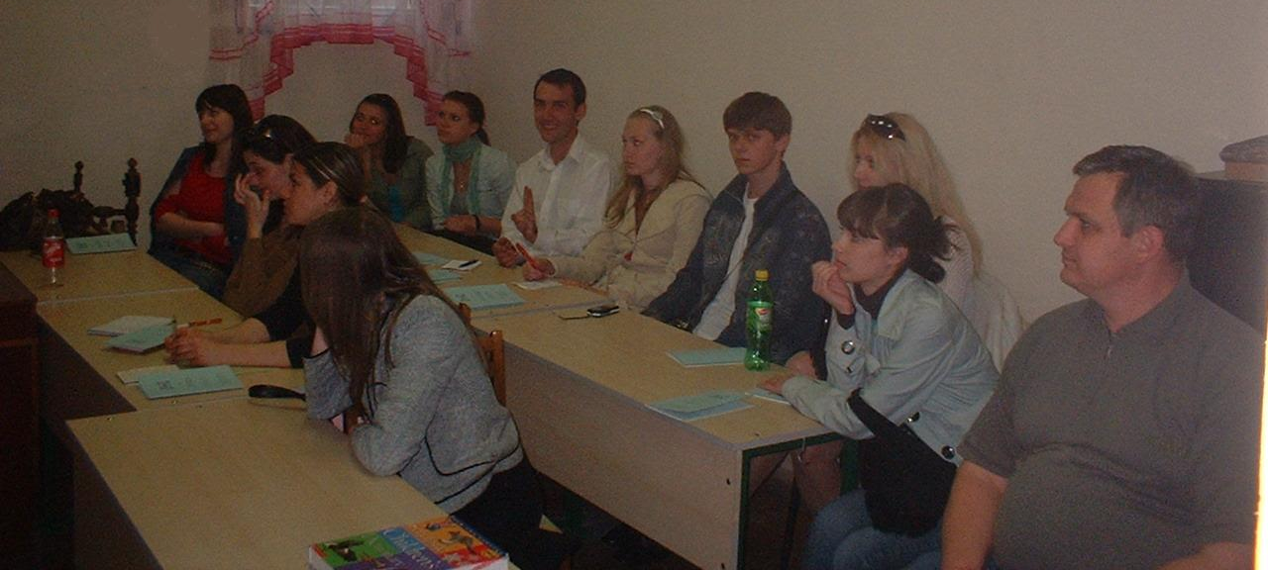
English Clubs
After the first meeting, the English Clubs met here in the Children’s Academy of Art.
Here is the group to which I gave my PowerPoint talk "Christianity & Science."

Slide 24
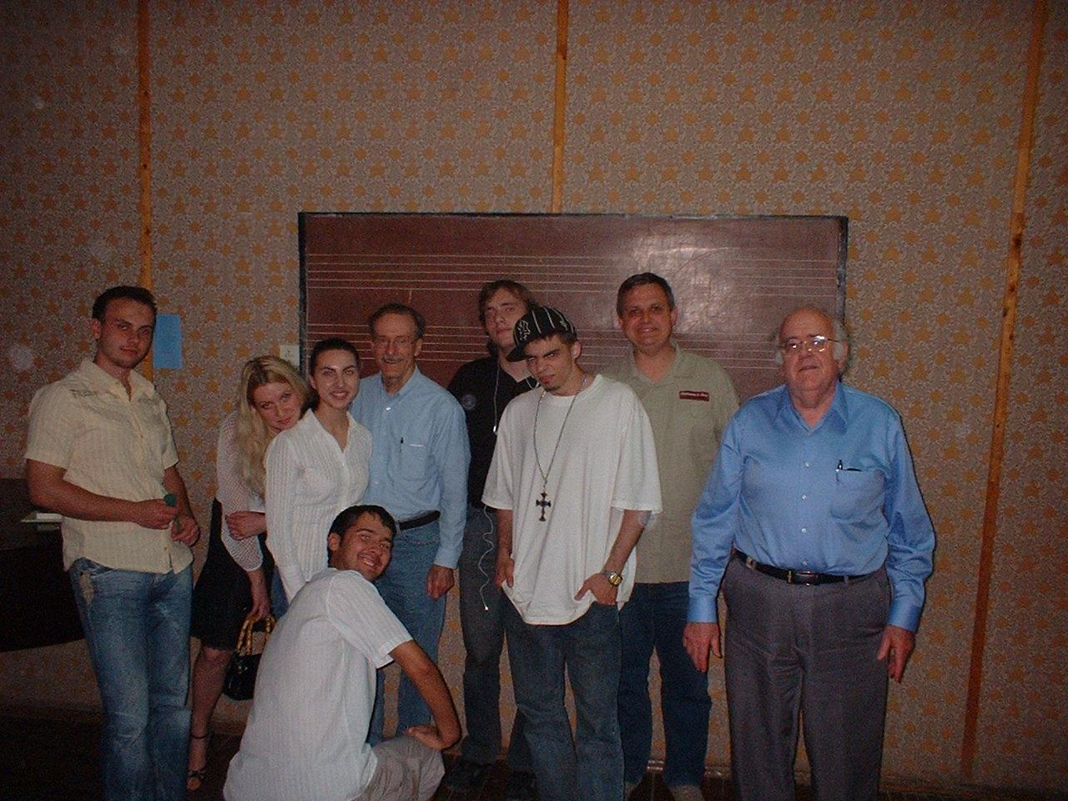
English Clubs
At one of the English Clubs, we played some tunes from American folk songs, and talked about their place in American history.

Slide 25
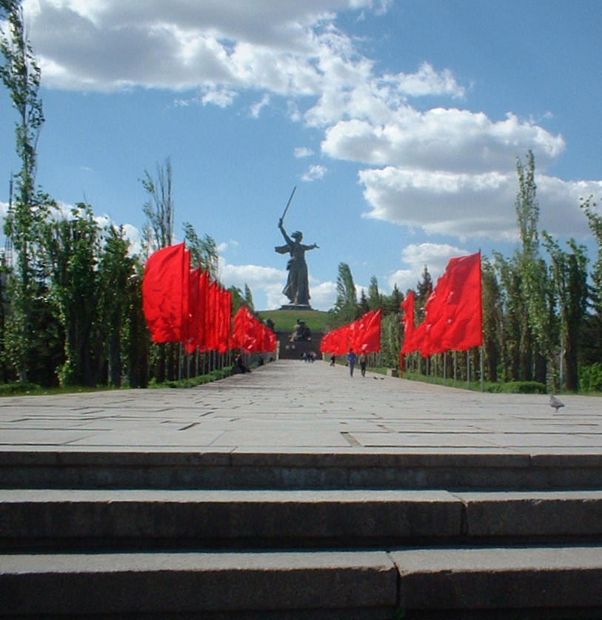
Some Sightseeing
Here & there during our time in Volgograd, and for a day & a half in Moscow on the way back, we did some sightseeing.
This is the ceremonial walkway up to a huge statue of 'Mother Russia,' a memorial to the defense of Stalingrad.

Slide 26
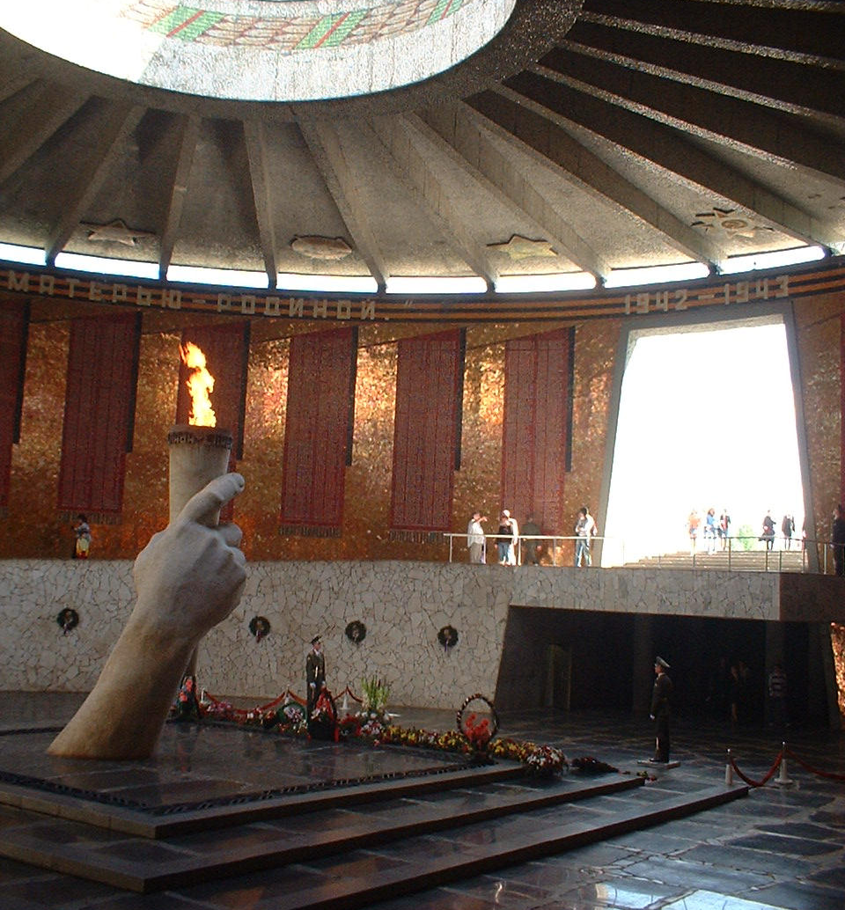
Sightseeing, Volgograd
This is the memorial flame at the same site.
It is guarded 24 hours a day by soldiers.

Slide 27
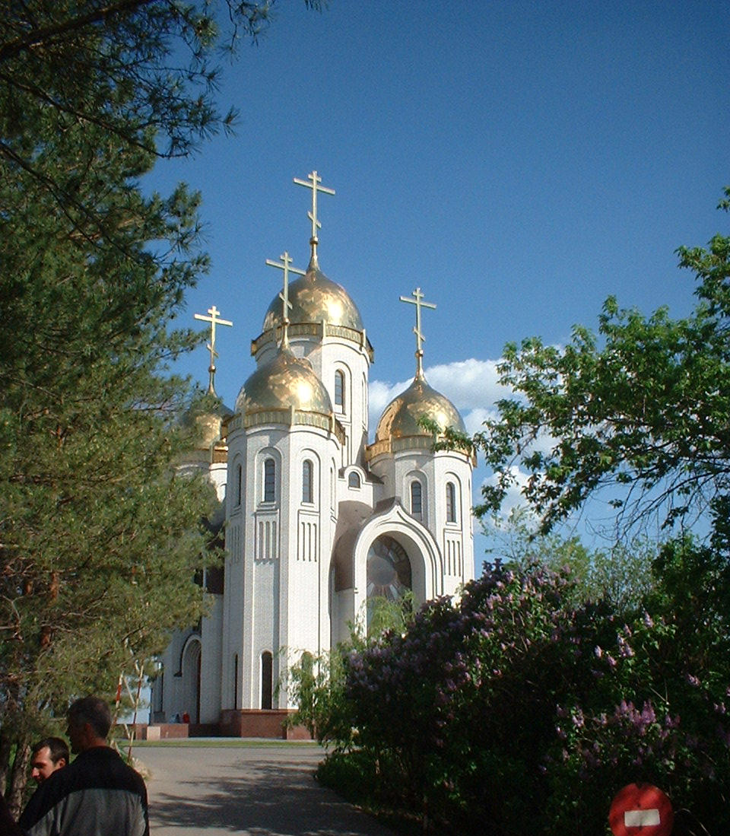
Sightseeing, Volgograd
This is a Russian Orthodox Cathedral at the same memorial, built since the end of the Communist regime.

Slide 28
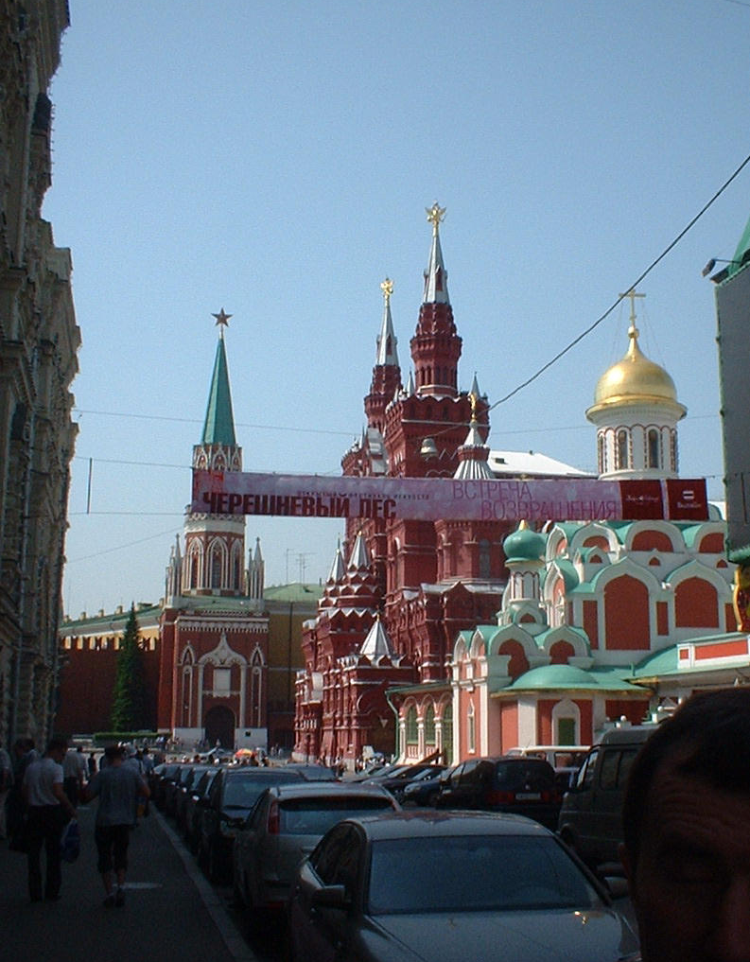
Sightseeing, Moscow
This is part of Red Square.
Note the refurbished church.
Since the fall of Communism, the government has allowed (& sometimes even aided) the rebuilding of Orthodox churches.

Slide 29
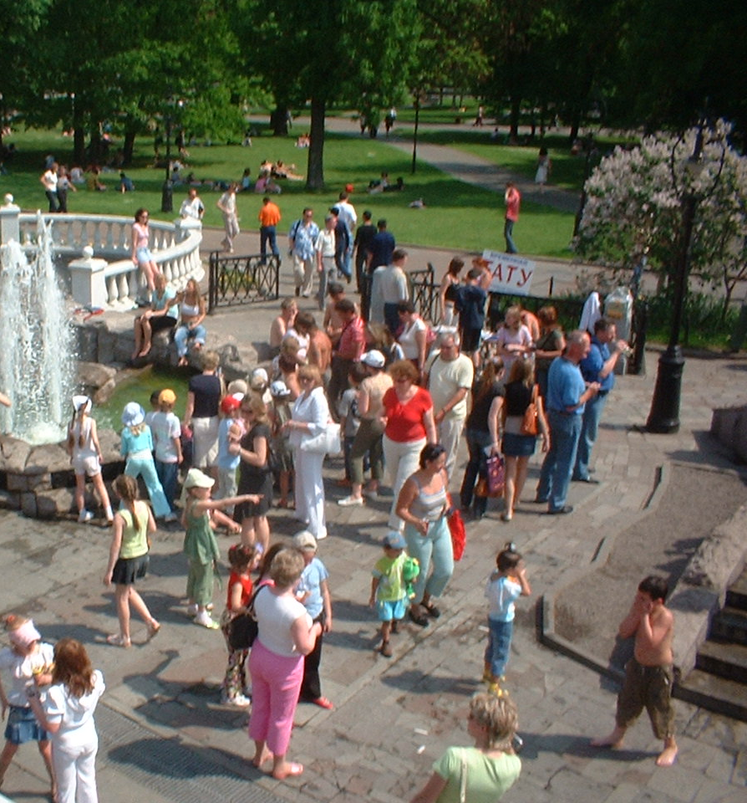
Sightseeing, Moscow
Everywhere we went, in Volgograd and Moscow, the economy seemed much more vibrant, and the people happier, than 15 years ago.
But they still need Jesus.

Slide 30
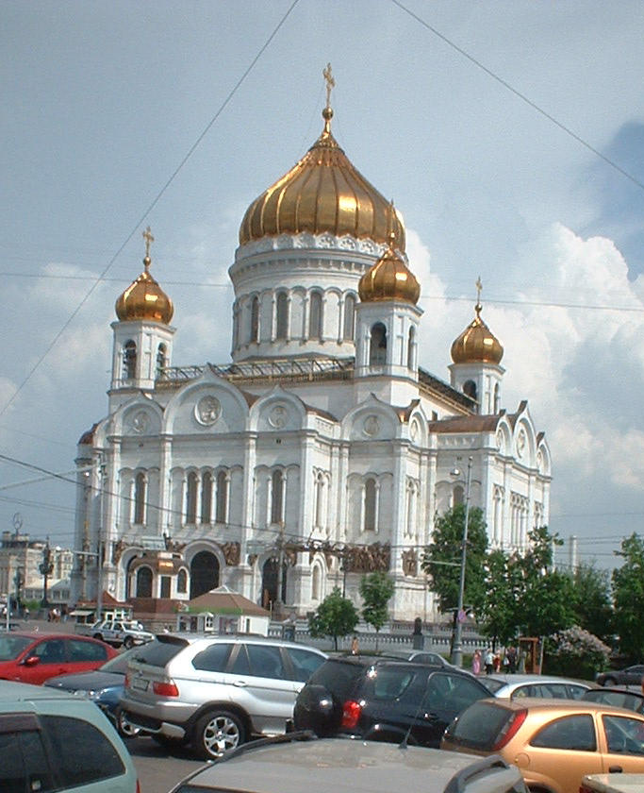
Sightseeing, Moscow
This is the rebuilt Church of the Savior, which Stalin destroyed in the 1930s.
Boris Yeltsin was recently buried here.

Slide 31
Conclusions
I found the trip both exciting and encouraging.
At present, Russia is still open to the Gospel, though there is not as much response as earlier.
There are now many evangelical churches, where there were only a few 15 years ago.

Slide 32
Pray for…
… the spiritual situation in Russia.
… the evangelical churches there
… revival in the orthodox church
… many to be drawn to Jesus
… the International School Project and Christian Teachers Associations
… the Dream Maker & Dream Breaker curriculum to be implemented & effective

Slide 33
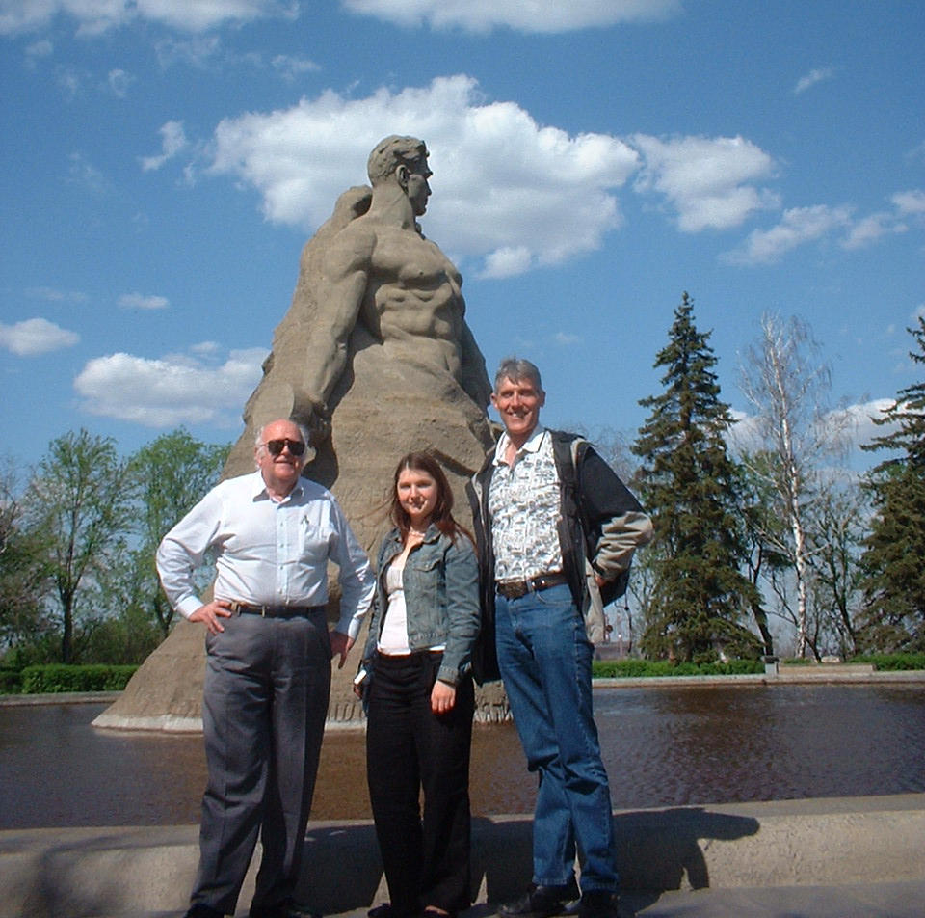
The End
May the Lord be glorified in Russia!

