Slide 1
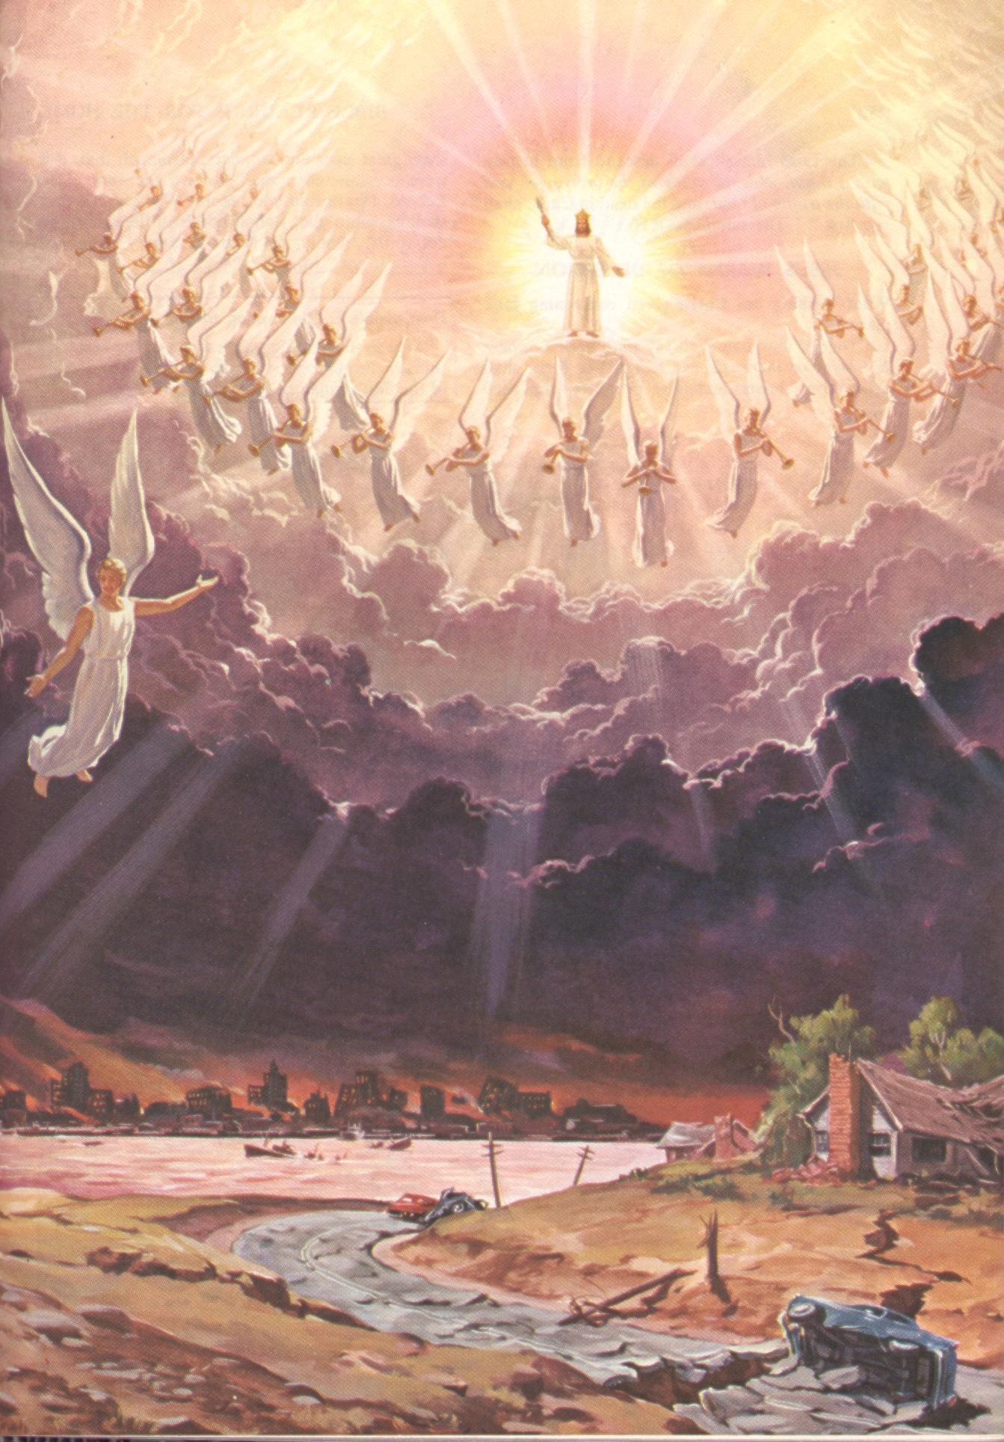

1994?
When is the 2nd Coming?
Robert C. Newman

Slide 2
Is 1994 the Year?
[This talk was originally given (twice) in January of 1994.]
Here we are now in 1994, the year Harold Camping of Family Radio says the Bible predicts the 2nd coming of Christ.
Is he right?
  I doubt it.

Slide 3
Is 1994 the Year?
Too much of Camping's biblical interpretation depends on:
  Theories about the meaning of numbers,
  Guessing that God is giving hints when He hasn’t spoken plainly.
Well, what can we say about the Second Coming of Christ?

Slide 4
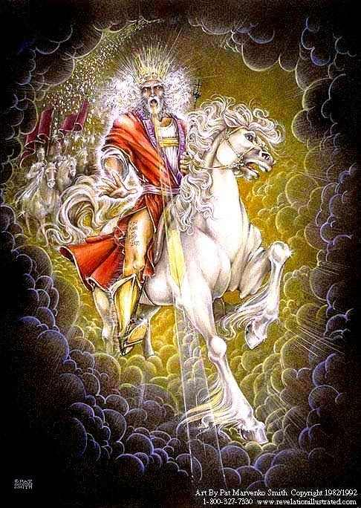
Is the End Near?
Some Indicators

Slide 5
We May Be Near the End
Though 1994 in particular is doubtful, we have several indications that we may be near the end:
  Israel has now been a nation since 1948.
  Jerusalem is an insoluble international problem (see Zechariah 12:2).
  We have growing pressures for a real world government.
  There is increasing antagonism toward Christianity even while many are being saved (Matthew 24:14).
  It looks like we are encountering more & more disasters.
Let’s look at each of these briefly.

Slide 6
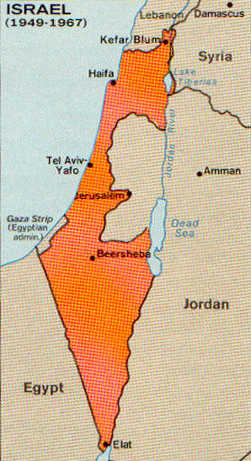
Israel a Nation
The Jews were scattered from Israel and their nation destroyed by the Romans in AD 70.
In 1948, Israel became a nation again.
There are indications in Scripture that the Jews will be in their land at the 2nd coming of Jesus.
This looks like a necessary pre-requisite for Jesus' return, but it sets no dates.

Slide 7
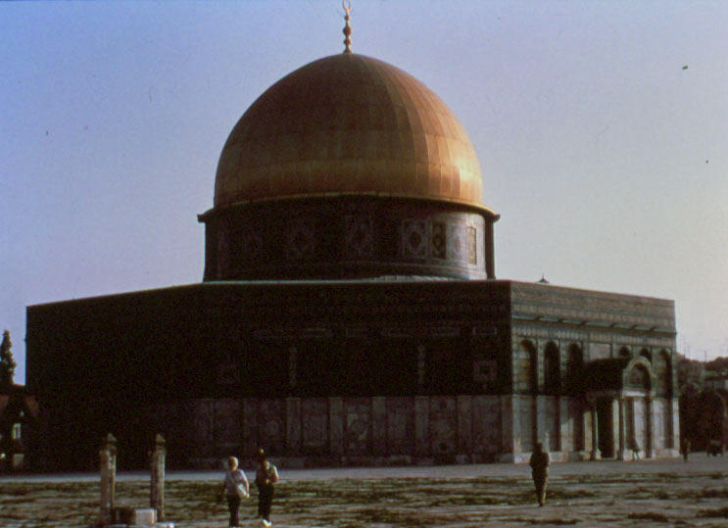
Jerusalem a Problem
Zech 12:1 (NIV) This is the word of the LORD concerning Israel. The LORD, who stretches out the heavens, who lays the foundation of the earth, and who forms the spirit of man within him, declares: 2 "I am going to make Jerusalem a cup that sends all the surrounding peoples reeling. Judah will be besieged as well as Jerusalem. 3 On that day, when all the nations of the earth are gathered against her, I will make Jerusalem an immovable rock for all the nations. All who try to move it will injure themselves."
It looks like Jerusalem will be an insoluble international problem at the end.
That's what Jerusalem looks like right now.

Slide 8
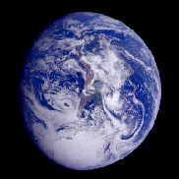
Real World Government?
Several biblical passages suggest a world government at the end (Revelation 13).
There are growing pressures tending toward this today:
  Nuclear proliferation
  Global warming
  Terrorism
  Explosive Population growth

Slide 9
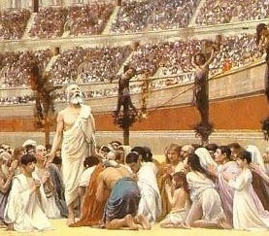
Antagonism to Christianity
The Bible pictures antagonism to Christianity along with world evangelism at the end:
  Matt 24:9 (NIV) "Then you will be handed over to be persecuted and put to death, and you will be hated by all nations because of me. 10 At that time many will turn away from the faith and will betray and hate each other, 11 and many false prophets will appear and deceive many people. 12 Because of the increase of wickedness, the love of most will grow cold, 13 but he who stands firm to the end will be saved. 14 And this gospel of the kingdom will be preached in the whole world as a testimony to all nations, and then the end will come."
These sorts of things are also present today.

Slide 10
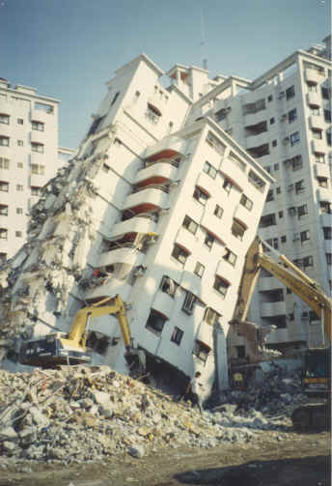
Increasing Disasters?
In USA Today of 20 Jan 1994, the following list of "Most Costly US Disasters" was published (in 1991-94 dollars):
  Hurricane Andrew (1992): $30 billion
  LA earthquake (1994): $30 billion
  Midwest flooding (1993): $12 billion
  Hurricane Hugo (1989): $5.9 billion
  SF Bay earthquake (1989): $5.9 billion
  SF earthquake (1906): $5.1 billion
  Tropical storm Agnes (1972): $4.7 billion
  Southeastern drought (1986): $3 billion
  Oakland CA fire (1991): $1.5 billion
  Chicago fire (1871): $1.5 billion

Slide 11
Increasing Disasters?
Notice how many of these were recent.
When this list was compiled, it did not include the AIDS epidemic and the Savings & Loan bailout.
This list is just for US disasters.
If you have been following the news after 1994, you should be aware of a number of far worse disasters since then.
How do we evaluate such things?
What should we be doing?

Slide 12
The Time is Unknown

Slide 13
Matthew 24:33-36
33 (NIV) Even so, when you see all these things, you know that it is near, right at the door. 34 I tell you the truth, this generation will certainly not pass away until all these things have happened. 35 Heaven and earth will pass away, but my words will never pass away. 36 No one knows about that day or hour, not even the angels in heaven, nor the Son, but only the Father.

Slide 14
Paired Parables of Matthew 24-25
Consider these two parables:
  Wise & foolish household manager (24:45ff)
  Wise & foolish bridesmaids (25:1-13)
Taken together, these parables indicate that for some, the Lord will come back too soon; for others, too late!
  Matt 25:13 (NIV) "Therefore keep watch, because you do not know the day or the hour."

Slide 15
Yet Signs Will Precede

Slide 16
Matthew 24
3 (NIV) As Jesus was sitting on the Mount of Olives, the disciples came to him privately. "Tell us," they said, "when will this happen, and what will be the sign of your coming and of the end of the age?" 4 Jesus answered: "Watch out that no one deceives you. 5 For many will come in my name, claiming, 'I am the Christ,’ and will deceive many. 6 You will hear of wars and rumors of wars, but see to it that you are not alarmed. Such things must happen, but the end is still to come. 7 Nation will rise against nation, and kingdom against kingdom. There will be famines and earthquakes in various places. 8 All these are the beginning of birth pains."

Slide 17
Matthew 24
9 (NIV) "Then you will be handed over to be persecuted and put to death, and you will be hated by all nations because of me. 10 At that time many will turn away from the faith and will betray and hate each other, 11 and many false prophets will appear and deceive many people. 12 Because of the increase of wickedness, the love of most will grow cold, 13 but he who stands firm to the end will be saved. 14 And this gospel of the kingdom will be preached in the whole world as a testimony to all nations, and then the end will come."

Slide 18
Matthew 24
15 (NIV) "So when you see standing in the holy place 'the abomination that causes desolation,' spoken of through the prophet Daniel–let the reader understand– 16 then let those who are in Judea flee to the mountains. 17 Let no one on the roof of his house go down to take anything out of the house. 18 Let no one in the field go back to get his cloak. 19 How dreadful it will be in those days for pregnant women and nursing mothers! 20 Pray that your flight will not take place in winter or on the Sabbath. 21 For then there will be great distress, unequaled from the beginning of the world until now–and never to be equaled again. 22 If those days had not been cut short, no one would survive, but for the sake of the elect those days will be shortened. 23 At that time if anyone says to you, 'Look, here is the Christ!' or, 'There he is!' do not believe it. 24 For false Christs and false prophets will appear and perform great signs and miracles to deceive even the elect–if that were possible. 25 See, I have told you ahead of time."

Slide 19
Matthew 24
29 (NIV) "Immediately after the distress of those days 'the sun will be darkened, and the moon will not give its light; the stars will fall from the sky, and the heavenly bodies will be shaken.' 30 At that time the sign of the Son of Man will appear in the sky, and all the nations of the earth will mourn. They will see the Son of Man coming on the clouds of the sky, with power and great glory. 31 And he will send his angels with a loud trumpet call, and they will gather his elect from the four winds, from one end of the heavens to the other. 32 Now learn this lesson from the fig tree: As soon as its twigs get tender and its leaves come out, you know that summer is near. 33 Even so, when you see all these things, you know that it is near, right at the door. 34 I tell you the truth, this generation will certainly not pass away until all these things have happened. 35 Heaven and earth will pass away, but my words will never pass away."

Slide 20
Signs Listed in Matthew 24
False Messiahs
Wars
Famines
Earthquakes
Hatred of Christians
False Prophets
Lawlessness
Spread of the Gospel to all nations
Abomination of Desolation
Great tribulation
False miracles
Signs in heaven

Slide 21
Signs in 2 Timothy 3
1 (NIV) But mark this: There will be terrible times in the last days. 2 People will be lovers of themselves, lovers of money, boastful, proud, abusive, disobedient to their parents, ungrateful, unholy, 3 without love, unforgiving, slanderous, without self-control, brutal, not lovers of the good, 4 treacherous, rash, conceited, lovers of pleasure rather than lovers of God– 5 having a form of godliness but denying its power. Have nothing to do with them.

Slide 22
How Do We Get Ready?

Slide 23
An Illustration: Death
How do we get ready for death?
None of us knows the day nor hour of our death.
We are not to get ready for it by trying to guess when it will come:
  Looking carefully for the signs of approaching death
This is not sensible…
  for we are concentrating on what we can do nothing about,
  Instead of concentrating on what we can do.

Slide 24
An Illustration: Death
We get ready for death by trying to find out what life is all about…
  Then making preparations consistent with what we have found.
Have you made such preparations?
The apostle Peter tells us how to get ready:

Slide 25
2 Peter 3
10 (NIV) But the day of the Lord will come like a thief. The heavens will disappear with a roar; the elements will be destroyed by fire, and the earth and everything in it will be laid bare. 11 Since everything will be destroyed in this way, what kind of people ought you to be? You ought to live holy and godly lives 12 as you look forward to the day of God and speed its coming. That day will bring about the destruction of the heavens by fire, and the elements will melt in the heat. 13 But in keeping with his promise we are looking forward to a new heaven and a new earth, the home of righteousness. 14 So then, dear friends, since you are looking forward to this, make every effort to be found spotless, blameless and at peace with him. 15 Bear in mind that our Lord's patience means salvation…

Slide 26
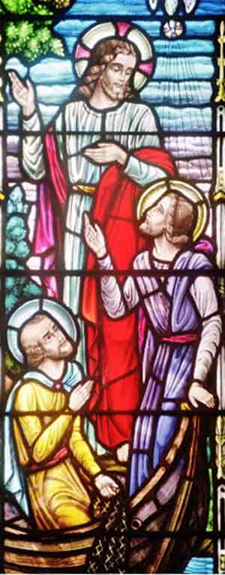
Getting Ready
There is nothing more practical you can do than:
  To be sure your sins are forgiven
  And that you are living for God and not yourself.

Slide 27
The End…
Not 1994, but it may be soon.
Are you ready?

